Slide 1
A Visual Interface for Product Exploration on Online Shopping Websites
By: Cameron Smith
Advisor: Kristina Striegnitz

Slide 2
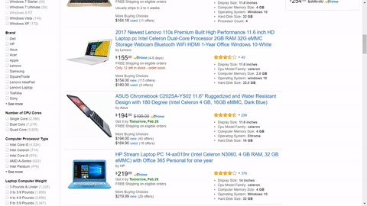
The Problem
Common Interface
Not ideal: Can’t get information about product attributes from position

Slide 3
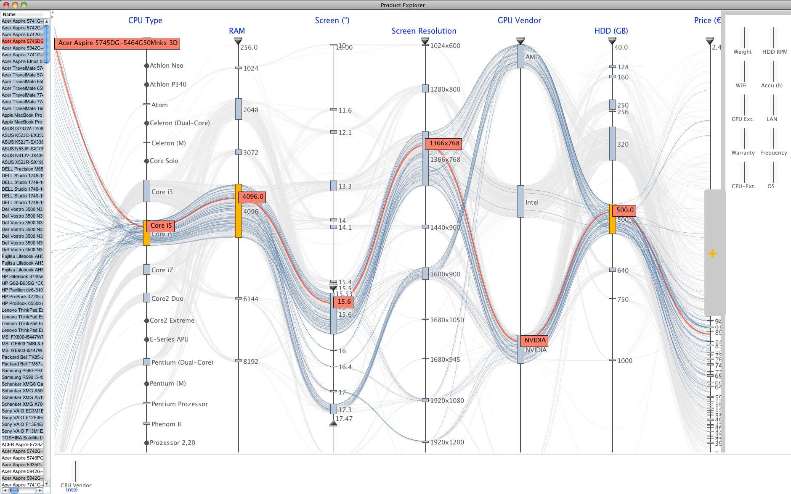
Reihmann, et al. 2012

Slide 5
Presentation Roadmap
What does it take to implement?
Similarity Calculation
Algorithm for placing Products
How to evaluate performance?
User Study
What can we conclude from results?

Slide 6
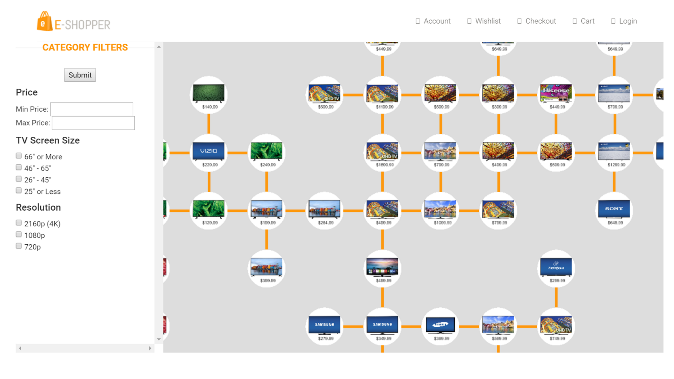

Slide 7
Similarity Metric
Extract Numeric and Categorical attribute data -- normalize it -- put in a vector
Numeric = Weight, Height… etc
Categorical = Color, Brand… etc
Laptop Product Vector = <0.863, 1, 0.732, 0.1432, 0, 1, 0, 0, … etc>
Hard Drive Capacity
Built-In-Webcam
Processor Speed
Screen Size
HP
Dell
Asus
Acer

Slide 8
Calculate Euclidean Distance between every product
Laptop1 = <0.863, 1, 0.732, 0.1432, 0, 1, 0, 0, … >
Laptop2 = <0.127, 0, 0.453, 0.6016, 1, 0, 0, 0, … >
Store in csv for later use

Slide 9
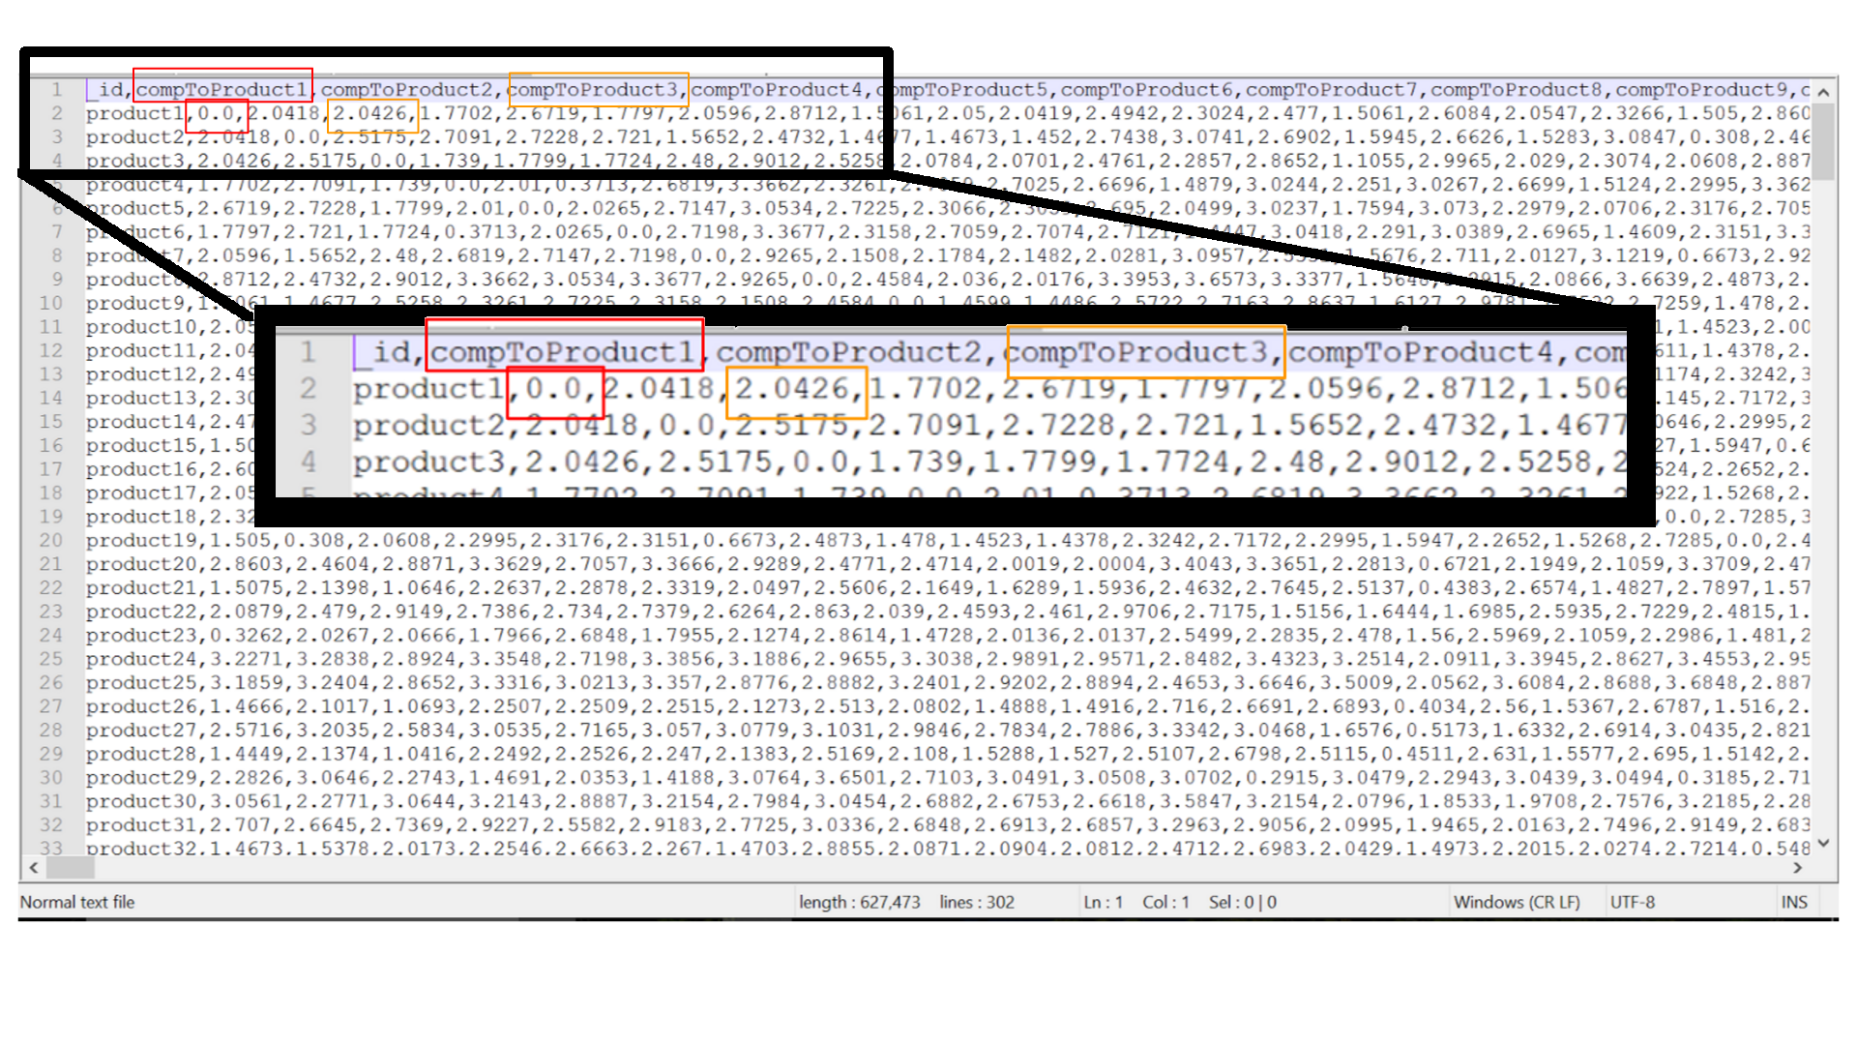

Slide 10
For each product, find 8 products that are most similar
Prod1-CloseProducts:
Prod66, Prod88, Prod286, Prod125, Prod234, Prod277, Prod7, Prod43
Prod2-CloseProducts:
Prod59, Prod133, Prod167, Prod11, Prod8, Prod281, Prod90, Prod31
Prod3-CloseProducts:
Prod27, Prod182, Prod234, Prod211, Prod38, Prod49, Prod296, Prod206
...etc

Slide 11
Implementing the Visual Interface
Product Placing Algorithm
Queue
Prod1
Prod1-CloseProducts: Prod66, Prod88, Prod286, Prod125, Prod234, Prod277, Prod7, Prod43

Slide 12
66
Queue
Prod1
Prod66
Prod1-CloseProducts: Prod66, Prod88, Prod286, Prod125, Prod234, Prod277, Prod7, Prod43

Slide 13
88
66
Queue
Prod88
Prod1
Prod66
Prod1-CloseProducts: Prod66, Prod88, Prod286, Prod125, Prod234, Prod277, Prod7, Prod43

Slide 14
286
88
66
Queue
Prod286
Prod88
Prod1
Prod66
Prod1-CloseProducts: Prod66, Prod88, Prod286, Prod125, Prod234, Prod277, Prod7, Prod43

Slide 15
125
286
88
66
Prod286
Queue
Prod88
Prod1
Prod66
Prod125
Prod1-CloseProducts: Prod66, Prod88, Prod286, Prod125, Prod234, Prod277, Prod7, Prod43
Prod66-CloseProducts: Prod125, Prod45, Prod88, Prod1, Prod70, Prod17, Prod96, Prod130

Slide 16
45
125
286
88
Prod286
Queue
Prod88
Prod1
Prod66
Prod45
Prod125
Prod66-CloseProducts: Prod125, Prod45, Prod88, Prod1, Prod70, Prod17, Prod96, Prod130

Slide 17
70
45
125
286
88
Prod286
Prod70
Queue
Prod88
Prod1
Prod66
Prod45
Prod125
Prod66-CloseProducts: Prod125, Prod45, Prod88, Prod1, Prod70, Prod17, Prod96, Prod130
Prod286-CloseProducts: Prod88, Prod1, Prod70, Prod245, Prod165, Prod125, Prod45, Prod96

Slide 18
?
?
Prod24
?
Prod165
Prod194
Prod18
Prod286
Prod70
Queue
Prod149
Prod122
Prod88
Prod1
Prod66
Prod45
Prod223
Prod262
Prod203
Prod125
Prod89
Prod182
Prod24-CloseProducts: Prod149, Prod18, Prod194, Prod1, Prod203, Prod182, Prod70, Prod165

Slide 19
...
37
Prod37
Prod24
Prod165
Queue
Prod194
Prod18
Prod286
Prod70
Prod149
Prod122
Prod88
Prod1
Prod66
Prod45
Prod223
Prod262
Prod203
Prod125
Prod89
Prod182

Slide 20
...

Slide 21
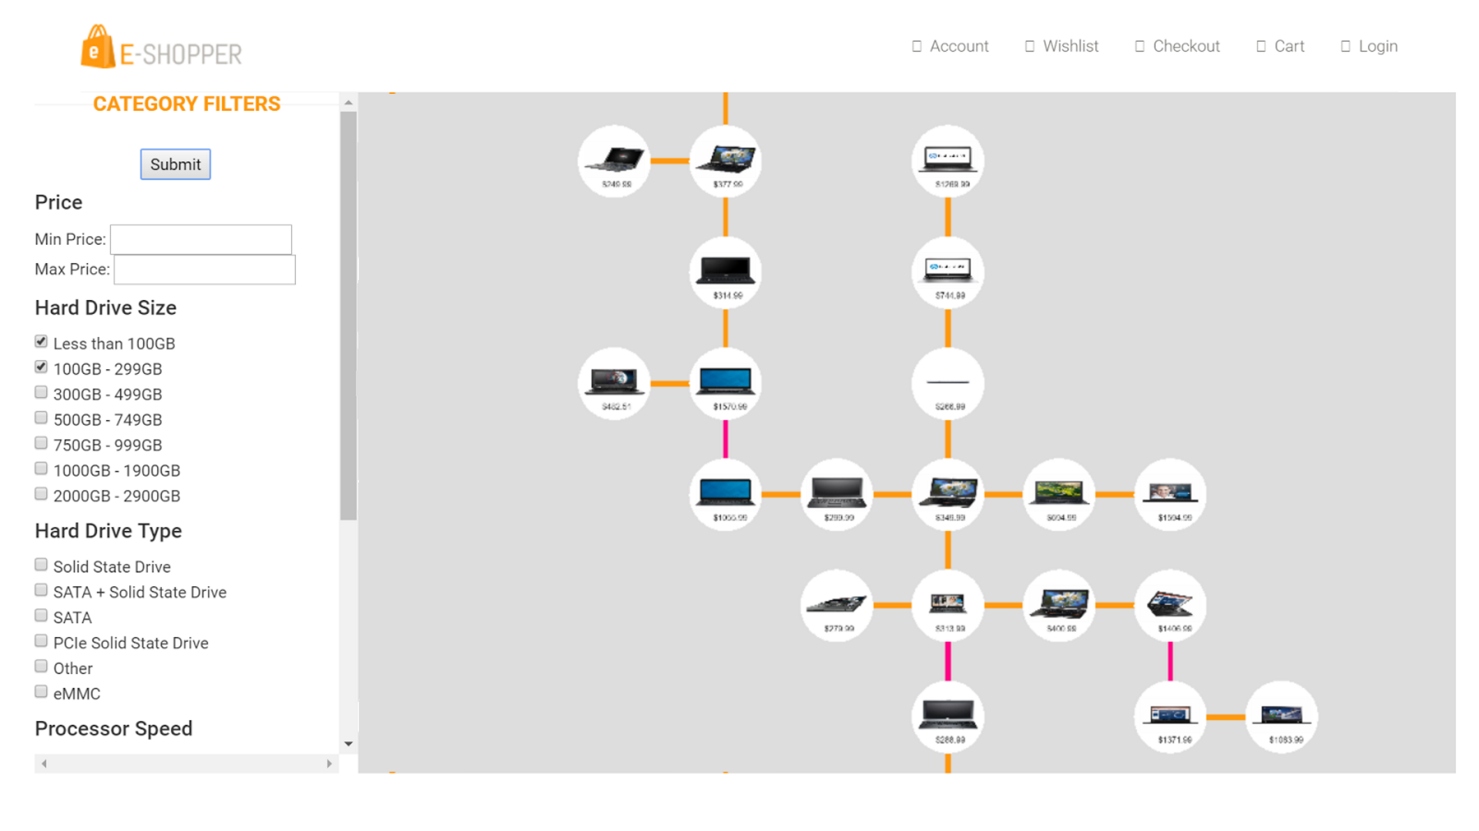

Slide 22
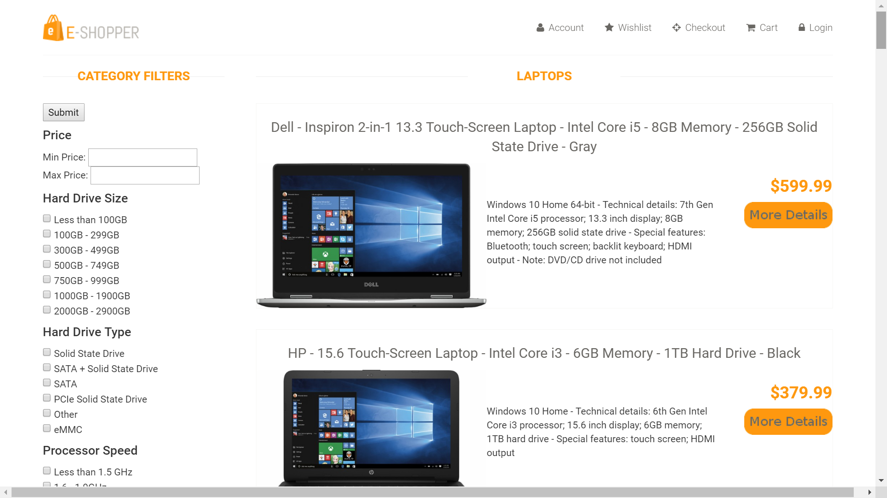
User Study: Materials
Conducted in the Crochet lab
Product data from Best Buy website (300 for each product domain)
Laptops
Cameras
Televisions
Refrigerators
Control List Interface

Slide 23
User Study: Methods
4 tasks - “Use interface to find product you would like to buy”
Switch between List and Visual Interfaces after each task
Odd Participants
Task 1: List Laptop
Task 2: Vis Camera
Task 3: List T.V.
Task 4: Vis Refrigerator
Even Participants
Task 1: Vis Laptop
Task 2: List Camera
Task 3: Vis T.V.
Task 4: List Refrigerator

Slide 24
Results
Hard to simulate genuine shopping behavior in lab setting
Decided time data not a good method of comparison
Some took short time, some long for the same task and interface
10 out of 12 prefered list - more familiar, and easier to use than visual
Usability problems
Do not know where to start
Confused about similarity

Slide 25
Future work
Interface Revisions
Insist upon an exploration strategy
Suggest starting items
Make similarity more explicit
Explicitly say which attributes are the same and which are slightly different
Best way to test: deploying interface on an established ecommerce website
sales volume change?
user experience and satisfaction change?

Slide 26
Conclusion
Can Visual interface be a good replacement for List?
Still unanswered
Participants liked the concepts of 2D representation and similarity sorting
Revisions to the interface have the potential to definitively answer

Slide 27
References
Patrick Riehmann, Jens Opolka, and Bernd Froehlich. The product explorer: Decision making with ease. In Proceedings of the International Working Conference on Advanced Visual Interfaces, AVI 12, pages 423432, New York, NY, USA, 2012. ACM.

Slide 28
Proper exploration strategy?

Slide 29
What does similarity mean though?
My intention: it be based on all attributes of the product
Not intuitive for users
Focus on certain a couple of important attributes
Laptop111 = <0.127, 1, 0.732, 0.5488, 1, 0, 0, 0, … >
Laptop265 = <0.127, 1, 0.653, 0.6016, 1, 0, 0, 0, … >
Hard Drive Capacity
Built-In-Webcam
Processor Speed
Screen Size
HP
Dell
Asus
Acer

