Slide 1
Navigation In Dynamic Environment
Chao Lin
Advisor - Aaron Cass

Slide 2
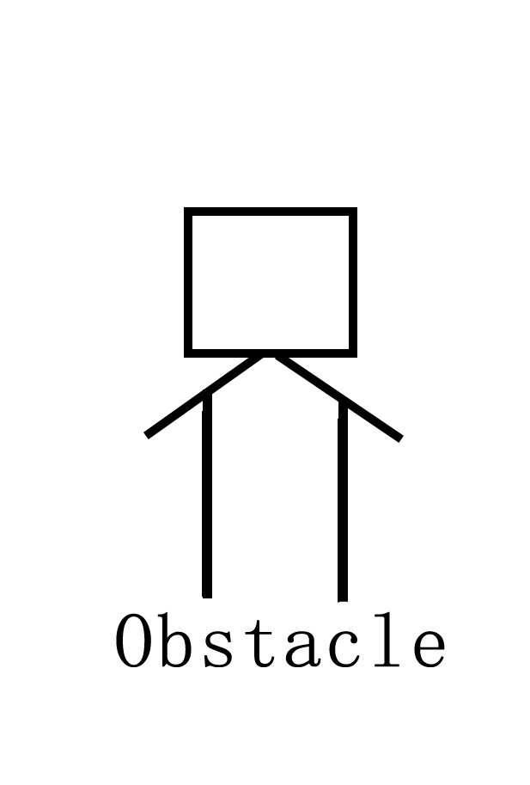
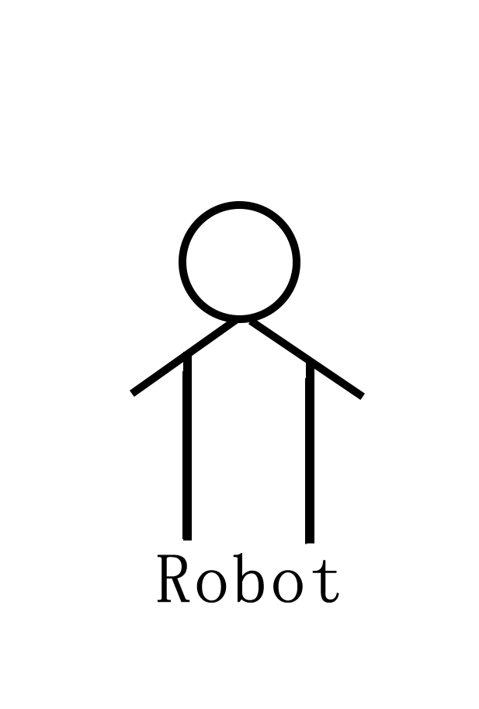
Introduction
Collision!!!!!
Notes:
First, I would like you to imagine a situation. There is a map with some complex topography. A robot who has perfect knowledge to the map is currently standing at a point on the map. Its task is to move to a random position on the map. This task seems to be easy, since the robot knows everything about the map. It can take its current position and the goal position as parameters and plan a path by using some path planning algorithms such as A* algorithm. However, the story changes if there also exists some moving obstacles, and the robot doesn’t know the existence of these obstacles. The planned path may lead to a collision. Therefore, in order to prevent robot from colliding the moving obstacles, we want to introduce a navigation approach in the dynamic environment. Note that, the dynamic environment in our project is the environment where exists moving obstacles.

Slide 3
Goal
Plan a path from the start position to a goal position
Collision free
Ideally, spend less time on traveling
Shortest path length ?
Notes:
Or may be, the planned path will have a shortest path length

Slide 4
Proposed Algorithm
Plan/Re-plan
Use A* Algorithm
Use A* to re-plan a path if a collision is predicted
Collision Prediction
Detect the moving obstacle
Collision?
Update the map if predict a collision
Notes:
We separate the goal into 2 sub-goals: one is to do plan and re-plan, another is to predict the collision. We have two agents, path plan agent and collision prediction agent, to handle with these two sub-goals. For the planning part, we will first use A* algorithm to plan a path from the start position to goal position. The heuristic is the direct distance between the current position and the goal position. While the robot is moving to the goal position, the path planning agent may be called to do a re-planning based on the map updated from collision prediction agent when a collision is predicted.
Once the robot start to move, the collision prediction agent will start to detect the moving obstacles. And if any of them was detected, the agent will do the calculation and see if there will be a collision. If so, it will mark the motion trail of the obstacle on the map and notice the path planning agent to plan a new path to get around the obstacle.

Slide 5
Experiment Design
Robot and Moving obstacle
One robot and one moving obstacle
Share the rule of movement
Robot: stick with planned path
Obstacle: some randomness in moving direction
Velocity
After collision
Robot: stop and wait
Obstacle: keep moving
Notes:
In our experiment, we only have one robot and one obstacle. They share the same rule of movement. That is, they have a heading direction, and they are only allowed to moving in the heading direction. So in order to make a turn, they must stop, change the heading, and then start to move again. Note that the robot will always stick with the path planned by the path planning agent, while the obstacle will move randomly, but not completely randomly. That means the obstacle will move in a direction for a certain time, and then will choose a random direction and keep going. Both of the robot and obstacle will be assigned a velocity before the experiment starts. The velocity is constant during the experiment. Note that, for each run, the velocity is different, and the velocity of the robot could be faster or slower than that of the obstacle. After a collision happens, the robot will stop and wait, but the obstacle will keep moving.

Slide 6
Experiment Design
 | Re-planning
 |  | NO | YES
Collision | Allow | Control | Control + Re-planning
 | Predict | Control + Predict Collision | Proposed Algorithm
Measurement:
Travel time
Numbers of collisions
Notes:
We set up one control group and 3 non-control groups. Each group will have the same robot and moving obstacle. In the control group, the robot always will move along the planned path, and no prediction or re-plan will be done. In the group of re-planning only, the robot will re-plan a path once it collides the obstacle. It will wait until the re-planning is completed, and it will move along the re-planned path. In the group prediction only, the robot will stop moving after a collision is predicted until the obstacle passes the predicted collision area.

Slide 7
Experiment Design
10 groups of starting and goal positions
Run 10 time for each group of starting and goal position
Notes:
Our experiments are carried out in a simulator. We constructed a complex map in the simulator, which is 20 units by 15 units. We choose 10 groups of starting and goal positions from the map. We ensured that each of them has an actual path length larger than 15 units. So that for each run, the problem will be complex enough. Before the experiment begin, we manually choose a group of starting and goal position and assigned to the robot. Each group of positions will be tested by 10 times. So we have 100 runs in total for each experiment.

Slide 8
Result
Summary
 | Control | Re-plan only | Prediction Only | Proposed
Travel Time (Sec) | 40.61907 | 41.25087 | 42.6072 | 50.965657
# of Collision | 0.35 | 0.21 | 0.11 | 0.08
P-value_{Travel Time} | - | <5% | >5% | <5%
P-value_{# of Collisions} | - | >5% | >5% | >5%
Distribution of Number of Collisions
Distribution of Travel Time
Notes:
So here is the result. The chart is the statistical summary of the data collected from the experiments. The graph shows the distribution of # of collisions and travel time in each group. From the graph we can see that there are a lot of zero’s in the re-plan only, prediction only, and proposed group, which means the number of collision did be reduced. However, the data of number of collision are not statistically significant. On the other hand, the proposed algorithm has a poor performance in terms of travel time. The robot spends 10 more seconds in average on travelling. But the data are statistically significant.

Slide 9
Discussion
Trade off
Travel Time vs Number of Collisions
Notes:
The result leads us to think whether our proposed algorithm is worth to be implemented. Well, we have to make a trade off. If the cost of collision is larger than the cost of the additional time we spent on travelling, then we absolutely want to use the proposed algorithm. Otherwise, it may not be necessary to implement the algorithm. But we need to do more investigations to figure out that in what kind of situation will our algorithm be more likely used.

Slide 10
Future Work
More advanced Collision Prediction algorithm
Run the experiment in a larger map
Multiple moving obstacles
Zero knowledge about the map
Notes:
Also, in the future, we want to improve the collision prediction algorithm so that it can more accurately predict a collision. And we want to run the experiments in a lager world with more obstacles. Moreover, we want to test if our algorithm can be used on a robot who has zero knowledge about the map.
So that’s pretty much about our project. Thank you for watching. Any questions?

Slide 11
Questions?

