Slide 1
Program Usability Based on the Perception of Bugs as Features
Luke Badini

Slide 2
User Interface
Having a responsive user interface is important for user satisfaction
UIs are a major part of a program
48% of the code for a program
45% of the design process is devoted to the user interface_{[1]}

Slide 3
Bugs
A bug is a flaw in a program that causes it to behave in an unexpected way
Herzig et al. suggests that it is difficult to convince humans that a bug is a feature_{[2]}
A challenge I faced was convincing people that my changes actually were a feature rather than a bug

Slide 4
Research Question
How much does telling a user that a bug is a feature affect their satisfaction with using a program?

Slide 5
Hypothesis
The feature group reports a higher user satisfaction score than the bug group

Slide 6
Experiment Overview
Two experimental groups:
Feature group
Bug group
Introduce a bug into a program
Tell the feature group that the bug is a feature

Slide 7
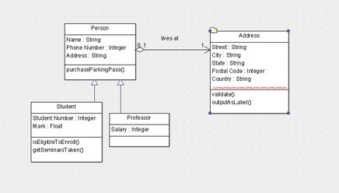
Unified Modeling Language (UML)
ArgoUML is an open source UML editor programmed in Java_{[3]}
Visual language used create models of programs

Slide 8
ArgoUML Modifications
Tooltip responsiveness: 2000ms (2 seconds)
Click delay: 1000ms (1 second)
Graphical distortion: random from -10 to 10 units

Slide 9
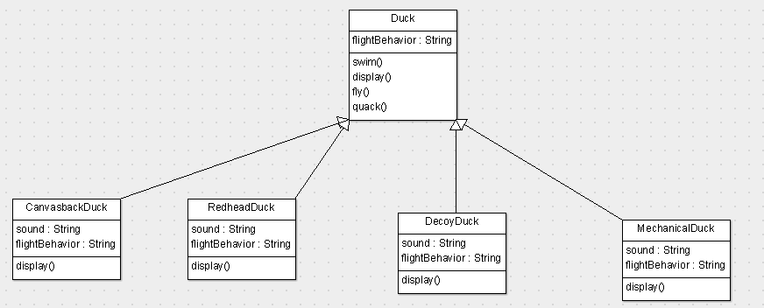
ArgoUML (normal)

Slide 10
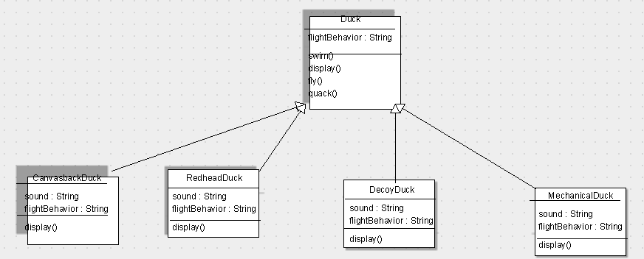
ArgoUML (modified)

Slide 11
Challenges of ArgoUML
Function documentation is not descriptive
Code is poorly structured

Slide 12
Experiment
Participants:
Union College students aged 18-22 (N = 16)
6 participants had previously taken CSC-260 Large Scale Software Design
3 groups:
Control (n = 5) used normal ArgoUML
Feature (n = 5) used modified ArgoUML and was told about the modifications
Bug (n = 6) used modified ArgoUML and was not told about the modifications

Slide 13
Experiment
“You will notice that hovering over icons and making new classes will be slower than normal, and that when you make a new class it will be displaced from where you click the mouse.”
Extra information given to the feature group

Slide 14
Data
Each participant took a survey following the experiment
Included questions about the modifications I made as well as red herring questions
Times for each of the UML diagrams (in seconds)

Slide 15
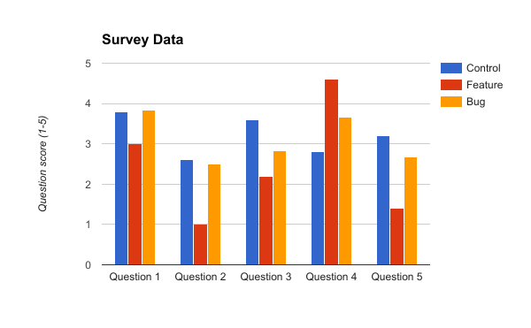
Data

Slide 16
“Stop making everything move every .2 seconds pls”

Slide 17
“Make clicks more responsive”

Slide 18
“Increased responsiveness and accuracy of the clicks”

Slide 19
Data Analysis
Survey data: two-sample chi-squared tests
Time data: two-sample t-test

Slide 20
Data Analysis
Statistically significant results for:
Hovering over tooltips: Feature vs. Bug
Click accuracy: Control vs. Feature
Frustration: Control vs. Feature
 | x²-value | p-value
i | 8.927 | 0.02 - 0.01
ii | 6.900 | 0.05 - 0.025
iii | 7.723 | 0.025 - 0.02

Slide 21
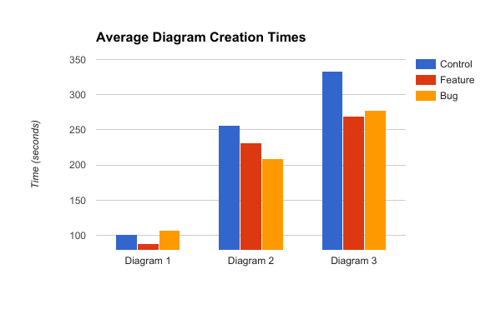
Data Analysis
No statistically significant results for the time data

Slide 22
Results/Conclusions
A few conclusions:
Changes did not affect how long it took to draw UML diagrams
Bug group less satisfied with tooltips than feature group
Feature group was able to notice the change to click accuracy
Feature group was more frustrated with using ArgoUML

Slide 23
Summary
With these results, I am not able to fully prove my hypothesis
Not enough statistically significant data to back it up
Could be due to multiple things, including:
Not enough data
Poor experiment design

Slide 24
Citations
[1] Brad A. Myers and Mary Beth Rosson. Survey on user interface programming. In Proceedings of the
SIGCHI Conference on Human Factors in Computing Systems, CHI ’92, pages 195–202, New York, NY,
USA, 1992. ACM.
[2] Kim Herzig, Sascha Just, and Andreas Zeller. It’s not a bug, it’s a feature: How misclassifi-cation impacts bug prediction. In Proceedings of the 2013 International Conference on Software Engineering,
ICSE ’13, pages 392–401, Piscataway, NJ, USA, 2013. IEEE Press.
[3] ArgoUML, 2009.

