Slide 1
Examining the Reliability and Performance of Consumer Operating Systems
By Joshua Loew
Advisor: Matthew Anderson
http://unapaginamasenlaweb.bligoo.cl/media/users/19/986897/images/public/233152/MINIX.png?v=1338512399473
Notes:
Compare different OS implementations and explore trade-offs, functionality offered, and performance costs that come with these implementatios

Slide 2
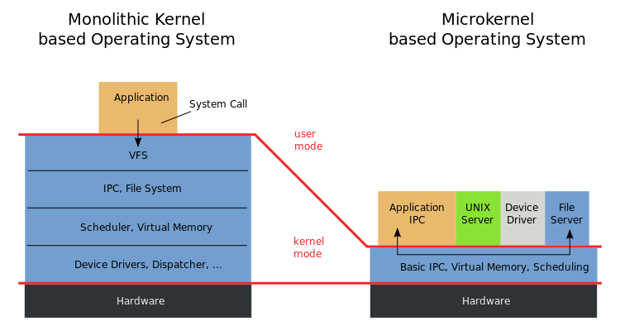
What is MINIX 3?
https://en.wikipedia.org/wiki/Microkernel#/media/File:OS-structure.svg
Notes:
Minix is:
OS in development
Microkernel-based operating system
As little kernel code as possible, it is responsible for essentials: interrupts, scheduling, inter-process communication, etc.
Other components exists in user space (see image)
User space cannot access “important” parts of the OS without special permissions
It is very modular and thus very reliable
This means that most components (e.g. drivers) cannot break the OS
Contrast with a monolithic kernel:
more in kernel space makes them faster
Less IPC, so less overhead

Slide 3
Background
Built for reliability, not for speed
Implemented in only 12 thousand lines of code (less bloat, easier to track bugs)
“...crashes of a system component can in many cases be automatically and transparently recovered without human intervention.”
Andrew Tennenbaum
Notes:
Minix devs unhappy with so-called “reliability”
Minix is:
Built on the “TV principle”
Plug it in, and it will work perfect for 10 years
Linux, OSX, Windows all monolithic/fusion with 2,000,000 + lines of code in the kernel, MINIX 3 has fewer than 6,000
The reason: speed was the end-goal for all systems developers in decades past, which is why modern OSs are fast, but not so reliable

Slide 4
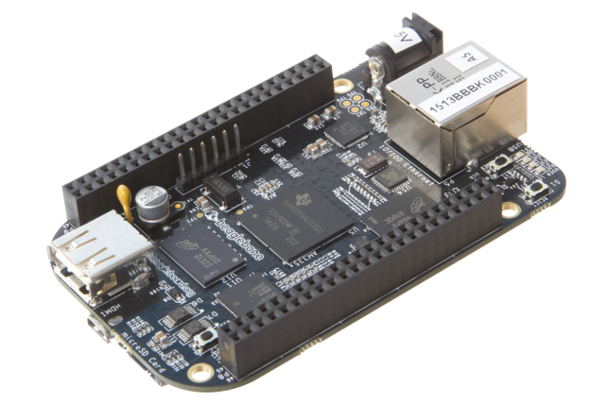
Emulating a Mobile Device
Challenges: restricted kernel access, protected memory, restricted UI port access, and restricted interprocess communication (IPC)
http://cdn.arstechnica.net/wp-content/uploads/2013/04/BeagleBoneBlack01-640x426.png
Notes:
First for my project:
Attempt to implement a frame-buffer driver on Beaglebone running MINIX 3 for ARM (port over 1,000 lines of C code from FreeBSD to MINIX 3)
Can the microkernel-based OS perform adequately for the average user with the added IPC?
Problems: Learning how to build the system, interfacing with the device, and transfer files (obviously no FB)
MINIX 3 Google Group: The MINIX 3 developers were helpful
Beyond the scope of my ability

Slide 5
Performance vs. Reliability
Is the tradeoff in performance worth the added reliability?
Use profiling tools to compare program execution on two different operating systems
Statistical profiler on MINIX 3
DTrace on FreeBSD
https://www.freebsd.org/logo/logo-full.png
Notes:
This term, the project changed scope
Is the increase in reliability worth the tradeoff in performance?
Determine by comparing MINIX 3 and FreeBSD
One is microkernel-based, and one is not
To accomplish this, I have want to use a statistical profiler in MINIX 3 and the DTrace utility in FreeBSD
Chose to run both OSs because they are POSIX-conformant and fairly light (able to run on my hardware: ~1GB RAM, aging processor)

Slide 6
More on IPC
Because MINIX 3 is a microkernel, more IPC must take place
Sender/receiver will block unless the other process is waiting to interact
Components, such as the FS, exists in user-space
Notes:
Procs are similar to Unix-like OSs
Private address space to store limited amount of data
Hold resources
Proc communicate by sending typed, fixed-length messages over pipes
Rendezvous principle
Procs with no sender/receiver will block
This can influence the performance of nearly all aspects of the operating system

Slide 7
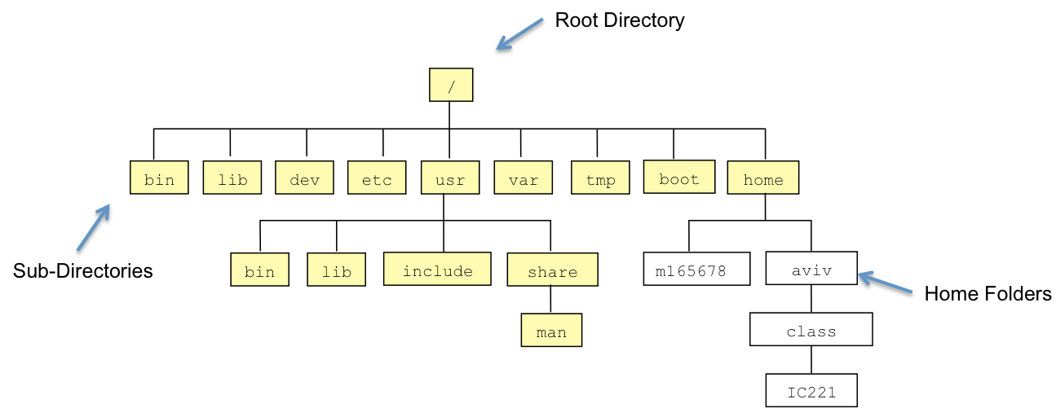
Methods
Test the filesystem
Use a VM
http://www.usna.edu/Users/cs/aviv/classes/ic221/s14/lec/02/img/unixfs.png
Notes:
The FS is quite dependent on system calls
We will test reading and writing files to the file system
The FS will receive data perform an action (I/O) and report back to the process
Use “profiling” tools to view what is happening inside of the kernel

Slide 8
Profiling in MINIX 3
Static profiler
Does not make binary modifications
Two types of statistical profiling:
One allows kernel profiling, one does not
NMI profiling is broken: cannot profile the kernel
Notes:
Uses a static profiler:
Static profilers use sampling methods to obtain results (they are somewhat rudimentary)
Contrast this with dynamic profiling tools that use:
Binary instrumentation
Probing
Static profilers wrap themselves around the execution, take control flow, and pause at certain points to record the state of the system
The kernel will write profiling samples based on the process name, program counter, etc.
Only provides a subset of executions taking long enough to be seen by the profiler (set the interrupt frequency, higher slows the execution time)
All profiling was broken in a recent version of MINIX 3
A post that I made in the Google group brought the bug to the developer’s attention
They fixed it in a subsequent release
Kernel profiling is still broken in the latest versions of MINIX 3 because there is no support for one of the interrupt controllers (an interrupt is a signal the process sends to the system to indicate that something needs immediate attention)
Tried running this on a native install and a virtual machine; no luck

Slide 9
Profiling in FreeBSD
DTrace (Dynamic Trace) is a kernel module for FreeBSD and other Unix-like operating systems
Specify “probes” that fire under certain conditions
http://www.rwaconsultants.com/sites/default/files/Sun-Microsystems-1.png
Notes:
DTrace is available on many unix-like operating systems
It is a powerful profiling tool
Users can write scripts in the D programming language to extract meaningful data about a system’s performance
Dynamic profiling tools rely on binary-level alterations to gather statistical information
They inject analysis routines into arbitrary locations
The default toolkit comes with a variety of scripts to use that activate certain probes to retrieve data
Example: some included probes fire when a syscall is made, memory is allocated, and so on (there are thousands)

Slide 10
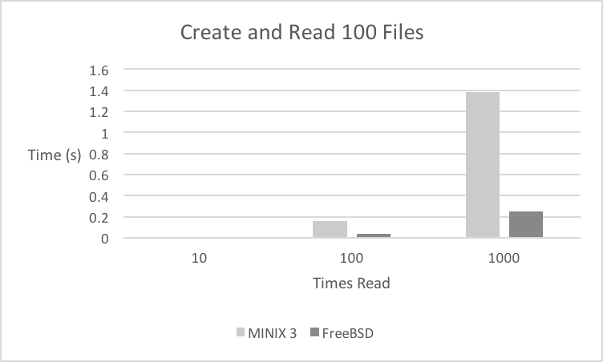
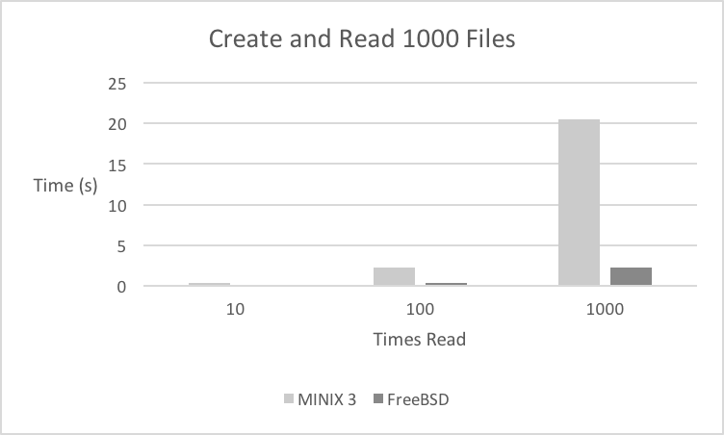
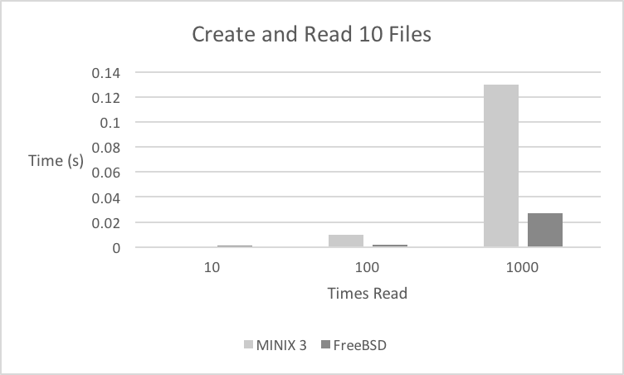
Results
Notes:
DTrace was dropping dynamic variables and producing inaccurate results
MINIX 3’s profiler was static and broken
These results were captured using the time command over the program execution
You are looking at a chart showing the time it took for MINIX 3 and FreeBSD to create 10 files, write the contents of an array to them, then open and close each file 10, 100, and 1000 times each
Repeated this two more times:
Creating 100 files
Creating 1000 files
Clearly, FreeBSD is MUCH faster when completing these tests

Slide 11
Conclusions
MINIX 3 is clearly focused on reliability over performance
More of a research project than a usable OS
This particular OS is not as robust as the developers claim
Notes:
The lack of robust profiling tools makes it evident that MINIX 3 is not built for performance
I did in fact encounter some system lockups and crashes
My tests broke the window manager and network driver
It was very difficult to get all of the tools up and running
It is still very much in development, and more of a research tool than anything else
I would not recommend anyone installing it on their machine
This is not to say that other microkernel-based operating systems (such as Mach) aren’t more reliable

Slide 12
Future Work
Perform tests in a more stable environment
Develop a more comprehensive test plan
Devise a way to accurately use more robust profiling tools
Notes:
Develop a more reliable testing environment
Physical hardware
Prepare more tests to run over different parts of an operating system
Get the advanced profiling tools running

Slide 13
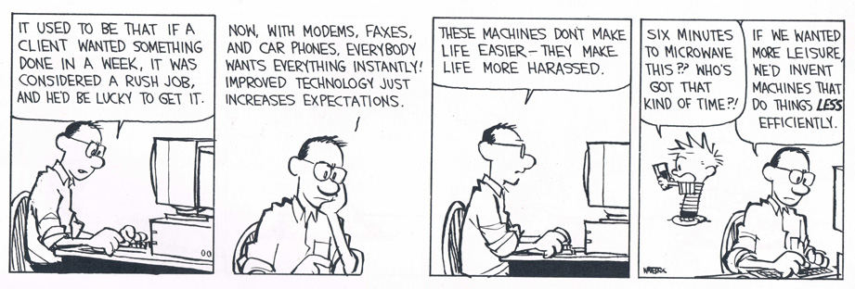
Thank You!
Special Thanks: Matt Anderson, Tom Yanuklis, The MINIX 3 Devs, Pete, Frank, and Jakub Kaczmarzyk
https://howwewatch.files.wordpress.com/2011/05/calvin_hobbes_efficiency.gif

