Slide 1
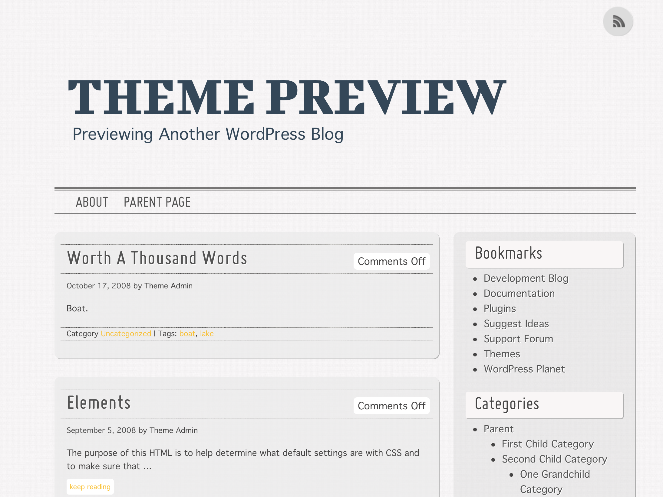
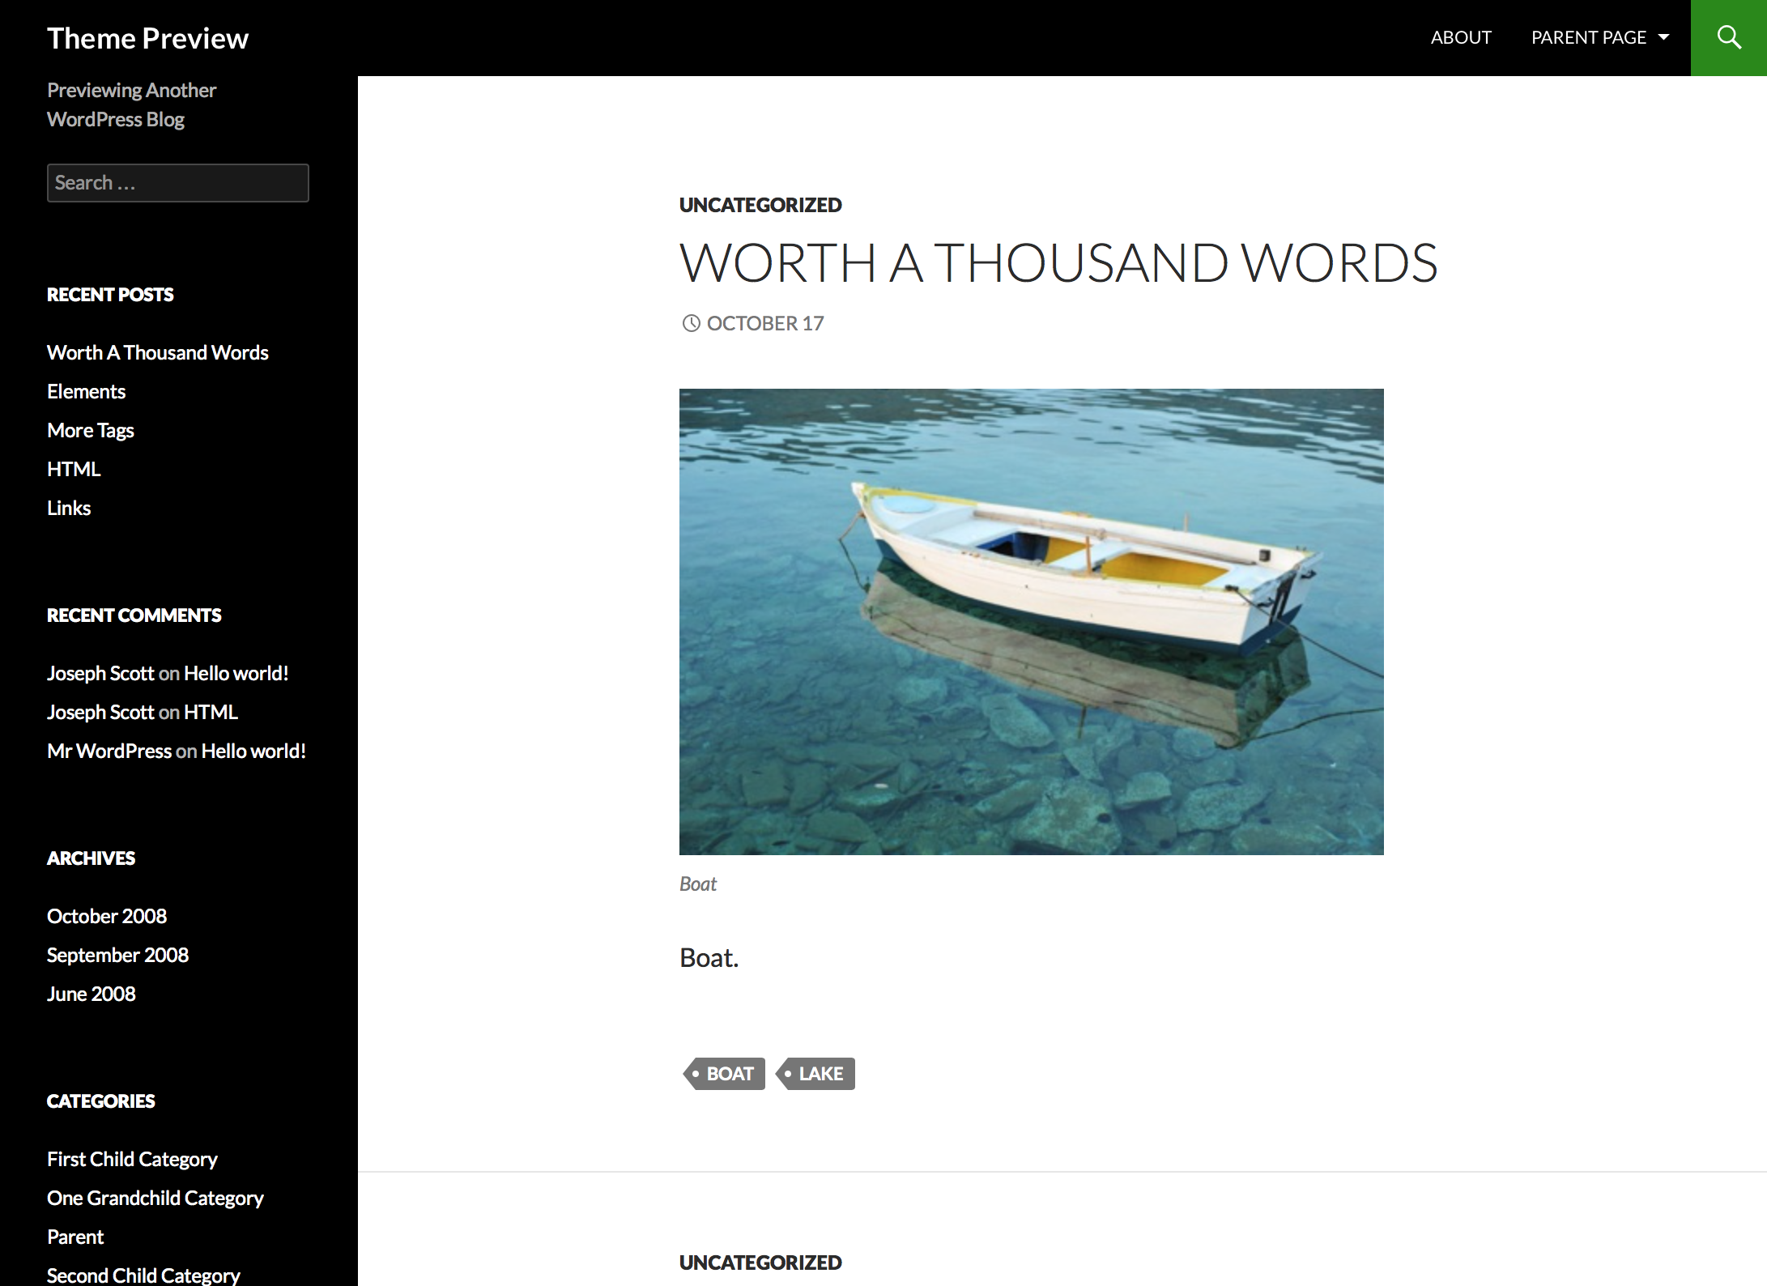
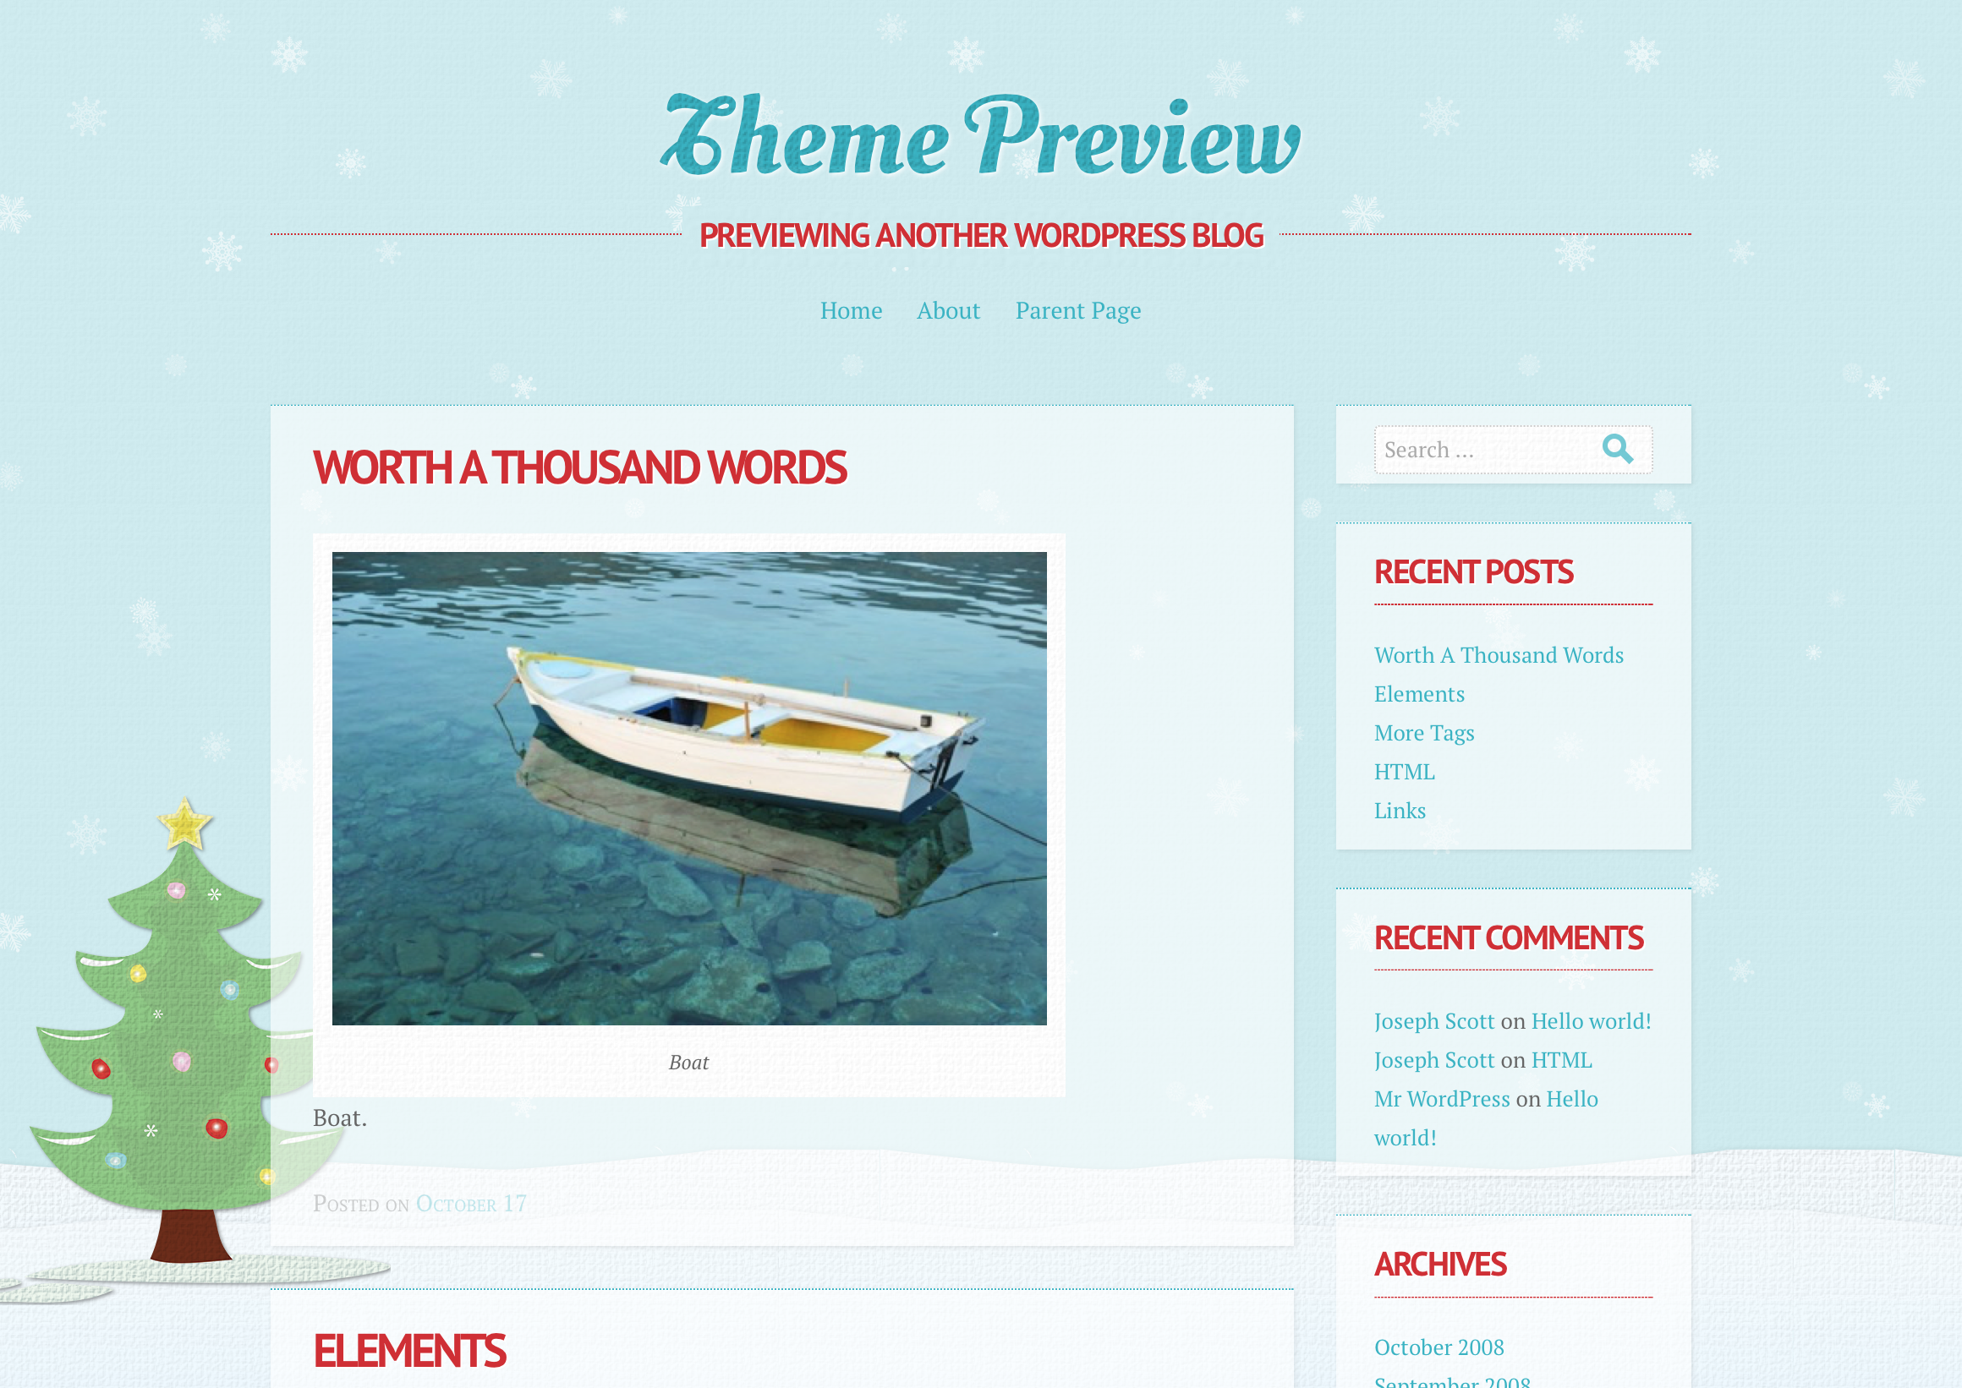
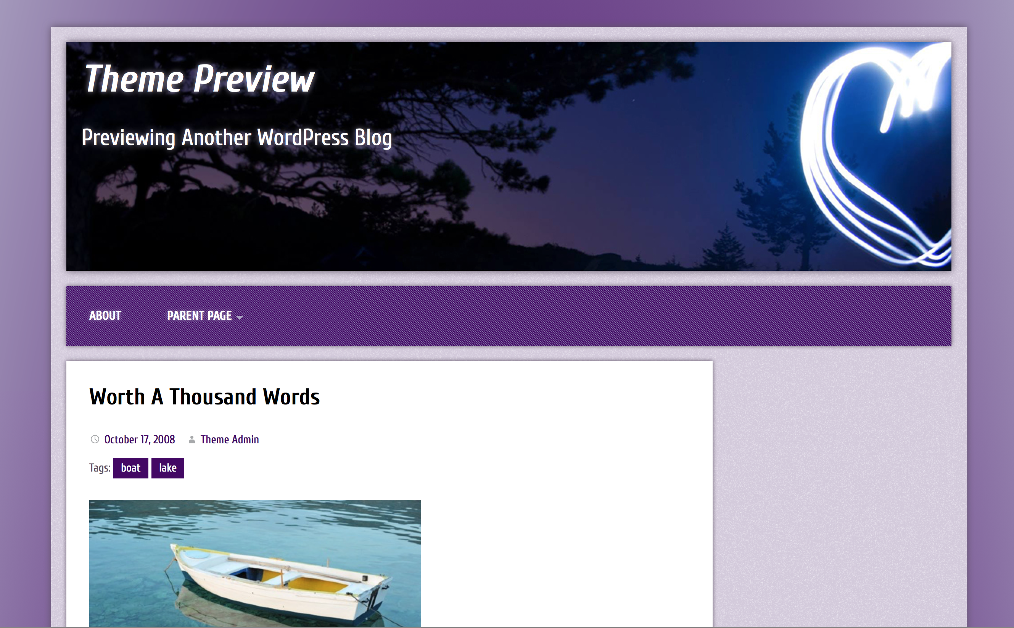
Automated Evaluation of WordPress Theme Design
Derek Ohanesian | Senior Project | Computer Science | 2015 | Advisor: Prof. Chris Fernandes
Abstract
A major obstacle in publishing a website is developing a well-designed user interface for the content being published. The World Wide Web democratizes publishing by providing an open platform on which even amateur web publishers can communicate, but a well-designed website remains less accessible to amateur publishers. Past research has focused on finding qualitative heuristics that could be used to provide useful design feedback to non-professional web designers. By analyzing the well-defined functions for displaying content in WordPress themes, as well as the CSS style sheets from those themes, a WordPress theme’s design can be heuristically evaluated. The result of this evaluation can provide the theme’s developers with feedback and suggestions for design improvement. For this research project, a set of heuristics measured: color quantity and contrast, balance, density of content, and font size and quantity. Data was collected for over 200 WordPress theme designs and analyzed for these heuristics. The feedback that this automated system provides can be compared to a heuristic evaluation completed by professional designers, to assess the value of the feedback that the automated system provides.
Why WordPress?
WordPress is an open-source content management system that powers tens of millions of websites. WordPress provides a repository of thousands of WordPress themes. Each theme can provide a unique design for the website, while the content remains the same. For the purpose of this research, only traditional two-column blog themes were analyzed. By heuristically evaluation a website with the same content, but a different theme, we can see how the theme independently affects the design of the website.
Data Collection
Data collection was completed by automatically reloading the WordPress blog in the browser with a different theme on each reload. Major HTML elements and the CSS attributes of those elements were stored in a database for over 200 unique themes. This data set could then be analyzed to do a heuristic evaluation of each theme.
Theme Heuristics
Quantity of unique colors used
Text contrast on background
Left/right balance of major elements
Density of content elements (percent of area)
Font size for some elements
Quantity of fonts used
Anatomy of a WordPress Theme
WordPress themes include a set of functions that the theme designer can call to access the blog’s content and present it in the design of the page. By intercepting these function calls, we can identify exactly what elements of the blog are being displayed on the page.
Evaluation & Future Work
By completing an automated heuristic evaluation on a set of over 200 WordPress themes, we are left with a set of scores judging the theme’s performance in each heuristic. Depending on the theme and heuristic, these scores vary in their potential usefulness to a non-professional designer. There are examples where the score correctly indicates a problem, as well as examples where the score seems arbitrary. We have set aside a test set of unevaluated themes and completed a human heuristic evaluation using 10 of these themes. By comparing the automated evaluation to a human evaluation, we conclude that our algorithm is providing at least some level of valuable feedback about potential user interface and design improvements. Future work includes finding additional heuristics and assessing their value to an automated system.

