Slide 1
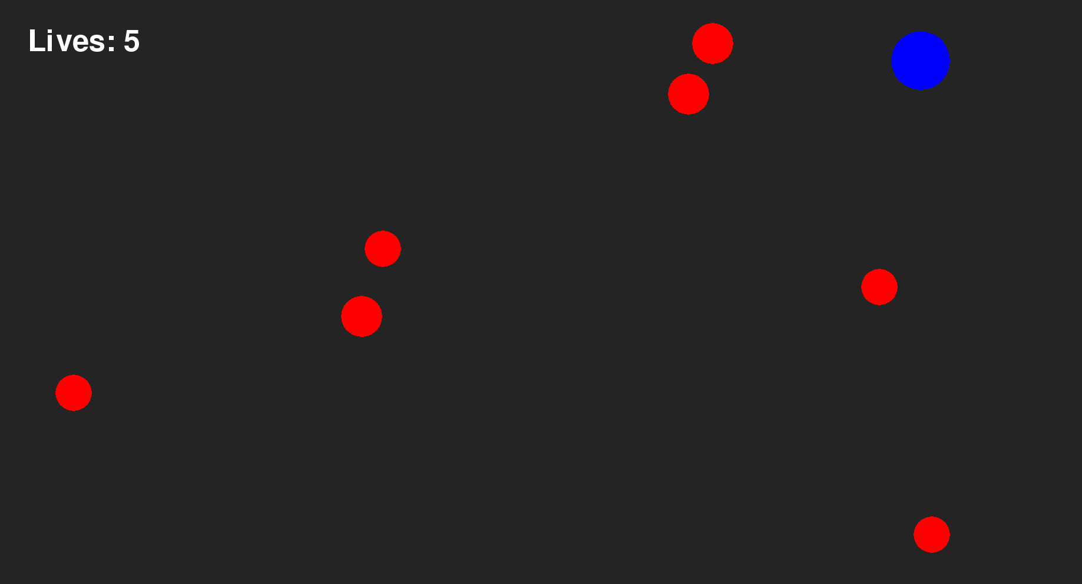
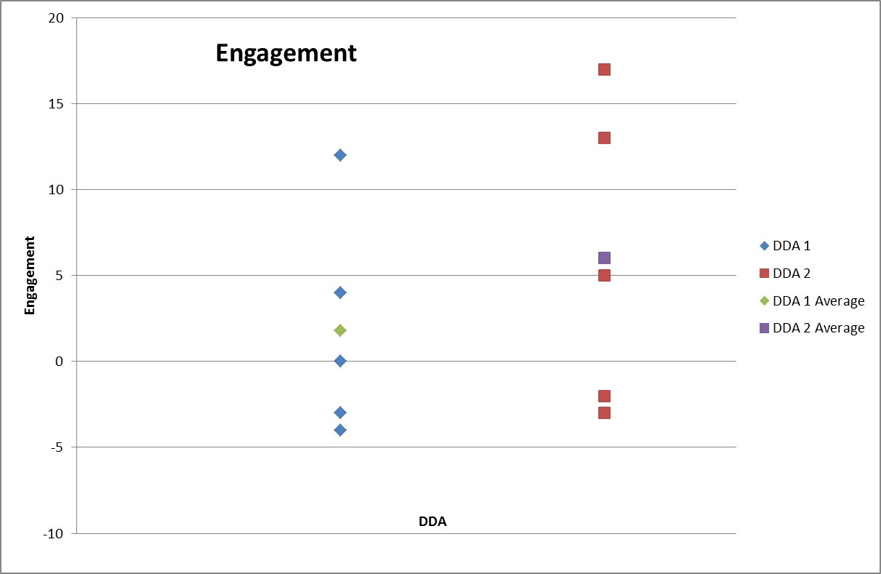
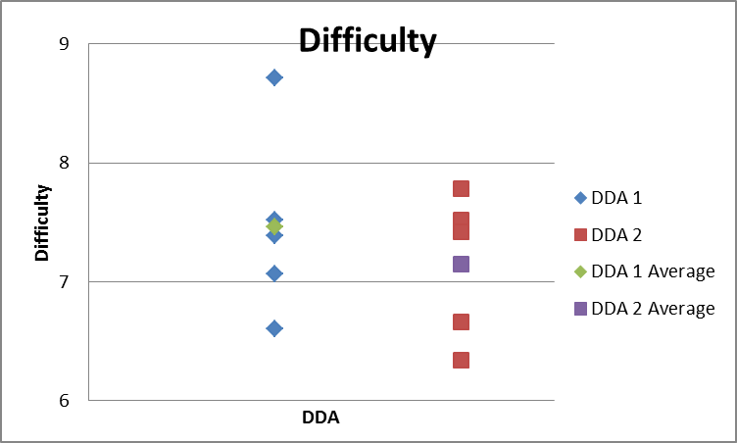
Senior Project – Computer Science – 2015 Engaging Players by Dynamically Adjusting the Difficulty William Cody Menge Advisor – Prof. Aaron Cass
Abstract
Video game designers constantly explore ways to enhance a video game’s experience by keeping a player engaged. Dynamic Difficulty Adjustment (DDA) and other similar systems attempt to create a unique experience by adapting the game based on player behavior. The approach was focused on changing the rate at which the game dynamically adjusts it's difficulty level. The effectiveness of this study was determined by the player’s engagement level. By keeping the game at the optimal difficulty, based on the player’s performance, the game will keep the player in the Flow.
The player starts with 5 lives. The objective is to destroy the red targets before they start to self destruct, turning blue, causing an explosion resulting in a loss of life. They player has 1 second to destroy the target to prevent this
Design
Two DDA’s were implemented into the game design in Python. The first DDA was implemented to adjust them game’s difficulty at a fixed percentage. The rate of change describes the distance the game is allowed to change from the current difficultly to the desired difficulty calculated based on the players performance. The second one uses a ratio determined by the time to determine the allowable change in difficulty.
Results
Data Collection
The subjects were placed in an isolated environment and asked to play continuously for 10 minutes. After the ten minutes the subjects filled out the 19 question Game Engagement Questionnaire. These were then converted into a numerical scale for evaluation. Average game difficulty and high scores were also recorded.
After running tests on the data I found a p value of .309. This shows there is no statistical significance between engagement levels and the DDA’s . Even though DDA 2 has a higher average engagement level there are not enough data points to correctly identify a relationship between engagement and difficulty.
Future Work
We would like to gather more test subjects to better find a trend. The next steps to be taken are expanding the amount of different rates being tested. A better way of determining a player’s current difficulty level would be needed to further the research

