Slide 1
Stock Market Prediction Using Machine Learning
By Conor Carey
Advisors – Professor Cass and Professor Yaisawarng

Slide 2
Background
Many previous studies on discovering variables to improve stock market prediction
Many previous studies on machine learning techniques to discover most effective method for stock price trend prediction

Slide 3
Hypothesis
Thesis Question
Can manipulating stock datasets by sector improve predicting ability of stock price trend prediction models?
Manipulating stock data by sector will improve predicting ability of stock price trend prediction models

Slide 4
Variables
My dataset includes 9 independent variables and 1 dependent variable
Dividend Yield, Price, Effective Tax Rate, Gross Profit Margins, Inventory, Long Term Interest Rate, Inflation, US Industrial Production Rate, and a nominal sector variable - Independent
BUY/DNB (Do Not Buy) - Dependent

Slide 5
Data
4200 Data points
Stocks from 50 most traded companies
8 Sectors

Slide 6
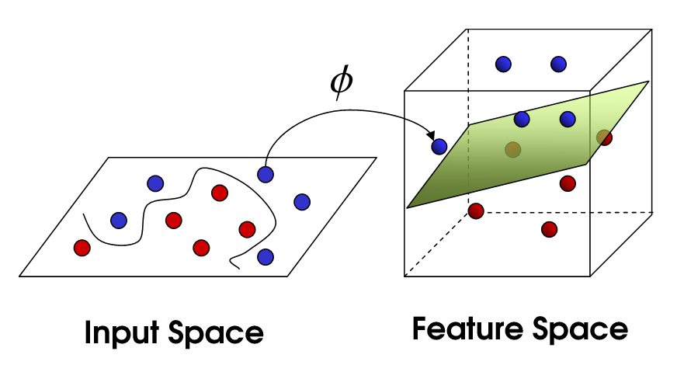
Machine Learning
Support Vector Machine as implemented in WEKA

Slide 7
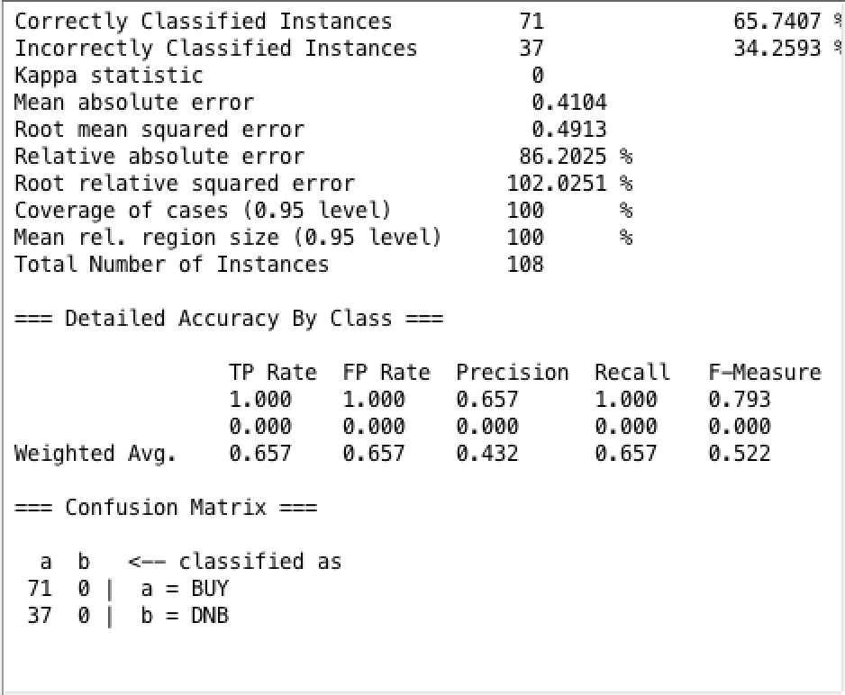
Results
Jn;klj
This dataset was equally partitioned by percentage of data make-up to percentage of test data make-up

Slide 8
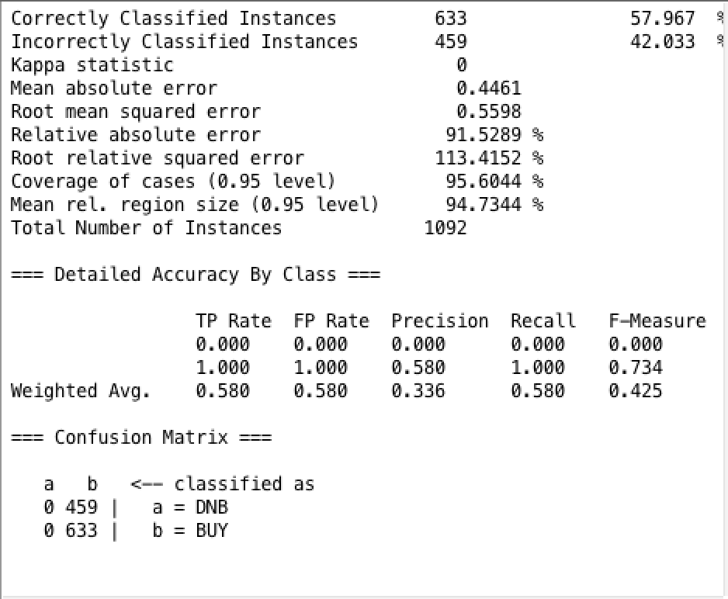
Results (cont.)
\
dwfqwdfq
Basic Material sector tested separately produces only BUY markers as well

Slide 9
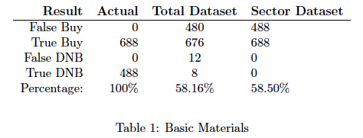
Results (cont.)
Basic Materials sector tested individually vs. tested within the 50 stock dataset

Slide 10
Discussion of Results
No correlation found between nominal sector variable and improved predictability of price increasing or decreasing
Unexplained BUY phenomenon

Slide 11
Future Work
Determine cause of lack of DNB signals
Attempt with different set of stocks
Attempt further partitions that may show correlation between sector specificity and stock price trends

