Slide 1
Evolving Scalable
Soft Robots
Senior Thesis Presentation
Ben Berger
Advisor: John Rieffel

Slide 2
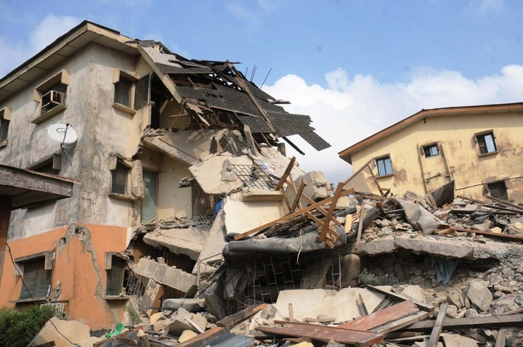
http://www.nigeriaintel.com/wp-content/uploads/2013/07/collapsed-building.jpg

Slide 3
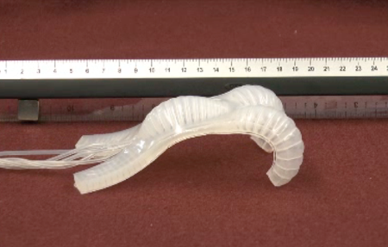
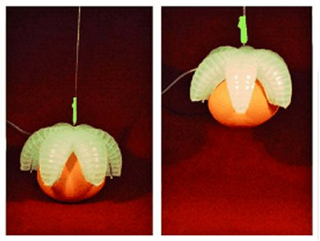
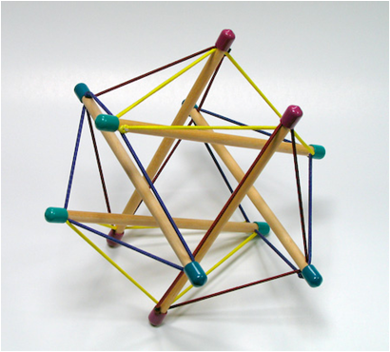
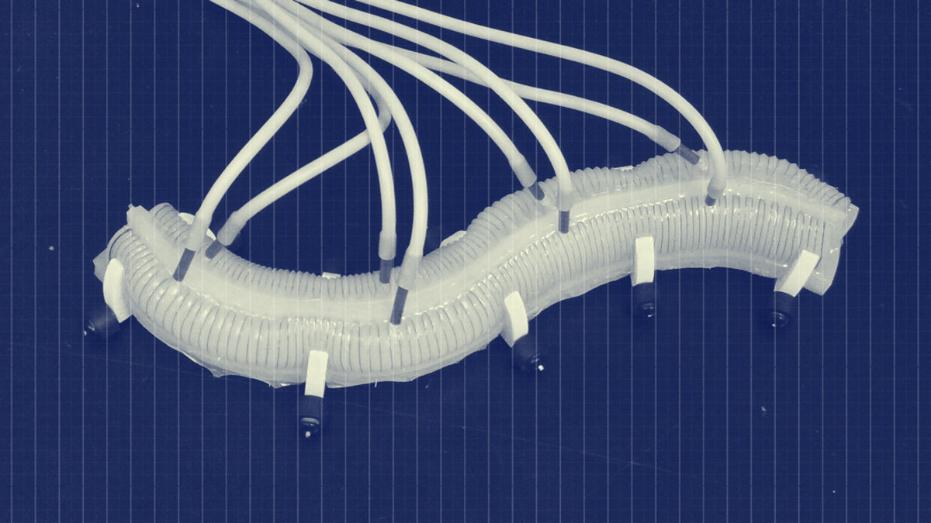
Soft robot examples
http://spectrum.ieee.org/img/soft%20robot%20flexibot-1322569462509.png
http://www.chemistryviews.org/common/images/thumbnails/source/12daa023d4a.jpg
http://www.intensiondesigns.com/images/tensegrity_icosahedron.jpg
http://cdn2.vox-cdn.com/uploads/chorus_image/image/31706045/soft_robot_lead.0_cinema_1200.0.jpg

Slide 4
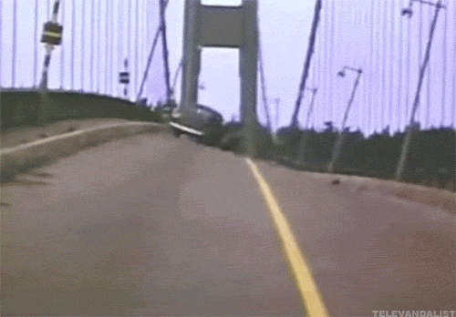
https://gs1.wac.edgecastcdn.net/8019B6/data.tumblr.com/tumblr_m678xczbji1qedb29o1_r1_500.gif

Slide 5
How do we make soft robots move?
(Hint: It’s really hard!)

Slide 6
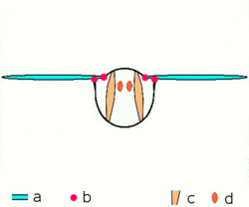
We can outsource cognition to the body, analogous to how a fly’s wings beat 4x faster than its nerve impulses
https://upload.wikimedia.org/wikipedia/commons/thumb/6/6e/Drosophila-drawing.svg/236px-Drosophila-drawing.svg.png
https://upload.wikimedia.org/wikipedia/commons/thumb/c/c2/Motion_of_Insectwing.gif/250px-Motion_of_Insectwing.gif

Slide 7
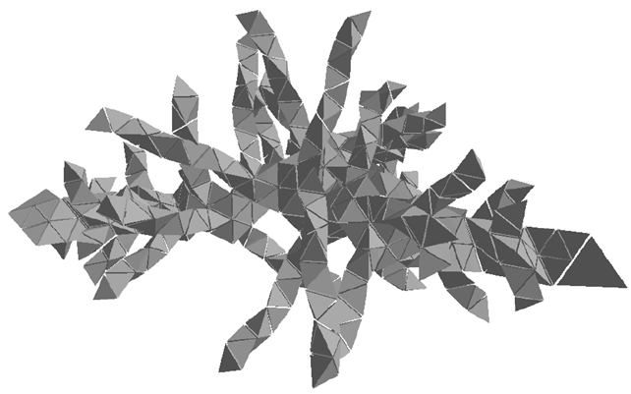
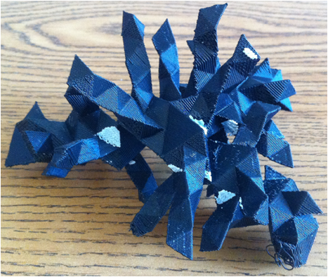
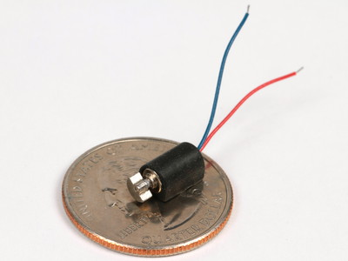
Rieffel and Smith [7]
http://shop.emscdn.com/catalog/components/motor/pager/imgmed/4.jpg

Slide 8
<Interesting video of simulation here>
idbdb gadbc rabcb sddcc sadcd 1

Slide 9
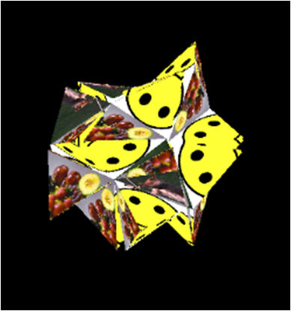
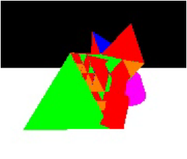
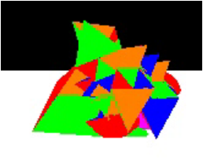

Slide 10
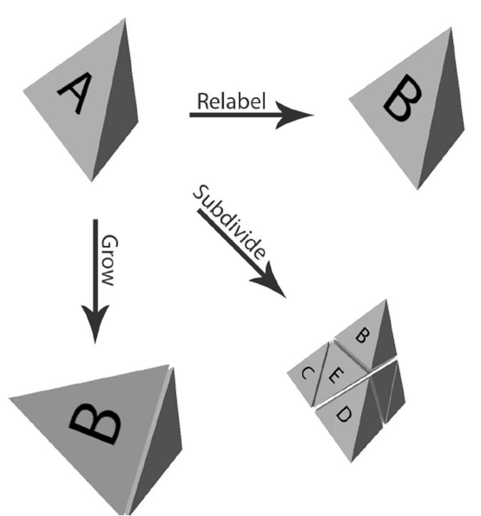
Generative
Encoding
Rieffel and Smith [7]

Slide 11
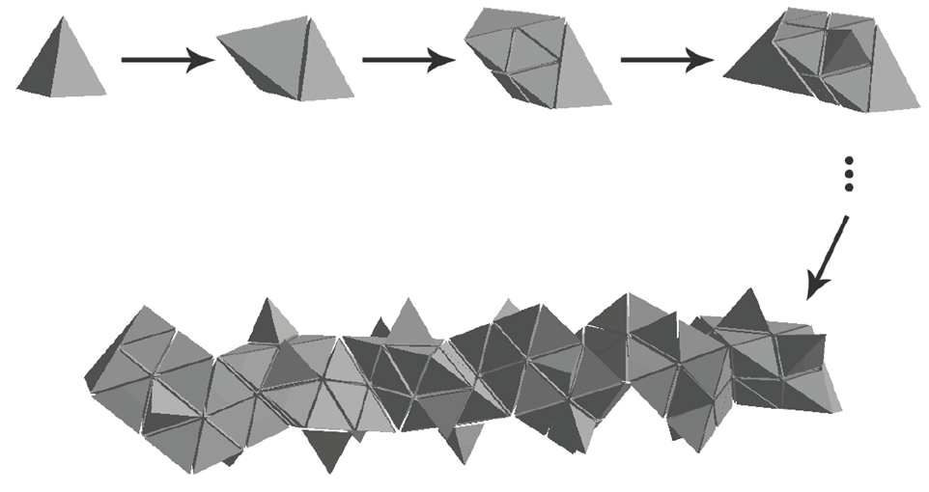
Rieffel and Smith [7]

Slide 12
Generate Population of Encodings
For each encoding:
Select Best Designs
Breed New Population
Grow Robot
Evaluate in Simulation

Slide 13
SEGMENTATION FAULTS
Too many graphics windows
Command line arguments
Global variables
Memory leaks....
https://upload.wikimedia.org/wikipedia/commons/thumb/6/6e/Drosophila-drawing.svg/236px-Drosophila-drawing.svg.png

Slide 14
Fitness jumps to
over 40 trillion

Slide 15
<Interesting video of simulation here>
icdbc gbccc sadbc rcabb gaacd 100

Slide 16
<Interesting video of simulation here>
ibdcb gcbdb sacda gbabb raccc

Slide 17
How do we create scalable soft robots?

Slide 18
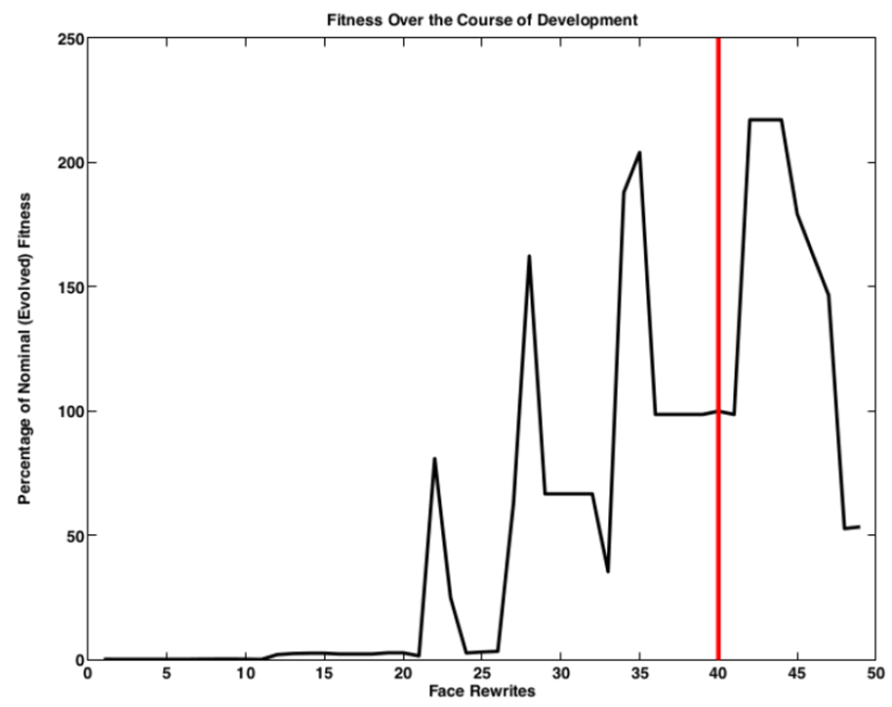
Ontogenetic Trajectory
Danise [1]

Slide 19
Extra Small
Small
Medium
Large…

Slide 20
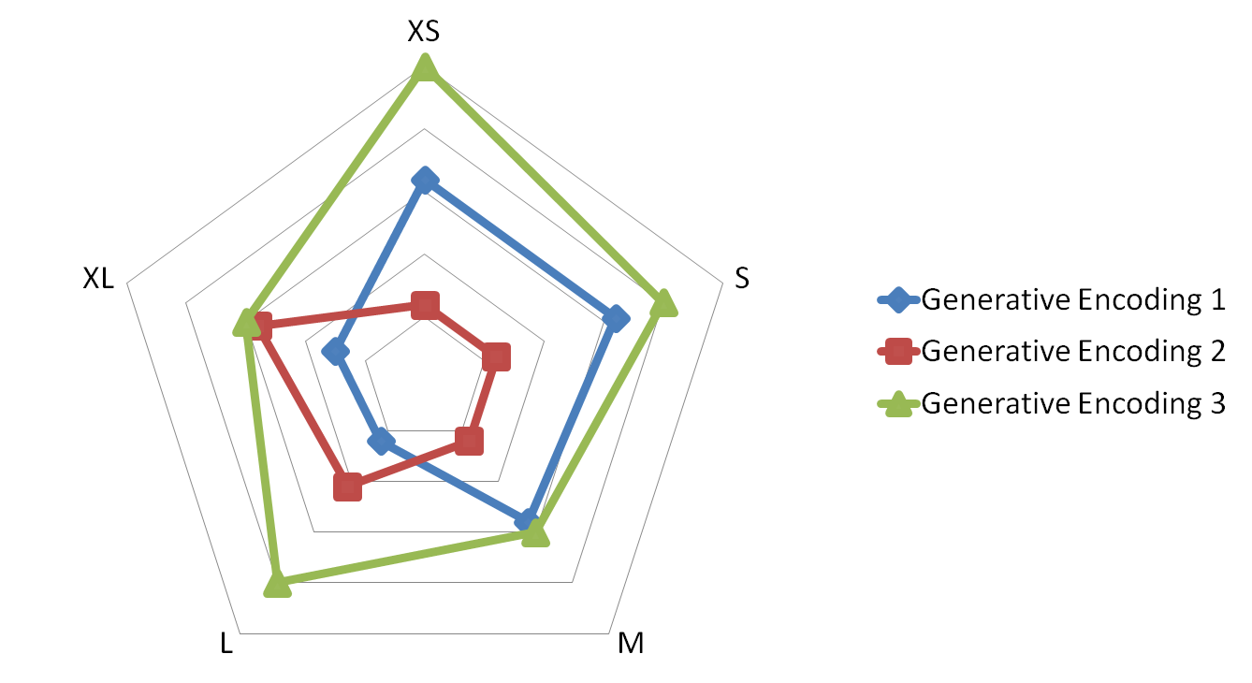
Pareto Dominance
GE3 dominates
across all categories

Slide 21
Generate Population of Encodings
For each encoding:
Select Best Designs
Breed New Population
Grow Robot
Evaluate in Simulation

Slide 22
Generate Population of Encodings
For each expansion:
Remove Dominated Individuals
Breed New Population
For each encoding:
Grow Robot
Evaluate in Simulation

Slide 23
Future Work
Pareto front code will be done next week.
Jupiter, I’m coming for you!

Slide 24
<Interesting video of simulation here>
ibdcb gcbdb sacda gbabb raccc

Slide 25
Sources
Andrew Danise. Evolving soft robots with vibration based movement, 2014.
Gregory S Hornby and Jordan B Pollack. The advantages of generative grammatical encodings for physical design. In Evolutionary Computation, 2001. Proceedings of the 2001 Congress on, volume 1, pages 600–607. IEEE, 2001.
Holmes, Kenneth C. "Steric blocking mechanism explains stretch activation in insect flight muscle." Proceedings of the National Academy of Sciences 108.1 (2011): 7-8.
Przemyslaw Prusinkiewicz, Aristid Lindenmayer, and James Hanan. The algorithmic beauty of plants. The virtual laboratory (USA), 1990.
John Rieffel. Heterochronic scaling of developmental durations in evolved soft robots. In Proceeding of the fifteenth annual conference on Genetic and evolutionary computation conference, pages 743–750. ACM, 2013.
John Rieffel, Davis Knox, Schuyler Smith, and Barry Trimmer. Growing and evolving soft robots. Artificial life, 20(1):143–162, 2014.
John Rieffel and Schuyler Smith. A face-encoding grammar for the generation of tetrahedral-mesh soft bodies. In ALIFE, pages 414–420, 2010.
John Rieffel, Francisco Valero-Cuevas, and Hod Lipson. Automated discovery and optimization of large irregular tensegrity structures. Computers & Structures, 87(5):368–379, 2009.
Shivakumar Viswanathan and Jordan Pollack. How artificial ontogenies can retard evolution. In Proceedings of the 2005 workshops on Genetic and evolutionary computation, pages 273–280. ACM, 2005.

