Slide 1
Evaluating body posture and ball trajectory to determine fastpitch softball pitch types
Alyssa Wolejko
Advisor: Nick Webb

Slide 2
How do we distinguish differences?
Terminology: A pitching motion is a single pitch thrown by a pitcher
Each pitch type has distinguishable features
Different pitches are very different in appearance, but are difficult for the untrained eye to see

Slide 3
Pitch Differences
Curveball
hand across the body (finishing along the hip line)
Change-up/ Off-speed
speed of pitch is slow; hand ends straight out in front with palm down
Riseball
speed of pitch is fast; hand ends by the pitchers shoulder/head

Slide 4
Goals of the Thesis
Accurate and Instructional Program that determines a pitch type from 3D data
Using Microsoft Kinect to collect data
Long Term: Be able to keep track of pitching statistics

Slide 5
Process
Kinect is placed behind the pitcher
Kinect + OpenNI tracker—tracks 15 different joints
Get the X, Y, Z coordinates of each joint
Get the phi and theta for specific joints
Relational space between joints
Accounts for the joints being on different planes

Slide 6
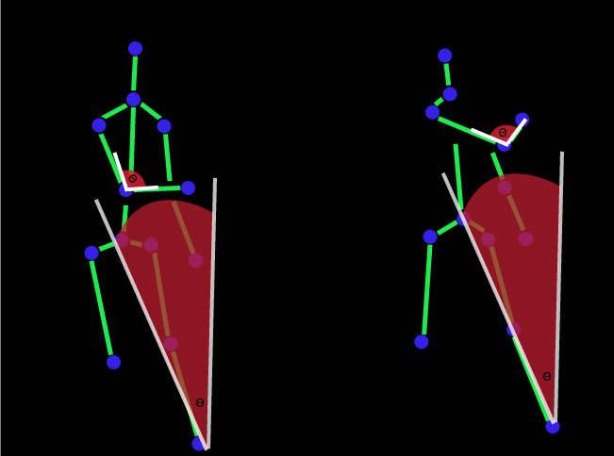
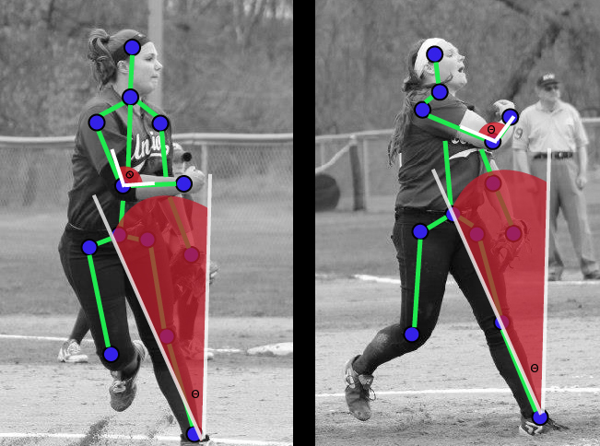
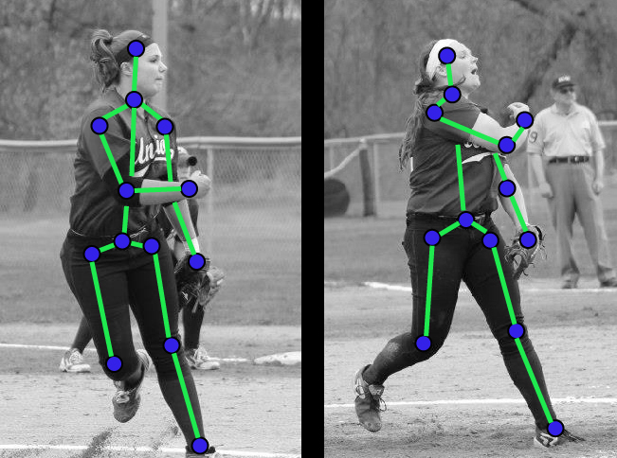
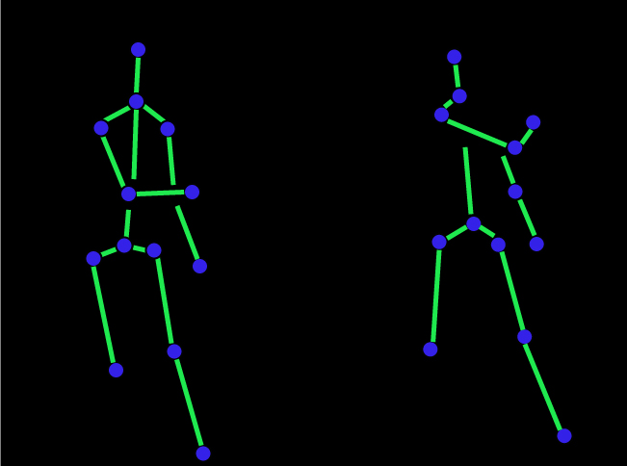
Curveball Stance

Slide 7
Working with Multi-Instances in Weka
Use a machine learning algorithm to classify data
Weka is a machine learning tool
Multi-instance classifier must be used because the gesture of a pitching motion is a dynamic gesture
Each pitch type is one class

Slide 8
Data Being Collected
Kinect publishes 30 times per second
i.e. 30 frames per second
One frame = all 15 joints published at the same time
One pitching motion is about 7 seconds long
~240 frames that are published belong to a single pitch
Notes:
Following slide: hypothesis about

Slide 9
Original Results
Trained one set of data with 14400 instances on another set
Second set of data is a recording of another pitcher throwing the same pitch types
The data set is composed of all XYZ coordinate values of each joint and 4 Theta/Phi pairs—100% accuracy

Slide 10
Hypothesis: Accuracy can be maintained by decreasing the number of instances.
Take out as many instances as possible without making the accuracy decrease
Original:
Reduced:
Instances reduced from 14400 to 7800

Slide 11
Selecting Theta and Phi
Calculated Theta and Phi for 10 of the 15 joints
Eliminated one by one until certain joints became more important than others
Left Knee, Right Shoulder, Right Elbow, Torso

Slide 12
Hypothesis: The Theta and Phi values of a joint can replace the XYZ coordinates without losing accuracy.
Reduced the XYZ values, until only the Theta and Phi values were left
Retains 100% accuracy when only 4 (Theta, Phi) values are used
Torso, left knee, right shoulder, and right elbow

Slide 13
Hypothesis: The last couple seconds of a pitching motion is more distinguishable than the first couple seconds.
Remove instances from the end of the pitch instead of from the beginning
Removing instances from the beginning doesn’t effect the accuracy
Therefore, the end of a pitch is distinguishable

Slide 14
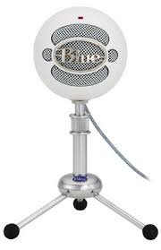
Determining the End of a Pitch
External USB Microphone
Find the peak value of the sound captured by the microphone
Ball hitting plywood board
Pull the jpeg image from the file
at the moment the sound occurred
store.apple.com

Slide 15
Location of a Pitch (Curveball)

Slide 16
Position of the Ball
OpenCV library—HoughFindCircles() and HoughFindEdges()
Finds the circle within an image
Finds the edges of a grid within an image
Find center of circle and determine location within the grid
http://en.wikipedia.org/wiki/OpenCV

Slide 17
Position of the Ball
Red dot clearly marks the center of the ball
The red dot is within one of the 9 zones of the grid
Riseball

Slide 18
Further Steps…
Compiling deductions made into a record for further use
Evaluate pitch speeds—turning data from Kinect into a radar gun
Live Streaming
Real-time pitch evaluation

Slide 19
Thank You!
Any Questions…?

