Slide 1
Machine Learning Examination of Nba Defense
Alex Block
Advisors: Chris Fernandes & Nick Webb
Notes:
Im _______ my advisors are _____

Slide 2
Project Goal
Determine the attributes that are most characteristic of defensive effectiveness
Notes:
What makes a good defense good?
What makes a bad defense bad?

Slide 3
Dean Oliver
Specifically, at the NBA level, the general ranking of importance of the Four Factors is
Shooting percentage (40%)
Turnovers per possession (25%)
Offensive rebounding percentage (20%)
Getting to the foul line (15%)
Notes:
Dean Oliver – Basketball Statistician who has investigated this problem before
Oliver concluded that there were four factors to success in basketball on both offense & defense (Shooting, Turnovers, Rebounding, Free Throws)
The percentages represent the relative importance of each factor
Q & A:
I actually found this after I began my project. My results validated and further investigated this conclusion.

Slide 4
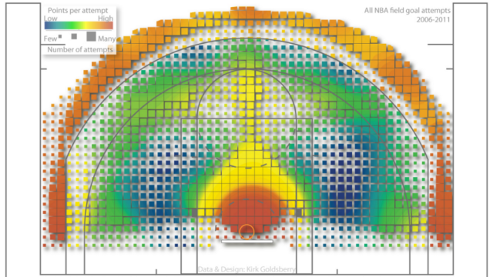
Kirk Goldsberry
Notes:
This chart was the source of a lot of what I expected to find.
The color represents the points per attempt from that location – reds are efficient locations, blues are not
The size of the square represents the frequency of attempts from that location --
Suggests importance of protecting the basket and 3 pointers
Encourage opponents to shoot from the dark blue areas

Slide 5
Process Outline
Gather Data
Attribute Selection
Model Data
Analyze
Notes:
REALLY BASIC Outline of project
I will explain each of these sections more thoroughly later on.
There is a back and forth between the middle two a lot.
-checking to ensure that the removal of a certain attribute doesn’t ruin the performance of the model completely.

Slide 6
Data
Data gathered for all teams from the 1996-1997 to the present season
65 Initial Statistics
Gather Data
Attribute Selection
Model data
Analyze

Slide 7
Measuring Defense
Defensive Efficiency
Points normalized by 100 possessions
Gather Data
Attribute Selection
Model Data
Analyze
Notes:
Modelling requires a value to predict which means that…
…I need some way of measuring defense (ppg, fg%[shots made/total shots])
A stat like PPG is flawed because it is effected by the number of possessions per game which varies by team for up to 10 possessions a game
I’m going to use defensive efficiency because in my opinion it is a more robust measure
This is the value the machine learning algorithms will predict

Slide 8
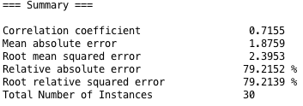
Machine Learning
Weka
Apply every available algorithm to the data
Best Performing Algorithms
Linear Regression
Multilayer Perceptron
Gather complete set of data
Attribute Selection
Model data with
Machine Learning
Analyze
Notes:
It will give me an output that makes some suggestions on the best way to proceed
Measure that I will focus on is the correlation coefficient which is a measure of the relationship between my input variables and my ouput variable
Closer to 1 indicates a higher correlation

Slide 9
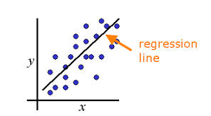
Linear Regression
y = a + b₁x₁ + b₂x₂ … b_{n}x_{n}
Correlation Coefficient: 0.9997
Gather data
Attribute Selection
Model Data
Analyze
Notes:
Simple Linear Regression ➔ one x variable and one y variable
Goal of a linear regression is to find a straight line that best “fits” the data (reduces the error)
Multiple Regression ➔ A lot of x variables and one y variable.
Two variables, you are fitting a flat plane to the data to reduce error
Same idea for more variables but it’s a little harder to visualize

Slide 10
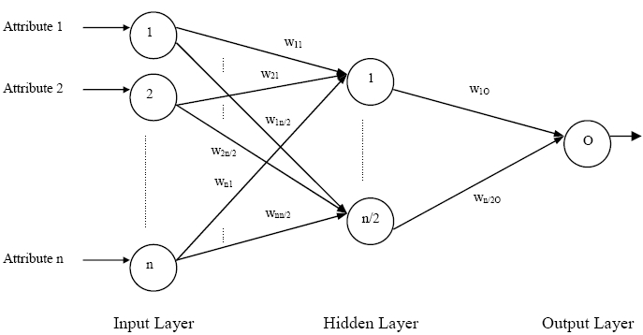
Multilayer Perceptron (Neural Network)
Correlation Coefficient: 0.9993
Gather Data
Attribute Selection
Model Data
Analyze
Notes:
Different in its build and the way it trains data
Since variables interact, Allows for a non-linear result variables can interact with each other
Weights start at random values
Multilayer Perceptron is trained using a technique called backpropagation
Two step Process
-Predicts the output variable and checks error
-Goes back through the network and adjusts the weights to minimize error
- Pushes it in the direction of gradient descent with a magnitude determined by the learning rate and momentum
-Learning Rate – The rate of improvement at a solution state. Will overcorrect for a single iteration
-Momentum – The ra

Slide 11
Attribute Selection
Attribute is…
…not an indicator of defense
…an indicator of defensive effectiveness, but not a cause of it
…highly correlated with another attribute
…a composite of other attributes
…not important for the success of the model
Gather Data
Attribute Selection
Model Data
Analyze
Notes:
Two models that are very good, but there is a lot of “clutter” (erroneous variables) that makes it difficult to analyze the model and also slower to compute
Goal now is to find the attributes that can be removed and still be able to model successfully
Not an indicator
- Offensive Statistics
Not a cause
- Field Goal %...obviously your opponents missing shots means good defense, but it doesn’t tell you why the defense is good
Highly Correlated
//Correlation
-// Turnovers & Steals
Different Form of the same statistic
-Turnovers &. Turnover Ratio
Composite
-Zonal data
-3 pters made, A,%
-Field Goals made, attempts, percentage
-percentage = made/attempts

Slide 12
Final Attribute Set (Ranked by Importance)
 | Correlation Coefficient
 | Initial | Final
Multilayer Perceptron | .9993 | .9952
Linear Regression | .9997 | .9816
Opponent Turnover Ratio
Restricted Area Field Goal %
Defensive Rebound %
Mid-Range Field Goal %
Opponent Free Throw Attempt Ratio
In The Paint (Non-RA) Field Goal %
Above the Break 3 Field Goal %
In The Paint (Non-RA) Field Goal Attempts
Mid-Range Field Goal Attempts
Restricted Area Field Goal Attempts
Opponent Free Throw %
Left Corner 3 Field Goal %
Right Corner 3 Field Goal %
Above the Break 3 Field Goal Attempts
Right Corner 3 Field Goal Attempts
Left Corner 3 Field Goal Attempts
Notes:
I went from 65 attributes down to 16, and still have a very successful model
I could cut more attributes and still have a successful model, but the result of removing any of these attributes results in a statistically significant decline

Slide 13
My Statistics
Dean Oliver’s
Opp TO Ratio
Restricted Area FG Percentage
DREB Percentage
Mid-Range FG Percentage
Opp FTA Rate
In The Paint (Non-RA) FG Percentage
Above the Break 3 FG Percentage
In The Paint (Non-RA) FGA
Mid-Range FGA
Restricted Area FGA
Opp FT Percentage
Left Corner 3 FG Percentage
Right Corner 3 FG Percentage
Above the Break 3 FGA
Right Corner 3 FGA
Left Corner 3 FGA
Shooting percentage
Turnovers per possession
Offensive rebounding percentage
Getting to the foul line
Notes:
If you look at my statistics, you may notice that they fit rather nicely into Dean Oliver’s categories

Slide 14
My Statistics
Dean Oliver’s
Opp TO Ratio
Restricted Area FG Percentage
DREB Percentage
Mid-Range FG Percentage
Opp FTA Rate
In The Paint (Non-RA) FG Percentage
Above the Break 3 FG Percentage
In The Paint (Non-RA) FGA
Mid-Range FGA
Restricted Area FGA
Opp FT Percentage
Left Corner 3 FG Percentage
Right Corner 3 FG Percentage
Above the Break 3 FGA
Right Corner 3 FGA
Left Corner 3 FGA
Shooting percentage
Turnovers per possession
Offensive rebounding percentage
Getting to the foul line
Notes:
I have a statistic that measures free throw attempts per possession

Slide 15
My Statistics
Dean Oliver’s
Opp TO Ratio
Restricted Area FG Percentage
DREB Percentage
Mid-Range FG Percentage
Opp FTA Rate
In The Paint (Non-RA) FG Percentage
Above the Break 3 FG Percentage
In The Paint (Non-RA) FGA
Mid-Range FGA
Restricted Area FGA
Opp FT Percentage
Left Corner 3 FG Percentage
Right Corner 3 FG Percentage
Above the Break 3 FGA
Right Corner 3 FGA
Left Corner 3 FGA
Shooting percentage
Turnovers per possession
Offensive rebounding percentage
Getting to the foul line

Slide 16
My Statistics
Dean Oliver’s
Opp TO Ratio
Restricted Area FG Percentage
DREB Percentage
Mid-Range FG Percentage
Opp FTA Rate
In The Paint (Non-RA) FG Percentage
Above the Break 3 FG Percentage
In The Paint (Non-RA) FGA
Mid-Range FGA
Restricted Area FGA
Opp FT Percentage
Left Corner 3 FG Percentage
Right Corner 3 FG Percentage
Above the Break 3 FGA
Right Corner 3 FGA
Left Corner 3 FGA
Shooting percentage
Turnovers per possession
Offensive rebounding percentage
Getting to the foul line
Notes:
Turnovers per 100 possessions

Slide 17
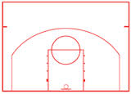
My Statistics
Dean Oliver’s
Opp TO Ratio
Restricted Area FG Percentage
DREB Percentage
Mid-Range FG Percentage
Opp FTA Rate
In The Paint (Non-RA) FG Percentage
Above the Break 3 FG Percentage
In The Paint (Non-RA) FGA
Mid-Range FGA
Restricted Area FGA
Opp FT Percentage
Left Corner 3 FG Percentage
Right Corner 3 FG Percentage
Above the Break 3 FGA
Right Corner 3 FGA
Left Corner 3 FGA
Shooting percentage
Turnovers per possession
Offensive rebounding percentage
Getting to the foul line
Notes:
Shooting % and num. attempts for a bunch of different zones on the court

Slide 18
Attribute Weights
Removed each attribute individually and tracked the change in the Correlation Coefficient
Summed the individual changes in Correlation
Divided the individual change by the total change and multiplied by 100
Weights are a percentage of 100
Notes:
Was able to rank the attributes because I calculated a weight for each of them
Stop here and make sure everyone understands this! It is important that they believe these values are real and not made up!

Slide 19
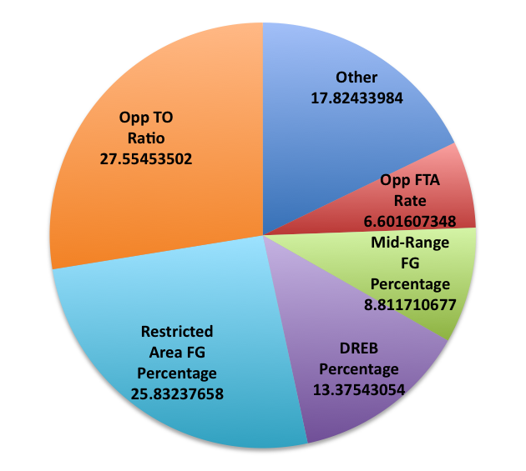
Attribute Weights
Opp TO Ratio | 27.55453502
Restricted Area FG Percentage | 25.83237658
DREB Percentage | 13.37543054
Mid-Range FG Percentage | 8.811710677
Opp FTA Rate | 6.601607348
In The Pain (Non-RA) FG Percentage | 4.592422503
Above the Break 3 FG Percentage | 4.47761194
In The Pain (Non-RA) FGA | 1.607347876
Mid-Range FGA | 1.463834673
Restricted Area FGA | 1.377726751
Opp FT Percentage | 1.205510907
Left Corner 3 FG Percentage | 0.975889782
Right Corner 3 FG Percentage | 0.918484501
Above the Break 3 FGA | 0.861079219
Right Corner 3 FGA | 0.229621125
Left Corner 3 FGA | 0.114810563

Slide 20
Attribute Weights
 | Dean Oliver | Alex Block
Shooting Percentage | 40% | 53.4%
Turnovers Per Possession | 25% | 27.6%
Offensive Rebounding Percentage | 20% | 13.4%
Getting to the Foul Line | 15% | 6.6%
Gather Data
Attribute Selection
Model Data
Analyze
Notes:
Obviously, mine is right.

Slide 21
Attempts vs. Percentage
Brad Stevens (Boston Celtics Coach) on the difference between college and NBA defense
In college, we really focus on who shoots the ball. In the NBA, there is much more of a focus on where they shoot from.
Notes:
Looking at this visualization, I would be inclined to agree with him. It seems to suggest that you can be successful by making your opponents shoot from the blue areas.
//However, notice that the blue areas are typically smaller squares which means they are used less frequently. Keep in mind the other team is trying to win too! They are trying to shoot from the red areas.

Slide 22
Attempts vs. Percentage
Restricted Area FG Percentage | 25.83237658
Mid-Range FG Percentage | 8.811710677
In The Paint (Non-RA) FG Percentage | 4.592422503
Above the Break 3 FG Percentage | 4.47761194
In The Pain (Non-RA) FGA | 1.607347876
Mid-Range FGA | 1.463834673
Restricted Area FGA | 1.377726751
Left Corner 3 FG Percentage | 0.975889782
Right Corner 3 FG Percentage | 0.918484501
Above the Break 3 FGA | 0.861079219
Right Corner 3 FGA | 0.229621125
Left Corner 3 FGA | 0.114810563
Notes:
Blue are percentages
Oranges are the attempts
Percentage is more important for every location!

Slide 23
Attempts vs. Percentage
The Opponent’s FG Percentage is more important than the Attempts for every zone
Explanation:
Little variation in attempts compared to the variations in percentage
Confirmation:
 | Correlation Coefficient
Removing all FGA | 0.9301
Removing all FG% | 0.7826
Notes:
You can’t force your opponent to shoot from locations. You can force them to shoot guarded, difficult, shots though.

Slide 24
Important Zones to Defend
Restricted Area
Mid-Range
In The Paint (Non-RA)
Above the Break 3
Corner 3
These are the differentiators between good/bad defense
Not necessarily the ranked list of most important areas to defend
Notes:
Question of variation – there is a lot less in 3 point atttempts and percentage than these other areas
You can’t simply let the other team shoot wide open three pointers or you will lose
Suggests that most teams are pretty much the same in their three point defense,
- the big differentiator is an ability to defend the basket (There is a reason that centers and power forwards typically win DPOY)

Slide 25
Future work…
Attribute Weights by Year
Has the 3 Pointer become more important?
Integrating players and player statistics
Evaluating offense using the same process

