Slide 1
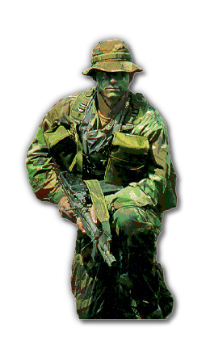
Senior Project – Computer Science – 2013 Recognizing military Gestures developing a Gesture Recognition interface
By: Jonathan Lebron
Advisor: Nick Webb

Slide 2
Motivation
Scenarios where speech would not be possible or optimal solution
Giving natural gestures to Robots that resemble Human-to-Human interaction
No need for special training
Incorporating both speech an gesture would be ideal, but this problem is out of scope
Notes:
- We do not poke people when we are communicating with them, so we shouldn’t have to do that with robots either.
- Why Military Gestures? Gestures are inherently complicated and indeterminate. Do not map 1 to 1 so I decided to use military gestures to have a controlled subset of gestures with predefined meanings.

Slide 3
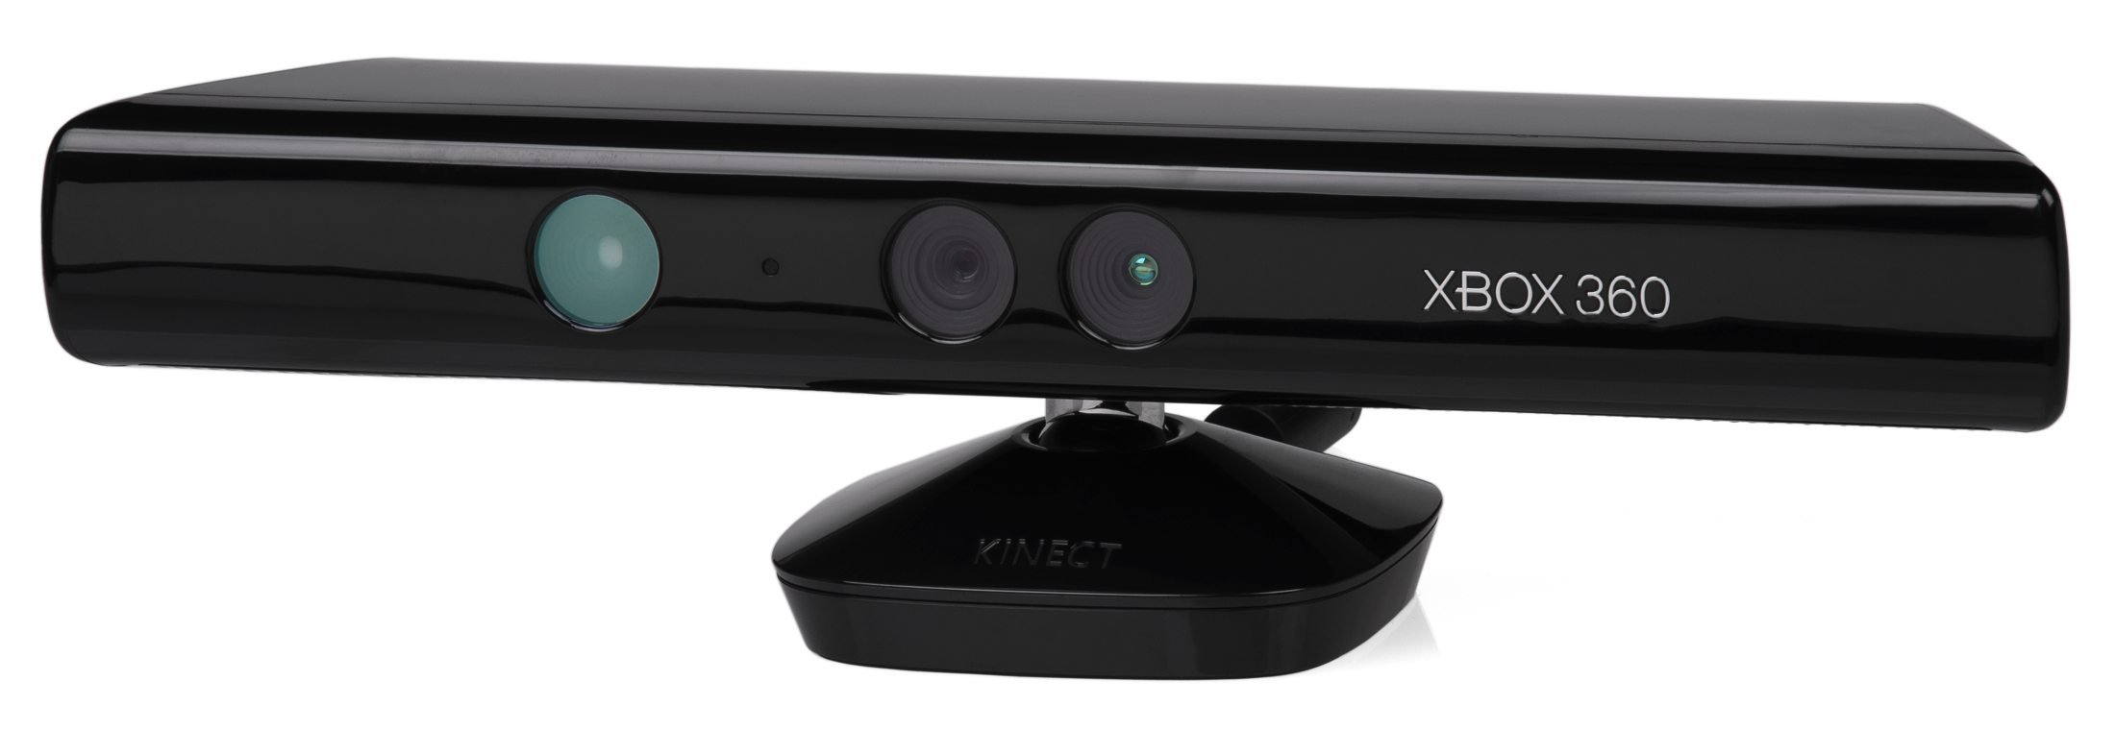
Research Question
How do you give a robot a sequence of natural gestures to interpret and act upon?
Xbox Kinect

Slide 4
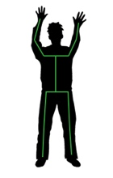
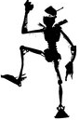
How It Works
Perform Gesture
Kinect reads skeleton data
Data gets transformed into angles
Classifier reads angles and determines gesture using C4.5 decision tree
left_shoulder: 0.35, 0.12, 2.19
left_elbow: -0.18, -0.10, 2.02
left_hand: -0.13, -0.34, 1.924
Notes:
- Perform Gesture
Talk about what type of gestures can be performed (static)
- Data transformed
angle of the hand in respect to the elbow: handPhi, handTheta
angle of the elbow in respect to the shoulder: elbowPhi, elbowTheta

Slide 5
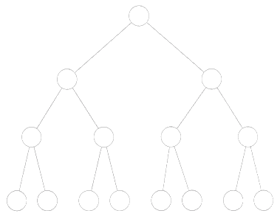
Classification
Classifier
Gestures
Abreast Enemy
Freeze Stop
Listen Rifle
Cover
Angles
handTheta
handPhi
elbowTheta
elbowPhi

Slide 6
Classification
How do we handle erroneous data?
When do we know when to execute the sequence?
What actions can we expect from the robot?

Slide 7
Software Design
Notes:
What nodes did you create? Which were provided?

Slide 8
Adding Gestures
Create new gestures
Replace old gestures
Combining gestures
Notes:
An interesting thing that came about during this project is the idea of adding new gestures on the fly
Not fully implemented because of issues with WEKA, have to manually create decision tree each time the training set is updated
How much training data do you collect?

Slide 9
Conclusion
Future Work
Wrap-up
Q&A
Notes:
Future Work
-Adding dynamic gestures
-improving gesture recognizer
-fully implementing add_new_gesture node
-combining with other input like speech to create multimodal interface

