Slide 1
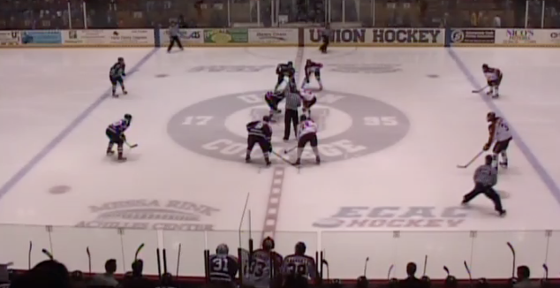
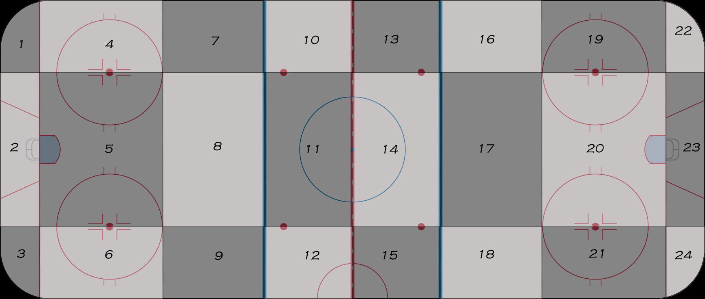
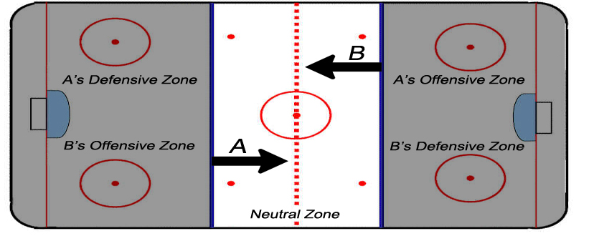
Senior Project – Computer Science – 2013 Classification of Game Events in Ice Hockey Game Film Phil Cohn Advisor – Prof. Cass
Abstract
In this project we aim to automate a way to identify what is happening in Union College men’s ice hockey game film. We manually gather location and orientation attributes for each individual player and use this information to classify game events in still video frames. This classification system aims to play a primary role in a comprehensive video analysis system capable of recognizing and classifying ice hockey game events automatically for coaching purposes.
Attributes
Attribute | Abbr. | Description
Zone | Z | What zone is player X located in?
Grid | G | What grid squadron is player X located in?
Facing | F | Is player X facing his offensive or defensive end of the ice?
Skating | S | Is player X skating forwards backwards?
H1_Z | H1_G | H1_F | H1_S | H2_Z | H2_G | H2_F | H2_S | …
N | 11 | O | F | N | 11 | O | F | …
Breakout
Face-off
Scoring Chance
Results
Classification accuracy is high
Grid attribute is more useful for location than zone attribute
Location is the most important attribute
Game Event Classification
All Events | 83.3333
Breakout | 90.625
Scoring Chance | 95
Face-off | 96.4583
Unknown | 84.37
Best Subset of Attributes - All Events
# of Attributes | Attribute Subset | Accuracy
4 | (Z - G - F - S) | 83.3333
3 | (G - F - S) | 83.3333
2 | (G - F) | 84.1677
1 | (G) | 81.6667
Location Attributes
Class | Zones | Grid | Both
All Events | 82.0833 | 83.3333 | 83.3333
Breakout | 90.4167 | 90.4167 | 90.625
Scoring Chance | 95 | 95 | 95
Face-off | 96.4583 | 96.6667 | 96.4583
Future Work
We aim to expand our system to gather player attribute information automatically using object tracking techniques and action recognition techniques. Additionally we aim to add additional game events for classification.

