Slide 1
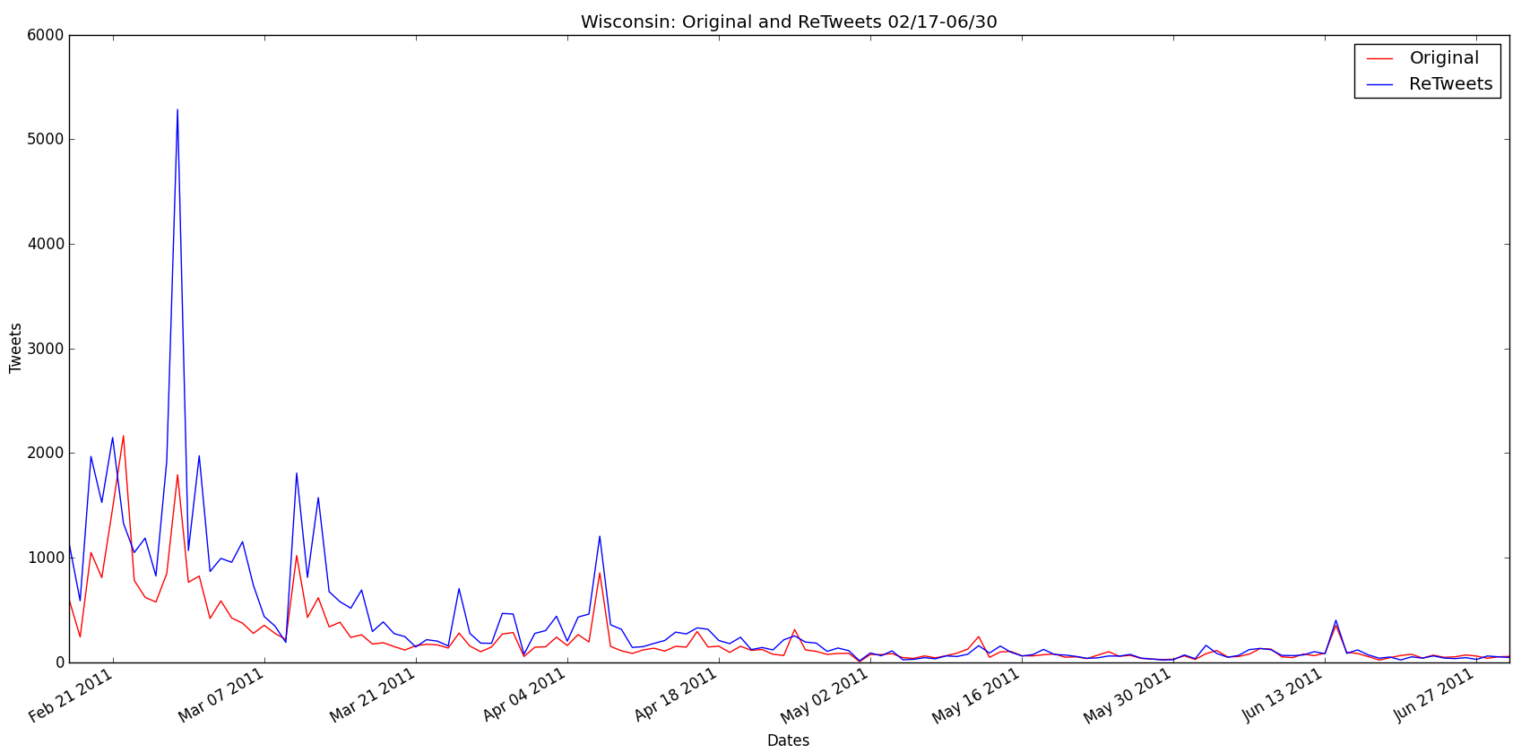
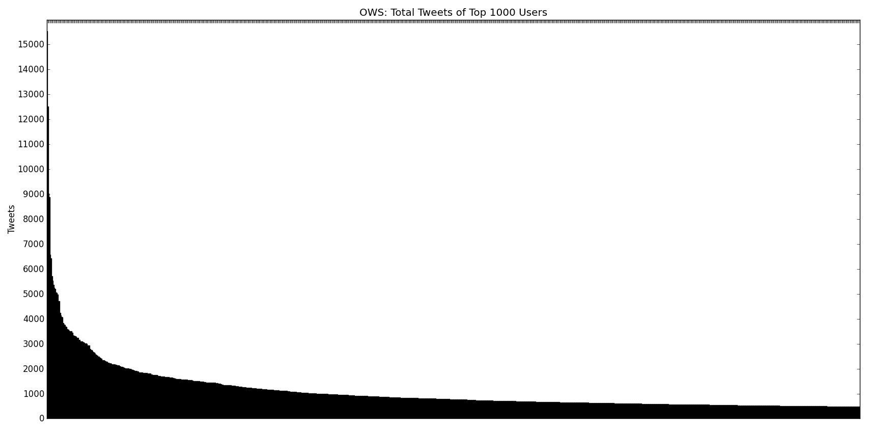
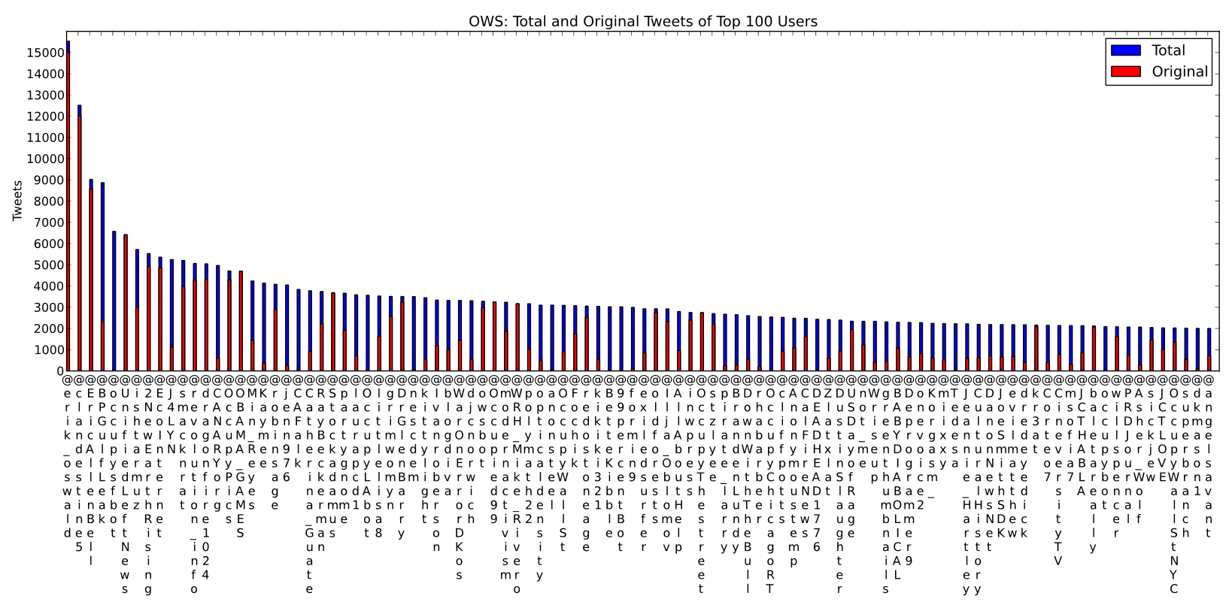
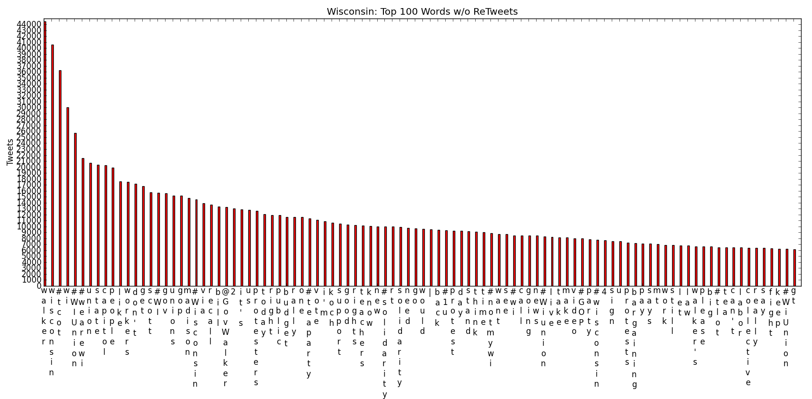
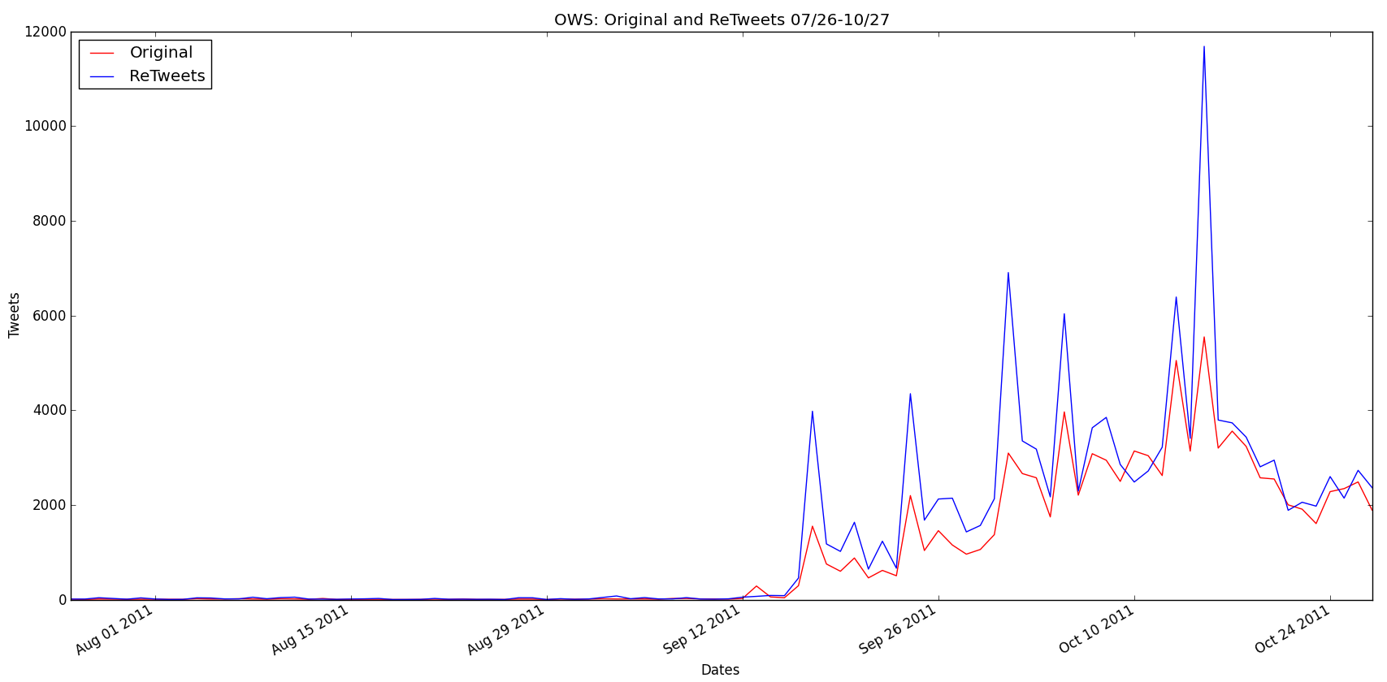
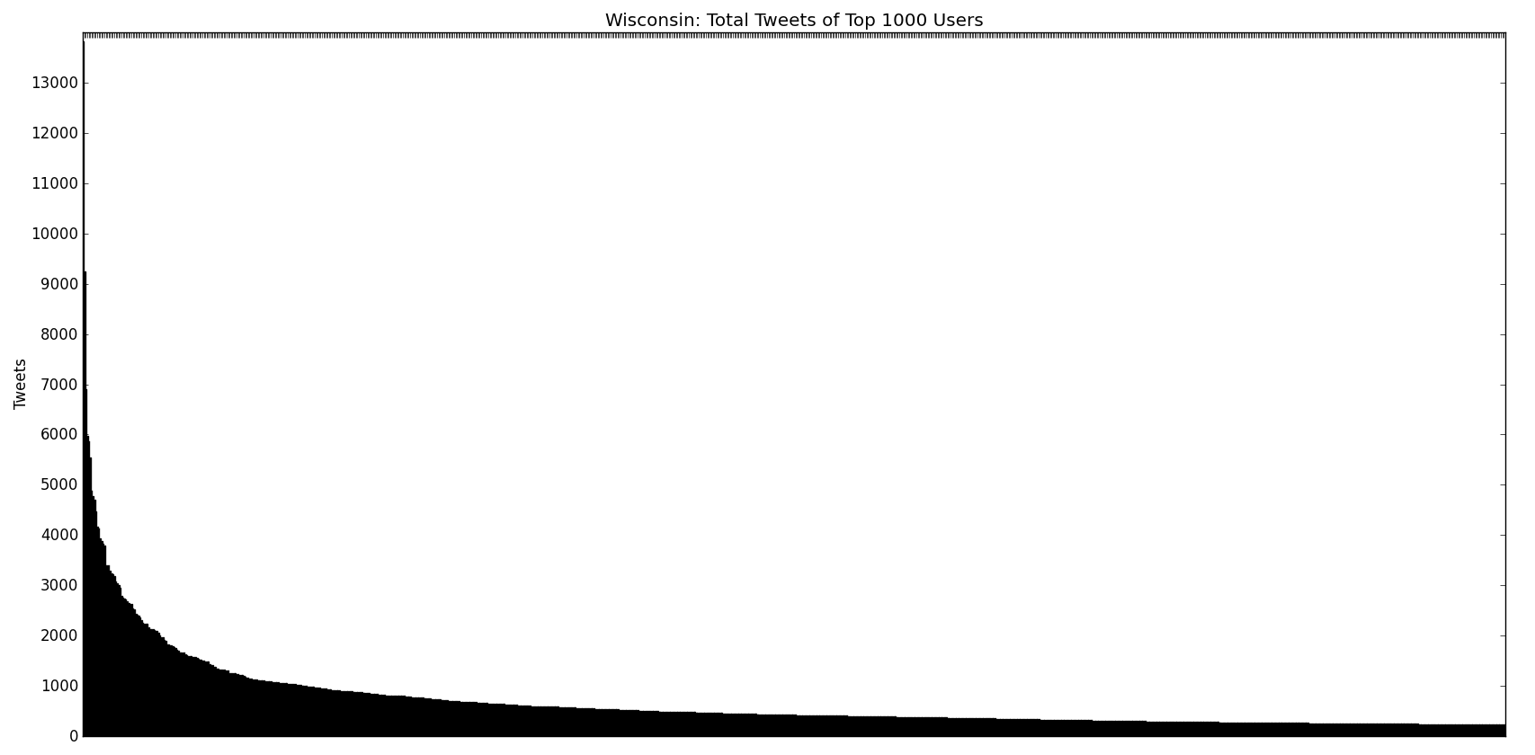
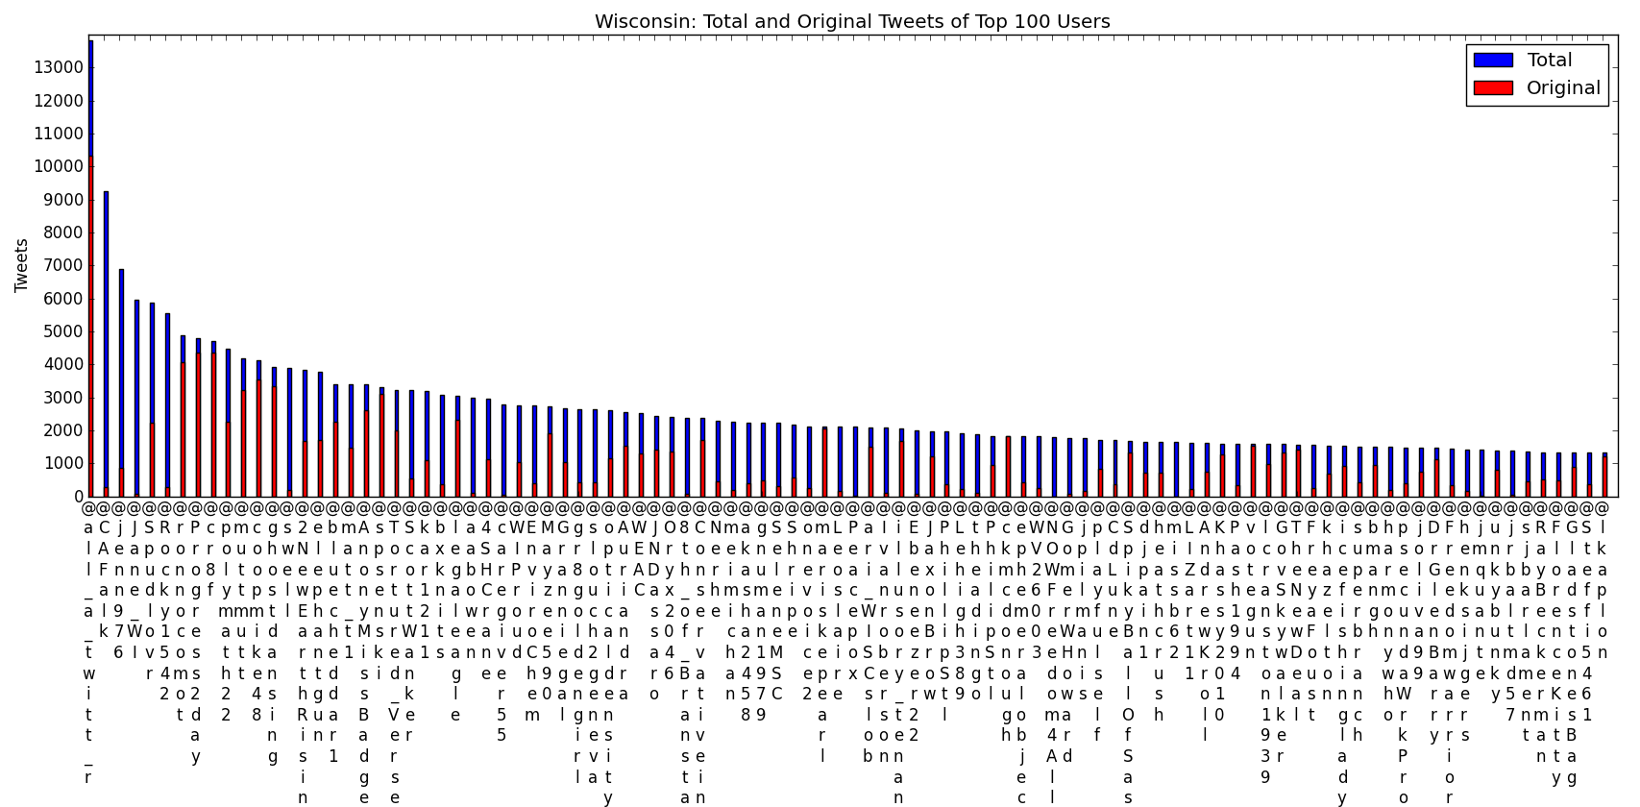
Senior Project – Interdepartmental Computer Science/Political Science- 2012 Contemporary Social Movements Through Twitter: The Cases of Madison, Wisconsin and Occupy Wall Street Kirk Winans Advisors – Prof. Striegnitz(CS), Prof. Seri(PSC)
Tarrow, Sidney. Power in Movements: Social Movements, Collective Action and Politics. New York: Cambridge University Press, 1996.
Abstract
This project investigates the Madison protests in response to Governor Scott Walker’s Budget Repair Bill, which took most collective bargaining rights away from state workers, and the Occupy Wall Street Movement. The overall questions I am posing are: What is unifying these protests? Are they following in the tradition of previous social movements or do they constitute a new movement in opposition to capitalism and our political system? How do the protestors themselves see the movement? Is the Occupy Movement inspired by the Madison protests?
Methods
To answer these questions I conducted interviews at Zuccotti Park in New York City, research the history of the protests, and am analyzing the Tweets with the hashtags of #wiunion from February 17th through June, and #occupywallstreet from June 26th until October 25th, and #ows from October 6th until October 27th. For the analysis I combined both hashtags for the Occupy Wall Street movement. To find out how many people actively participated, when people tweeted, and what people talked about I performed multiple steps. After obtaining the tweets from TwapperKeeper I ran scripts that counted how many tweets each user in the hashtag made and how many were original and how many included a retweet. I did this count in total and by the date. Also, I counted the words used in the tweets in total and by the date.
Results
I found that there were more active users in relation to the Occupy Wall Street protests than the Wisconsin protests. Many of the major actors made original tweets except for a few who had all retweets. Both sets of tweets show a sharp drop off of major actors with a small percentage of users posting 80% of the tweets (Wiconsin 6.5% of users and Occupy Wall Street 12% of users). By graphing the number of tweets over the date we can see spikes in activity that indicate important events. The top 100 words tweeted revealed important concepts to the protests.
Conclusions
Twitter played an active role in the formation and execution of the protests in both Madison and Occupy Wall Street. The extreme spikes in usage on certain dates reveal that Twitter was significantly linked to the protests. Through an analysis of the Protests using Sidney Tarrow’s concepts I discovered that the Wisconsin protests inspired the Occupy Wall Street protests and they used similar concepts , tactics, and purpose developed in Wisconsin. Hence they used a similar repertoire of contention and master frame (Tarrow 1996). The Wisconsin protests were the beginning of a cycle of protests continued by Occupy Wall Street. Also, the successful use of Twitter in Wisconsin and the Egyptian protests lead to its use with Occupy Wall Street.
Wisconsin
--------------
Total Users: 86,525
% of Tweets by top 10 users: 5.36%
% of Tweets by top 25 users: 9.31%
% of Tweets by top 99 users: 20.05%
Total number of Tweets: 1,312,947
Number of Users contributing 50% of tweets: 842 (.97% of users)
Number of Users contributing 80% of tweets: 5659 (6.54% of users)
OWS
-----------------
Total Users: 487,467
% of Tweets by top 10 users: 1.82%
% of Tweets by top 25 users: 3.15%
% of Tweets by top 99 users: 6.97%
Total number of Tweets: 4,050,812
Number of Users contributing 50% of tweets: 7430 (1.52% of users)
Number of Users contributing 80% of tweets: 62,537 (12.83% users)
References
Tarrow, Sidney. Power in Movements: Social Movements, Collective Action and Politics. New York: Cambridge University Press, 1996.

