Slide 1
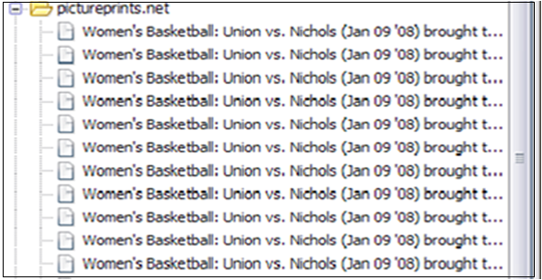
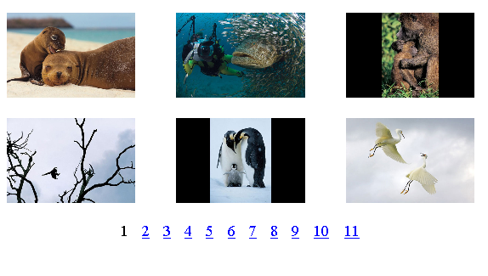
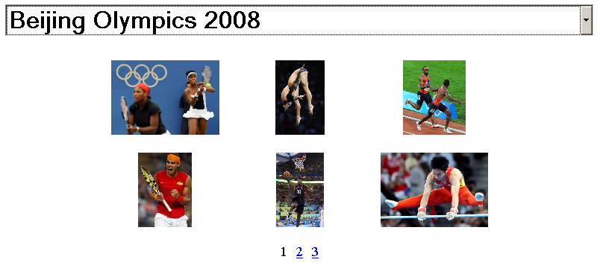
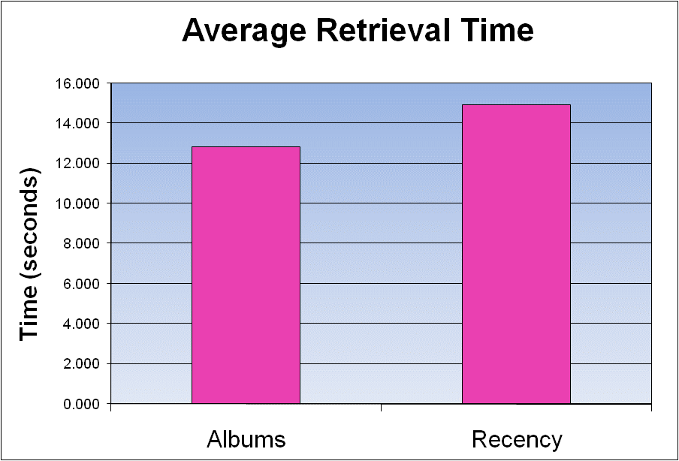
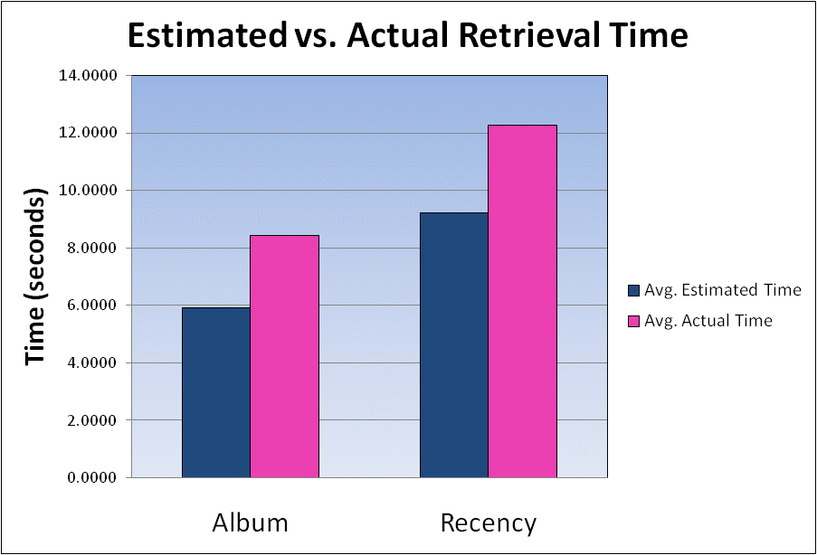
Senior Project – Computer Science and Psychology - 2009 Improving Photo Retrieval in a User’s Browser History Maria Tobin Advisors – Aaron Cass and Chris Fernandes
MOTIVATION
RESEARCH QUESTION
58% of pages viewed on the web are revisited
Current browser’s history list tool is used by less than 1% of users
Names of photo-sharing site pages in history list are identical or not meaningful
Need an easier way to organize and display data of history list- but how???
When searching for a previously viewed picture, does a user more naturally think of:
how recently was the picture viewed?
what album the picture came from?
Navigation Task
Users look at 63 pictures from 5 different albums
METHOD
Retrieval Task
Users find 15 of the 63 pictures from 2 different photo albums
Digit Recall
Filler task to distract users
Recency Condition
Pictures sorted by recency
Album Condition
Pictures sorted by album
RESULTS
FUTURE WORK
Generalize study to all pages in the history list
Collapse results of photo-sharing site pages to make it easier for users to search/match their mental model
Make a personal photo history outside of history list
Users retrieved pictures slightly faster when the pictures were sorted by albums as opposed to sorted by recency
Users also underestimated the time it took for them to find pictures in both the recency and album conditions

