Slide 1
Clickbait Detection using Natural Language Processing and Machine Learning
By Varun Shah
Advisors: Kristina Striegnitz and
Nick Webb

Slide 2
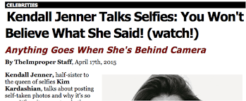
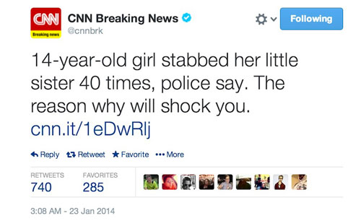
What is Clickbait?
Source: Google Images

Slide 3
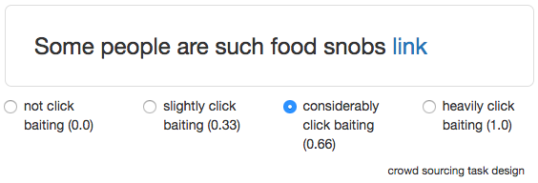
The Clickbait Challenge!
Organizers: M. Potthast, T. Gollub, B. Stein and M. Hagen
Competition to build a clickbait detector using provided Twitter data
Each post is judged by 5 annotators.
Source: http://www.clickbait-challenge.org/

Slide 4
Data
Small data set:
Big data set:
# Posts | # Clickbait | # No-clickbait
2459 | 762 | 1697
# Posts | # Clickbait | # No-clickbait
19538 | 4761 | 14777

Slide 5
Attributes: Post Text
SlideHunter
2 hours ago
Some people are such food snobs. http://link.com/
Post Text
Tweet

Slide 6
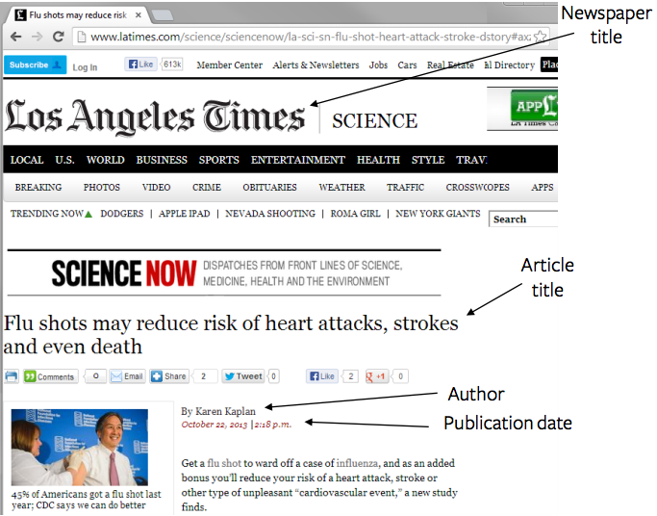
Attributes: Title of Linked Article
Actual title of the article linked in post text
Source: http://proyectoportal.com/

Slide 7
Attributes: Truth Class

Slide 8
Preliminary Results
Baseline classifier: ZeroR
Attributes in model: Post Text and Article Title
Classifier | Classification Accuracy
ZeroR | 50.0%
RandomForest | 74.9085%*
*statistically significant at 95%

Slide 9
Added Features: Use of Superlatives
Does given post have a superlative?
Is LeBron James’ NBA Finals performance the best ever? http://link.com/
Superlative? | # Clickbait | # No-clickbait
Yes | 60 | 87
No | 702 | 1610

Slide 10
Added Features: Use of Numbers
Does given post have a number?
5 incredible Italian dishes you haven’t tried before. http://link.com/
Number? | # Clickbait | # No-clickbait
Yes | 191 | 416
No | 571 | 1281

Slide 11
Added Features: Number of Words
How many words are in the post text?
Man dies when car plunges from parking garage. http://link.com/
8 Words
Overall Mean | Clickbait | No-clickbait
12.662 | 11.901 | 13.002

Slide 12
Added Features: Similarity between Post Text and Title of linked article
Post Text
Article Title
In example, # Overlaps = 4
Overall Mean | Clickbait | No-clickbait
3.997 | 3.150 | 4.378

Slide 13
Added Features: POS Ratio
Determiner + Adjective + Singular Noun + Plural Noun + 3rd Person Verb
These global warming skeptics have…
POS Sequence
POS Ratio = #Sequence in Clickbait / #Sequence in All
In example, POS Ratio = 0.8698
Minimum | Maximum | Mean | Std. Dev.
0 | 1 | 0.412 | 0.326

Slide 14
Results
Model tested on (unbalanced) big data set
Note: ZeroR (baseline) = 75.8553%
Attributes in Model | Accuracy
Post Text + Article Title + #Words + Overlap | 82.2864%
Post Text + Article Title + POS Ratio | 86.6860%
Post Text + Article Title + #Words + Overlap + POS Ratio | 88.2051%

Slide 15
Conclusion and Future Work
Improved model to achieve a classification accuracy of 88.2051%
Identified features that help detect clickbait
For the future: - Image analysis - # Ads on article webpage

Slide 16
Thank you!
Questions?

