Slide 1
Grasshopper Inspired Locomotion in Tensegrity Robots
Sharifa Sahai
Advisors: John Rieffel and Scott Kirkton

Slide 2
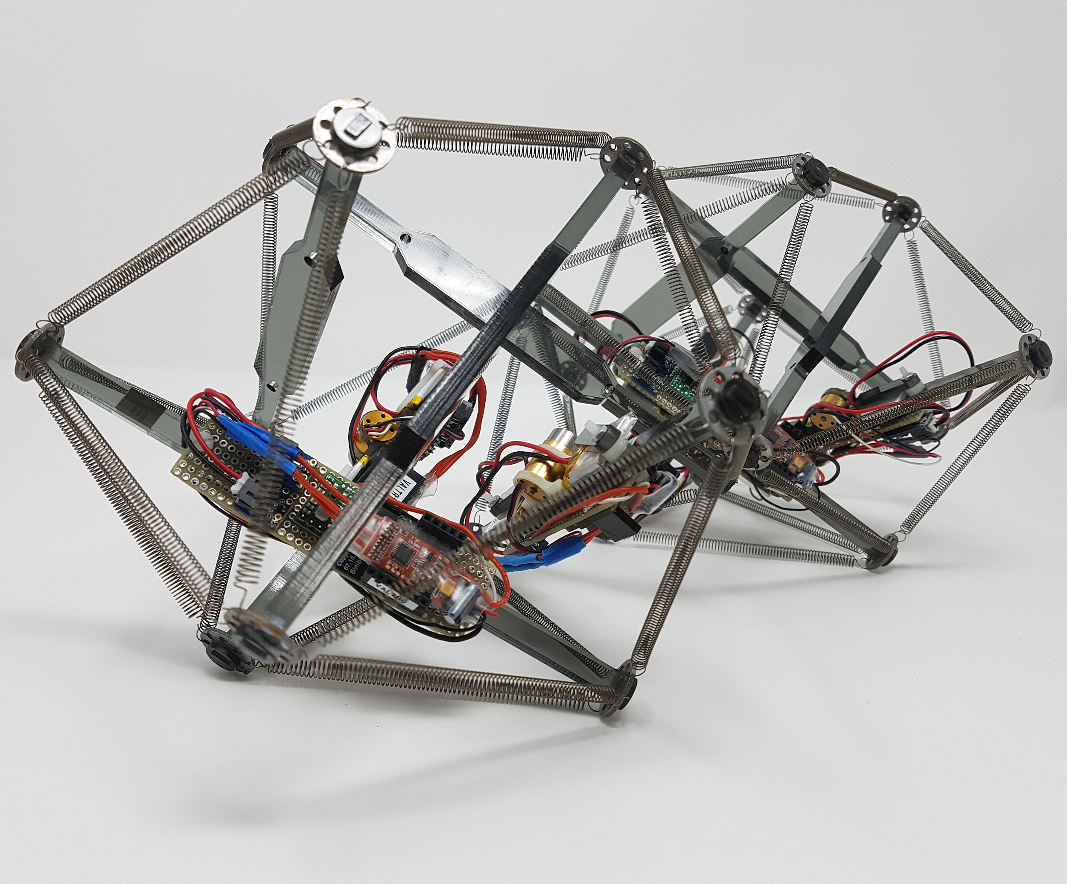
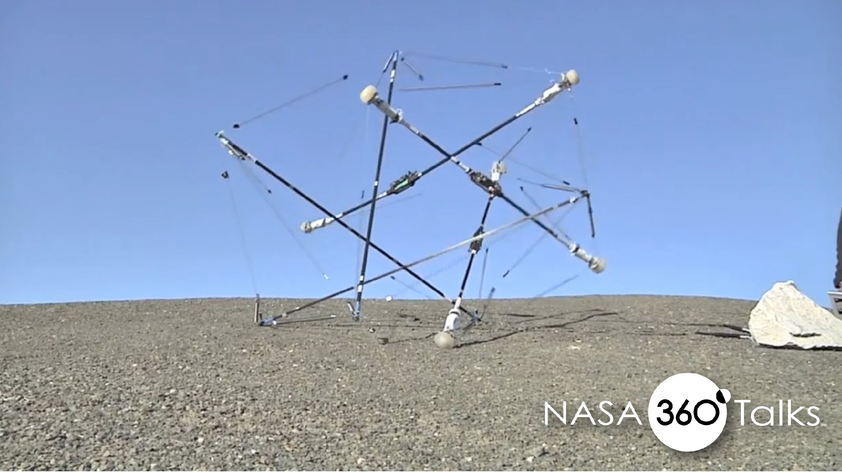
Tensegrities have versatile functionality
Image from https://i.ytimg.com/vi/0eC4A2PXM-U/maxresdefault.jpg
Notes:
Tensegrities are structures that maintain their stability through two types of elements: cables and struts. Cables are always tensioned and struts are always compressed. This creates a pre-equilibrated state, in which the internal forces of compression and tension stabilize the structure.
Tensegrities can be moved in a number of ways, including contracting the cables or through attached resonating motors.
Tensegrity robots are being developed because they have a high strength to weight ratio, are compressible and robust. For example, NASA is interested in tensegrites for exploration on other planets due to these qualities.
However, tensegrities are notoriously difficult to move move in meaningful ways. Many rely on environmental forces to direct movement. For example the nasa robot relies on the initial drop and shock absorbance for much of its initial movement.
I’m also a biology student and and I know that many robots are inspired by nature.
(highlight the differences between nasa and union robots)

Slide 3
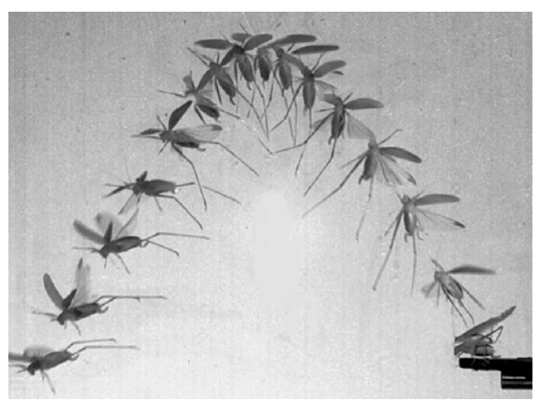
Grasshoppers have effective locomotion
Nguyen, Quoc & Park, Hoon. (2012). Design and Demonstration of a Locust-Like Jumping Mechanism for Small-Scale Robots. Journal of Bionic Engineering. 9. 271–281. 10.1016/S1672-6529(11)60121-2.
Notes:
One interesting example of efficiency in locomotion is the grasshopper. A grasshopper is able to jump 20x its body length due to the structure and firing of its leg muscles. It is highly evolved for this type of movement.
------
Fortunately grasshoppers are good at movement, effective in a single motion

Slide 4
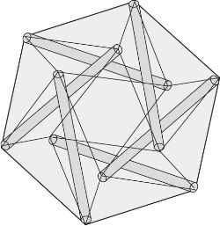
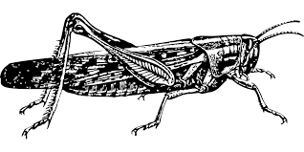
Motivation
What aspects of grasshopper locomotion can we apply to produce more interesting movement in tensegrity robots?
Notes:
Motivation slide. Guiding principle slide. But obviously there are many structural differences between a grasshopper and a tensegrity robot.

Slide 5
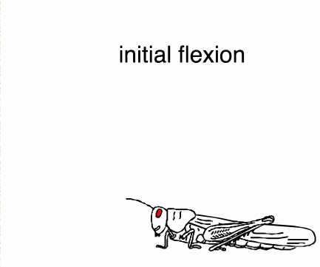
Grasshoppers move via a catapult-like mechanism
Nguyen, Quoc & Park, Hoon. (2012). Design and Demonstration of a Locust-Like Jumping Mechanism for Small-Scale Robots. Journal of Bionic Engineering. 9. 271–281. 10.1016/S1672-6529(11)60121-2.
Notes:
Grasshoppers hop by contracting their muscles and storing energy in a catapult like motion. They contract the extensor to store energy in locations such as the apodeme, semi lunar process and cuticle. When they flex their flexor, they then release the energy to move, similarly to a catapult. What’s really amazing about this process is that the force produced by the muscle is much less than the force with which the foot at the end of the tibia actually pushes on the ground.

Slide 6
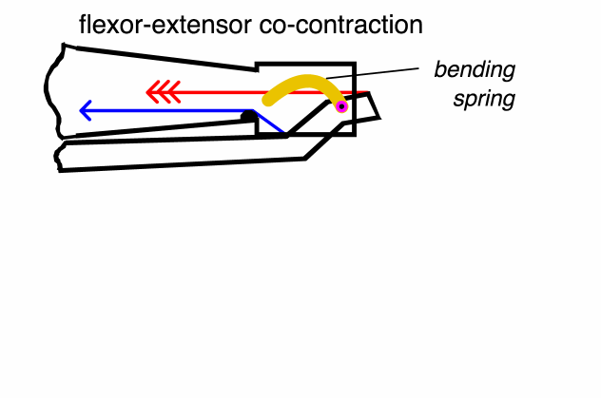
Grasshoppers move via a catapult-like mechanism
Nguyen, Quoc & Park, Hoon. (2012). Design and Demonstration of a Locust-Like Jumping Mechanism for Small-Scale Robots. Journal of Bionic Engineering. 9. 271–281. 10.1016/S1672-6529(11)60121-2.
Notes:
Grasshoppers hop by contracting their muscles and storing energy in a catapult like motion. They contract the extensor to store energy in locations such as the apodeme, semi lunar process and cuticle. When they flex their flexor, they then release the energy to move, similarly to a catapult. What’s really amazing about this process is that the force produced by the muscle is much less than the force with which the foot at the end of the tibia actually pushes on the ground.

Slide 7
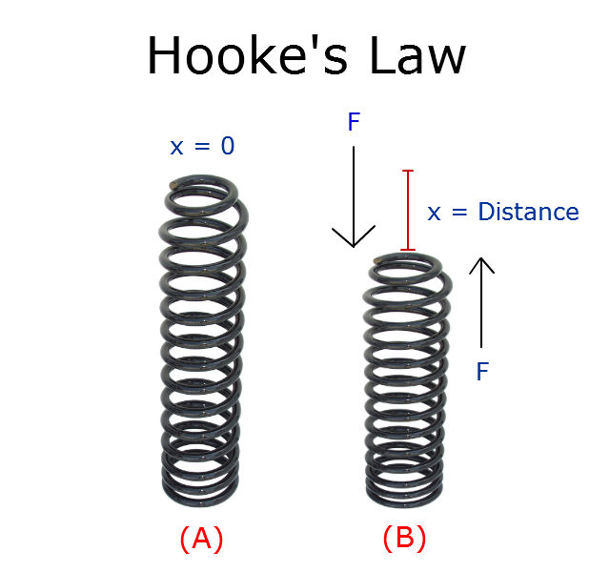
Hooke’s Law
F = kx
Image from https://s3.amazonaws.com/tinycards/image/53890284dacf313e3a72be59bbd9d81c
Notes:
x is the displacement of the spring’s end from its equilibrium position ;
F is the restoring force exerted by the spring on that end
k is a constant called the rate or spring constant. The k constant is determined by the slope of a stress-strain curve. When this holds, the behavior is said to be linear. If shown on a graph, the line should show a direct variation. Hooke’s law says that stress is directly proportional to strain.

Slide 8
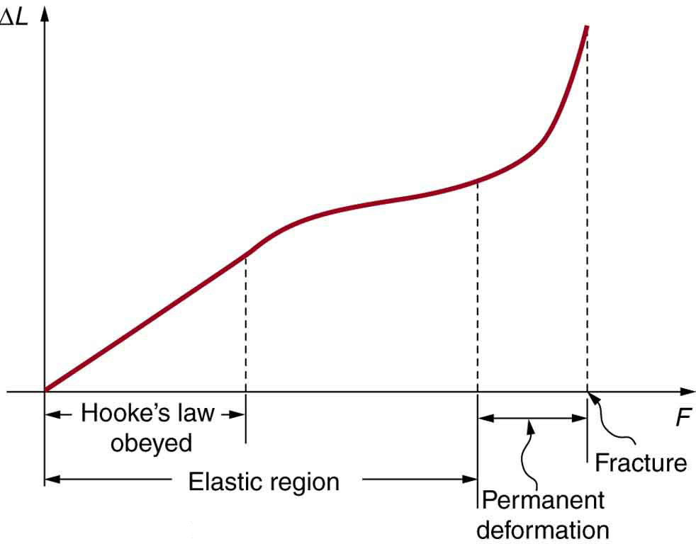
Deformation after elastic limit
OpenStax. “Physics.” Lumen, Open SUNY Textbooks, courses.lumenlearning.com/physics/chapter/5-3-elasticity-stress-and-strain/.
Notes:
Delta L is deformation
F is force

Slide 9
Force produced after strain in grasshopper semilunar process
Bennet-Clark, H.C.. (1975). The energetics of the jump of the locust Schistocerca gregaria. The Journal of experimental biology. 63. 53-83.
Notes:
Graph made by mechanically stimulating and loading the extensor tibiae
Increase strain on semilunar process, greater force produced
Biological springs - non linear relationship
After 0.4 mm fracture point is seen
-------

Slide 10
Research Question
To what extent does having non uniform spring stiffness produce qualitatively different movement for tensegrities?
Method
Compare uniform spring spring stiffness to non uniform spring stiffness in ODE simulation
Notes:
Say what I did - simulaiton, ODE, What
Extent varying spring spring stiffnes

Slide 11
Spring actuation determination
Active
Passive

Slide 12
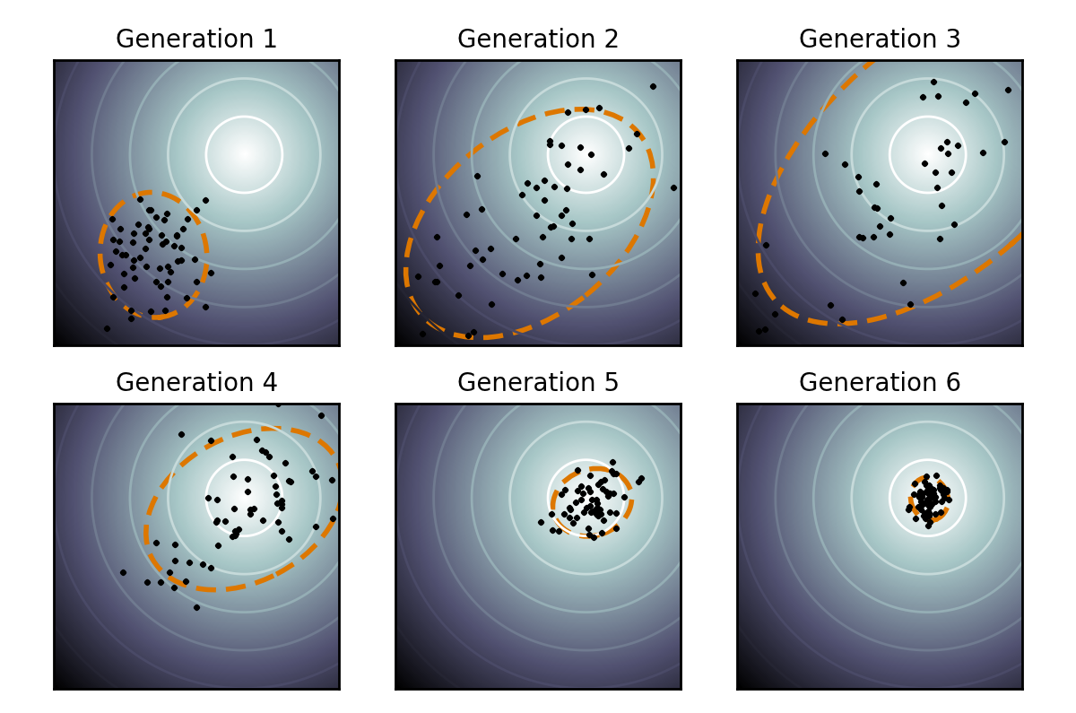
CMA-ES Optimization Algorithm
Notes:
Covariance Matrix Adaptation Evolution Strategy
Optimization
Genetic algorithm
Take starting inputs (2 for multiplier) and
Relatively strong off the shelf method

Slide 13
Optimization of spring stiffness uniformly using CMA-ES elitism

Slide 14
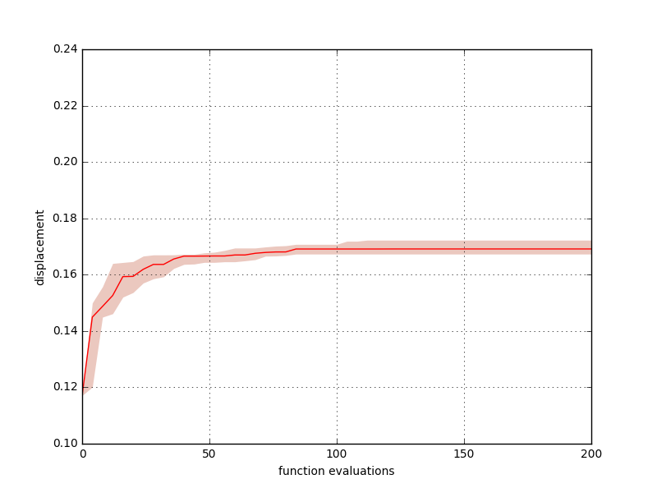
Results of 30 trials of uniform spring optimization

Slide 15
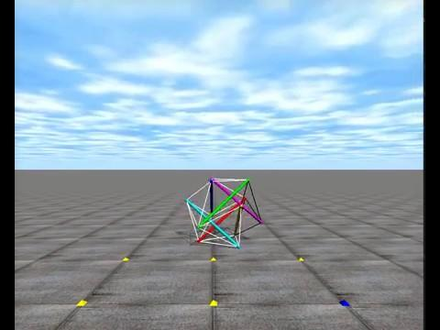

Slide 16
Optimization of spring stiffness of six springs using CMA-ES elitism
Notes:
Changing 6 of entire 24 springs

Slide 17
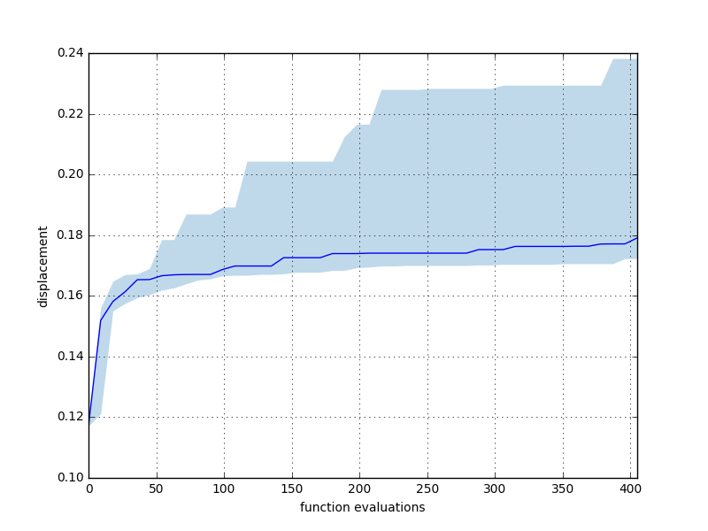
Results of 30 trials of variance of six springs optimization

Slide 18
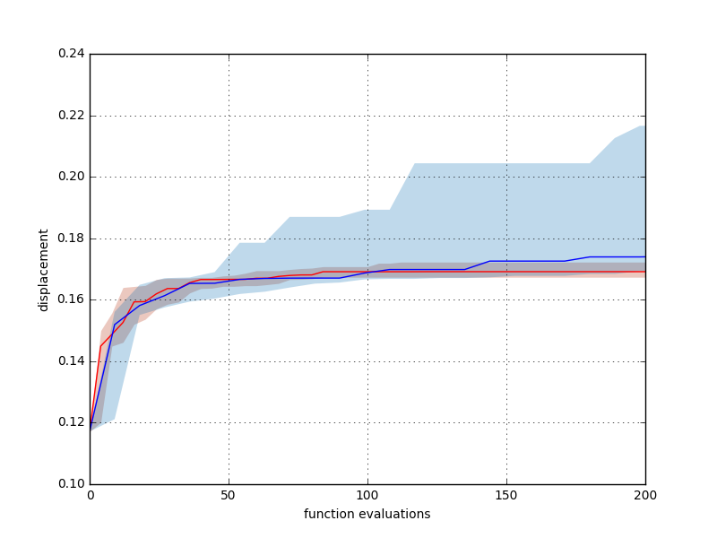
Results of 30 trials of variance of six springs optimization

Slide 19
Conclusions
Altering the spring stiffness produces a wider range of displacement values
The non linear trend of displacement with spring stiffness suggests that altering the spring stiffnesses could lead to more diverse patterns of locomotion which may also not follow a linear trend with increasing spring stiffness

Slide 20
Future Work
Optimizing firing pattern parameters with spring stiffness
Simulating on different tensegrity configurations
Scaling of tensegrity
Efficiency seen in extended intervals compared to grasshoppers

Slide 21
Acknowledgements
Advisors: Scott Kirkton and John Rieffel
David Frey
Tensegrity Lab

Slide 22
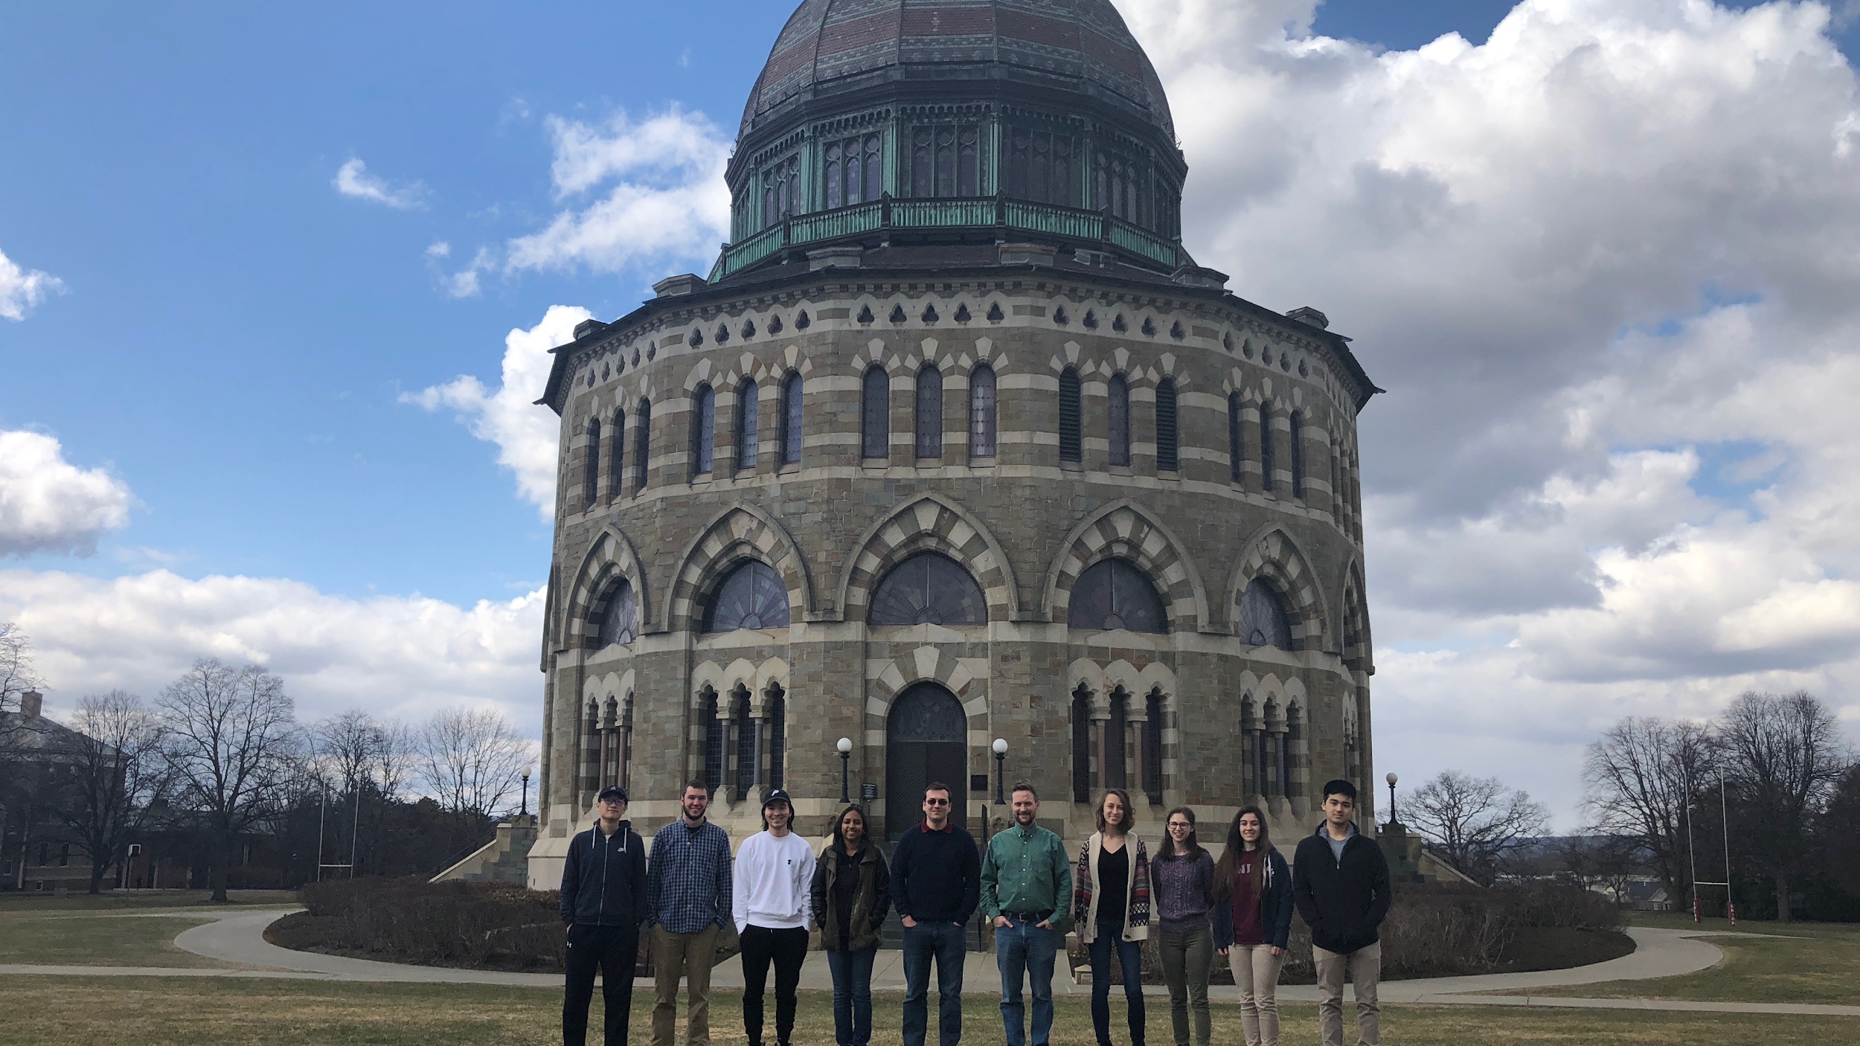
Thank you!
Questions?
Notes:
Say I made a simulation of tensegrities in ODE using hooke’s law
Know what a semi lunar process is

Slide 25
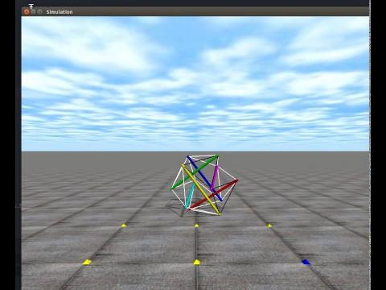
Notes:
Change video to those of uniform spring stiffness to non uniform spring stiffness

Slide 26
Conclusions
Altering the spring stiffness not only produces a range of displacement values but also produces greater displacement values than uniform spring stiffness
The non linear trend of displacement with spring stiffness suggests that altering the spring stiffnesses could lead to more diverse patterns of locomotion which may also not follow a linear trend with increasing spring stiffness

Slide 28
Firing pattern for springs
timestep % period >= phase && timestep % period < (phase + (duty cycle * period))

Slide 29
Firing pattern for springs
timestep % period >= phase && timestep % period < (phase + (duty cycle * period))
period
phase
duty cycle

Slide 31
Next Steps
Use machine learning to find more effective gaits
See if robot moves better with new non linear model
Notes:
Use machine learning (such as the ones discussed in the morning talk such as bayesian optimization) to find most effective gaits, instead of the arbitrary method used now
See whether the way the robot moves with one type of muscle model is different from other other models, perhaps better
Have muscle stiffness be a parameter in which robot can optimize
Be able to run machine learning over 12 parameters, per muscle to find effective gaits for robot

Slide 32
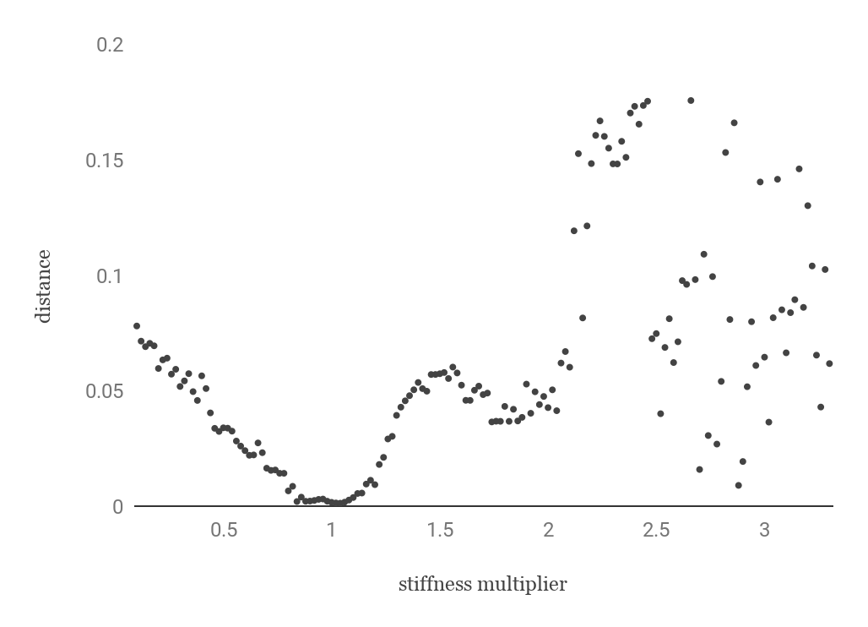
Distance traveled by change in spring stiffness
Notes:
Trial intervals of 500 simulation loops
Actuation parameters held constant at arbitrarily determined point while stiffness is changed
Stiffness at 1 = resting, no contraction
Stiffness below 1 = decreased stiffness like extension of spring coming back to form on next time step
Stiffness above 1 = increased stiffness like compression
Seemingly random points = change in motion, perhaps tensegrity is moving back to original position instead of away

Slide 33
Non linear Hookean models
F = kx
F = k₁x + k₂x²
F = k₁x + k₂x² + k₃x³
Image from https://s3.amazonaws.com/tinycards/image/53890284dacf313e3a72be59bbd9d81c

Slide 34
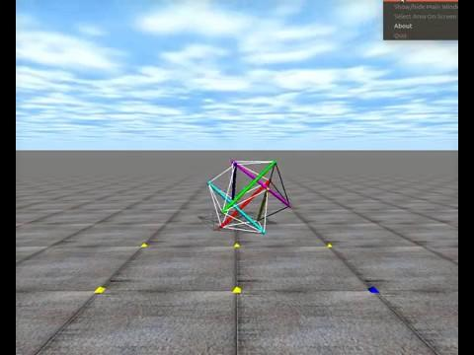

Slide 36
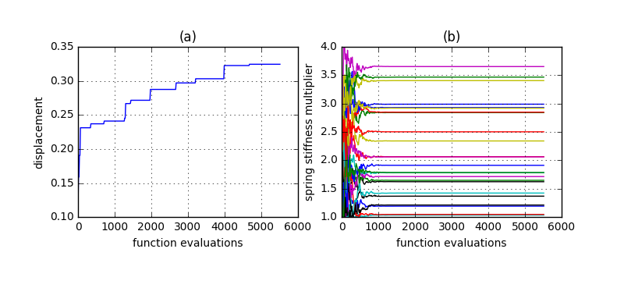
Optimization of spring stiffness of 24 springs using CMA-ES elitism

