Slide 1
Investigating the Impact of Image Stabilization on Facial Detection/Recognition
James Murphy IV
Computer Science and Economics ID Major

Slide 2
Thesis Inspiration
Fall term facial recognition project
Problems with consistent video feed
Had to hold down the PVC pipe with string

Slide 3
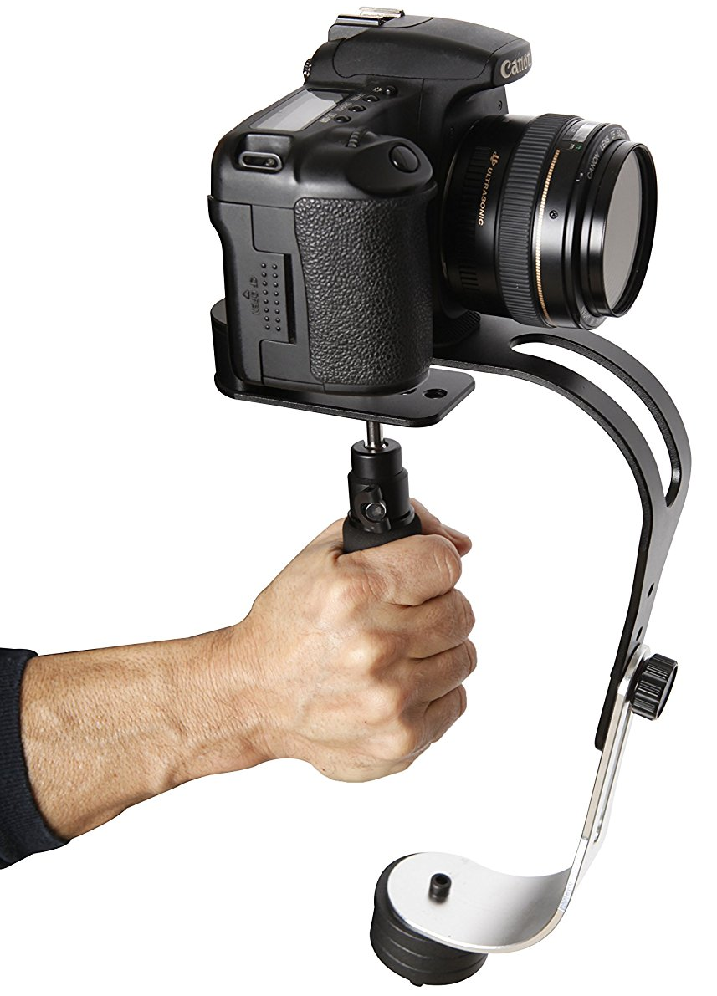
Goal
Determine if hardware stabilization, software stabilization, or a combination of both would improve the quality of computer vision applications. More specifically, facial detection and recognition.

Slide 4
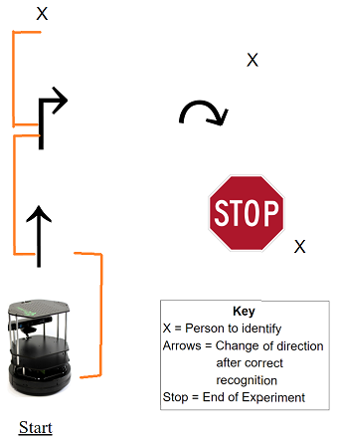
Experiment Design
Goal: Create a consistent course for the turtlebot to navigate
SLAM Navigation

Slide 5
Printed Images for Subjects/Training

Slide 6
Software Stabilizer
VideoPad
Deshaker

Slide 7
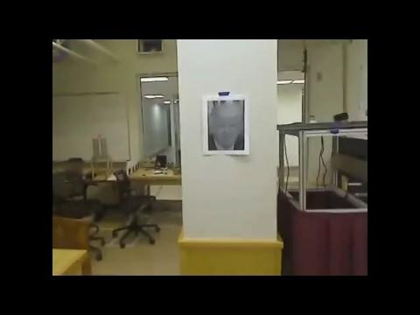
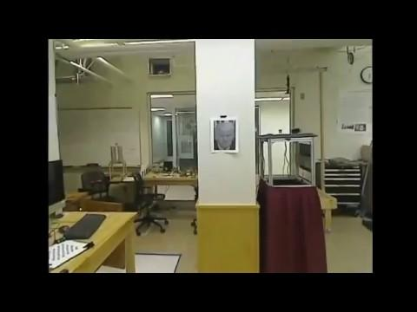
Base Vs. Software

Slide 8
Hardware Stabilizer
3-D Printed Mount
Uses counterweights to smooth video

Slide 9
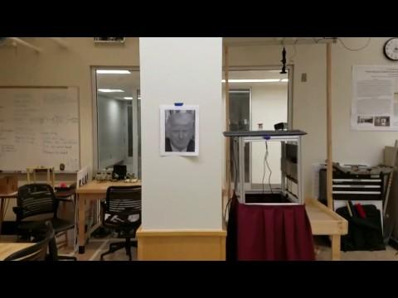
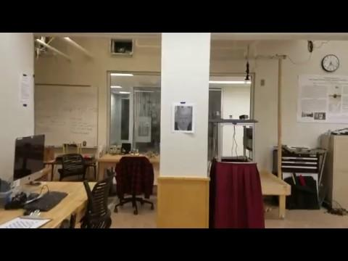
Base Vs. Hardware

Slide 10
Data Gathering
Four solutions
No stabilization
Software stabilization
Hardware stabilization
Both hardware & software stabilization
Two Cameras
Samsung Galaxy S7 (12 Megapixels)
Logitech USB (3 Megapixels)
For both cameras I performed 15 trials for each of the four solutions

Slide 11
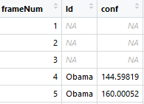
Individual Trial Data Example
Boolean values for detection and recognition
Calculations
Detection
Number of frames a face was detected/ number of frames
Recognition
Number of frames the Id == target/ number of frames
Confidence
1-200
Normalized later

Slide 12
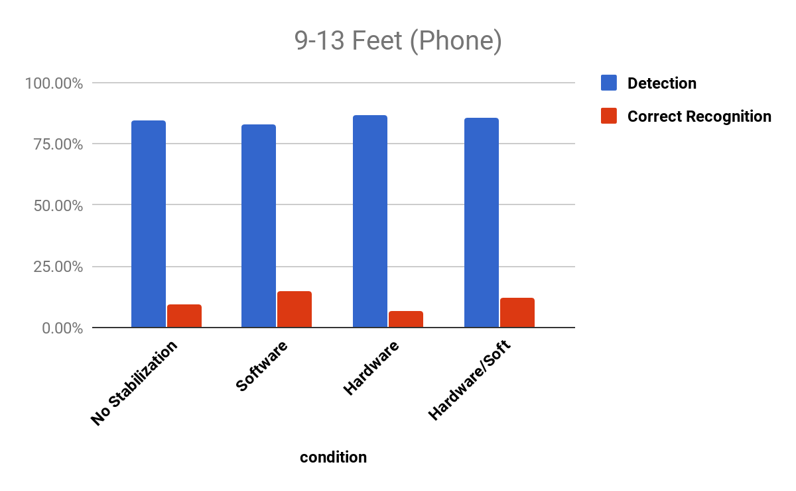
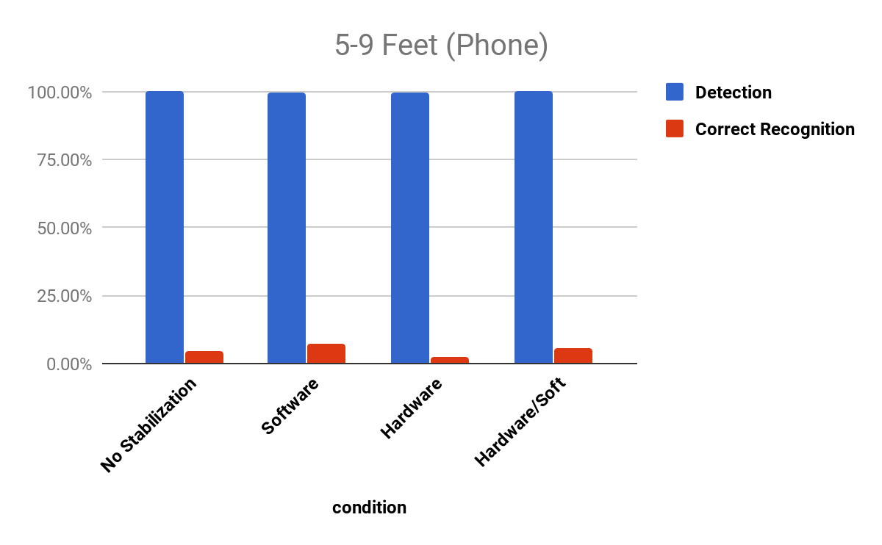
Results: Samsung S7-Straight On

Slide 13
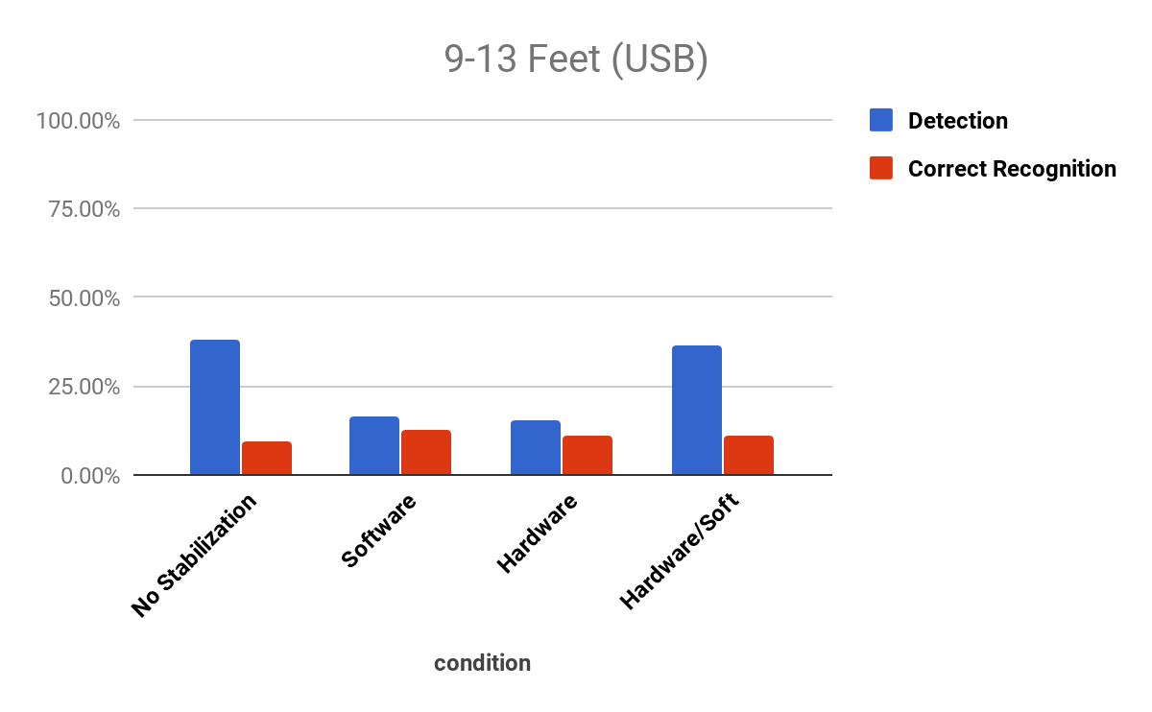
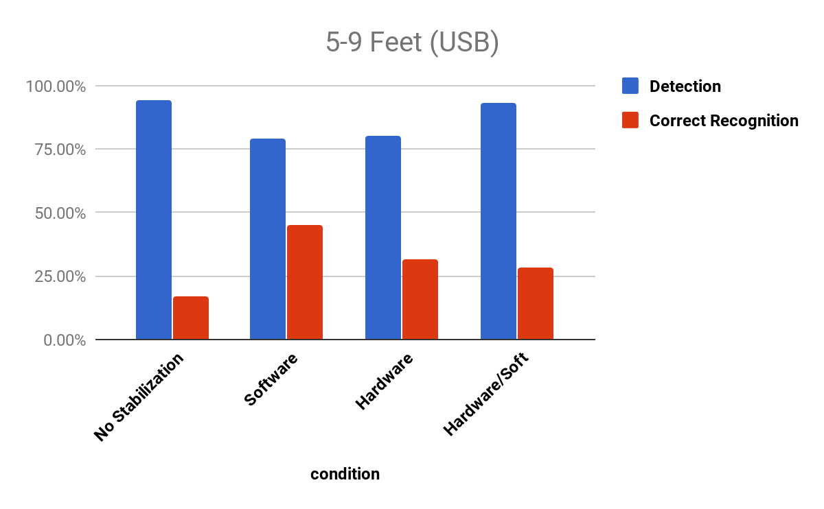
Results: USB Camera-Straight On

Slide 14
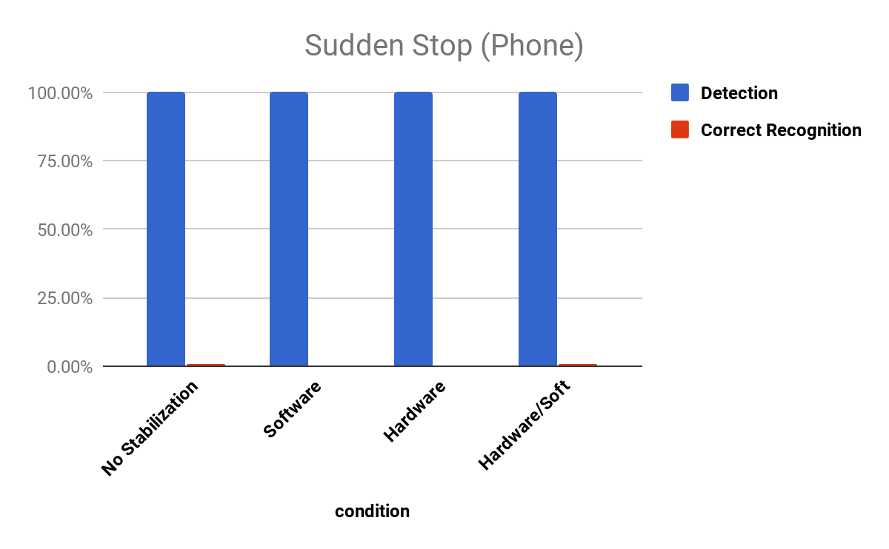
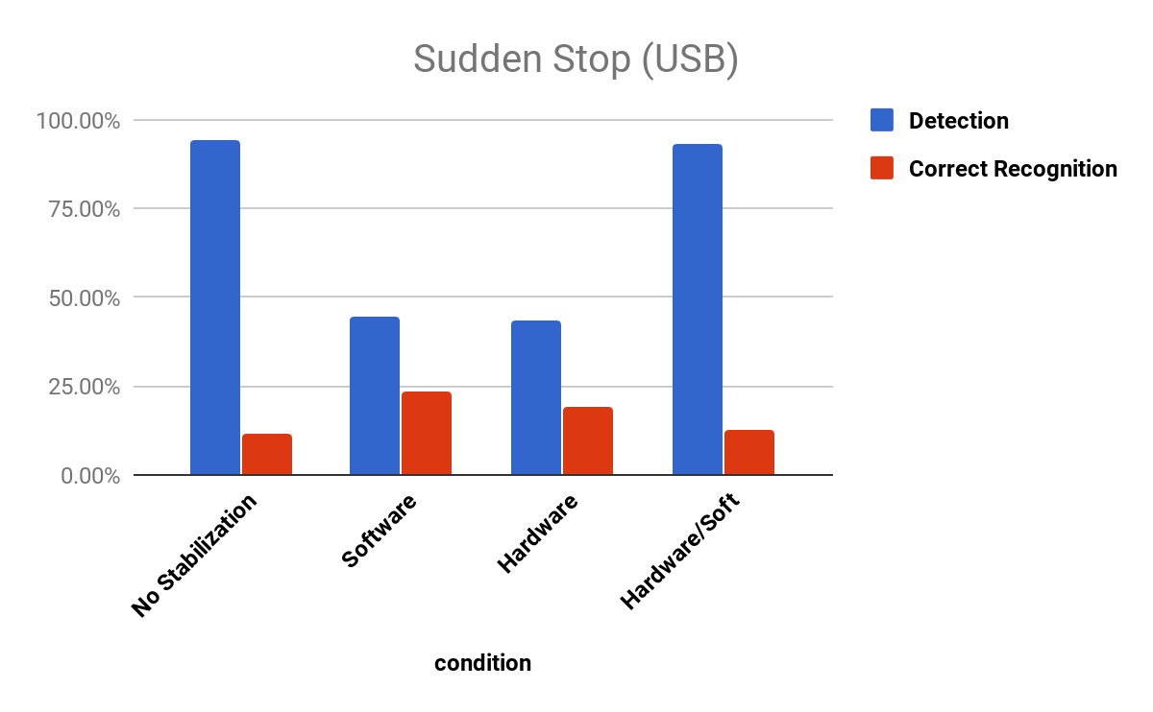
Results: Both Cameras-Sudden Stop

Slide 15
Conclusion
Quality of camera is important beyond 9 feet
Software is the most reliable solution at first glance

Slide 16
Economics Analysis
On going
Looking into Amazon reviews/rating of cameras and their impact on pricing

Slide 17
Thank you!
Nick Webb
Fuat Sener
David Frey
John Rieffel
Kamin & Piano Man

Slide 18
Questions?

