Slide 1
Combining VR and Gamification Techniques to Improve Academic Performance
Shinell Manwaring
Notes:
1) Introduce myself and the topic

Slide 2
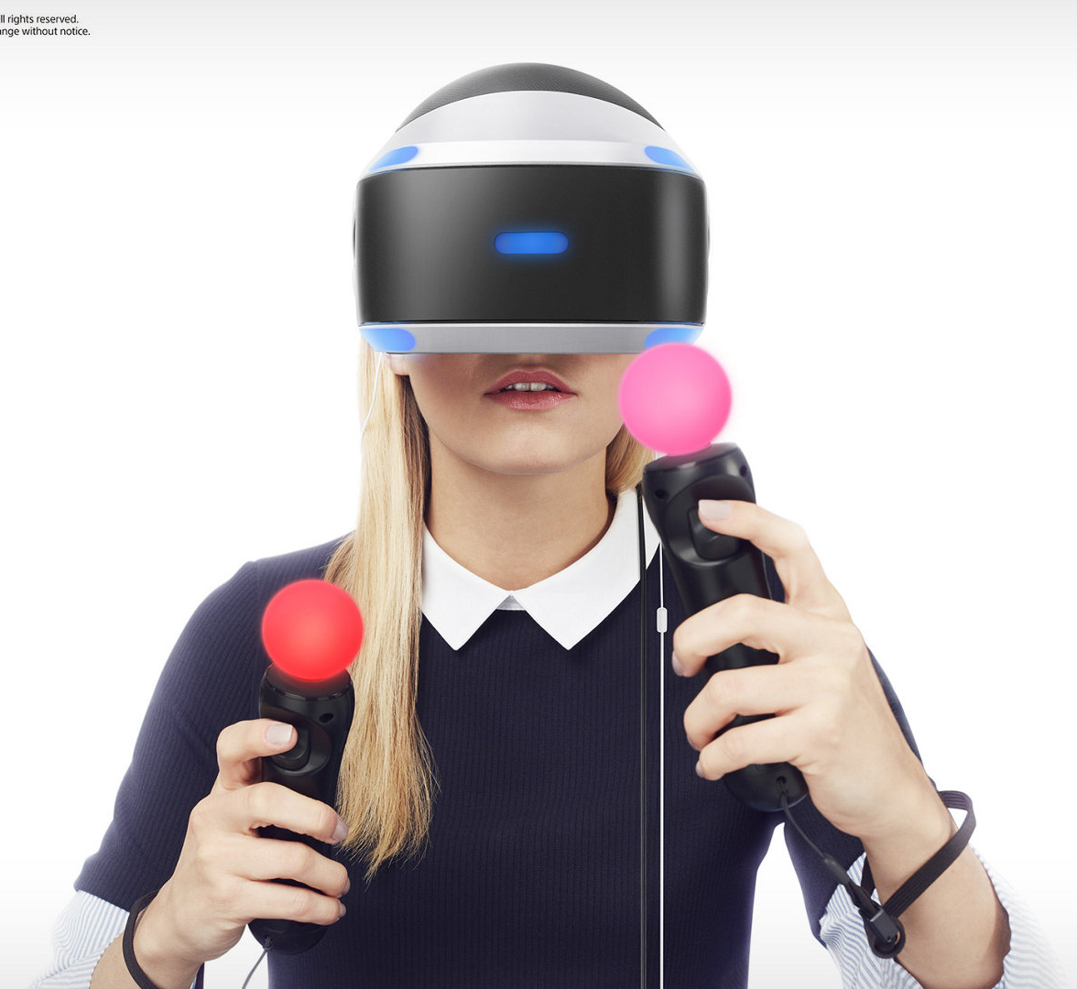
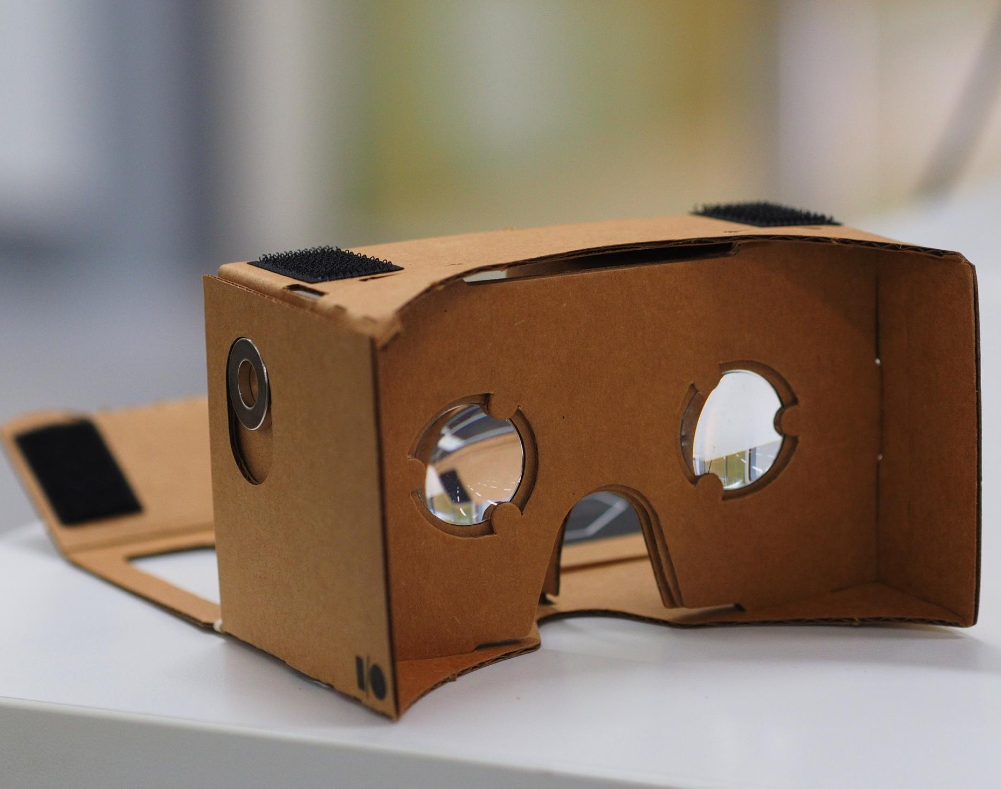
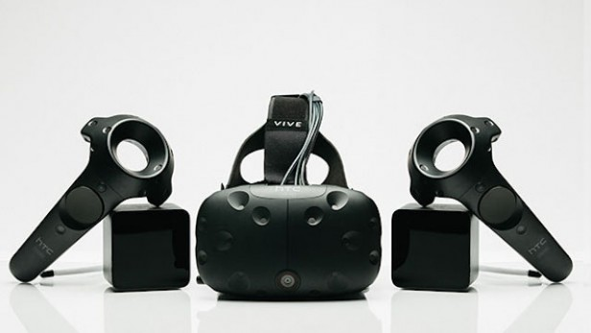
Introduction
Virtual Reality (VR) is a computer-generated simulation of "reality”.
Gamification is the application of game-like elements to non-gaming activities.
Notes:
1) PSP, Google cardboard, HTC Vive
2) Used to encourage people to participate in those activities and achieve specific goals.

Slide 3
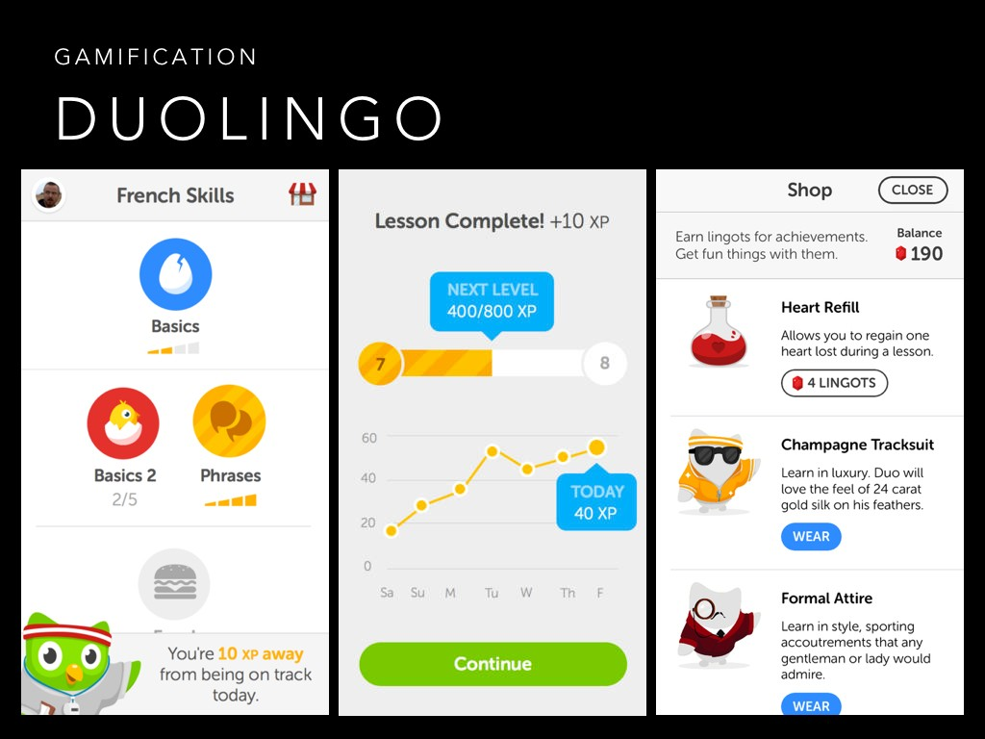
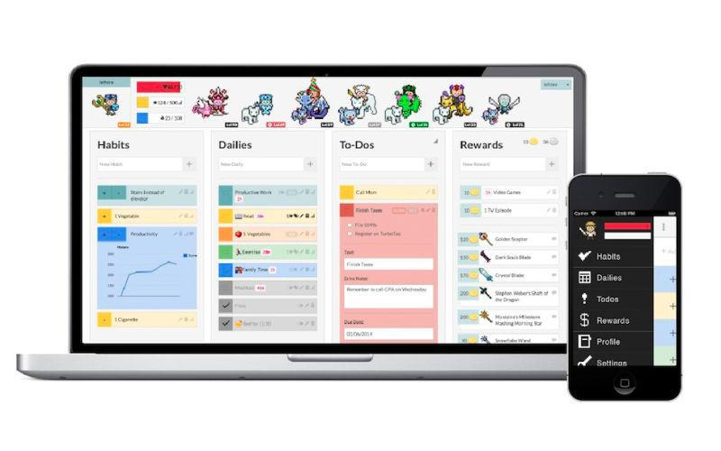
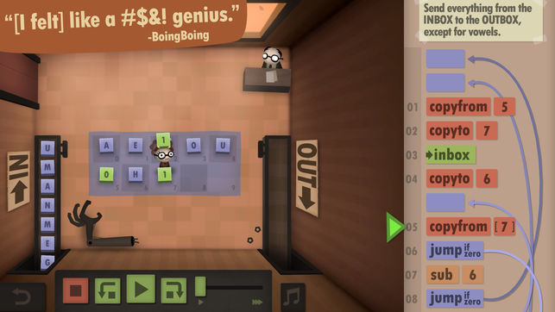
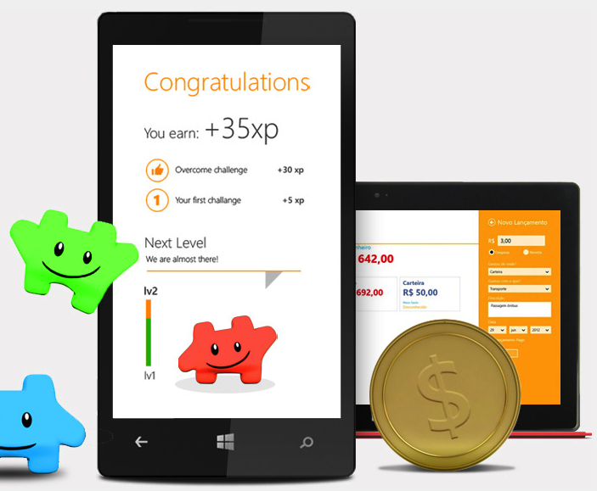
Background
Notes:
1) Examples: HabitRPG, Duolingo, Human Resource Machine, Magento shopping app, etc.

Slide 4
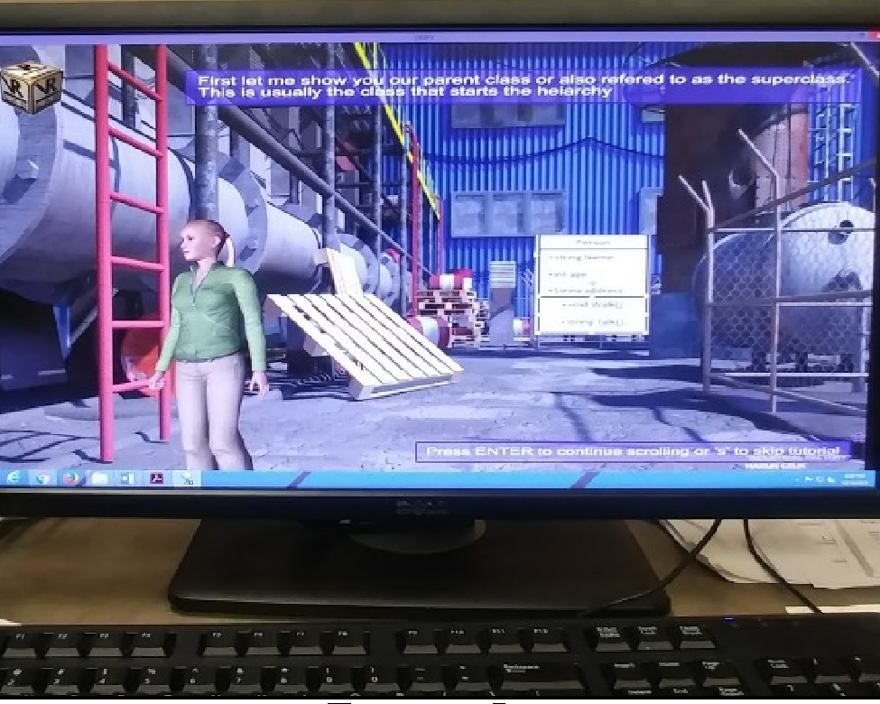
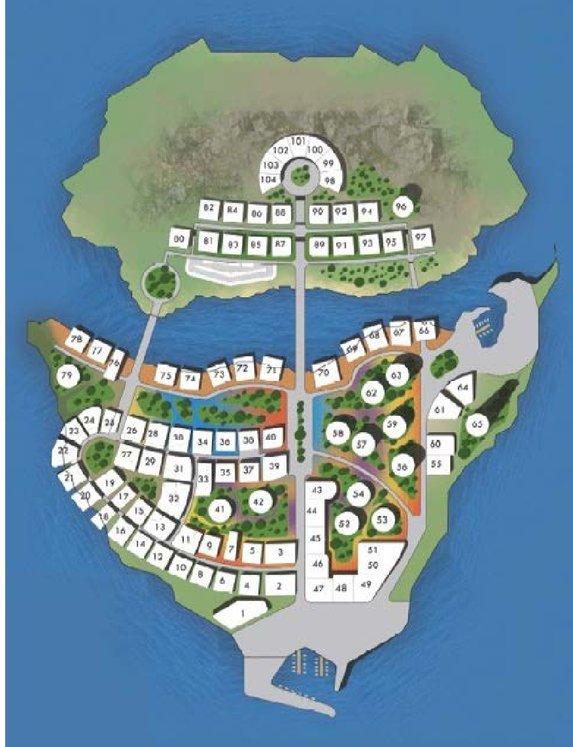
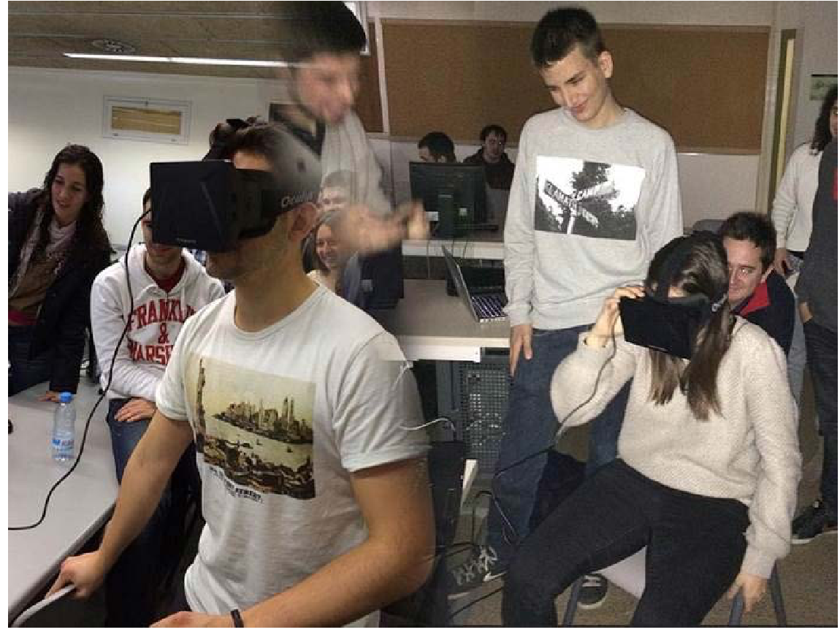
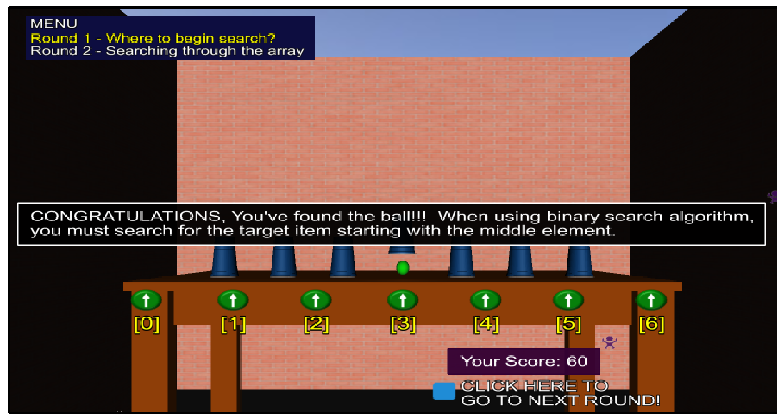
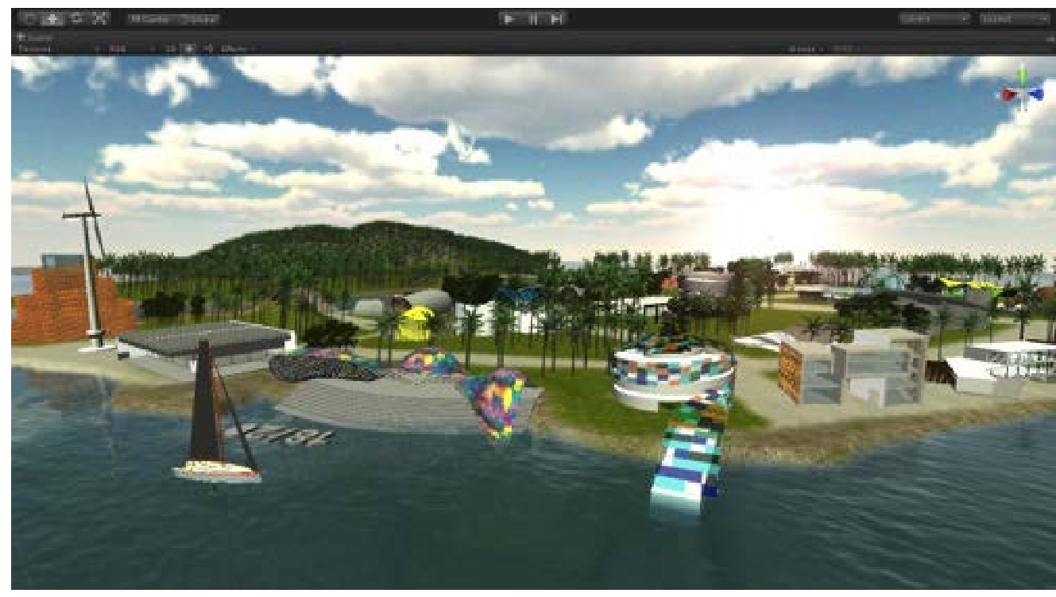
Related Works
Notes:
Teaching case: Applying gamification techniques and virtual reality for learning building engineering 3d arts: described a “real exercise applied in a Building Engineer and Architectural degree on the subject of ‘Computer Tools 2’ at La Salle, Ramon Llull University, a six ECTS-credit course that is taught annually with 65 students enrolled.” Combined virtual reality with programs such as Sketchfab, Unity, and Oculus Rift VR to create “immersive worlds that students used to enhance their architectural designs. “
Gamification for learning 3d computer graphics arts: Incorporated Problem-Based Learning (PBL) and Quest-Based Learning (QBL) into student collaborative work and mixed teacher support with virtual environments and visualization 3D on the web using webGL. (May briefly discuss)
Virtual reality instructional modules for introductory programming courses: Created two gaming modules for teaching object-oriented programming (OOP) and binary search and discussed the “design, development, and testing of virtual reality instructional (VRI) modules based on gaming metaphors.” Virtual reality instructional modules for introductory programming courses: authors created an immersive and non-immersive VR system, incorporated showing C++ source code, UML diagrams, and creative imaging to the user, and used used games centered around teaching the user about inheritance, polymorphism, encapsulation, binary search trees etc.
These papers focused primarily on gamification and less on the VR element, which is why I wanted to research more into its possible benefits.

Slide 5
Research: Question
Question: Can combining VR and gamification improve Intro CS students’ understanding of Lists?
Goals:
Create a module that combines the use of gamification and VR
Determine if the module improves the academic performance of Intro CS students
When selecting a topic for my module, I choose from the following list:
Loops, Conditionals, Binary Numbers and ASCII, Lists/Arrays, Strings, Recursion, Files, Dictionaries, and Regular Expressions and Pattern Matching.
After iterating through preliminary designs, Lists was ultimately selected
Notes:
1) Create a module, a self-contained unit of an Introductory Computer Science topic, which combines the use of gamification and VR
2) Determine whether the module can improve the academic performance of Union College Introductory Computer Science students

Slide 6
Why VR?
Provides immediate feedback
Depicts a storyline; Provides a game like initiative
Uses inherently learned concepts (e.g. spatial properties)
Visually shows known qualities of lists (e.g. the size of an list and the action of adding/removing items from a list)
Provides a more engaging and tactile approach to hardcoded qualities of lists

Slide 7
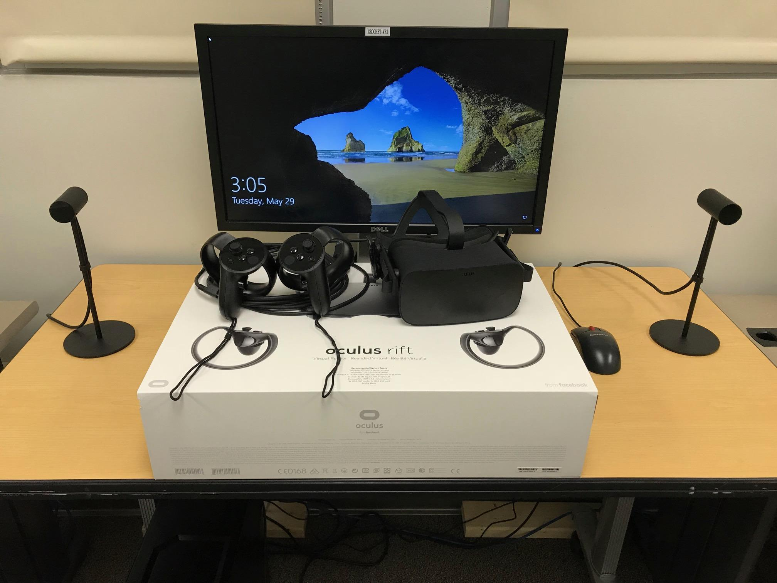
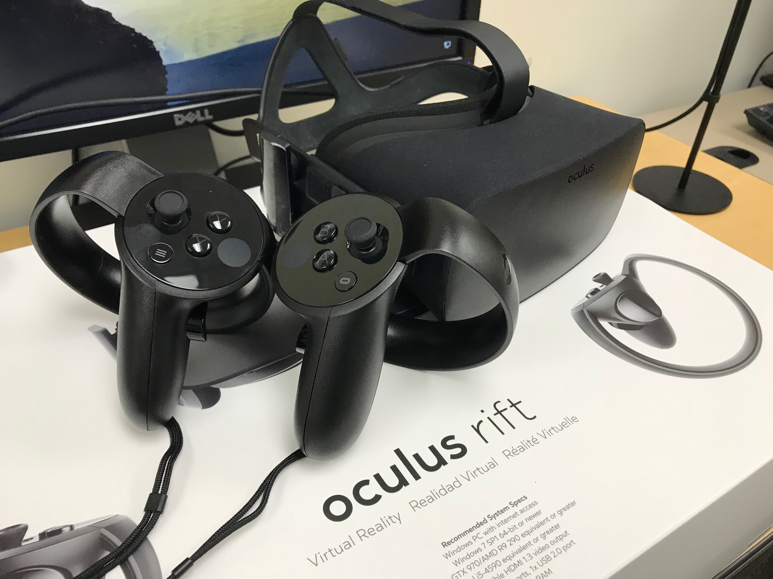
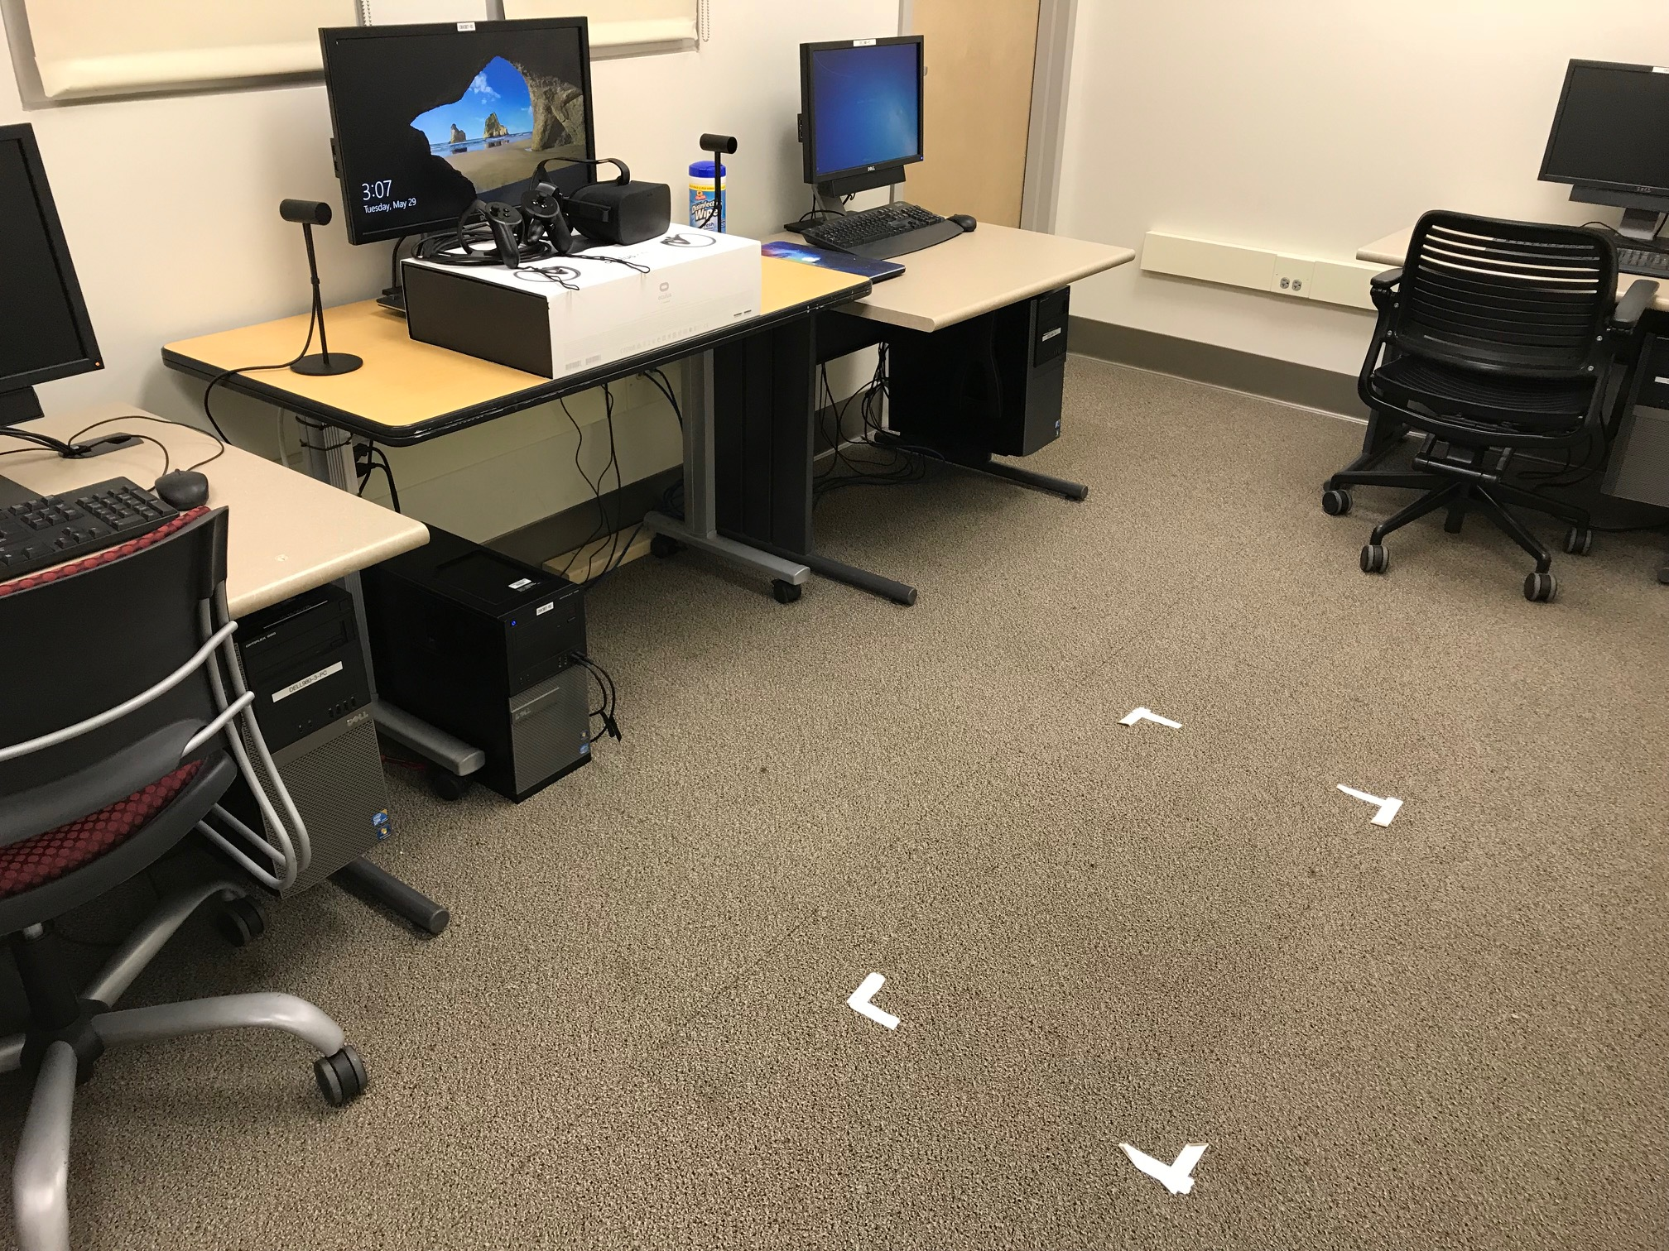
Equipment
Oculus Rift, Unity Software, and a compatible Windows workstation in the CRoCHET Lab
Notes:
1) I researched the compatibility and current support of various VR hardware (i.e. Google Cardboard, Windows Mixed Reality Headset, the Oculus Rift Virtual Reality Gaming System, and the HTC Vive Virtual Reality System) and various VR software (i.e. Unity, Amazon Sumerian, Amazon Lumberyard, and the Unreal Engine 4). After comparing and contrasting my findings, I determined that the best VR headsets to buy was the Oculus Rift Virtual Reality Gaming System since it has a variety of free compatible VR software, it’s cheaper in price, has clear documentation, and has numerous example projects/tutorials, which will help in the creation of my VR module since I do not have extensive knowledge on VR development.
2) Mention that the box on the ground is used as a bounding box for participants

Slide 8
Module: Design
Goal: Design a program, meant for enrichment, that practices different concepts relating to list.
E.g. Accessing, adding, removing, negative indexing, and multidimensional lists
Design:
Implement a grocery oriented storyline where the user is an employee of “Fruit Stands.”
Follow the orders of their manger, which may entail stocking shelves and/or serving customers.
Notes:
Mention that the module is meant to compound the user’s knowledge without explicitly teaching them.
Things taught by the module: How lists are organized, how to access a specific index of a given list, removing/adding to a specific index, determining the size of a list, negative indexing, index out of bounds, and multidimensional lists

Slide 9
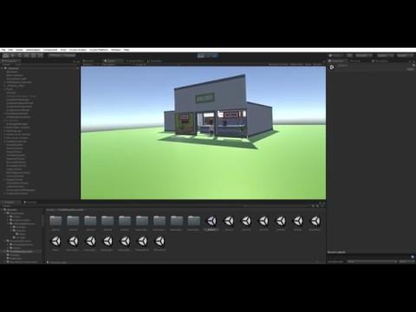
Module: Design

Slide 10
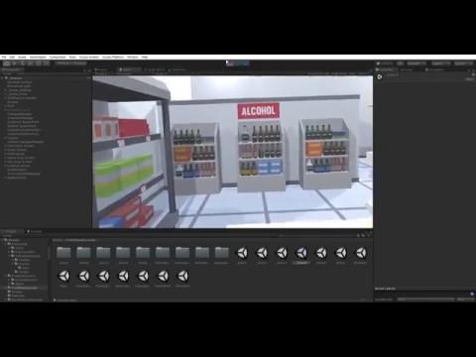
Module: Design

Slide 11
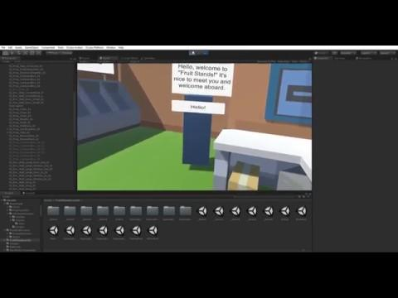
Module: Manager

Slide 12
Module: Bugs
Notes:
Talk about the purpose of the level
Talk about the infinite broccoli
Mention that this level was changed afterwards and how I manage the duplication bug

Slide 13
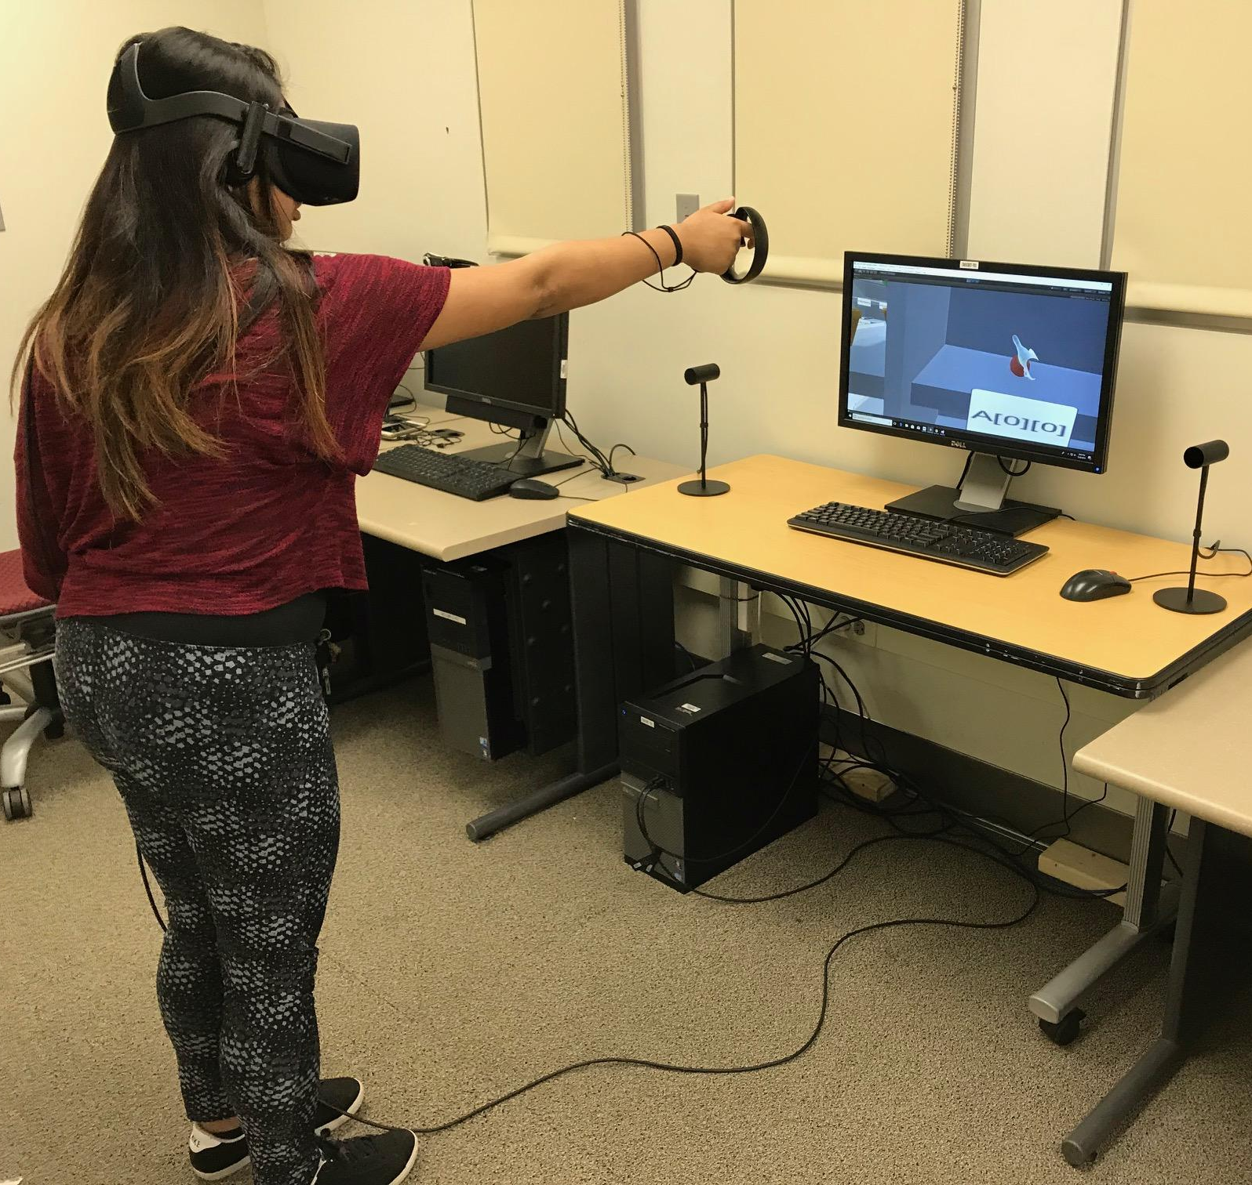
Evaluation
Two group of participants:
Use the VR module
Watch a video about Lists
Administer a test pertaining to Lists
Compare the performance of the two groups
Notes:
Mention that participants were recruited from CSC 104 and CSC 106
Mention the interactive component in the photo

Slide 14
Evaluation: Flow
Survey
Test
VR Module
Video
Test
Notes:
Mention how participants were divided
Mention that participants still filled out a consent form and were debriefed

Slide 15
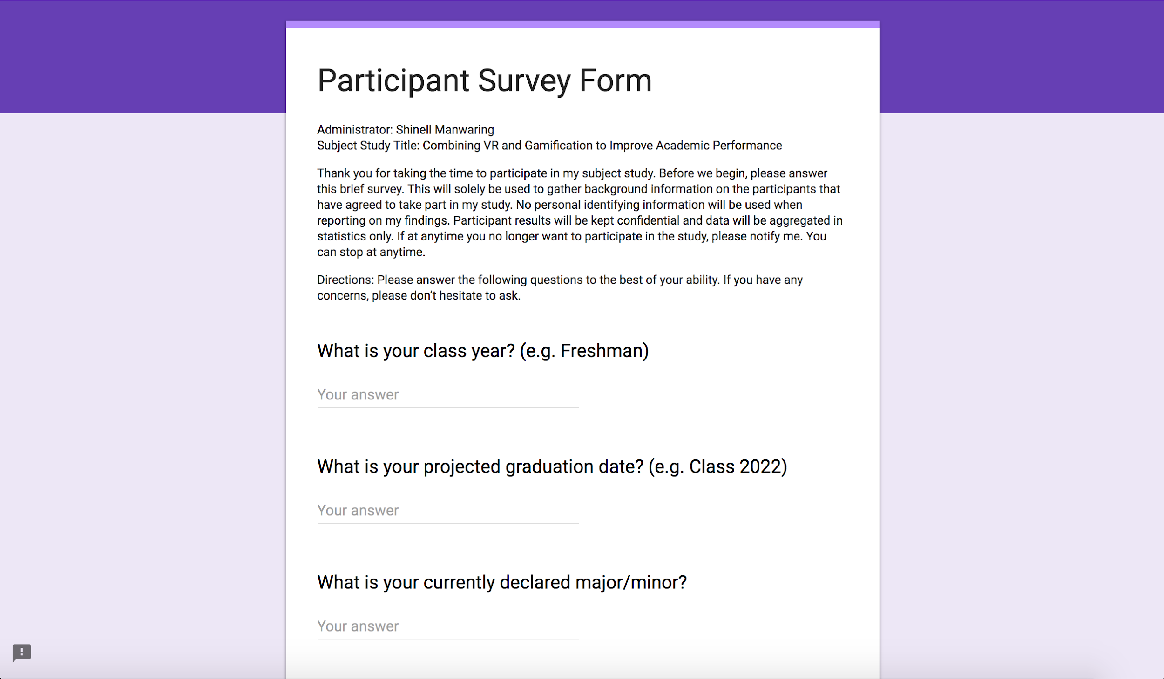
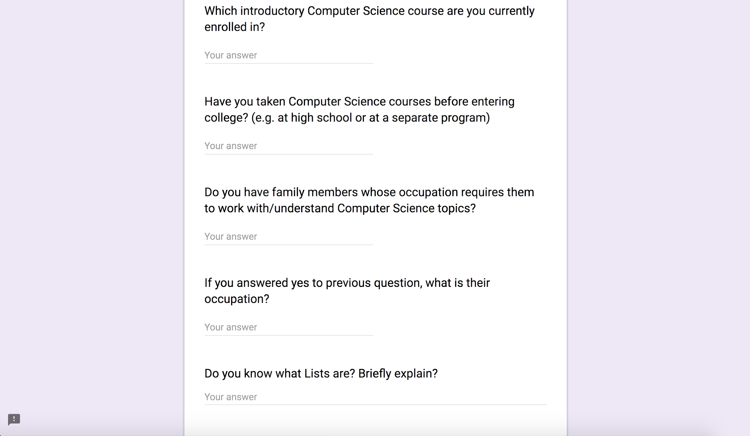
Evaluation: Survey

Slide 16
Evaluation: Test

Slide 17
Results
I am currently in the process of running experiments

Slide 18
Summary
Created a VR module that taught various concepts pertaining to lists
Collected data from two group of participants:
Use the VR module
Watch a video about Lists
Administered a test pertaining to Lists and compared each groups performance
Continuing to analyze participant data and to draw a better conclusion

Slide 19
Future Work
Incorporate audio/narration to make the manager more engaging
Repeatedly encourage participants to read/ think out loud
Have more than one level incorporating negative indexing
Incorporate more activities for the participants to complete
Have more variation in customers
Implement the module closer to when the participants first learn about Lists
Extend the module to include more CS topics
Include questions of greater difficulty for the testing portion

Slide 20
Questions?

Slide 21
Works Cited
Sergi Villagrasa, David Fonseca, and Jaume Duran. Teaching case: Applying gamification techniques and virtual reality for learning building engineering 3d arts. In Proceedings of the Second International Conference on Technological Ecosystems for Enhancing Multicultural- ity, TEEM ’14, pages 171–177, New York, NY, USA, 2014. ACM
Sergi Villagrasa and Jaume Duran. Gamification for learning 3d computer graphics arts. In Proceedings of the First International Conference on Technological Ecosystem for Enhancing Multiculturality, TEEM ’13, pages 429–433, New York, NY, USA, 2013. ACM
J. Stigall and S. Sharma. Virtual reality instructional modules for introductory programming courses. In 2017 IEEE Integrated STEM Education Conference (ISEC), pages 34–42, March 2017

