Slide 1
The Efficacy of Augmented Reality in the Classroom
Ben Kopchains
Advisor - Chris Fernandes

Slide 2
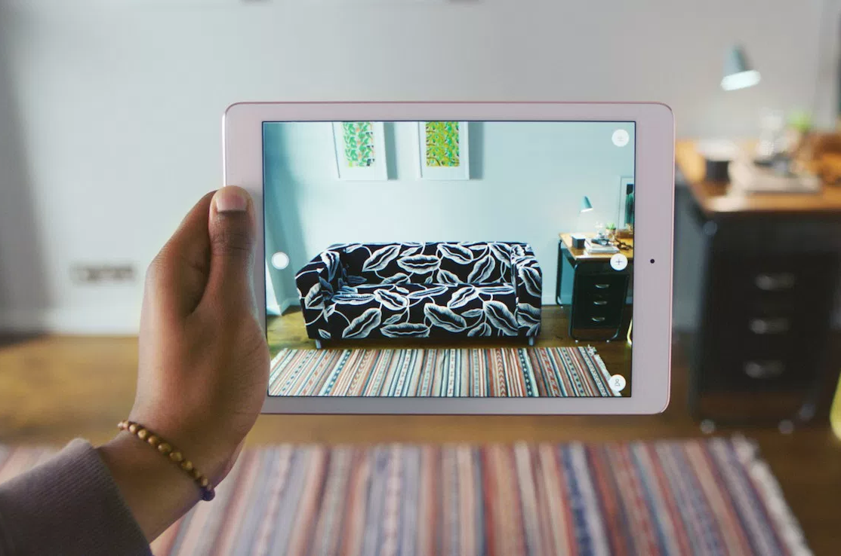
Augmented Reality (AR)
Blend of real and 3D images
Tablet / phone
Overlays digital information into the real world
Ex: IKEA, Pokémon Go

Slide 3
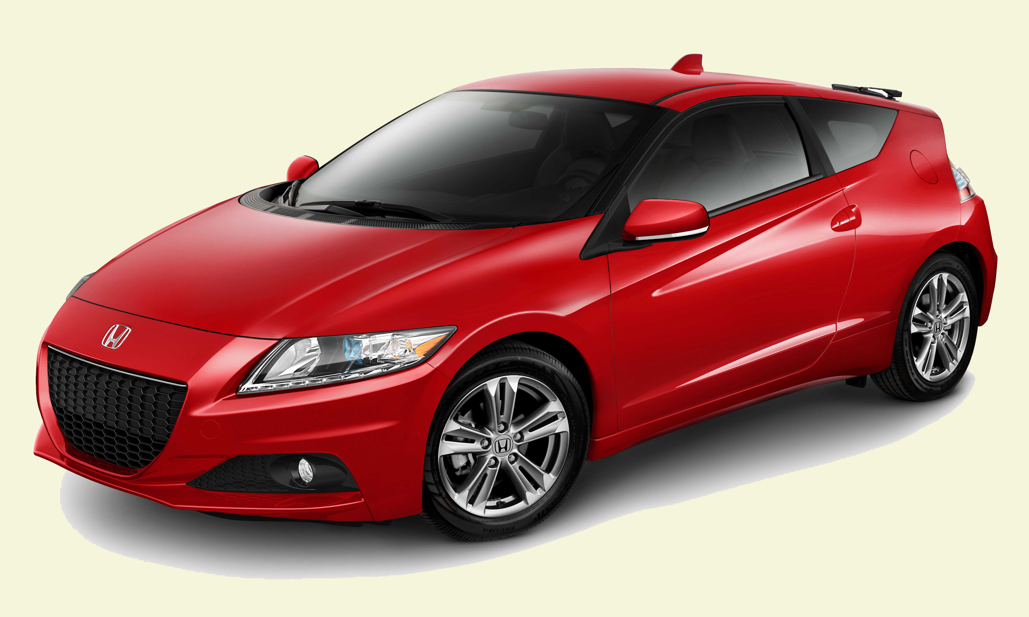
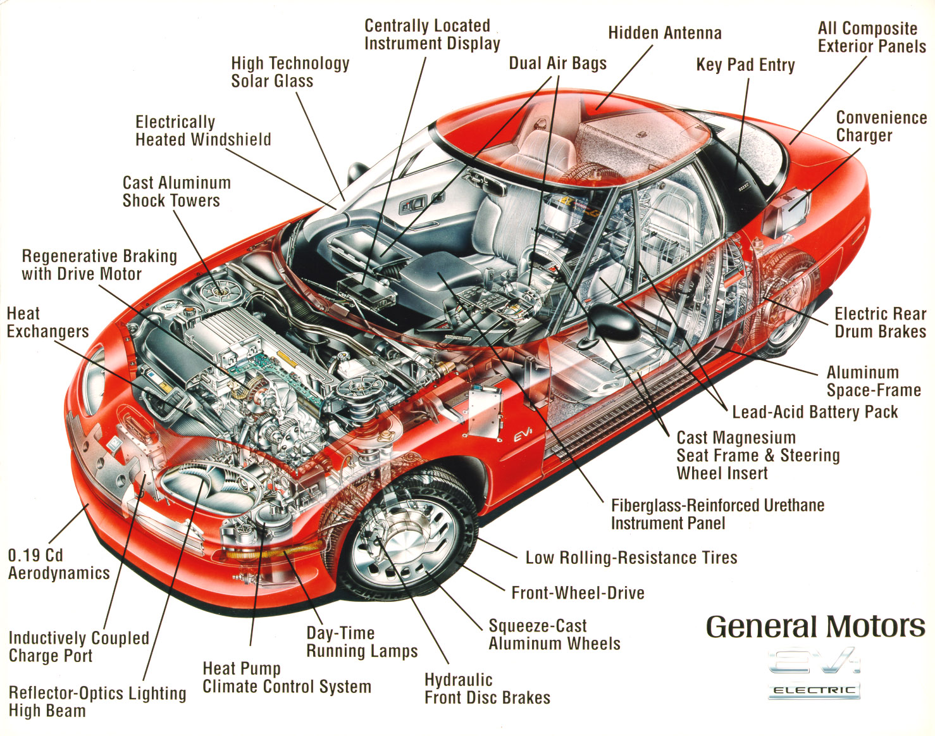
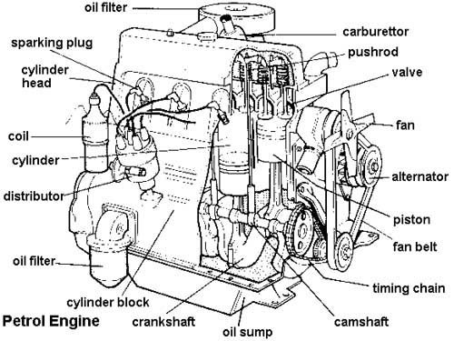
Why AR in the Classroom?
Engaging
Layers
Hierarchical, option to focus / separate
More Interactive
Use phone like a magnifying glass
Precedent
Data Visualization

Slide 4
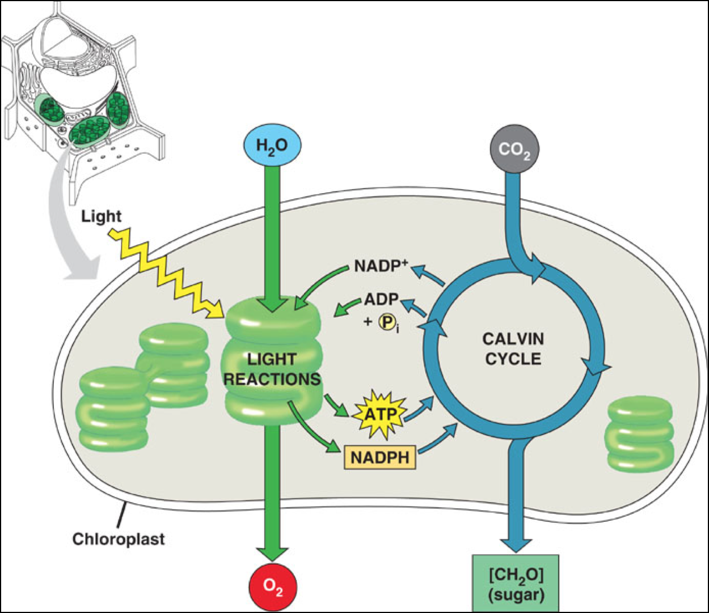
Photosynthesis
Understood at basic level
Benefits from AR
Hierarchical System

Slide 5
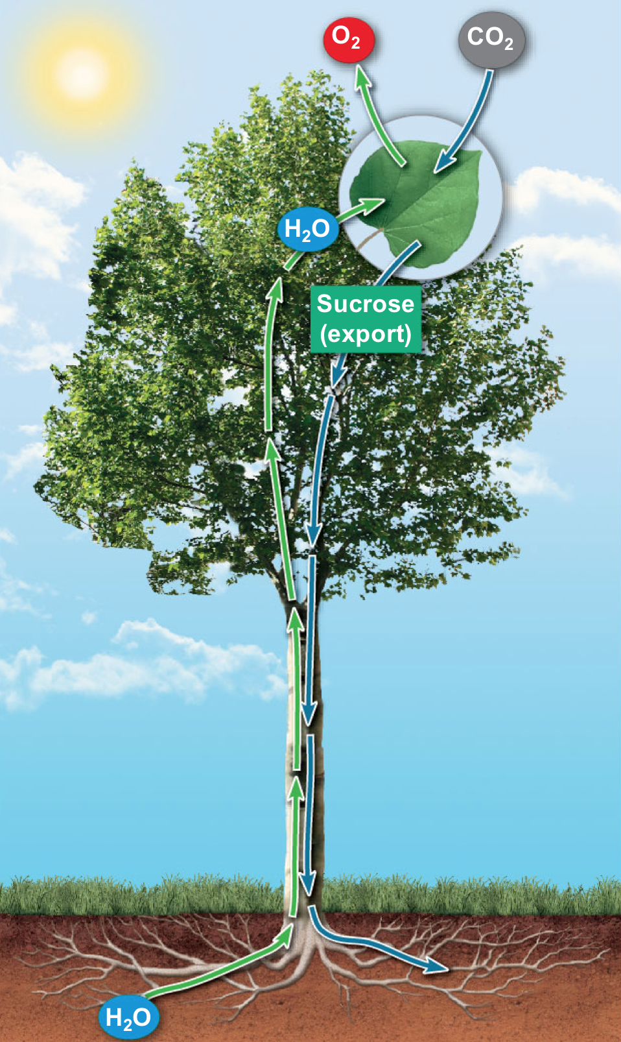
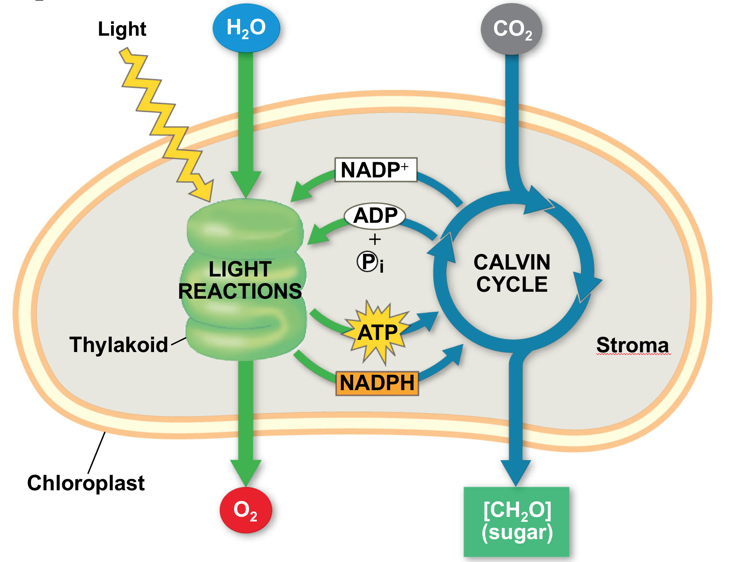
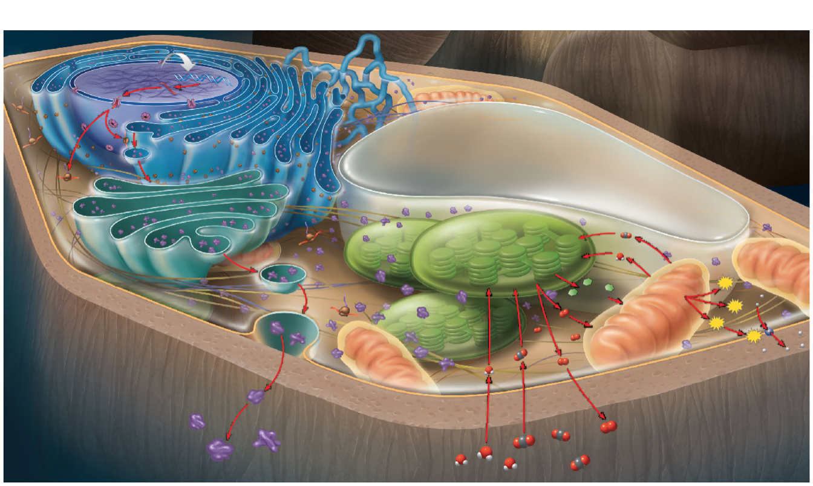
Sunlight

Slide 6
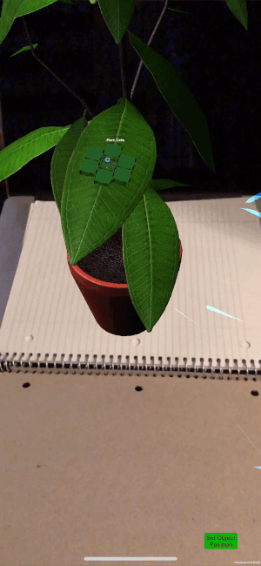
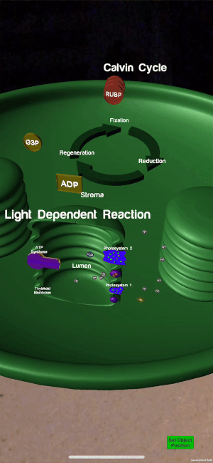
App Design

Slide 7
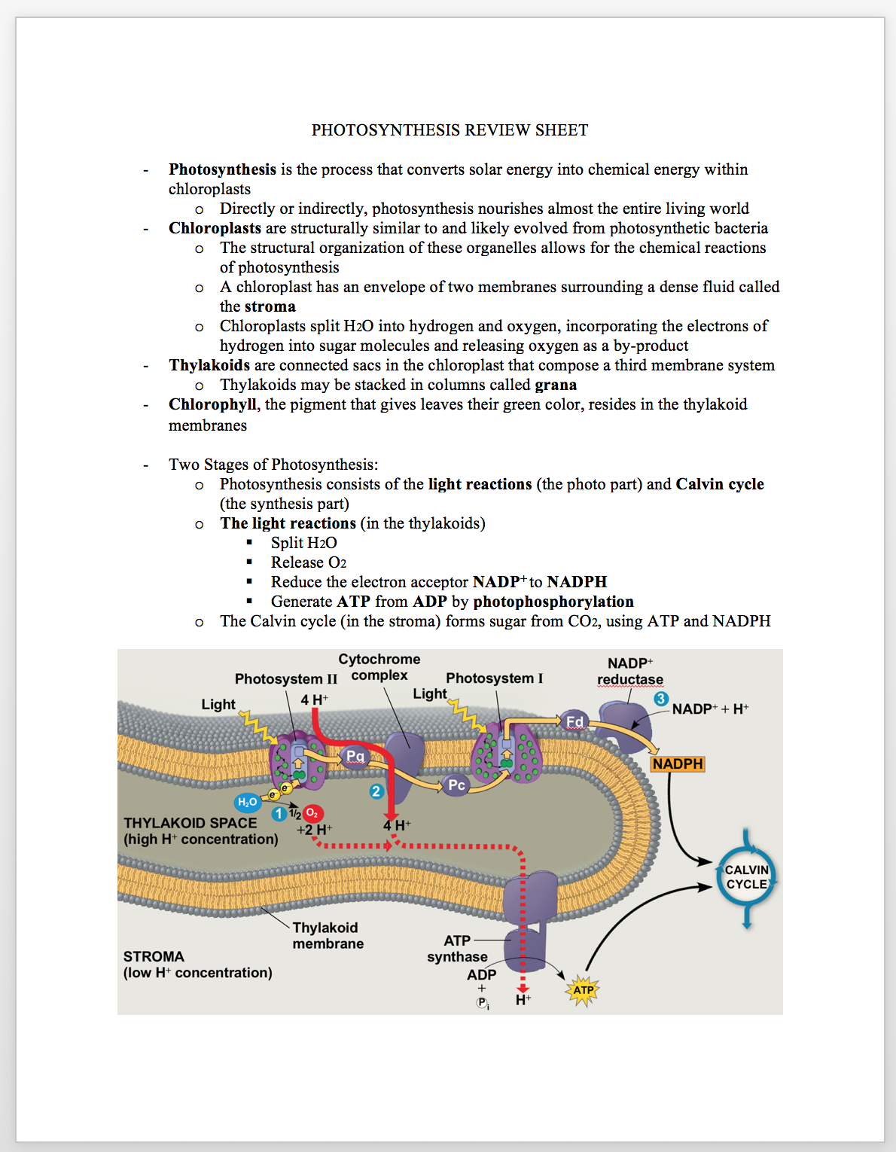
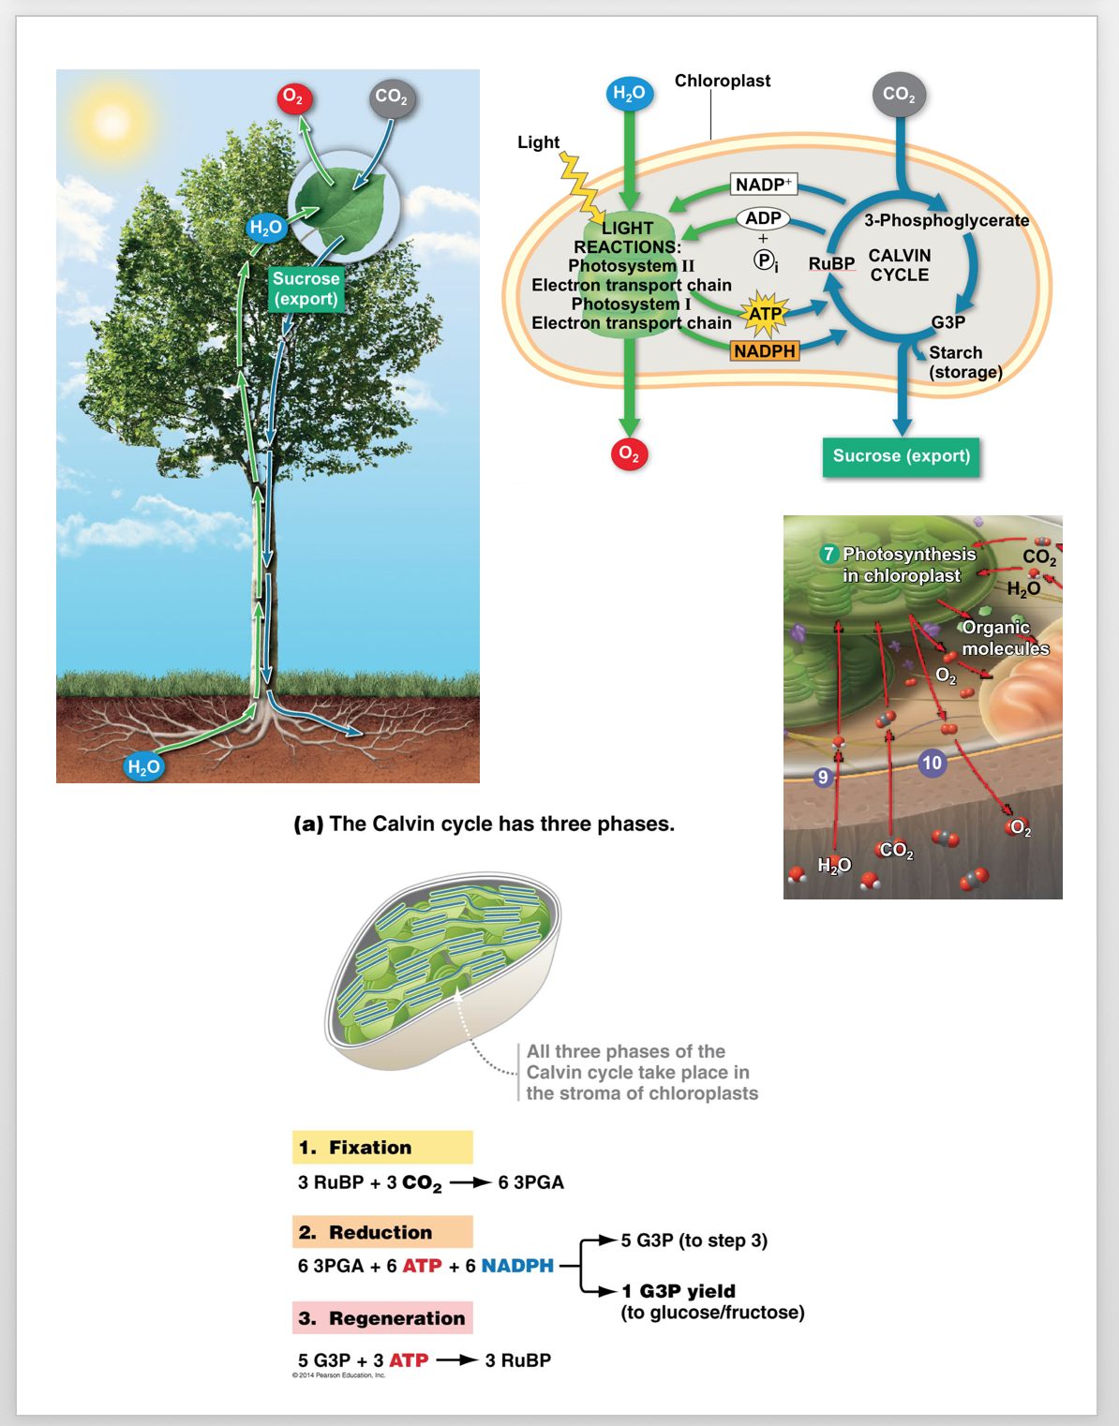
Experiment Design
Two groups - evenly divided
Intro biology students
10 subjects total
Pretest
Gauge initial knowledge
Study period
Cheat Sheet
Cheat Sheet & App

Slide 8
Experiment Design (Cont.)
Posttest
Gauge knowledge absorbed from study
Compare results
Test scores
Time spent studying
Time to complete pretest & posttest

Slide 9
Study Results – Test Scores
Total Possible | Average Score Improvement (AR) | Average Score Improvement (Non-AR)
15 pts | 1.60 pts | 2.40 pts
P-value = 0.5964

Slide 10
Study Results – Study Times (AR Group Only)
Avg Time Studying AR | Average Time Studying Cheat Sheet
5.54min | 4.51min
P-value = 0.0243

Slide 11
Study Results – Test-Taking Time Changes
Average Time Decrease B/W Pre- and Posttest
(AR) | (Non-AR)
1.89min | 1.34min
P-value = 0.0855

Slide 12
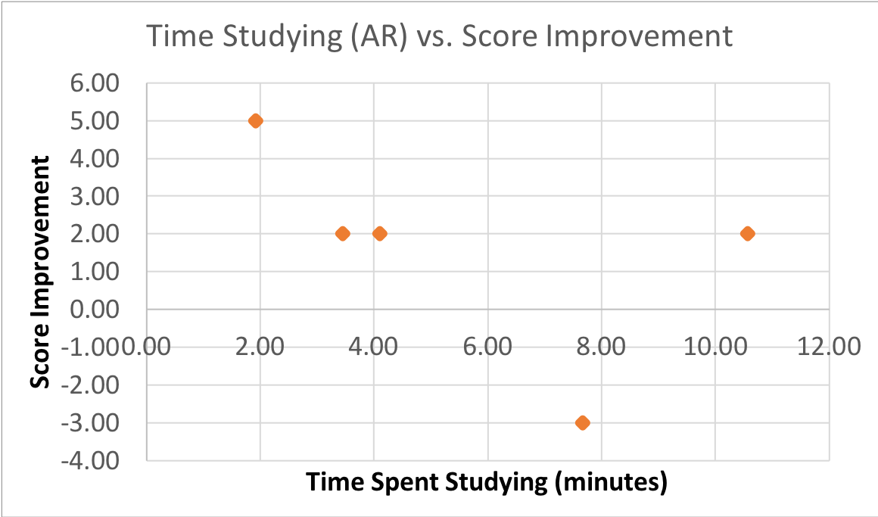
Study Results - AR

Slide 13
Conclusion
Measurement | Favors | Stat. Significant?
Score Improvement | Non-AR | No
Study Time Allocation | AR | Yes
Test Time Decrease | AR | No
Speaks more to engagement

Slide 14
Future Work
More subjects
Data not substantial enough
Improve app usability
Tutorial
“Zoom” recognition

Slide 15
Questions?

Slide 16
Study Results - Testimonials / Engagement
Positive Feedback
“Not gonna lie your app is very cool and useful!”
“I’ve always wanted a tool like this.”
Relates to student engagement
Inconclusive

