Slide 1
Classifying Physiological States of Hair-Cap Moss Based on Digital Images
Yuan Gao
(Advisors: Chris Fernandes, Steve Rice)

Slide 2
Background
Hair-cap mosses
play important roles in the ecosystem
desiccation-tolerant
physiological states: hydrated and desiccated
different physiological features and growth rates

Slide 3
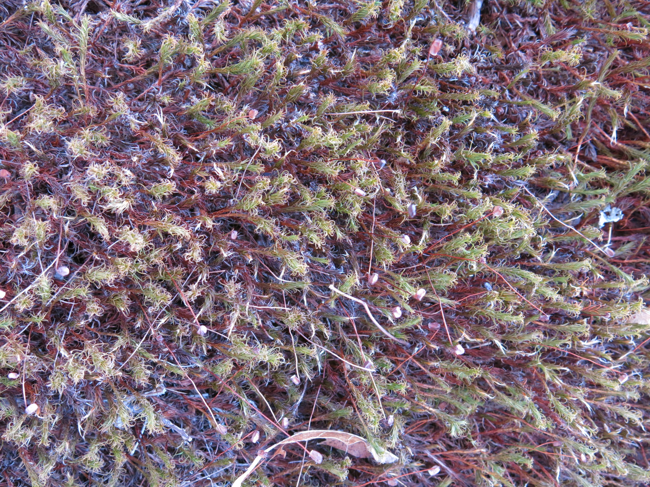
Desiccated
Hydrated

Slide 4
In reality mosses are in mixed states...

Slide 5
Research Question
Can we find an algorithm to identify hydrated areas from desiccated areas using only digital images of the moss canopy?

Slide 6
Research Question
Can we find an algorithm to identify hydrated areas from desiccated areas using only digital images of the moss canopy?
Labor intensive
Hydrated or desiccated?
Surface Roughness
Influence in the environment

Slide 7
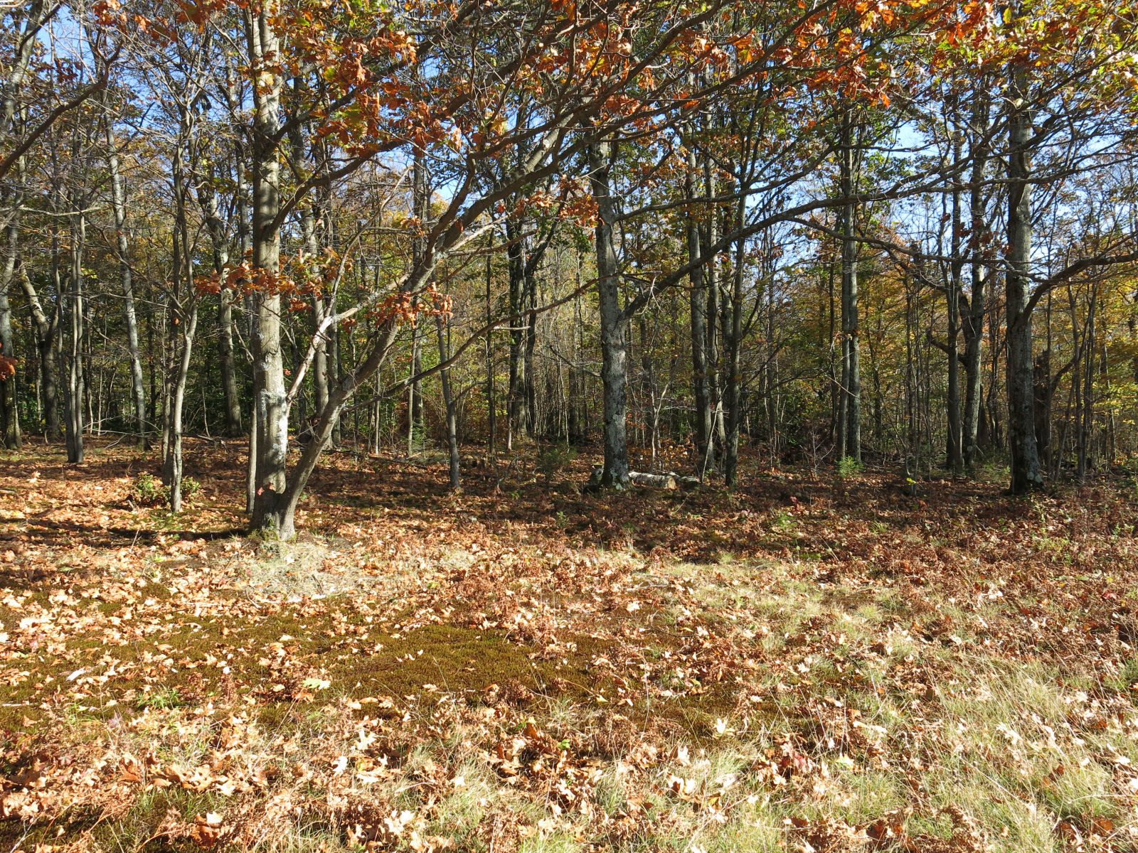
Methods
Collected 446 images in field:
196 hydrated, 200 desiccated, 50 mixed
Machine Learning
ImageJ Program: Extract attributes from pictures

Slide 8
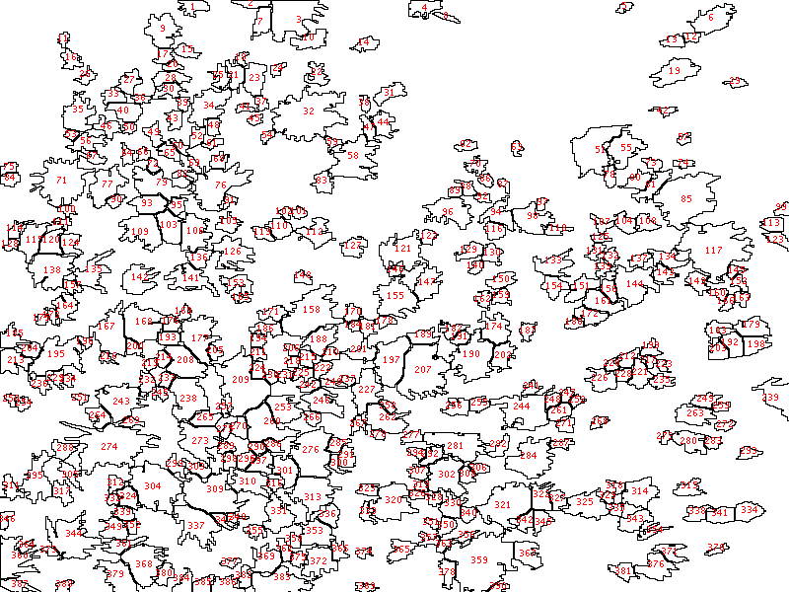
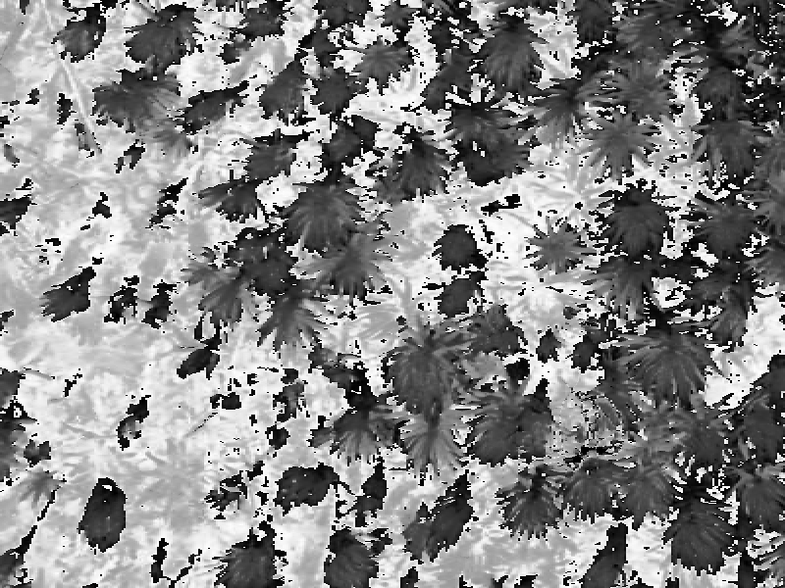
Dataset Attributes
Size and number of particles
Aspect ratio
Circularity
Green area coverage

Slide 9
Results
KNN = k-nearest neighbors algorithm
OneR = one rule algorithm
JRip = rules-based classifier
J48 = decision tree-based classifier
Logistic = logistic regression
NaiveBayes = probabilistic classifier
Baseline
 | KNN | OneR | JRip | J48 | Logistic | NaiveBayes
Classification Accuracy | 95.9% | 73.9% | 93.5% | 93.3% | 94.9% | 85.7%
Paired T-test result compared to baseline |  | worse | worse | worse | worse | worse

Slide 10
Results
Attributes evaluation:
1. Greenness
2. Circularity
3. Average size
4. Number of blobs
5. Aspect ratio

Slide 11
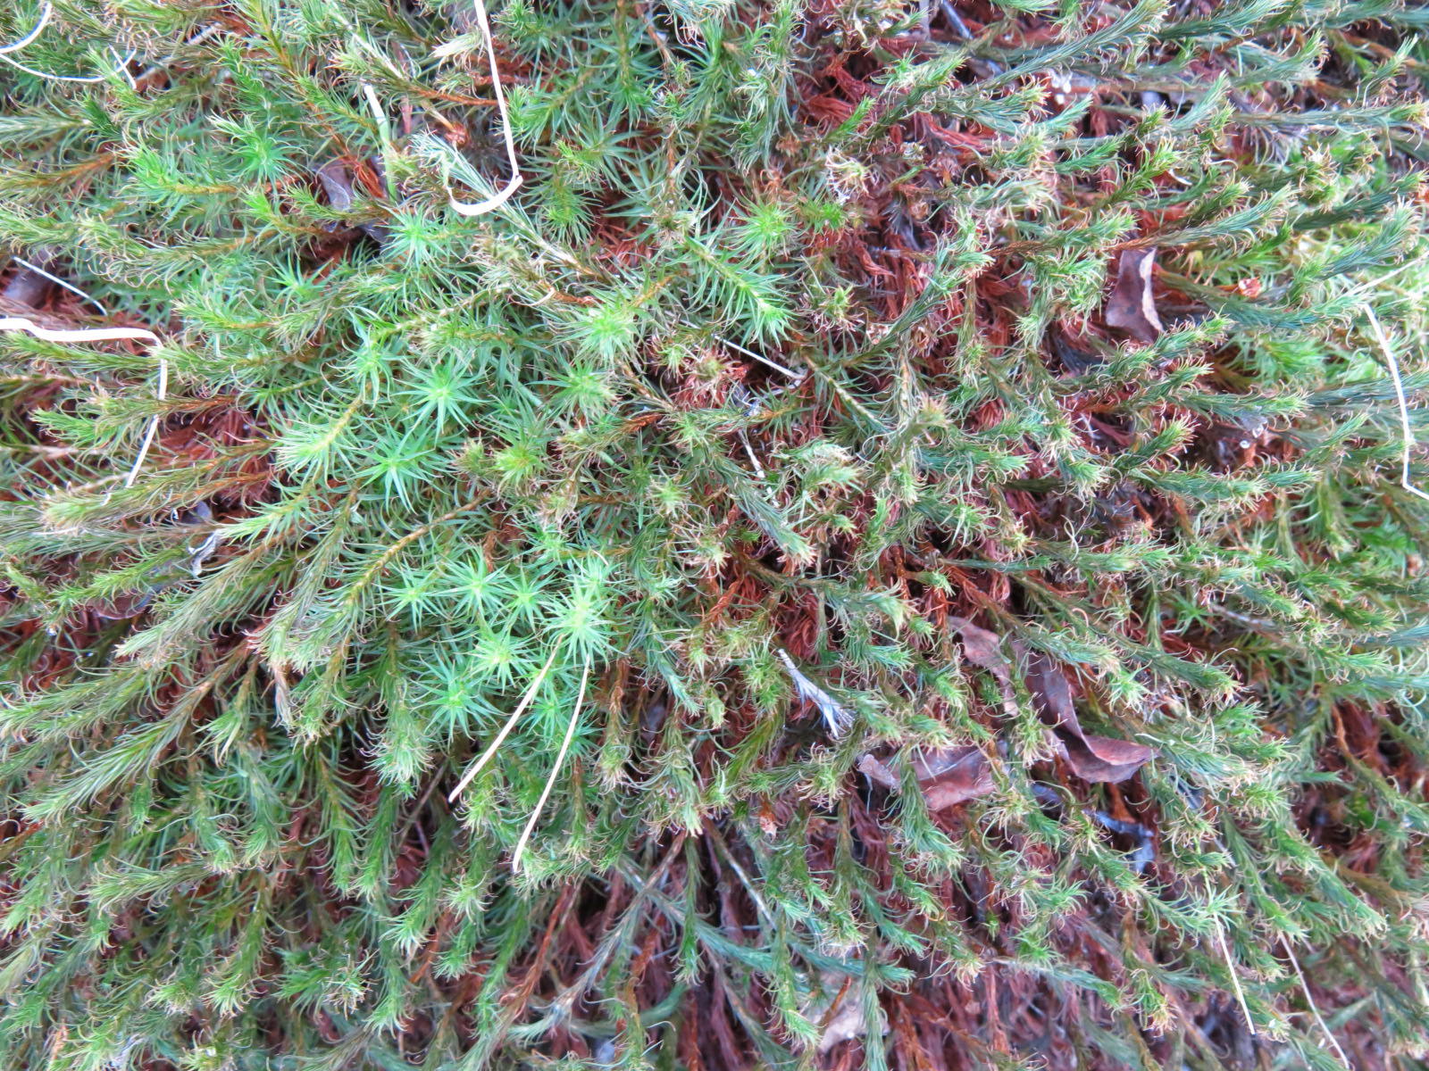
Evaluation
Compare to manual classification
MATLAB

Slide 12
H
H
Mix
D
Original Mixed Image
Slice Image
KNN Classification
Reconstruct Image
H
D
H
D
KNN
Slice
Mix

Slide 13
Results
- Desiccated
- Hydrated
Manual | kNN | Percent Overlap | ML: Desiccated Reality: Hydrated | ML: Hydrated Reality:Desiccated
 |  | 78.3% | 19.7% | 1.9%
 |  | 94.1% | 2.8% | 3.1%
 |  | 32.8% | 58.6% | 8.6%
Mean: 74.1% 15.8% 6.8%

Slide 14
Future Work
Manual classification from multiple people
Finish pipeline
Special thanks to Professor Nick Webb and Christina Dykas

