Slide 1
Specializing Generative Adversarial Networks To Render Terrain Textures
By Hein Htet Aung
Advisor: Matt Anderson

Slide 2
Why Do I choose this topic?
- Textures has to be drawn by artists
- Takes time
- What if we can create textures of a whole new world procedurally in games?
- What if we make a machine draw it for us?
A scene from No Man Sky

Slide 3
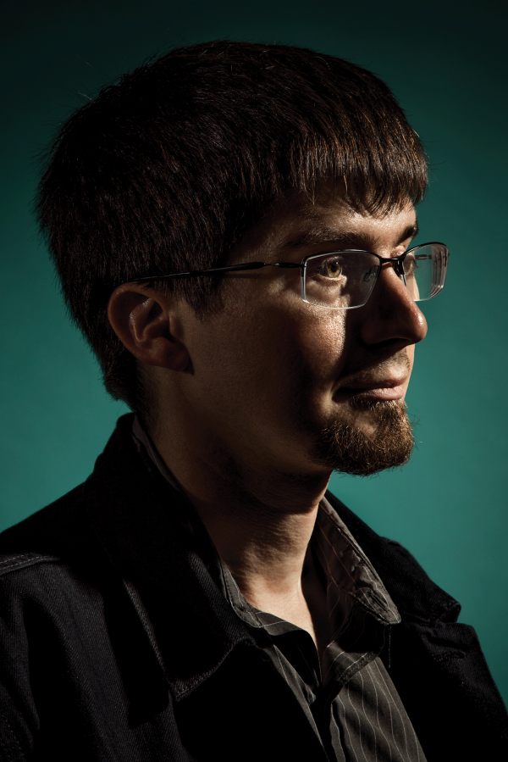
Lets build it then!
Ian Goodfellow
- Invented Generative Adversarial Network (GAN)
GAN
- Basically, Two Networks competing against one another to mutually learn and improve.

Slide 4
Research Question
Is it possible to create a Generative Adversarial Network that produces dynamic terrain textures?

Slide 5
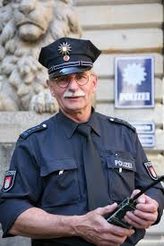
What is a Generative Adversarial Network?
Fake or Real
Discriminator
Generator

Slide 6
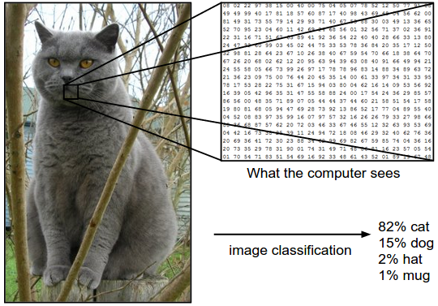
What is Image Classification?
Using a neural network to classify an image .

Slide 7
What’s Inside Discriminator (Rookie Policeman)?
Input Layer - Image
Convolution Layers – Apply a convolution operation to the input and pass the result to another layer
Output Layer - Probability that the image belongs to a certain class

Slide 8
What’s Inside Generator (Criminal)?
Input Layer - Random pixels
Deconvolution Layers – Apply a convolution operation and transpose the matrix of the input and pass the result to another layer
Output Layer - Image with necessary dimension
[128 x 128 x 3]

Slide 9
Quality of Discriminator and Generator
Error for Neural Network - The difference between the actual value and the predicted values

Slide 10
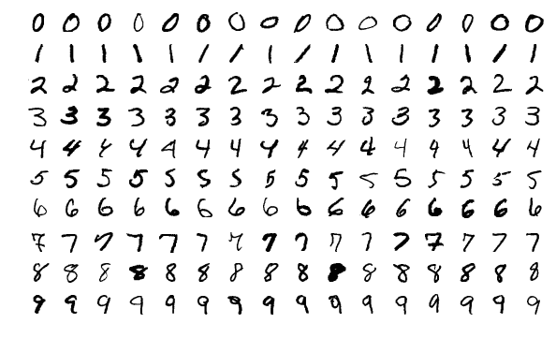
What did I do Fall Term?
During this term,
Researched about Convolutional Neural Networks (Image Classification)
Build algorithms for both Discriminator and Generator
Build prototype of both networks using [28 x 28] images from MNIST database
Modified National Institute of Standards and Technology

Slide 11
What did I do Winter Term?
During this term,
Revise what I did last term
Read more papers about other types of GANs
Modify prototype into [128 x 128 x 3] using ground textures.
Train the GAN
Now Running the experiment to evaluate the images created(50 evaluators)

Slide 12
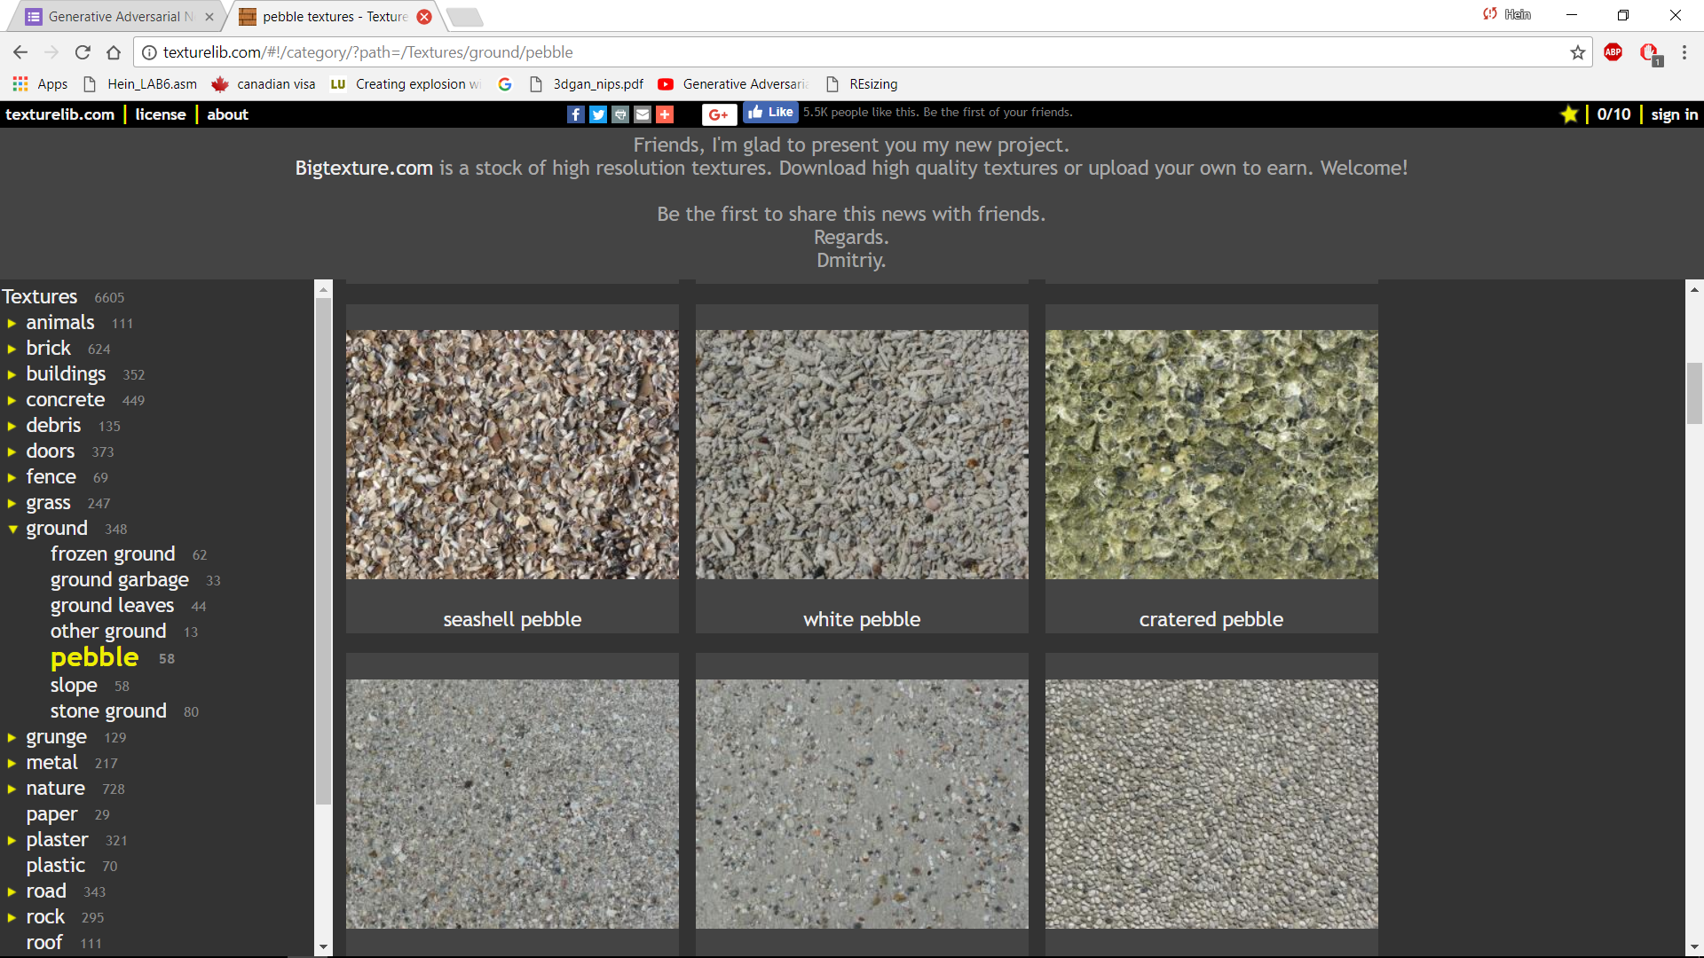
Datasets and Training
texturelib.com
647 images total
With 130 – 190 in four categories

Slide 13
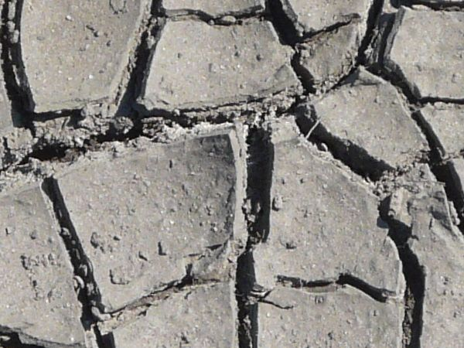
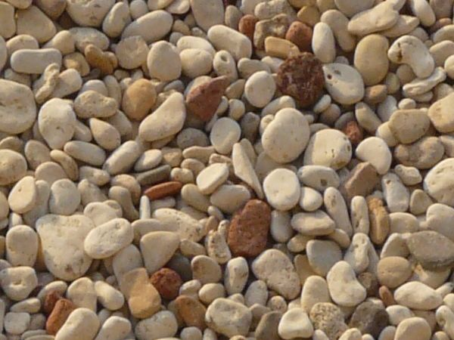
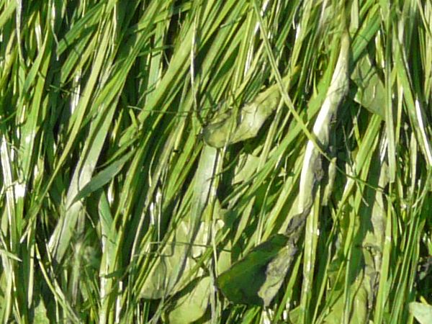
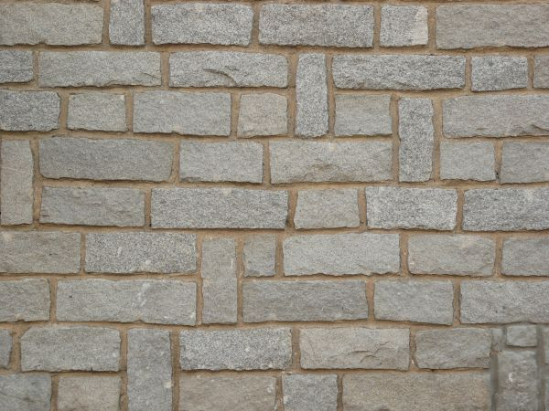
Datasets and Training
texturelib.com
647 images total
With 130 – 190 in each category

Slide 14
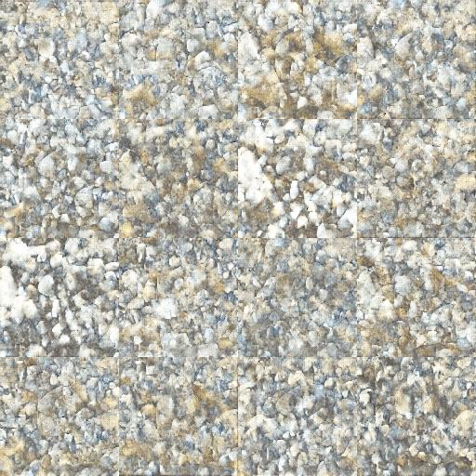
Training and Results
Training takes 20 to 30 hours
Pebbles
Grasses
Cracked ground

Slide 15
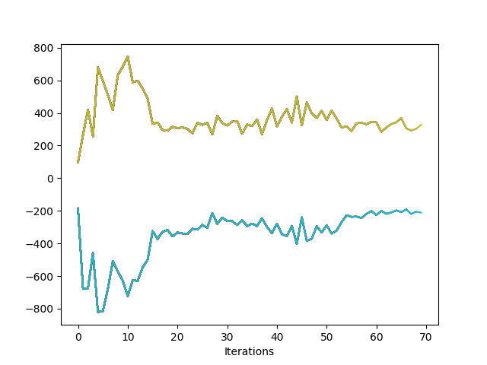
Training and Results
Training takes 20 to 30 hours
G_loss
D_loss

Slide 16
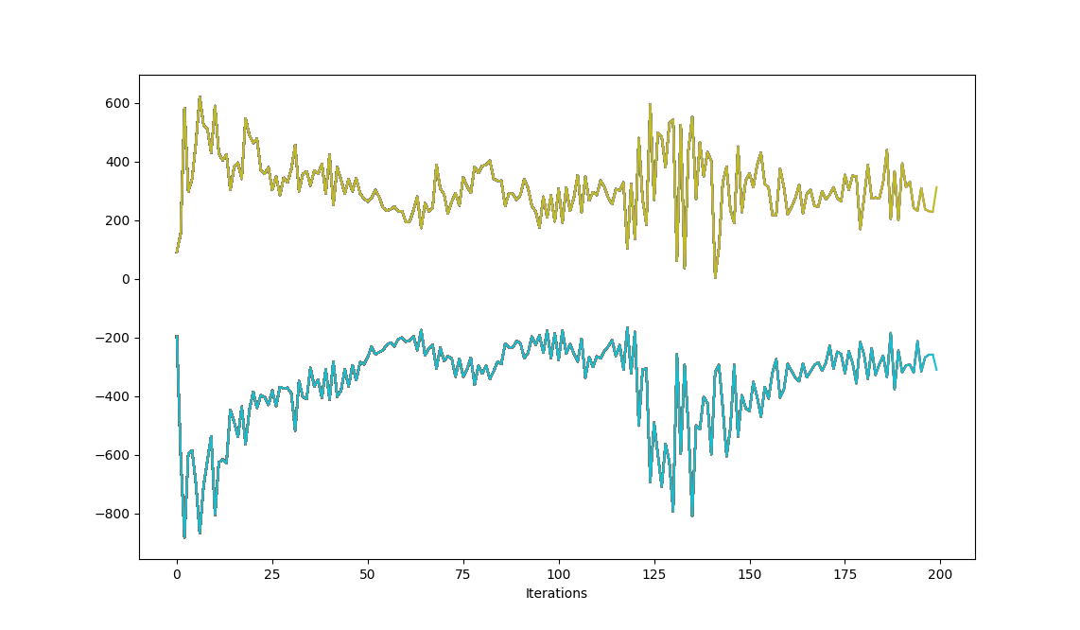
What happens when you over train GAN?
G_loss
D_loss

Slide 17
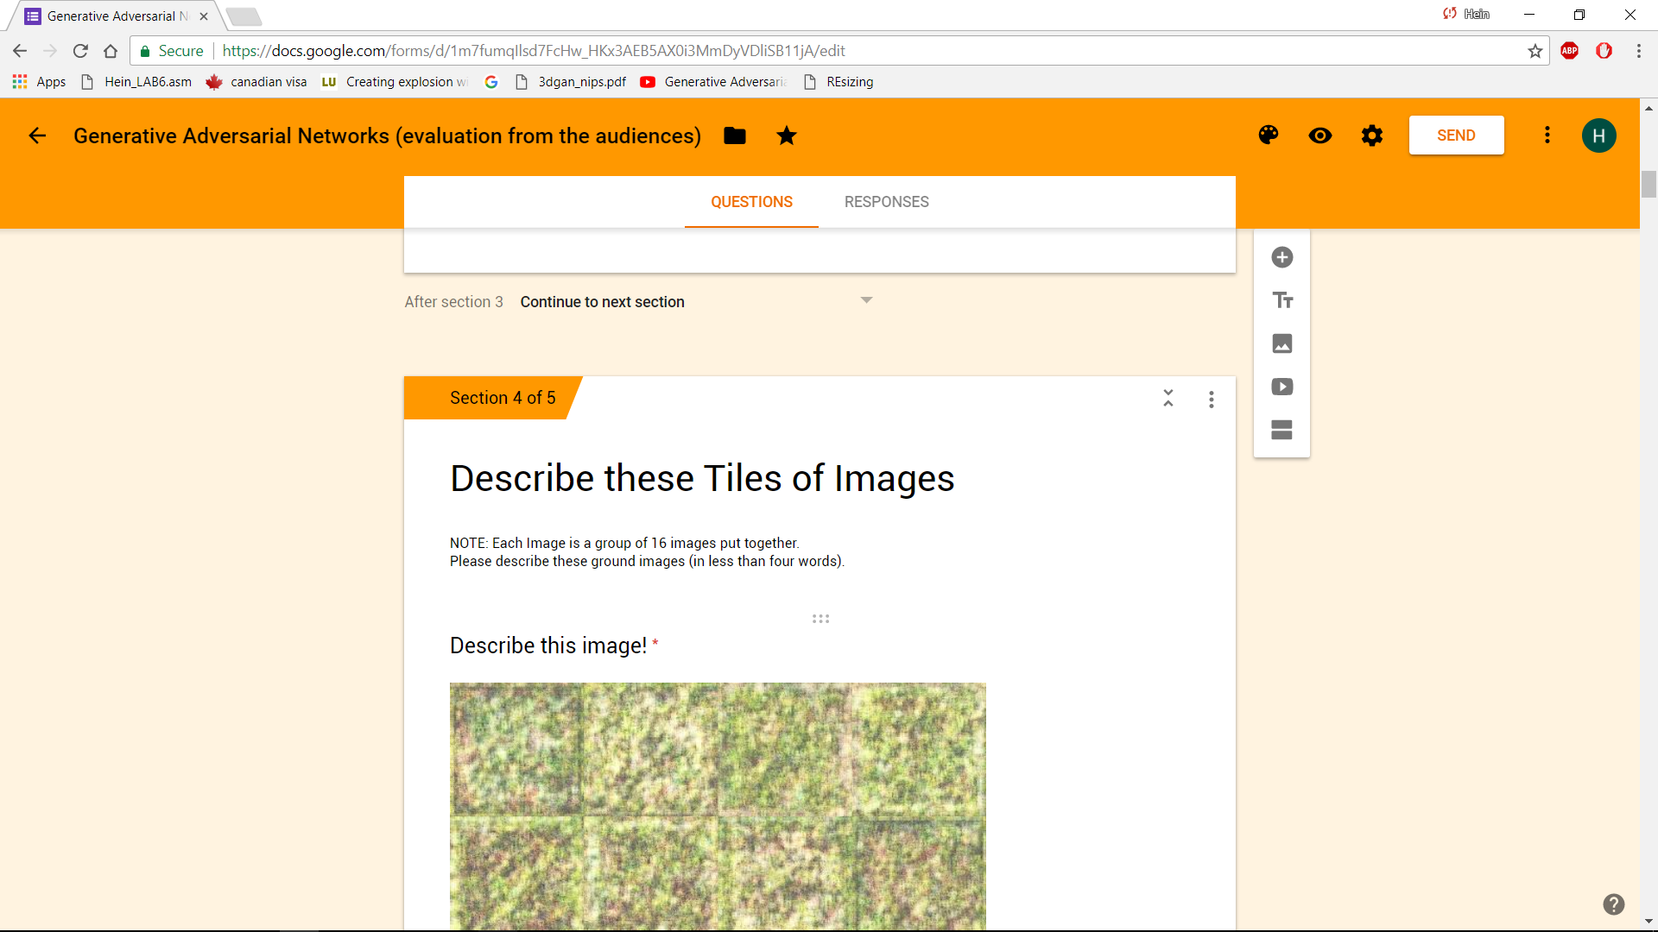
Design of the experiment and Evaluation

Slide 18
Design of the experiment and Evaluation

Slide 19
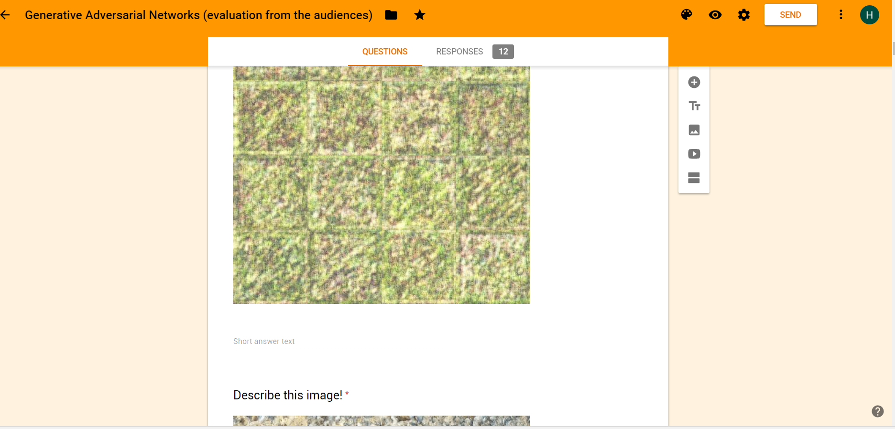
Design of the experiment and Evaluation

Slide 20
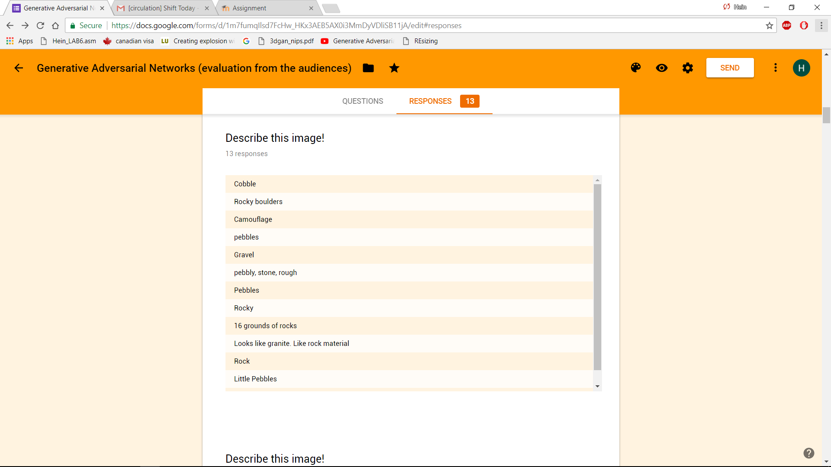
Design of the experiment and Evaluation

Slide 21
Future Work
Collecting evaluations from the campus
Analyze the evaluations and based on the responses, will determine my research question

Slide 22
Thank you
David Frey

