Slide 1
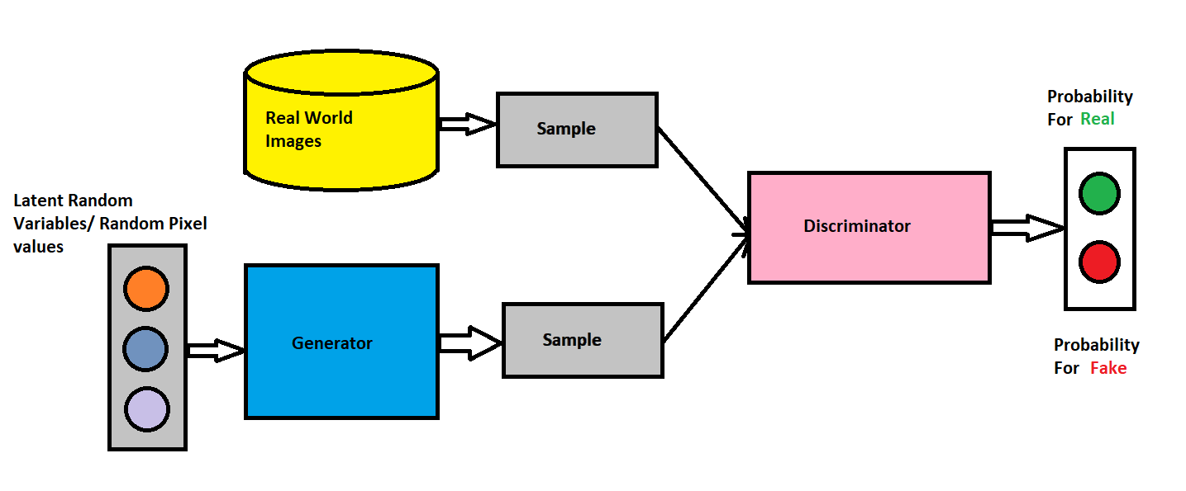
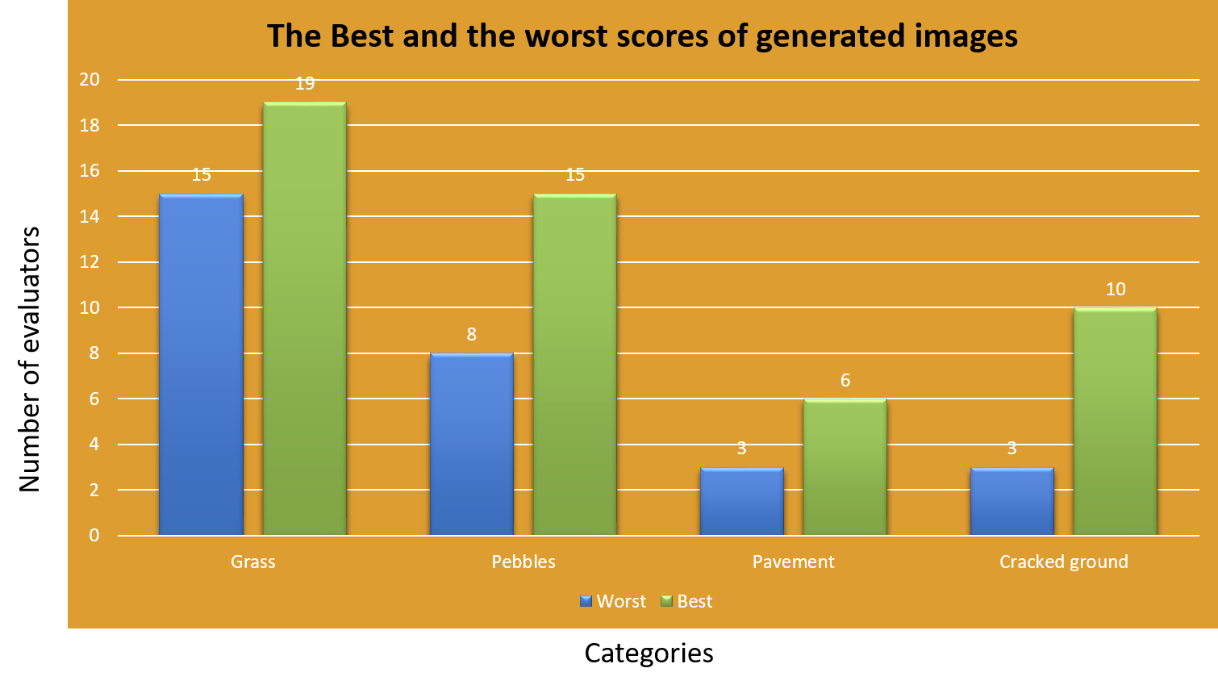
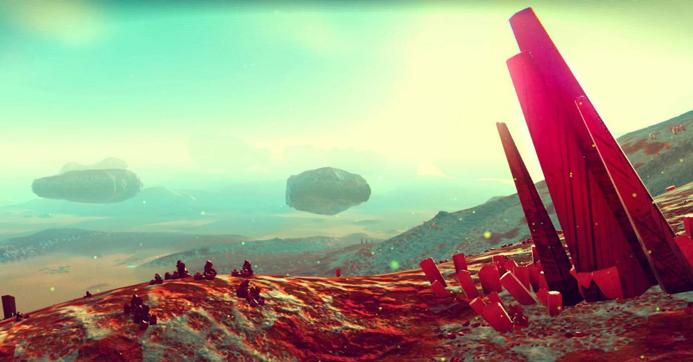
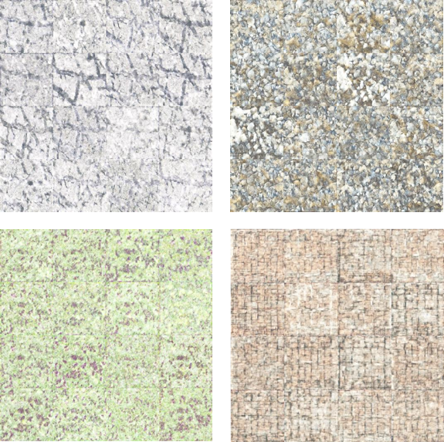
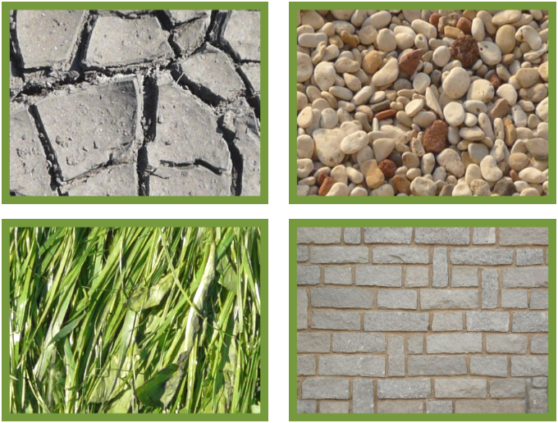
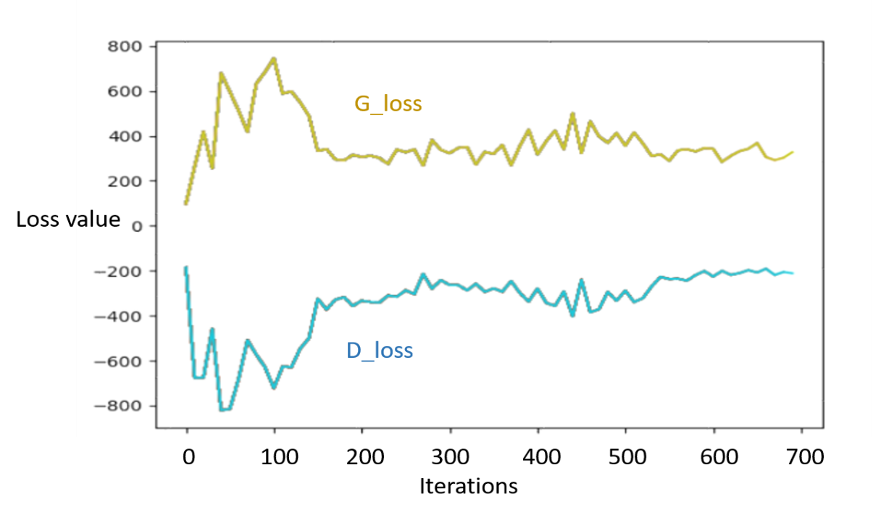
Generative Adversarial Networks for Dynamic Rendering of Terrain Textures
Hein H. Aung
Matt Anderson, Advisor
Introduction
Currently, most of the game world environments are hand-crafted by game designers. This greatly limits the extent to which the player can travel around since the human designer can only build the static game worlds to a limited extent. However, being able to train machine learning algorithms to learn about terrains is going to allow the game to dynamically generate new areas in the game.
Analysis of Evaluations
The results indicate that my GAN is capable of generating grass and pebbles since more than 75% think the generated images are real. For pavement and cracked ground, less than 50% of the evaluators thinks they don’t look realistic. In total, 56% of the Evaluators think the images are realistic.
Figure 3. Generative Adversarial Network (conceptual) [1][2][3][4] Generator creates image with random pixels and they are sent into the discriminator. The discriminator will compare these images with real images and decide if thy are fake or not.
Methodology
I sent out Google Forms with 30 generated images [4]. The evaluators are asked to write a short text description of each image. After I collected responses from 20 evaluators, I started analyzing (Table [1]).
Figure 1: No Man Sky, one of the games that uses procedural generation of terrains and has never-ending environment.
Table 1: A score distribution of four categories showing the best and the worst scores of all four.
Algorithm & Results
real_image = random_image
random_Input = random_Dimension
fake_image = generator(random_Input)
real_result = discriminator(real_image)
fake_result = discriminator(fake_image)
D_loss = fake_result - real_result
G_loss = - fake_result
while i <= Epoch do \\ Epoch = 2000
while j <= batch do \\ batch = 16
Update discriminator (D_loss)
Update generator (G_loss)
Future Work
I have limitations in my thesis, such as scale variation of input images. Due to the difference in the height of the images that was taken, the scale of objects in images are varied. I planned to find datasets that have the same scale. Moreover, the design of evaluation can be done better by using check box options for evaluators. Due to the freedom of text I have given to the evaluators, the a few of the responses were not helpful to analyze the evaluations.
Objective:
Can we create a generative adversarial networks (GANs) to dynamically render new images for different types of ground terrain textures (such as soil, grass plains). Given an input image, the GAN created will re-render a set of different variations images that is set on the original input terrain texture [1]. I created GAN based on Leon Gatys’[2] network algorithms (discriminator and generator) and the training algorithm is based on Raval’s pokeGAN training algorithm.
Acknowledgments
I would like to acknowledge Akshay Kashyap on the course for Deep Learning and CSC-231ln. Also David Frey for helping me out in CROCHET lab
References
[1] Grigory Antipov, Moez Baccouche, Jean-Luc Dugelay. Face aging with conditional Generative Adversarial Networks. 7, 2017
[2] Leon Gatys, Alexander Ecker, and Matthias Bethge. Texture synthesis using convolutional neural networks. In Advances in Neural Information Processing Systems 28, 2015
[3] Ian J. Goodfellow, Jean Pouget-Abadie, Mehdi Mirza, Bing Xu, David Warde-Farley, Sherjil Ozair, Aaron Courville, and Yoshua Bengio. “Generative Adversarial Nets”. In: (2014).
[4] Bengio, Y. (2009). Learning deep architectures for AI. Now Publishers
[5] Siraj Raval. Generative Adversarial Networks. 2017. Github.
[6] CSC-231n. CS23ln Convolutional Neural Networks for Visual Recognition. 2017. Stanford online course.
Figure 2: 4 categories are chosen. (1)cracked ground, (2)pebbles, (3)grass, (4) pavement as datasets
Figure 4: Generated Images of cracked ground, pebbles, grass, pavement at a certain point of loss value and a certain iterations

