Slide 1
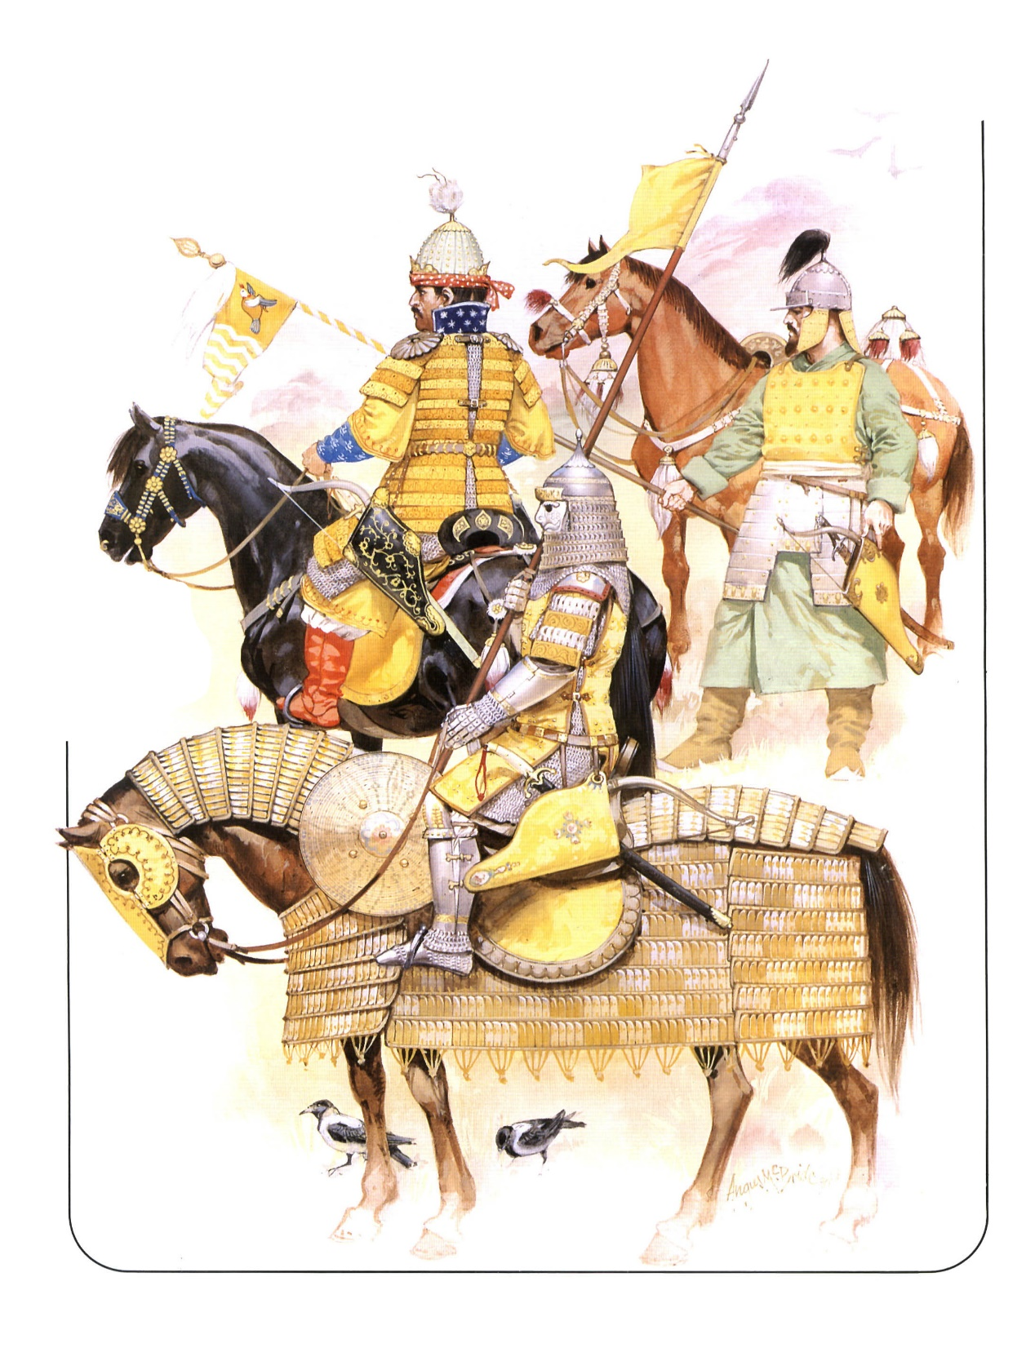
Multi-Agent Simulation of the Battle of Ankara, 1402
Ruili Tang
Advisors: Chris Fernandes,
Steven Sargent

Slide 2
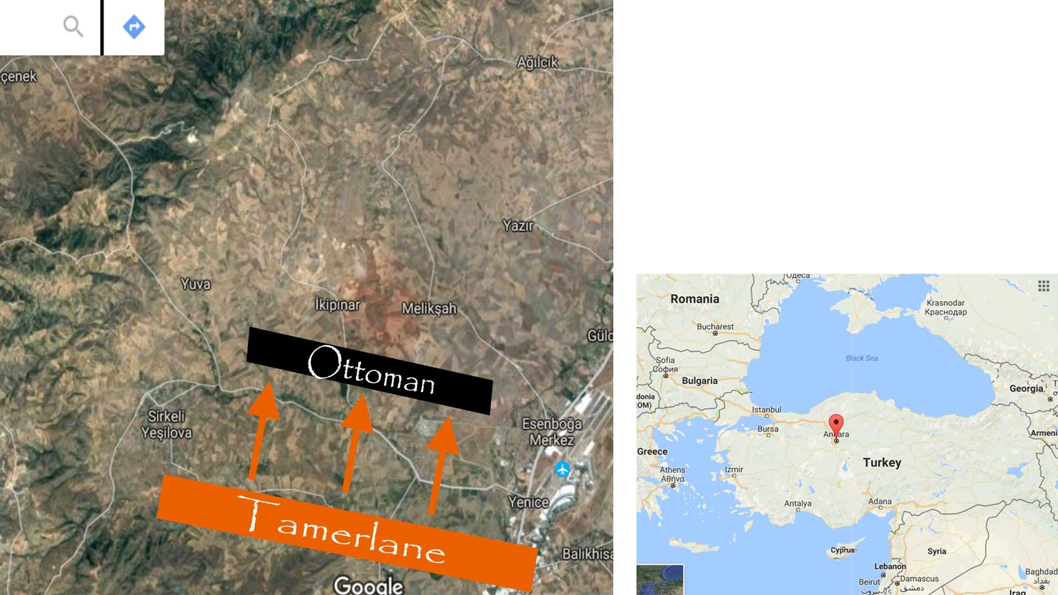
Ottomans | Tamerlane
86,400 | 150,000
Tamerlane WON!!!

Slide 3
Possible Reasons for Ottomans’ Defeat
Betrayal of several Ottoman units.
Ottoman size was much less than Tamerlane size.
The defensive position Ottoman took.
Ottomans drank from the well poisoned by Tamerlane
Ottomans got exhausted from forced march.
QUESTION: Which factor is most important to Ottomans’ defeat?

Slide 4

Simulation
Multi-Agent (116), each has 1500 soldiers
  Ottoman : 55 agents
  Tamerlane 61 agents
Takes into account
  Topography
  line-of-sight
  Melee and shooter
  Training and armor
  War elephant!

Slide 5
Analysis
Data set:
  4320 battles
  5 Attributes
  Result {Tamerlane Won, Ottomans Won, Draw}

Slide 6
Attribute | Effect
Ottomans endured a forced march | Ottoman agent fatigue++
Ottomans drank poisoned water | Ottoman agent size -- Ottoman agent morale --
Betrayal in Ottoman troops | An Ottoman agent becomes a Tamerlane agent. Also influence neighbor’s morale
Ottomans took a defensive position | Ottomans remain idle or attack at the start
Ottoman army could be bigger | Increase Ottoman size by a reasonable amount

Slide 7
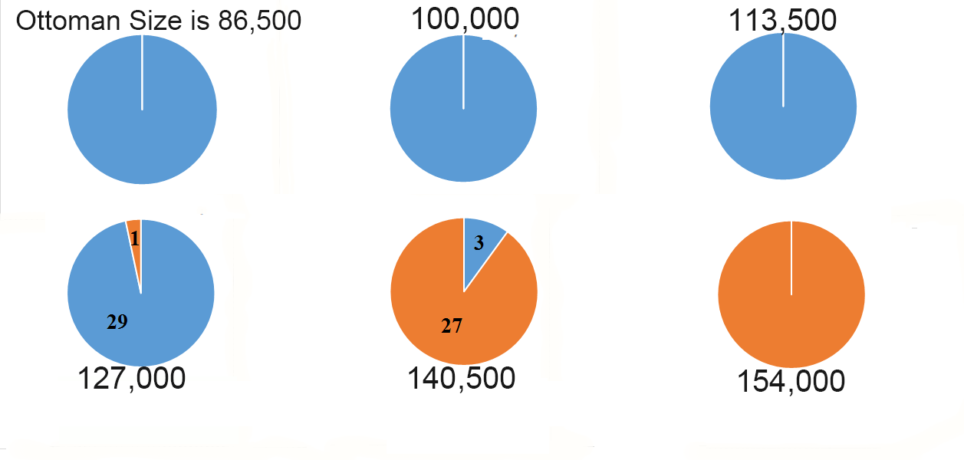
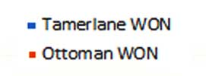
Influence of Size
Tamerlane Size is 150,000.

Slide 8
Influence Of Ottoman Tactics
Tamerlane Offensive
Ottomans Idle
(historical)
Offensive: move actively and search for opponents
Idle: does not move
Tamerlane Idle
Ottomans Offensive
Both Offensive

Slide 9
Influence of Betrayal
No Betrayal
Historically, betrayal took place
Given the best tactics and extra soldiers (upper pie chart)
Betrayal → Ottoman defeat
Betrayal!

Slide 10
WEKA Results (statistical analysis)
Classifier: J48
AttributeSelectClassifier
  InfoGain as the evaluator and Ranker as the search method
  Accuracy = 97.4306 %
Ranking:
  0.21926 Size
  0.21803 Betrayal
  0.01547 Offensive
  0.00175 Poisoned
  0 Forced March

Slide 11
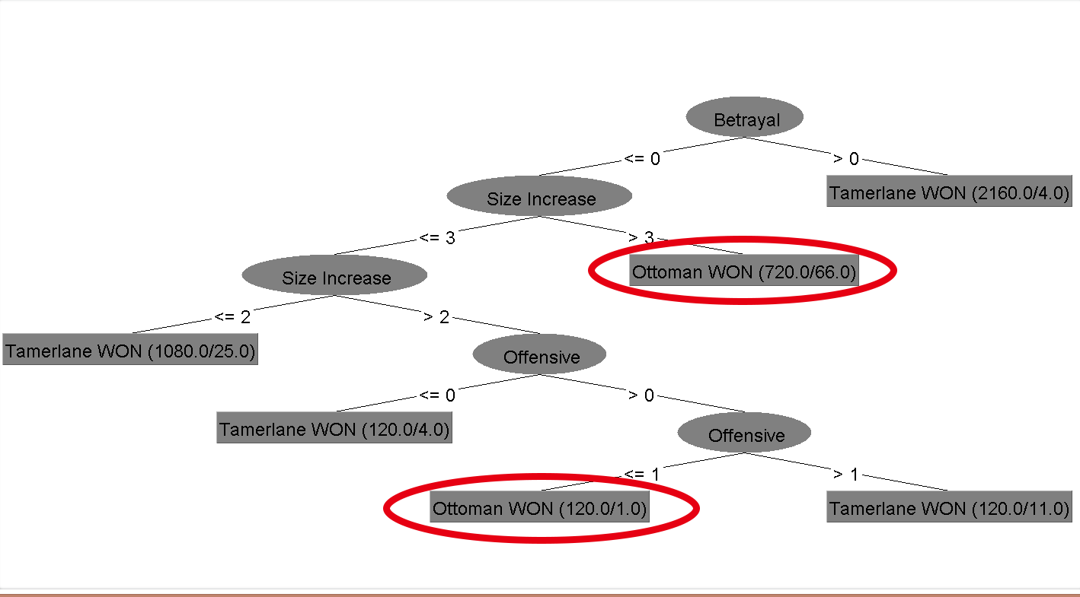
Counter-factual Results – Ottoman Victory
Ottomans Won
No Betrayal
Ottoman Size >127,000
Ottomans Won
No Betrayal
Ottoman Size = 127,000
Ottomans on the Offense,
Tamerlane Idle

Slide 12
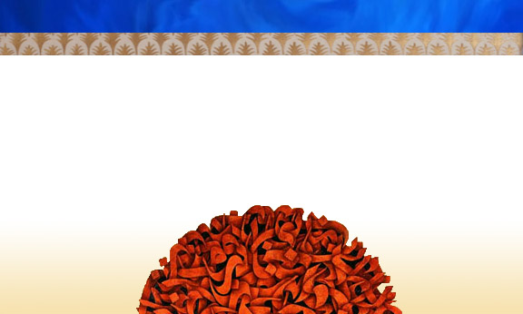
Counter-factual Result: Ottomans Win!
Attribute:
  No Betrayal
  Ottoman Size = 127,000
  Ottoman on the Offense,
  Tamerlane Idle
https://youtu.be/SEBn299iI6k

Slide 13

Conclusion
Most important factors: Size and Betrayal
Being on the offensive → more chance of winning
Counter-factual result if:
  No betrayal
  Ottoman has more soldiers
  Being Offensive

Slide 14

Thank you for your attention!

