Slide 1
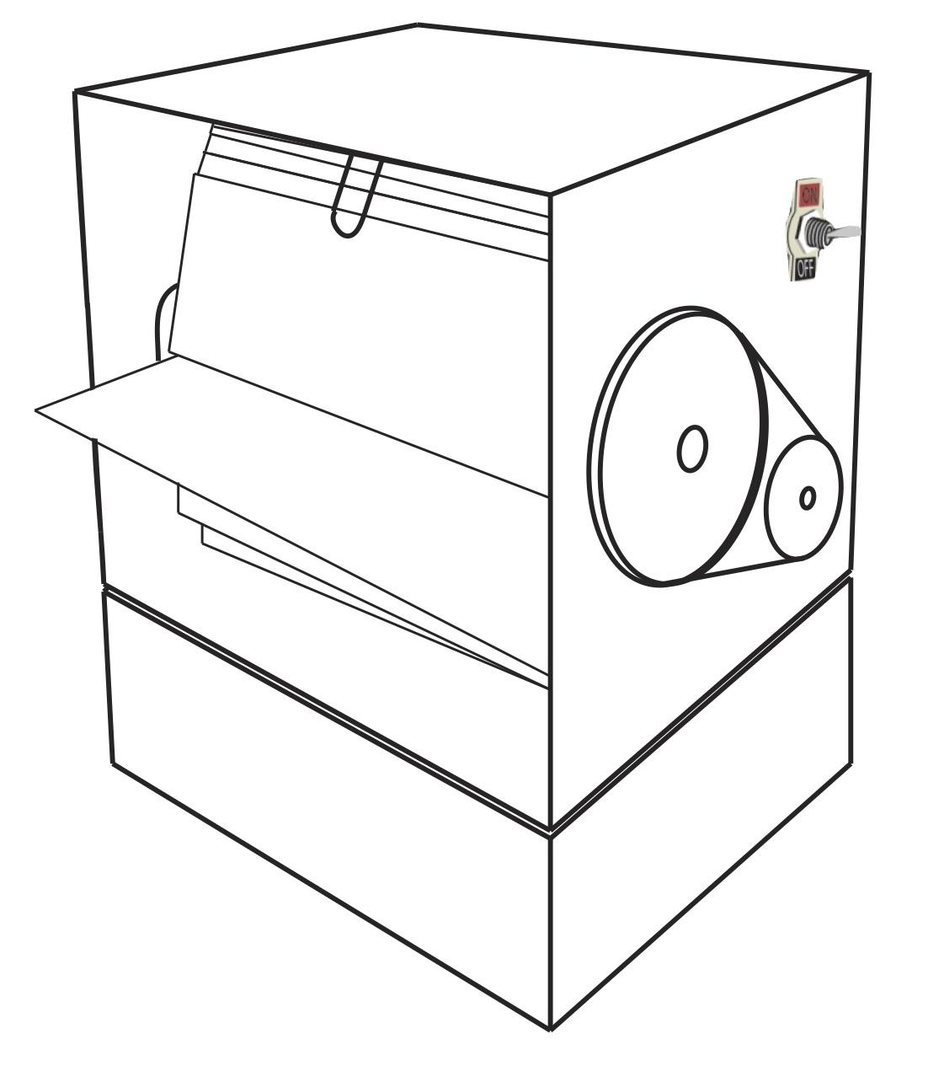
Flip Animated Road Sign
IDM-499
Yuki Shimano
Advisor: Professor Kristina Striegnitz

Slide 2
Introduction
How art and computer technology can be combined to make something helpful in everyday life.
Road sign design and imagery

Slide 3
Thesis Scope
Improve currently existing road sign imagery using:
dynamic motion (animation),
and without a digital display[1][2][3].
Idea from Cian et al, 2015.
Example of showing dynamic motion in road signs:
An even better way of showing dynamic motion in road signs:

Slide 4
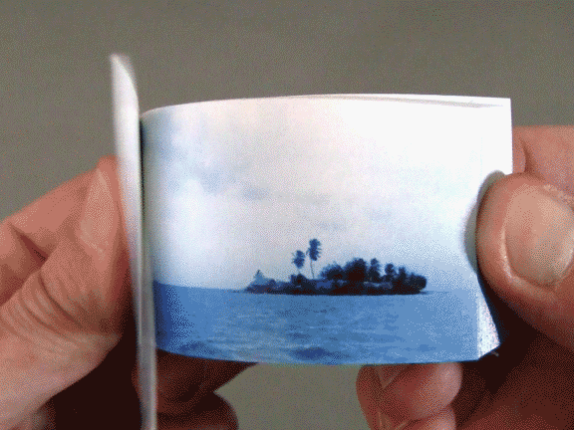
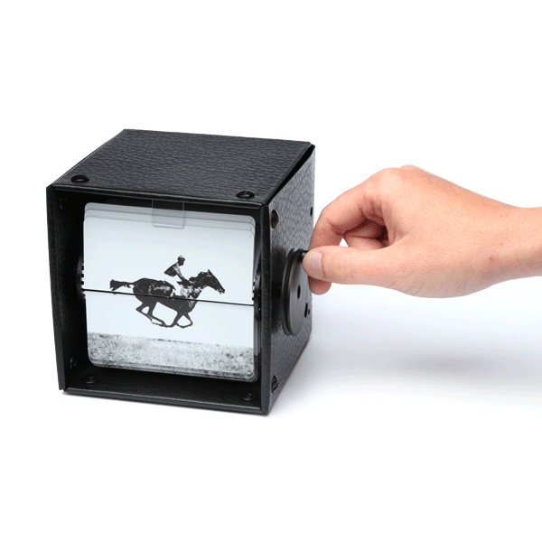
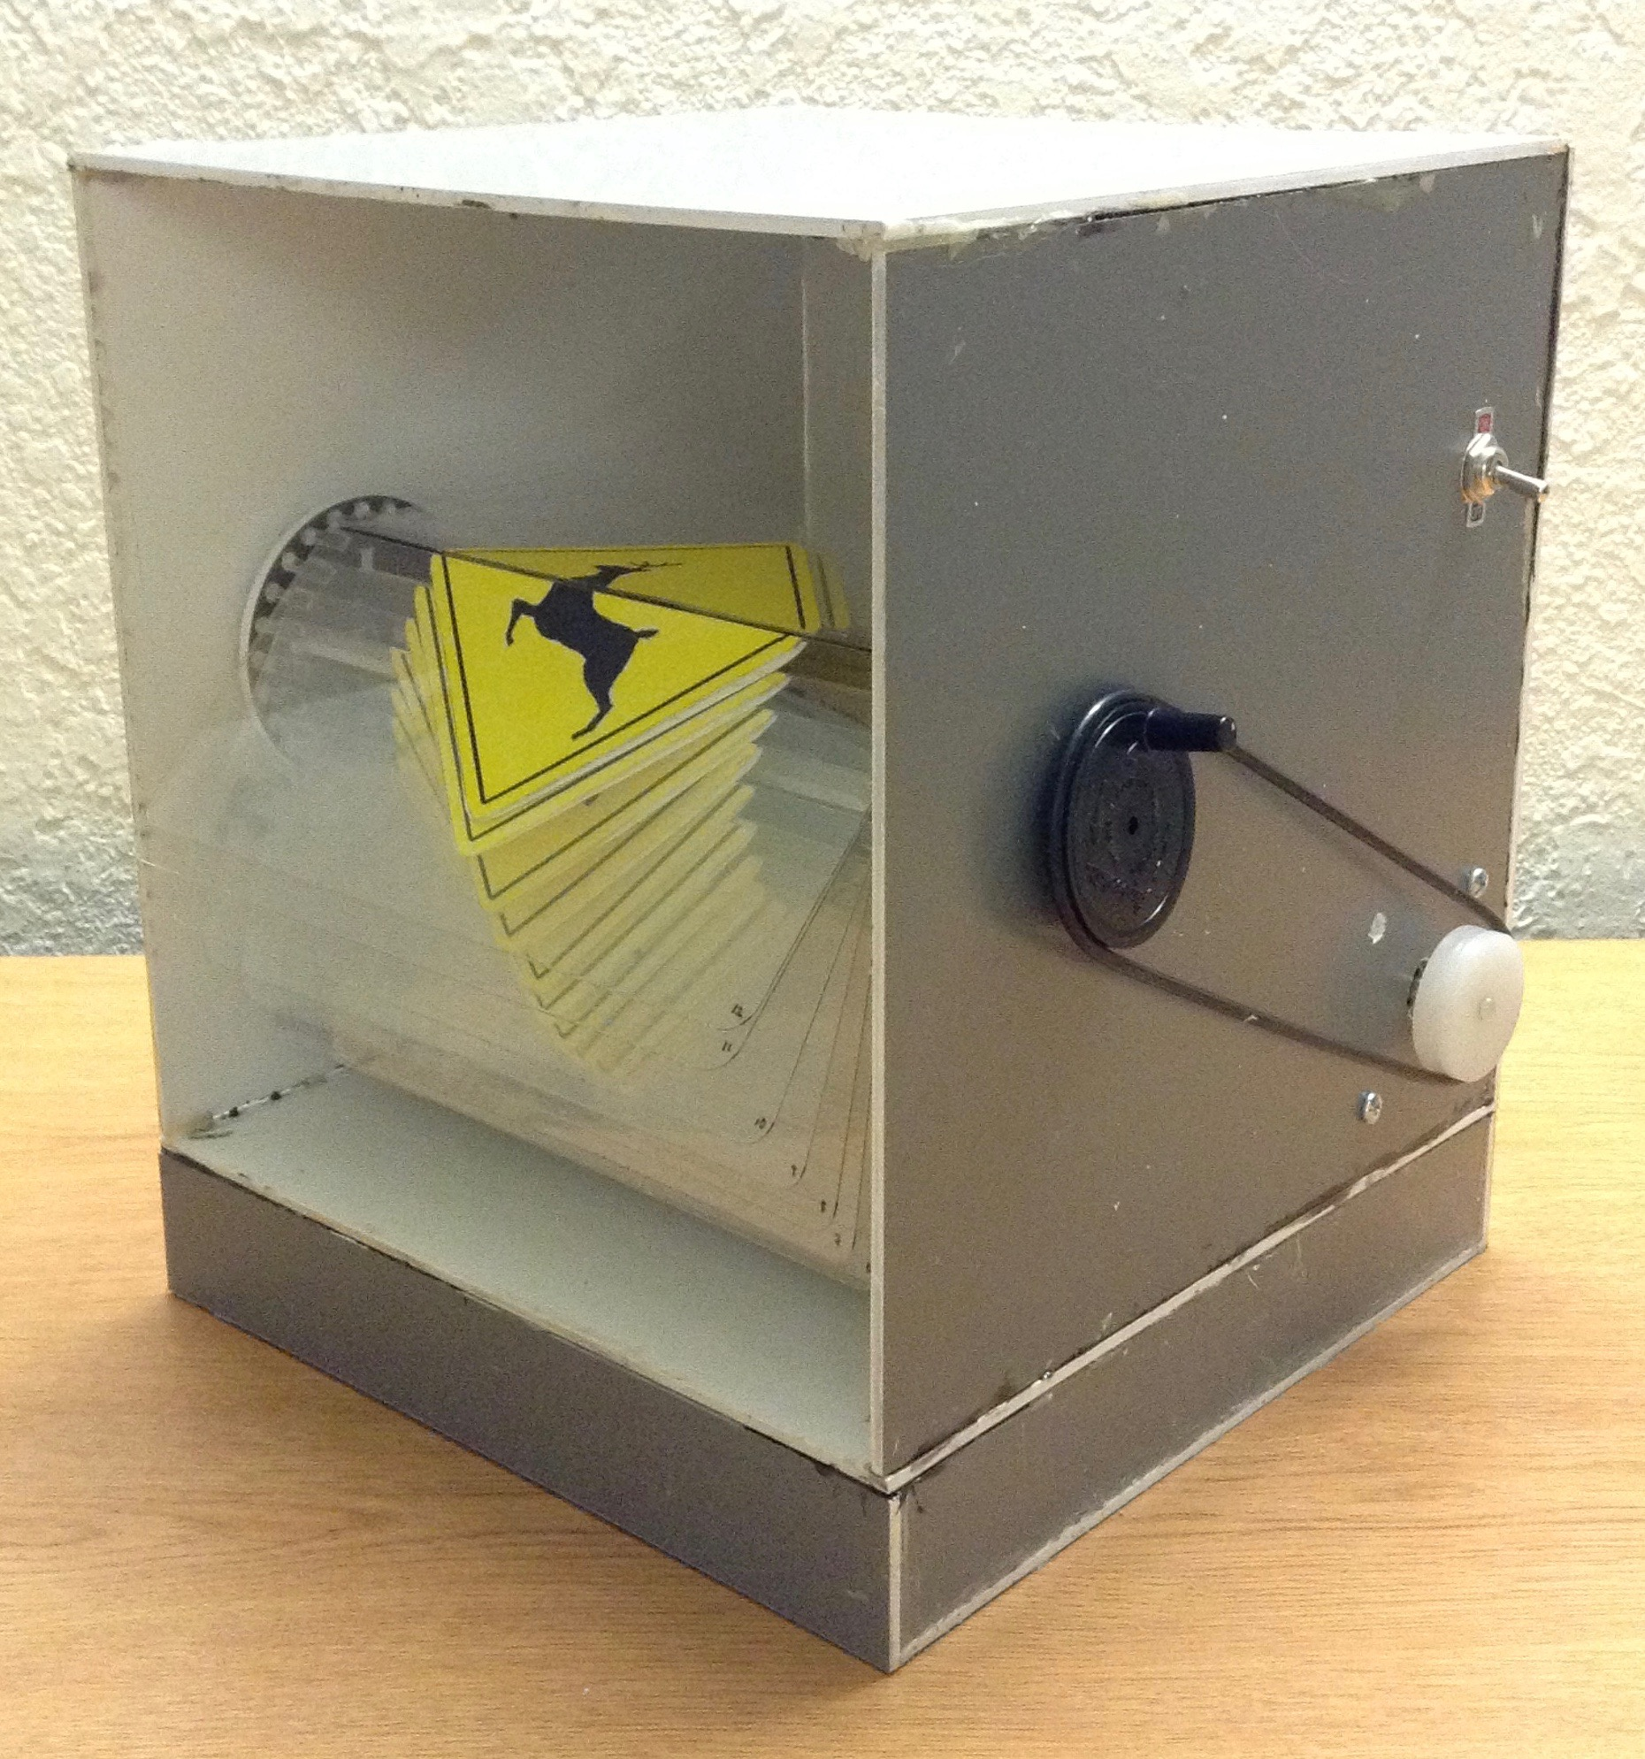
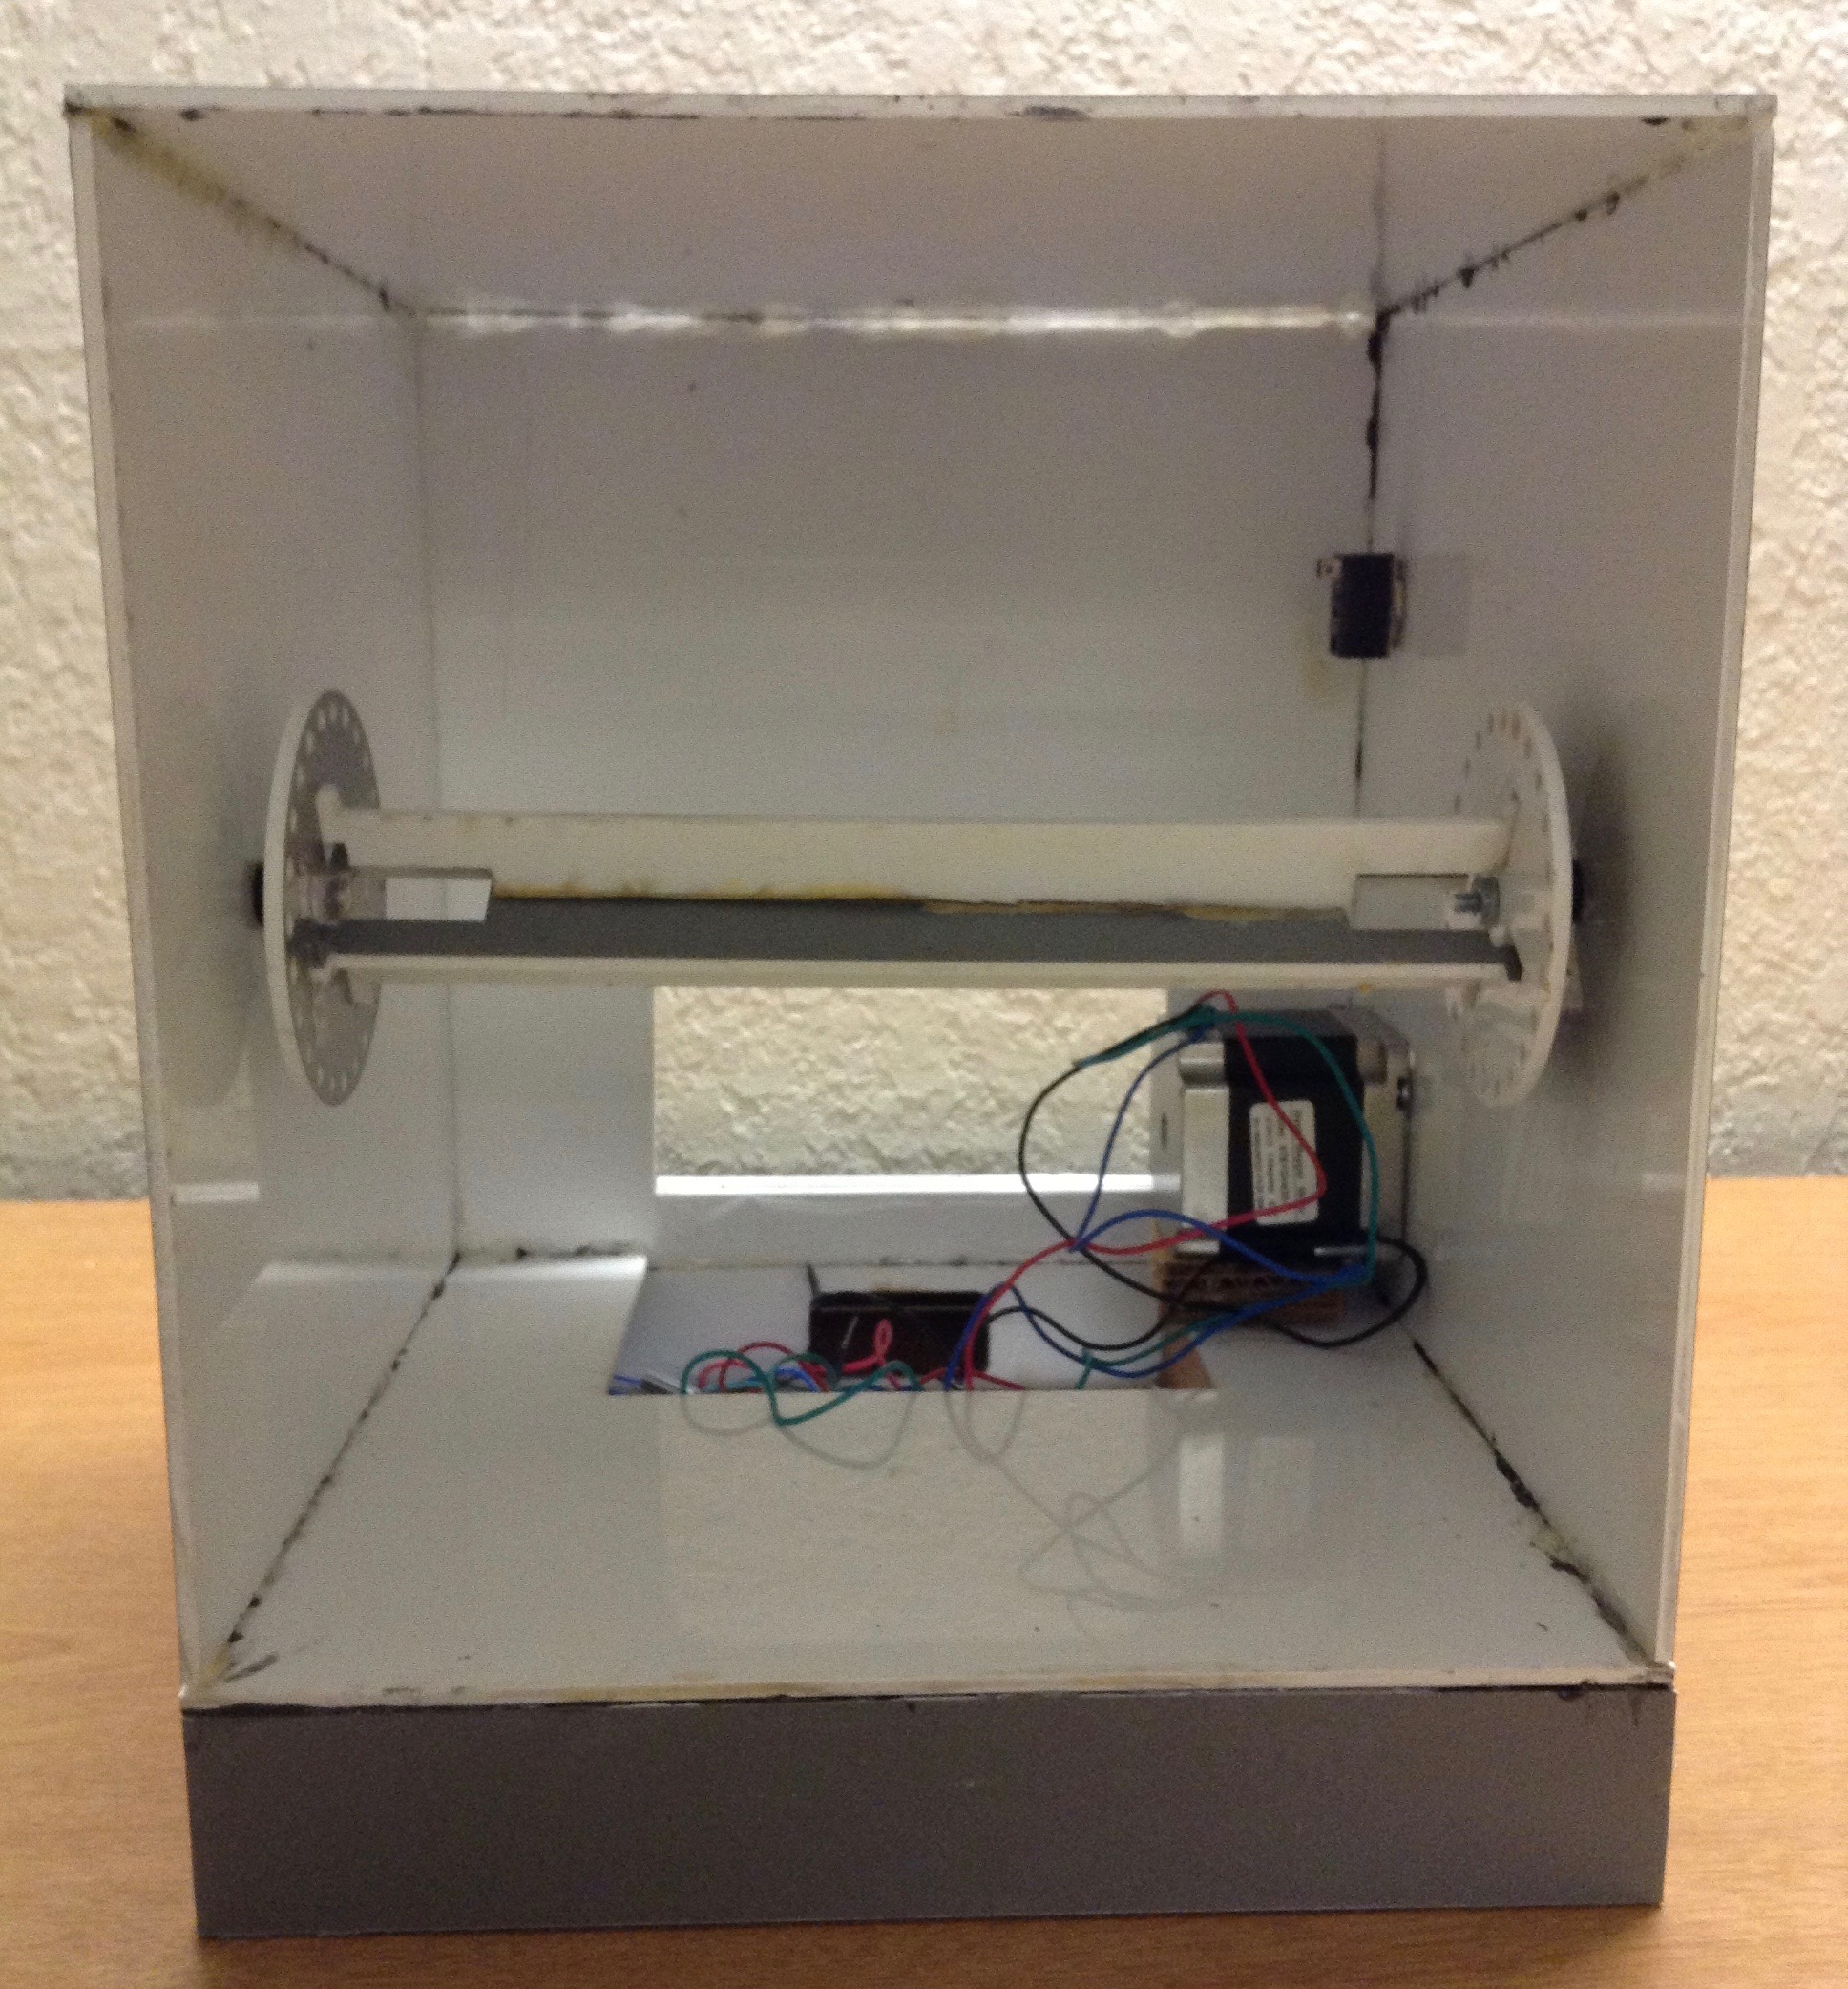
Method
using dynamic motion (animation), and without a digital display…
Featured the art of flipbook animation.
My Flip Animated Sign Device
Notes:
The method I proposed to make an animated road sign without the use of a digital display is to use a mechanism very similar as a mechanical flip book, except a stepper motor is used to make it operate automatically, and programmable and controllable with an arduino to make the flip animation stop at any specific slide. The outside box of my device is made with this grey acryllic sheet, and so is the spindle that the slides are attached to, The material of the slides are plastic. After choosing a currently existing warning sign that I wanted to animate, I designed the animation, planned how to divide it between 24 slides that the device can hold, and after testing and revising on a smaller prototype, I painted it to a larger size and glued it to each slide. From the art perspective, this device incorporates not only icon designing and painting for each image slide, but also the primitive form of animation using flip books. Benefits of incorporating this early motion picture device can be that its attractive animation will give the viewer the moment to stop in order to look at the unfamiliar animation, and as a result slow down.

Slide 5
Method
4 types of signs that were made:

Slide 6
Experimental Procedure
Similar test as Cian et al’s experiment
Task 1: Response Time Study
Task 2: Perceived Risk Study
47 Participants

Slide 7
Task 1: Response Time Study

Slide 8
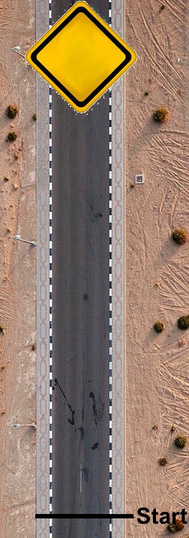
Task 2: Perceived Risk Study
Bird’s eye view of road used in Task 2.

Slide 9
Results/Conclusion
Hypothesis Unproven
Non-related t-test → no statistical difference between flip animated signs regular still signs.

Slide 10
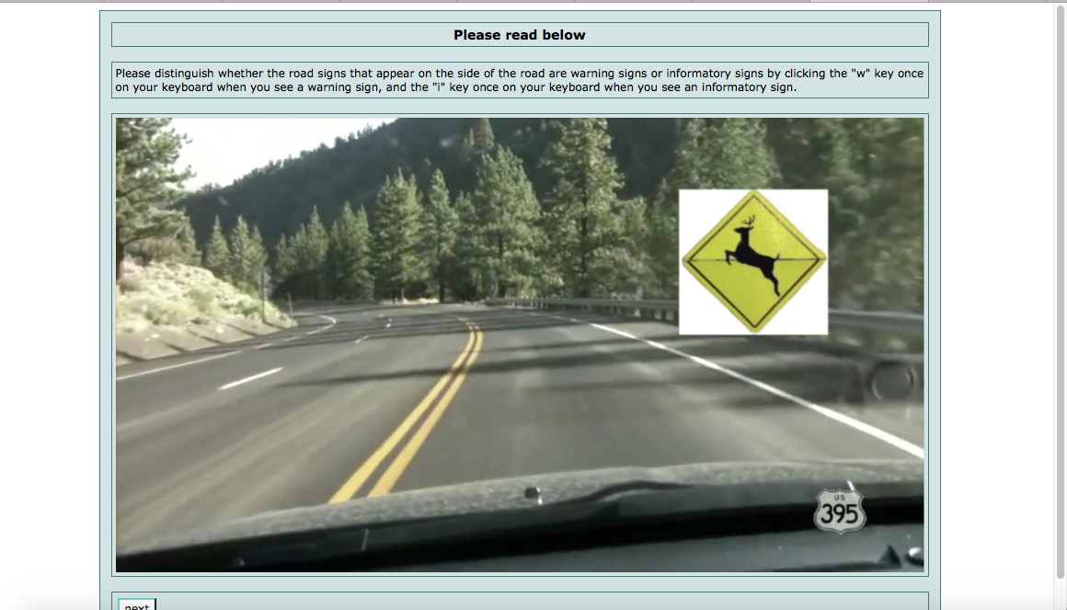
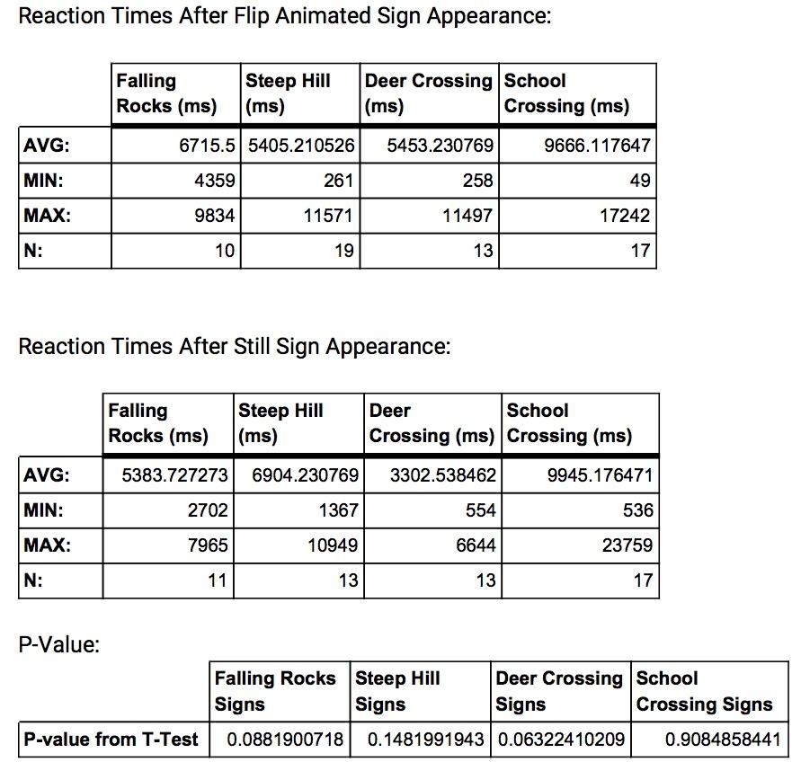
Results/Conclusion
From Task 1: Response Time Study
Not necessarily faster reaction times for flip animated sign

Slide 11
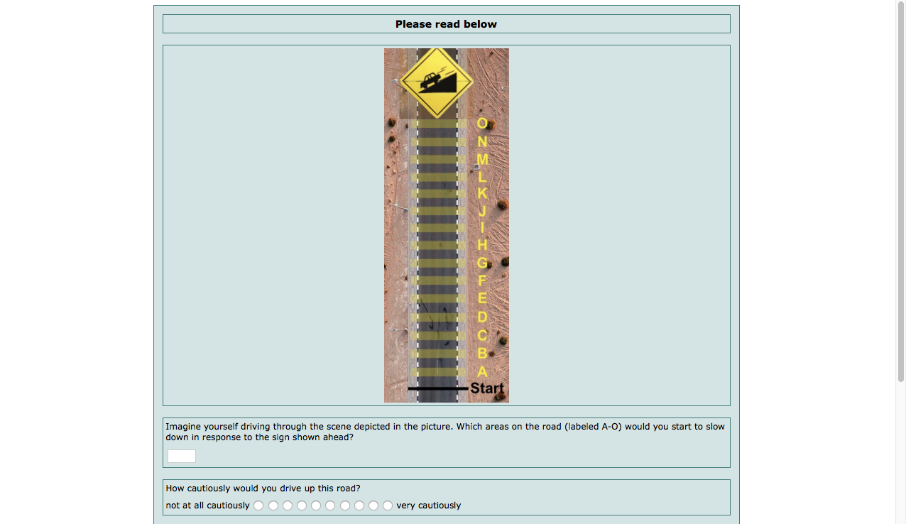
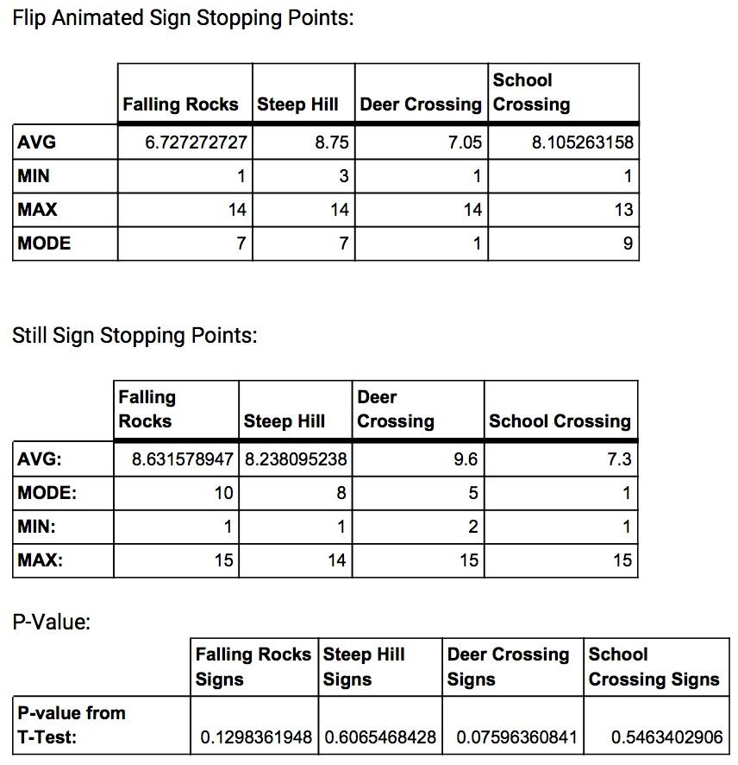
Results/Conclusion
From Task 2: Perceived Risk Study
Deer Crossing and Falling Rocks had more perceived risk
Signs with less perceived risk:

Slide 12
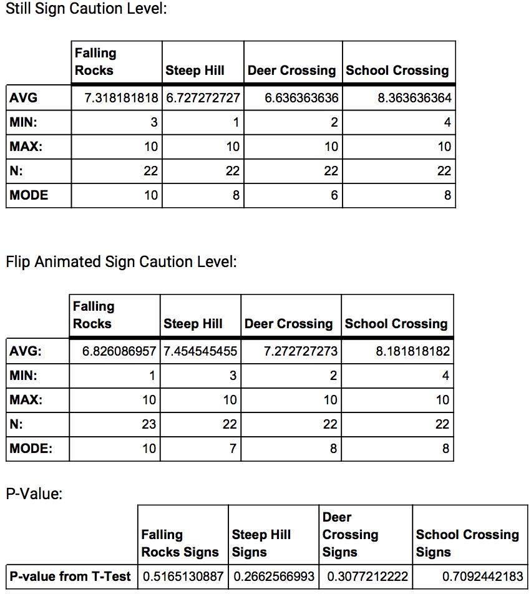
Results/Conclusion
From Task 2: Perceived Risk Study
Higher Caution levels for Deer Crossing and Steep Hill Flip Animated Sign

Slide 13
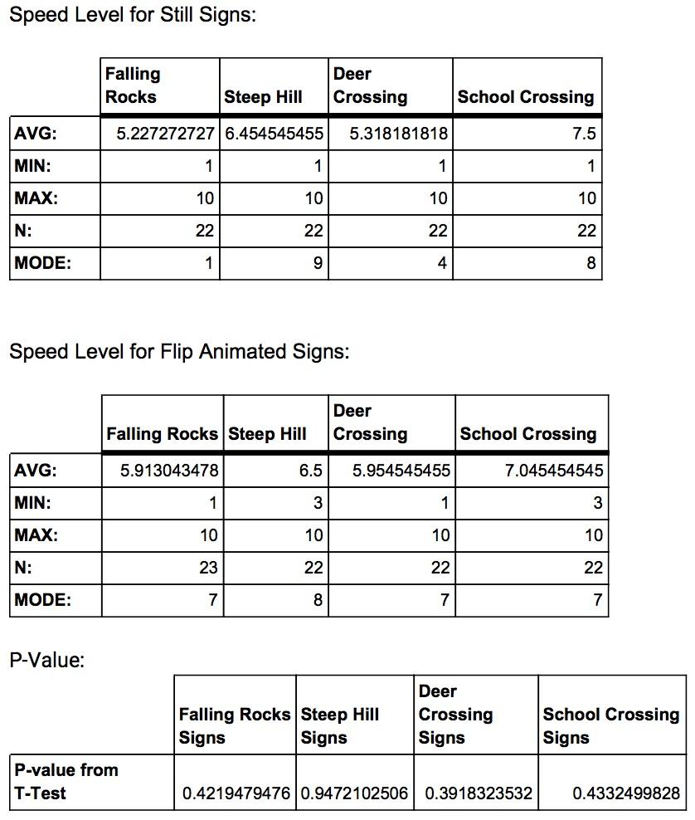
Results/Conclusion
From Task 2: Perceived Risk Study
Majority of Flip Animated Sign (except school crossing) slowed the speed of drivers

Slide 14
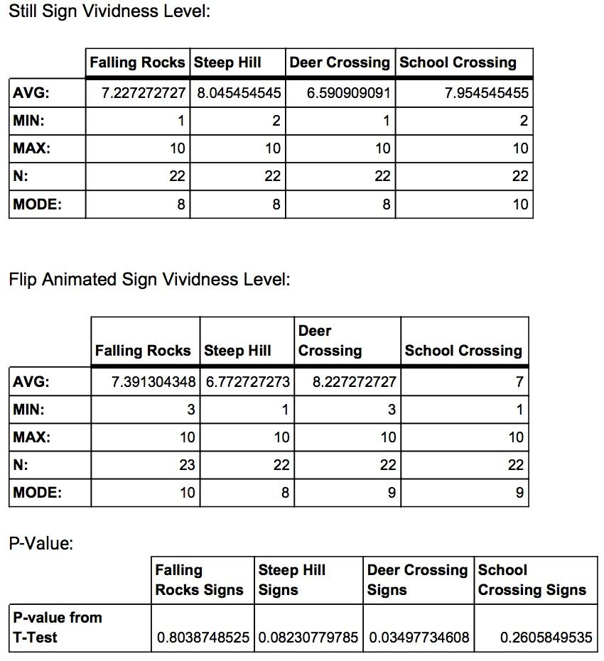
Results/Conclusion
From Task 2: Perceived Risk Study
No misinterpretation caused by the Flip Animated or Icon Design.

Slide 15
Other Conclusions
Attentive?
User-friendly?
Visually pleasing?
Non-distracting?
Energy saving?

Slide 16
Future Work
Study the effects of color in signs.
Study the ranges of dynamic motion
Deer Crossing and Falling Rocks had more perceived risk
Not necessarily faster reaction times for flip animated sign
3. Inform participants of reaction time test
4. Build using sturdier materials.
5. More participants

Slide 17
Thank you. Questions?

Slide 18
References
[1] L. Can, A. Krishna, and R. S. Elder, "A Sign of Things to Come: Behavioral Change through Dynamic Iconography," Journal of Consumer Research, vol. 41, p. 1427, Apr. 2015.
[2] J. Pratt, R. A. Abrams, and P. V. Radulescu, "It’s Alive!: Animate Motion Captures Visual Attention," Psychological Science, vol. 21, pp. 1724–1730, Oct. 2010.
[3] T. Greene and A. Valentini, "Wide Format Print vs. Digital Display – Part 1," Info Trends, pp. 1–10, Dec. 2013.

