Slide 1


Measuring the Complexity of ANN-produced Evolutionary Designs
John Peterson
Advised by Prof. John Rieffel

Slide 2
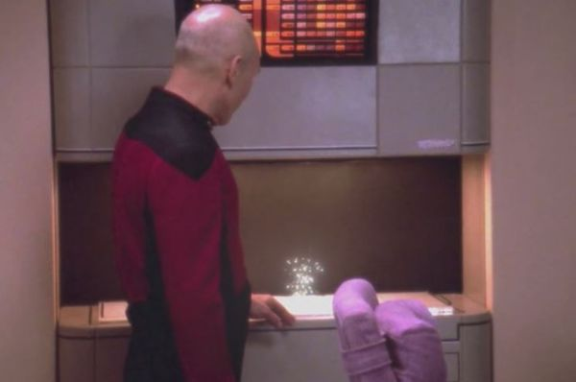
Vision

Slide 3
EvoFab System

Slide 4
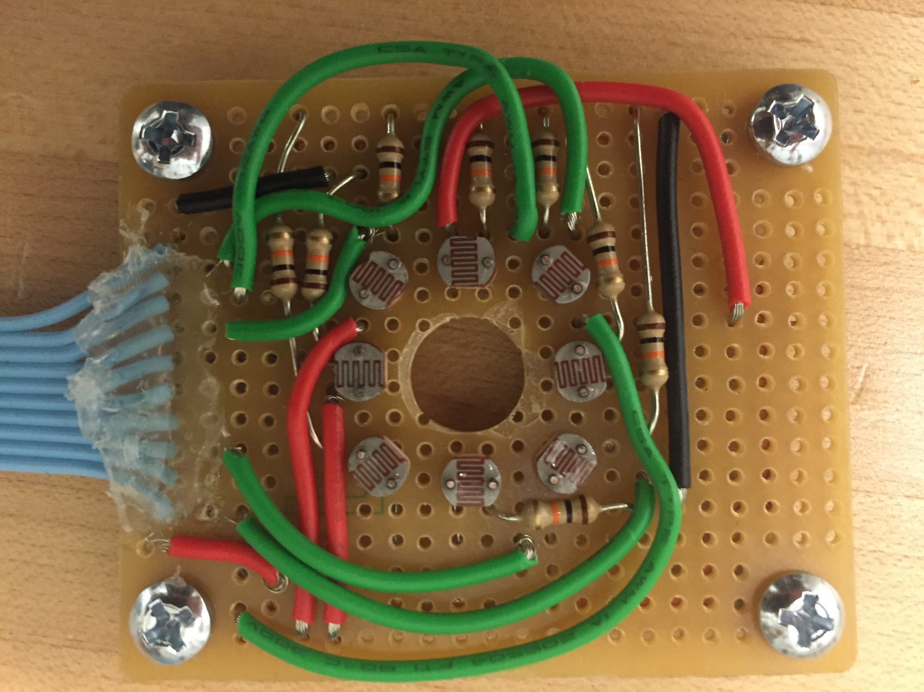
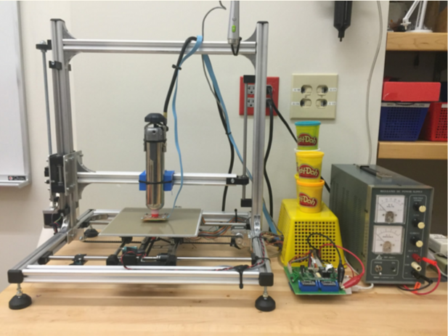
EvoFab System

Slide 5
Procedure for Optimization

Slide 6
Fundamental Open Question
What is the relationship between the structural characteristics of ANNs, and the “complexity” of the geometric outputs they can produce?

Slide 7
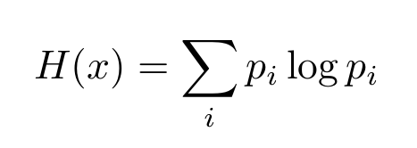
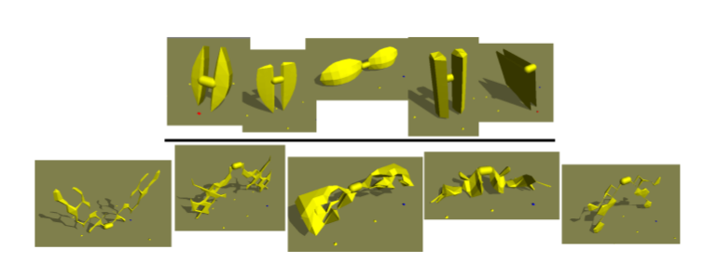
“Shape Complexity”
Shannon entropy of curvature
Page et al. 2003
Auerbach and Bongard 2012
  (Morphological Complexity)

Slide 8
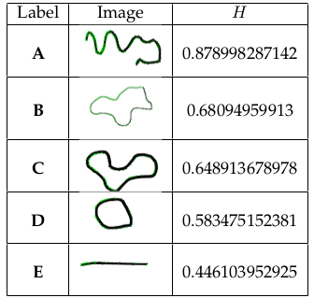
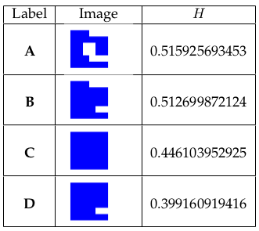
Morphological Complexity

Slide 9
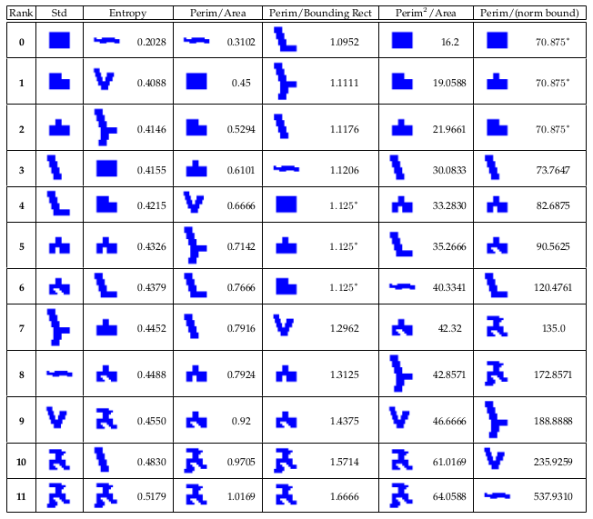

Slide 10
Candidate Measures
Perimeter^2 / Area
Perimeter / ((perimeter of bounding rect)/ area of bounding rect)

Slide 11
Optimizing ANNs to Geometric Measures
ANN Parameters:
number of hidden nodes
recurrence
global location information as input
(With both candidate geometric measures as fitness functions)

Slide 12
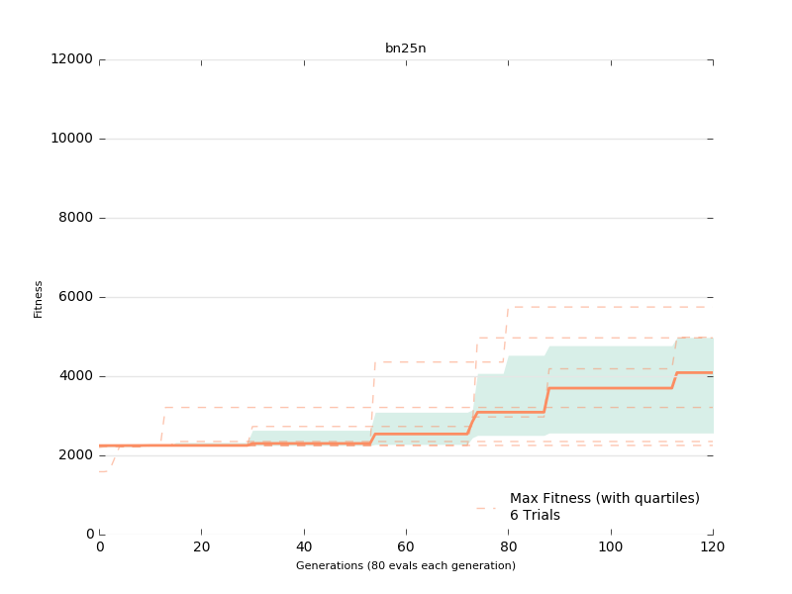
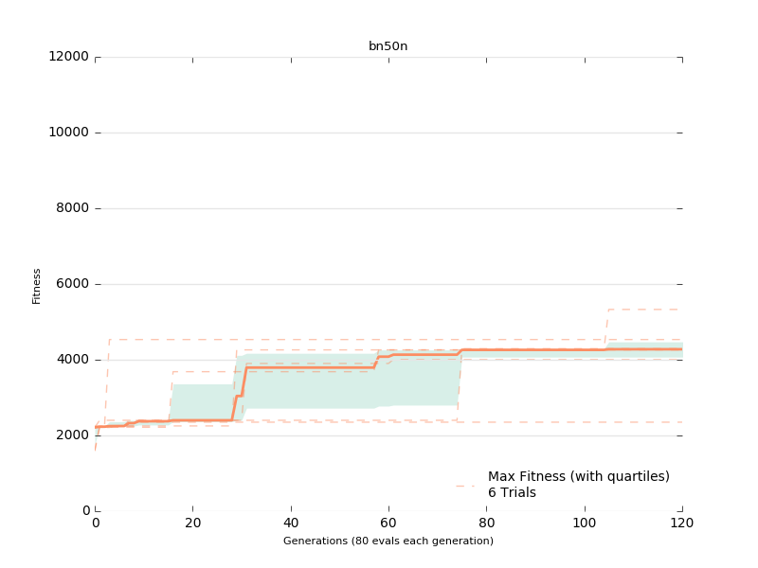

Slide 13
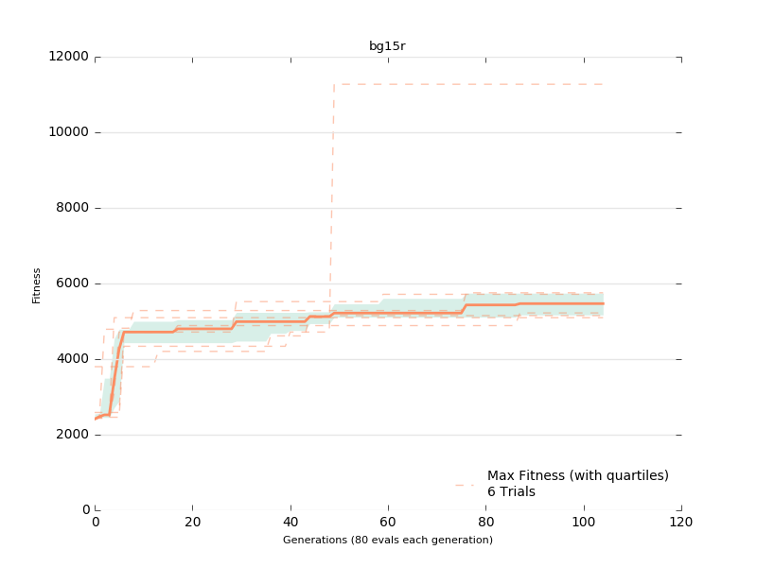
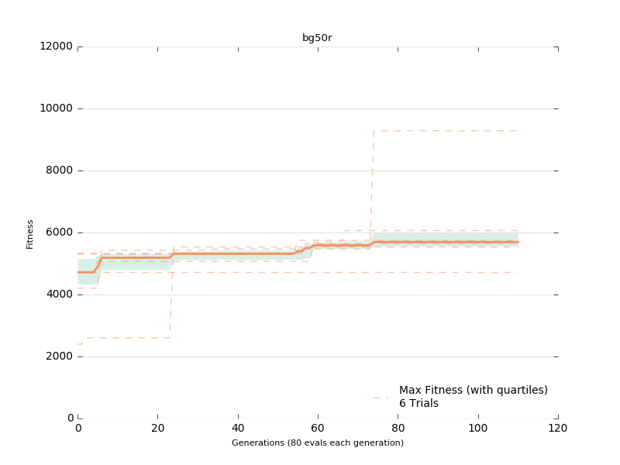
Initial Results (complex ANNs)

Slide 14
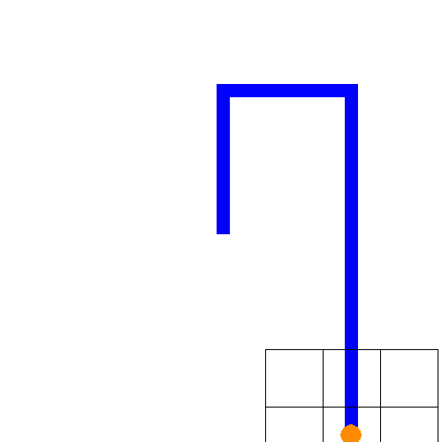
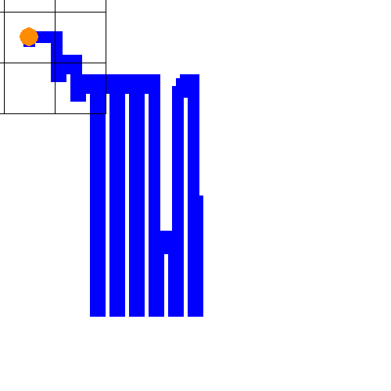

Slide 15
b(result) = 11270.76
p(result) = 435.05

Slide 16
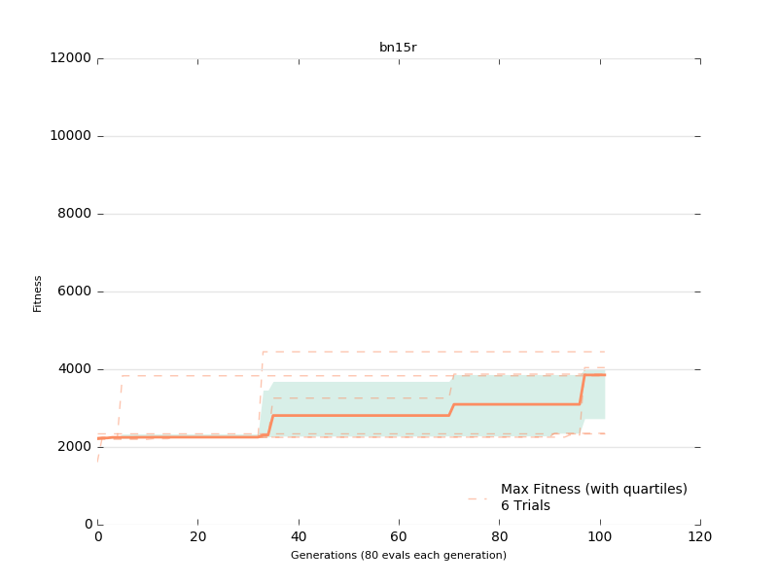

Slide 18
Conclusions And Future Work

Slide 19
Questions?

