Slide 1
Identifying Confusion from Eye-Tracking Data
Yupeng Lan
Advisor: Matthew Anderson

Slide 2
How to Build A Complex Model, Conceptually...

Slide 3
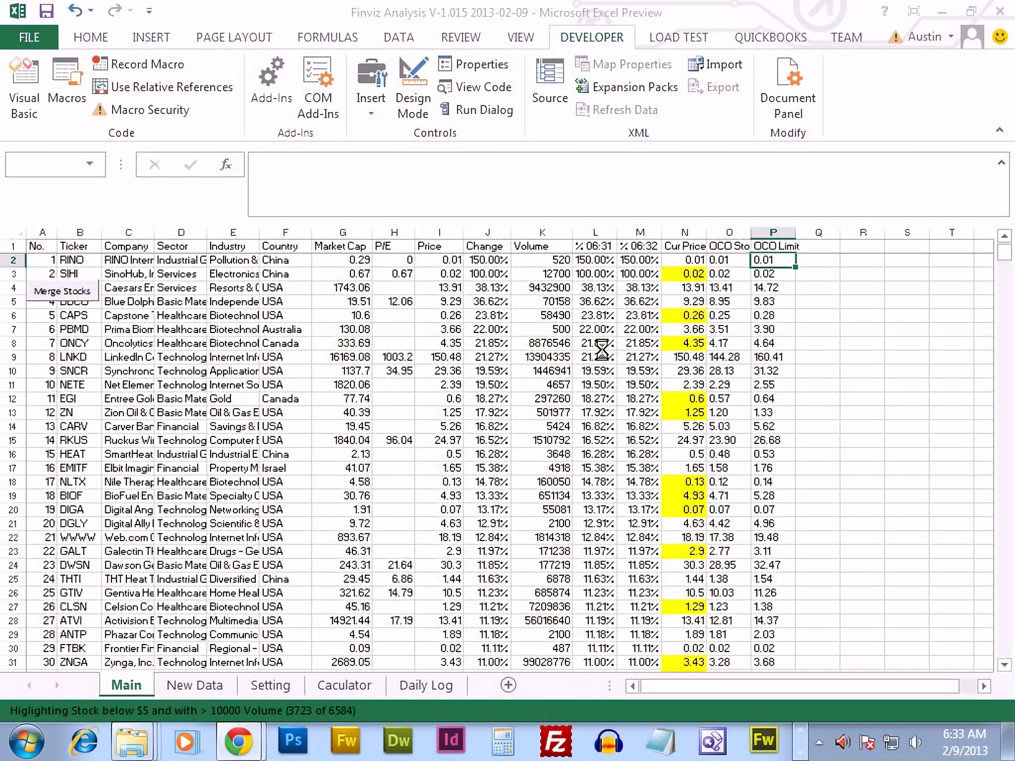
Collect Some Data

Slide 4
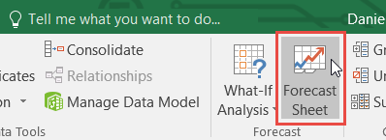
Find a button to do stuff you want

Slide 5
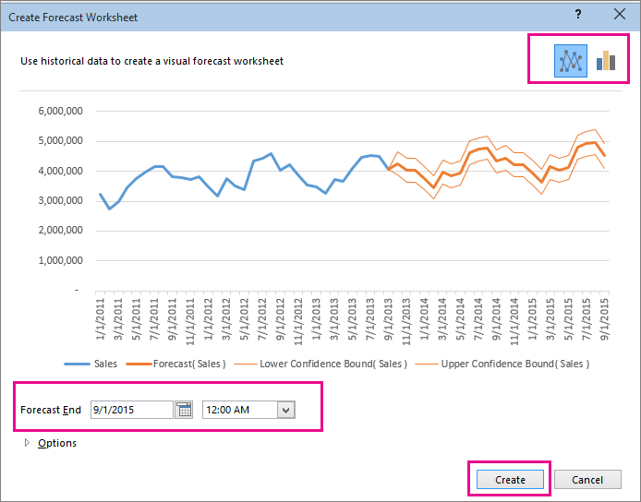
Adjust Parameters in menus

Slide 6
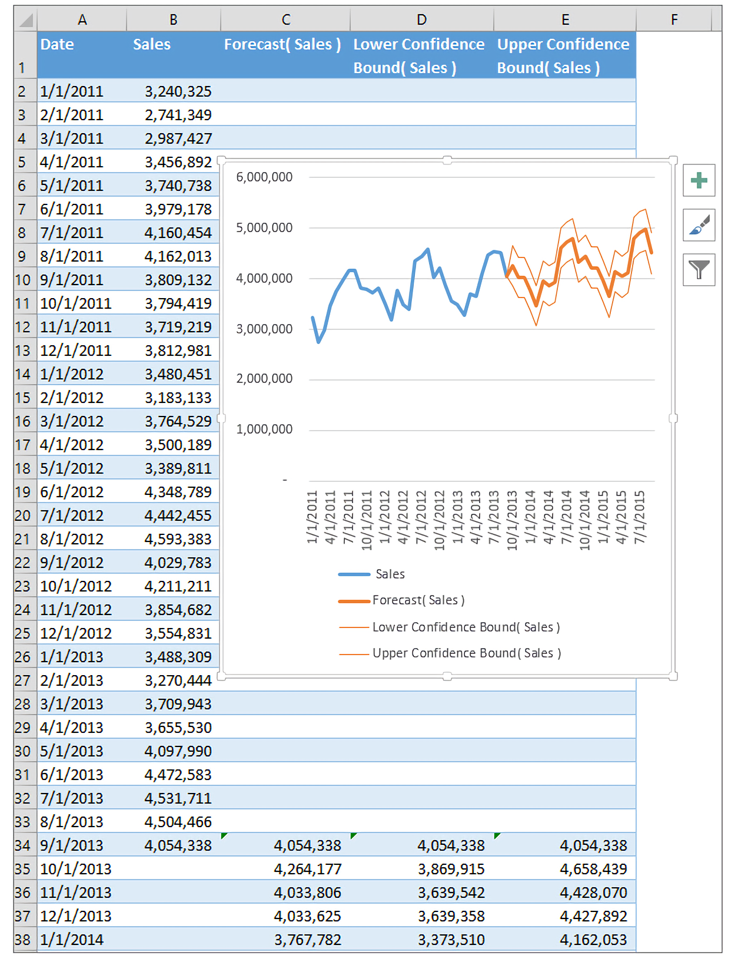
Then here is your model

Slide 7
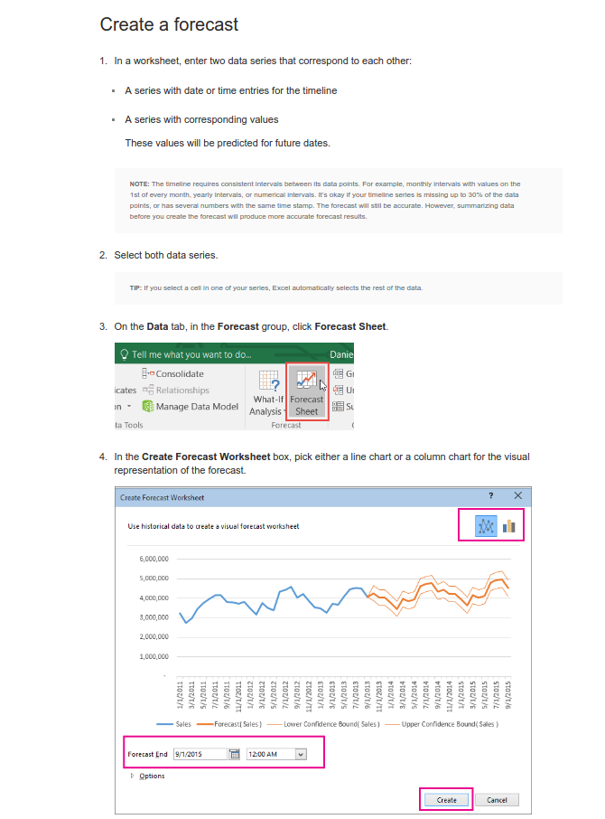
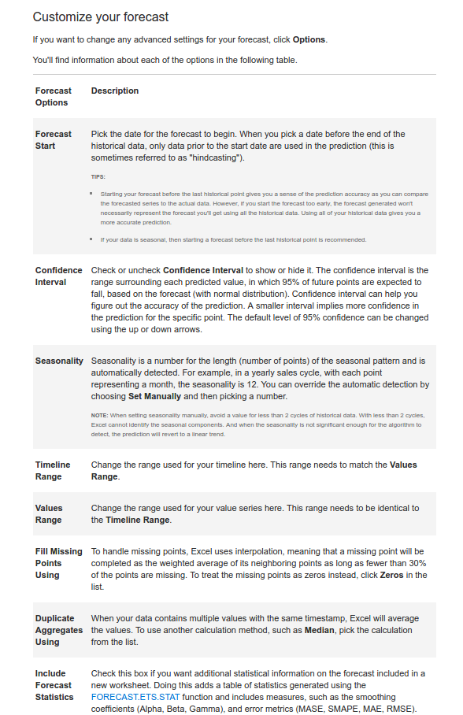
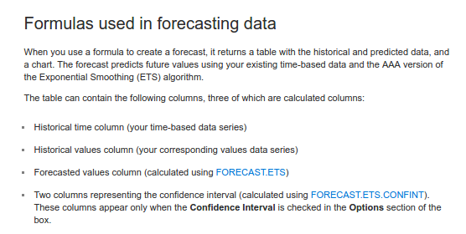
Sounds easy! But...

Slide 8
What if you get stuck?
Consult Google or other online resources
Find your friend
Try some automated help

Slide 9
A bad intelligent assistant

Slide 10
An observation
User Interface can be unfriendly
Immediate help may not available
Automated help is unsatisfactory

Slide 11
What we want is...
A more interactive UI
Software need to be friendly to users
UI can provide help in real time

Slide 12
A small step to make better UI
Understand what indicates confusion
Build a model to recognize confusion

Slide 13
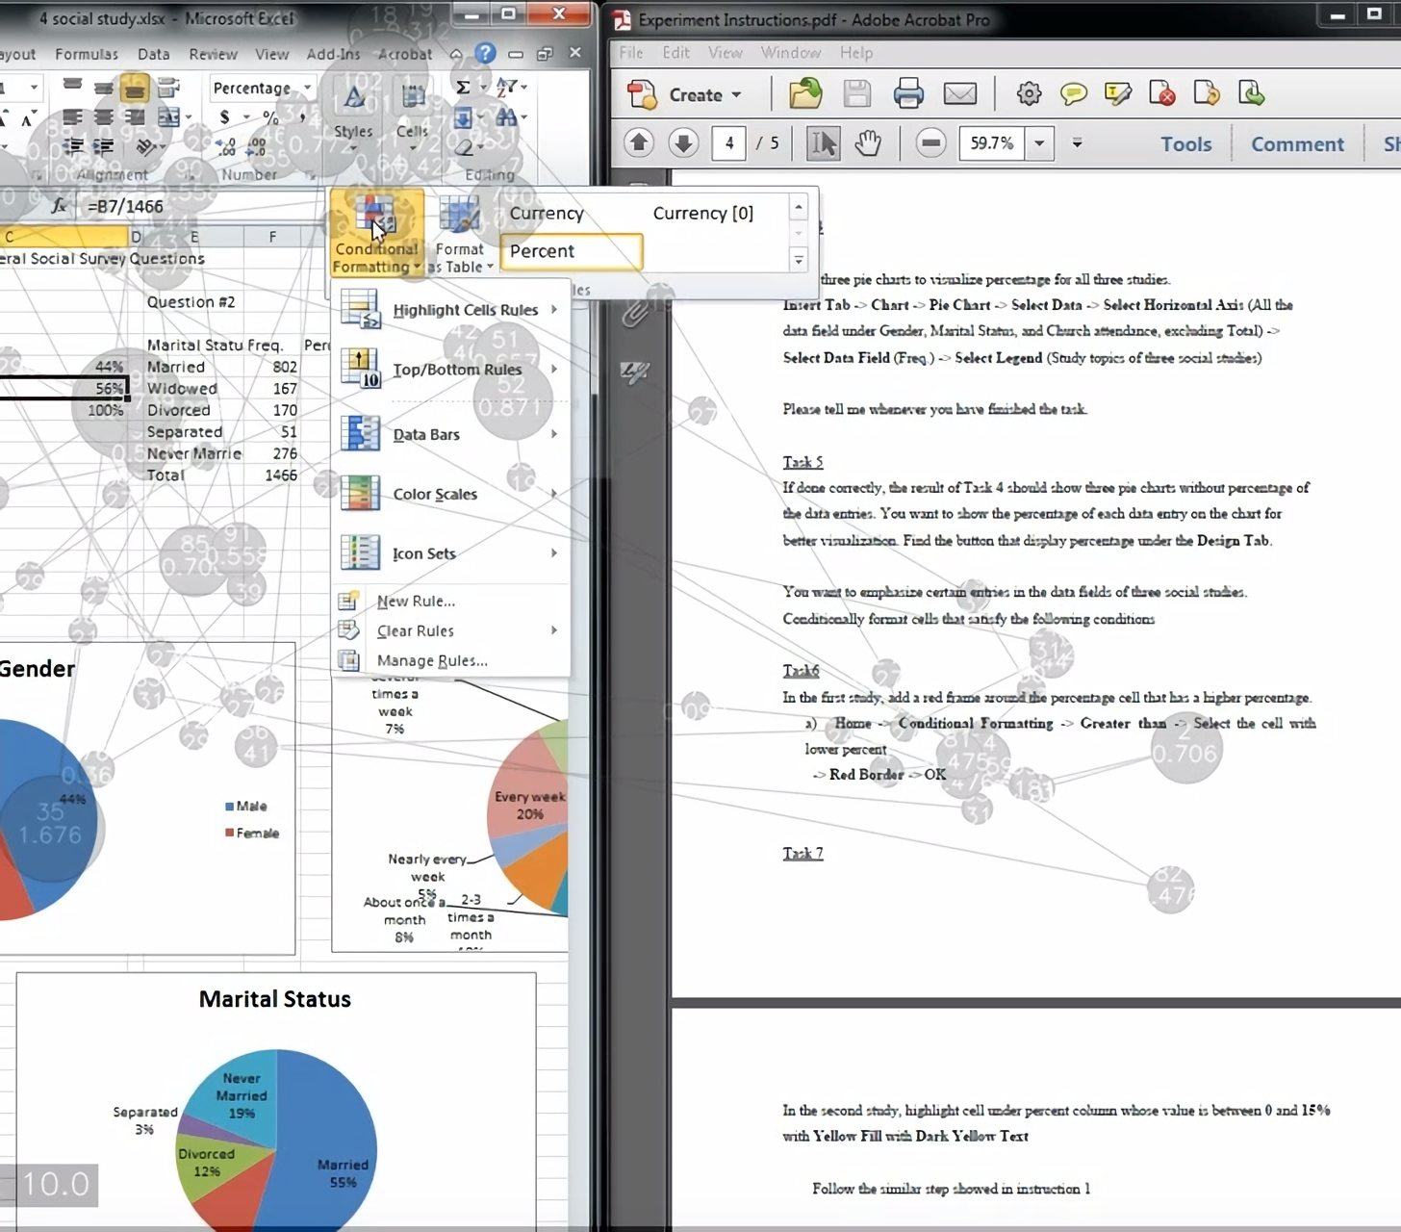
What happens when you are confused?
A screenshot from eye tracker
Records the moment during a confusion interval when the subject is doing conditional formatting
Grey dots and lines are gaze paths and fixations
You can find sparse and concentrated geometric patterns of gaze and fixations

Slide 14
Research Question & Hypothesis
Can we use eye-tracking data to identify confusion?
Which gaze pattern(s) indicate confusion?
Hypothesis: We can build machine learning models to identify confused gaze?
The geometric patterns, e.g. spread of gaze, can predict confusion

Slide 15
Related Work
Lalle et al. found that pupil size is the most important indicator of confusion. They also find that combining a set of gaze features can accurately predict confusion using Random Forest algorithm
Byrne et al. found the back-tracing pattern in gaze when users visually search for items in menus
Nakayama et al evaluated the importance of scan paths as an indicator of confidence level in multiple choice questions

Slide 16
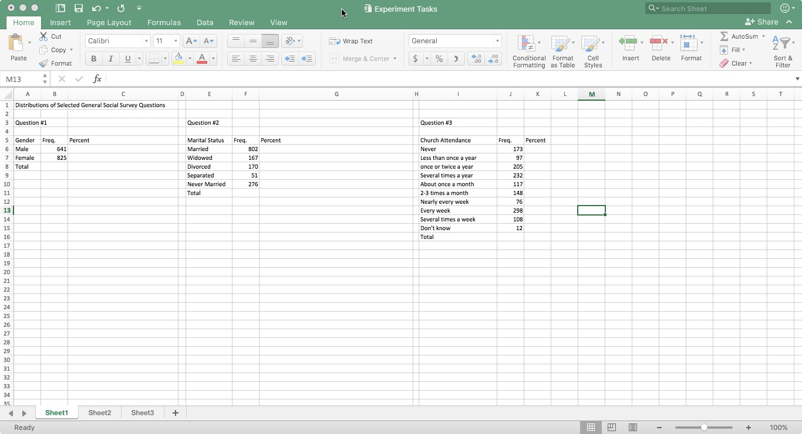
Experiment Design
8 common Excel questions
Subjects follow the instructions step by step
Subjects report confusion verbally
I take the time of each step
Record confusion interval
Notes:
Mention control groups.

Slide 17
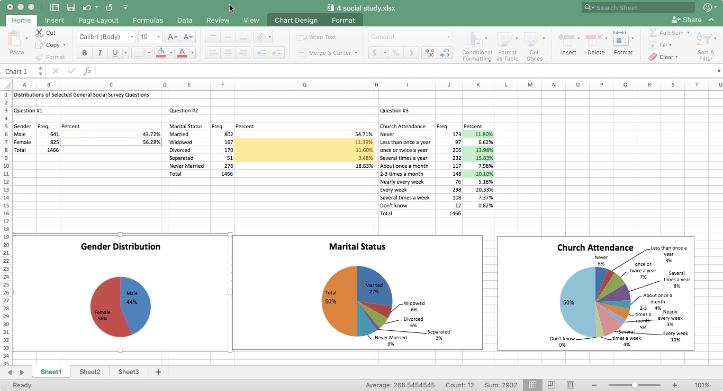
Experiment Tasks
Simulates Data Processing for a social study project
Data Calculation
Format Data
Chart Building

Slide 18
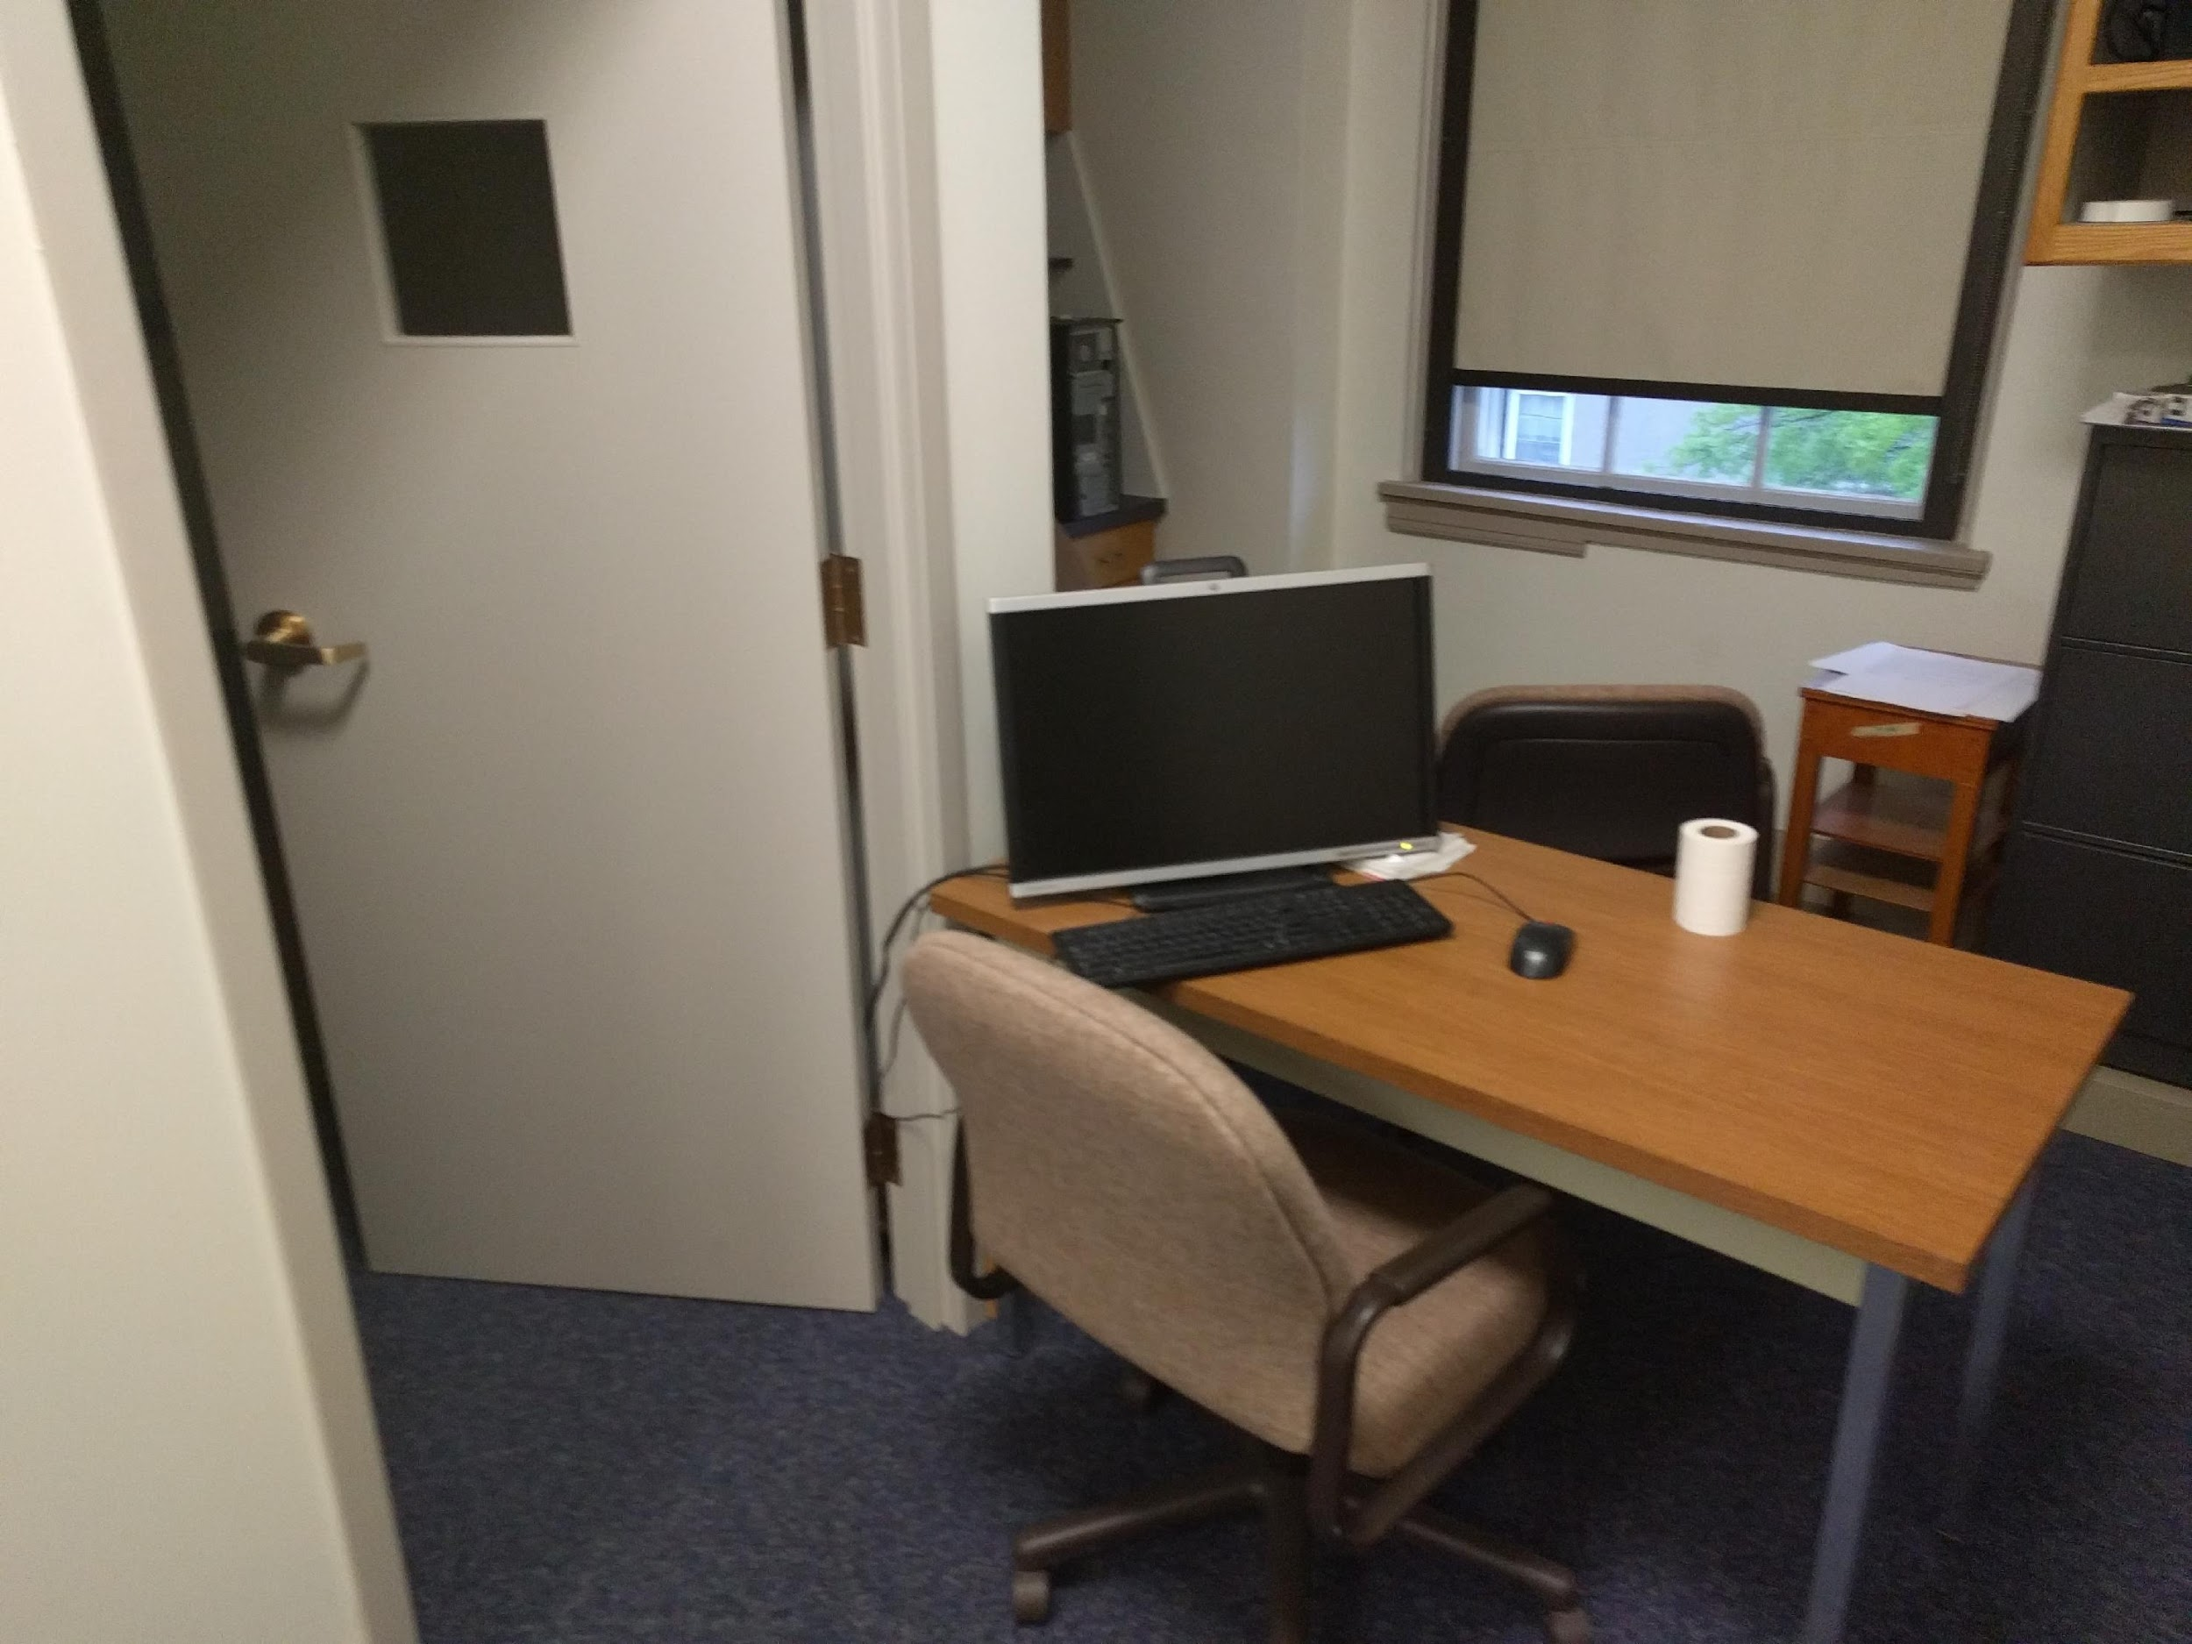
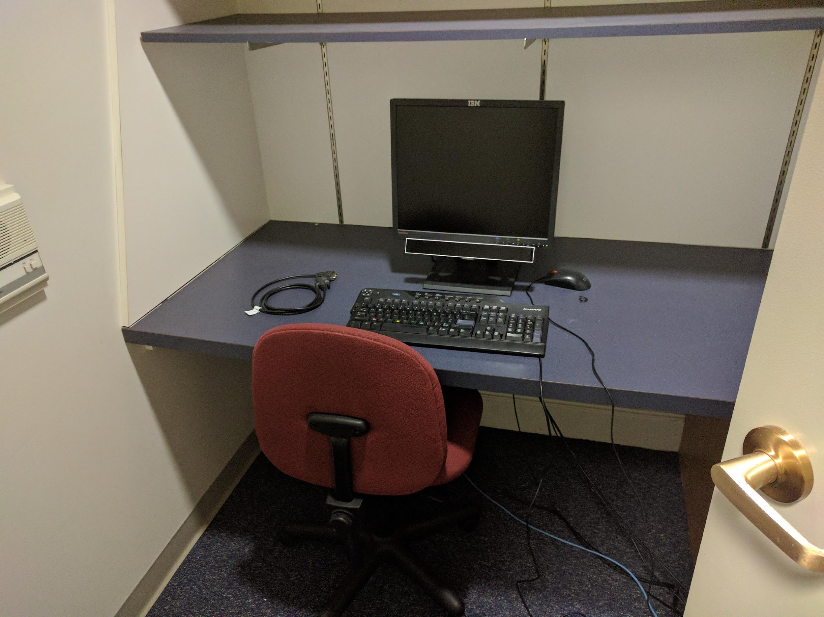
Lab Environment

Slide 19
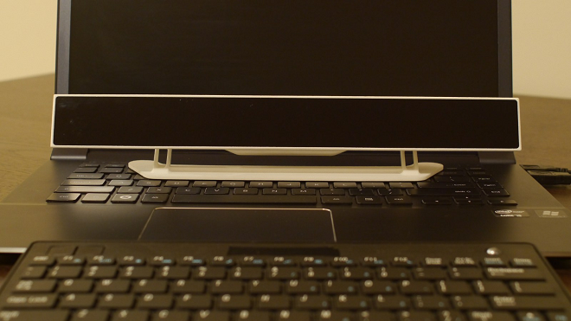
GazePoint GP3 Eye-Tracker
Use IR Reflection To Track Eye Movements
Produce x, y coordinate gaze path and fixation data
Calibration for each user
Open standard API
Notes:
Mention difference in the biometrics of each person creates differences in measurements
Subjects may change their body position during the experiment, which may negatively affect the measurements.

Slide 20
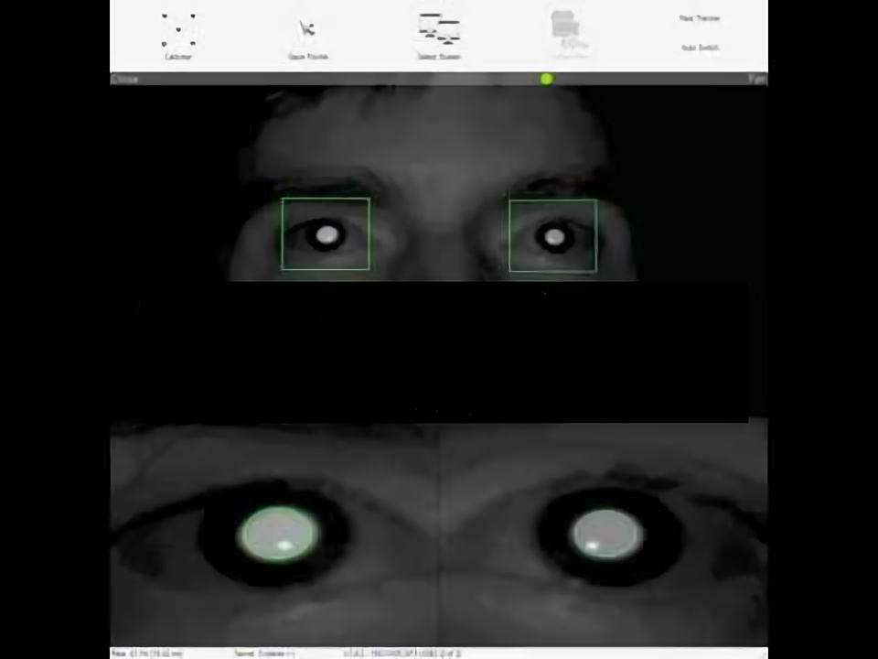
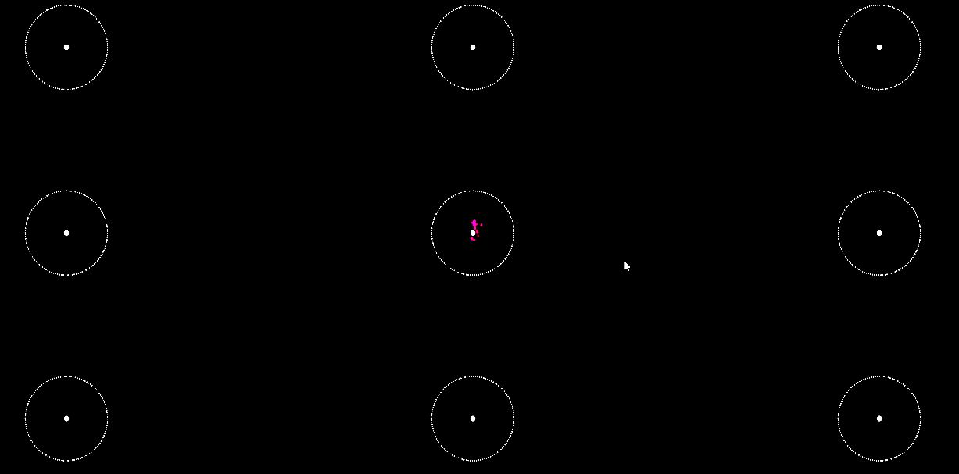
Calibration
Notes:
Tell a little bit about how to calibrate
Make sure head distance is in optimal range
Make sure gaze point is focused on the centers of circles.

Slide 21
Data Processing
Confusion Interval
Eye Tracker Data
Training Data
Reference Data Generator
Source Data Extractor
Feature Generator
Reference Data
Formatted Source Data
Notes:
python
explain why you process data this way: summarize time series data
make ref to related work

Slide 22
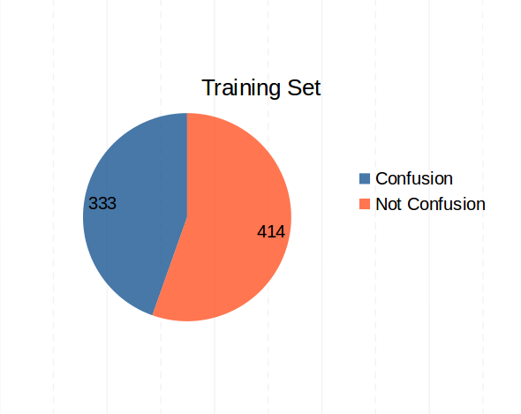
Generated Training Data
Used 5 seconds sampling window and generated 747 instances in total
Only used tasks containing confusion
Use Standard Deviation of Gaze Points, Fixation Points, Cursor Position as feature to measure the degree of spread in gaze
Put data into WEKA to build models
Used ten-fold cross validation method
Notes:
Mention related work to describe decisions of choosing features
why decide using upsampling

Slide 23
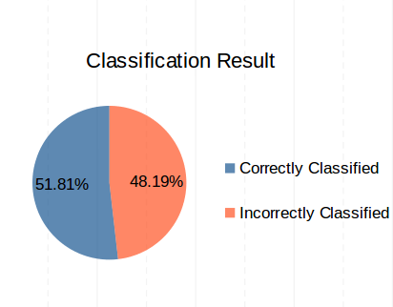
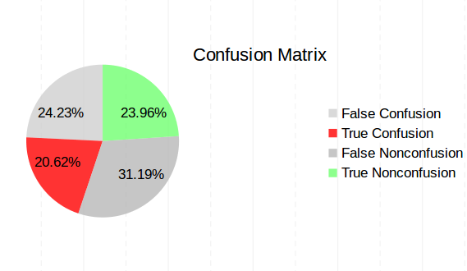
LibSVM
Notes:
Briefly describe algorithm
compare confusion matrix

Slide 24
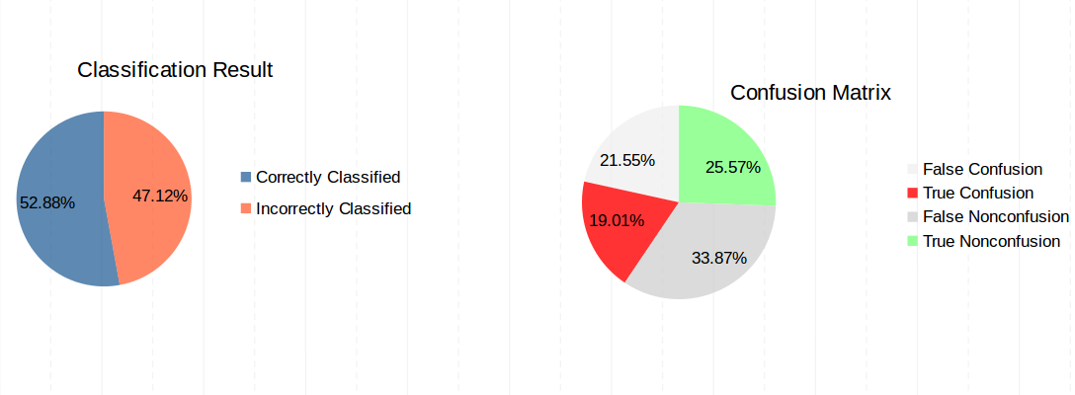
AdaBoost + LibSVM

Slide 25
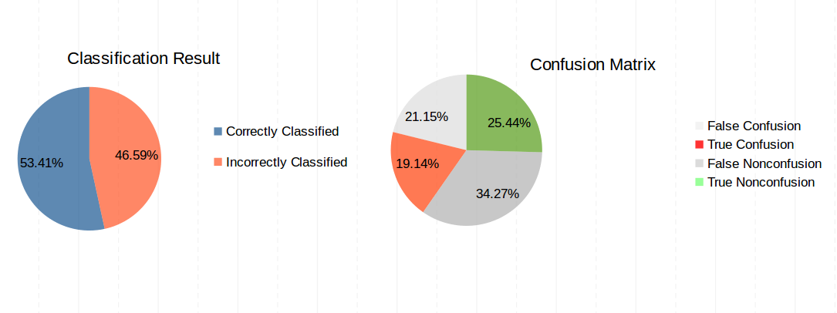
Random Forest

Slide 26
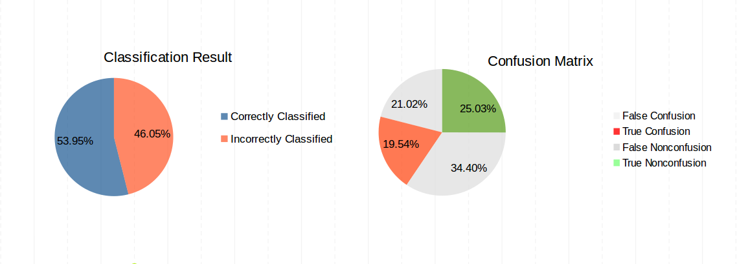
AdaBoost + Random Forest

Slide 27
Conclusion
No significant result found
Degree of spread of gaze is bad for confusion prediction
Notes:
Provide possible reason
1.should probably use full time frame
2.gaze point not very spread out

Slide 28
Future Work
Add more geometric features
Improve hardware
Improve data generation
Recruit more subjects
Notes:
more details for each point if you have some time left

Slide 29
Questions?

Slide 30
Thank you!

