Slide 1
Mimicking Human Gestures During Conversation
Peter Jacobo
Advisor: Nick Webb

Slide 2
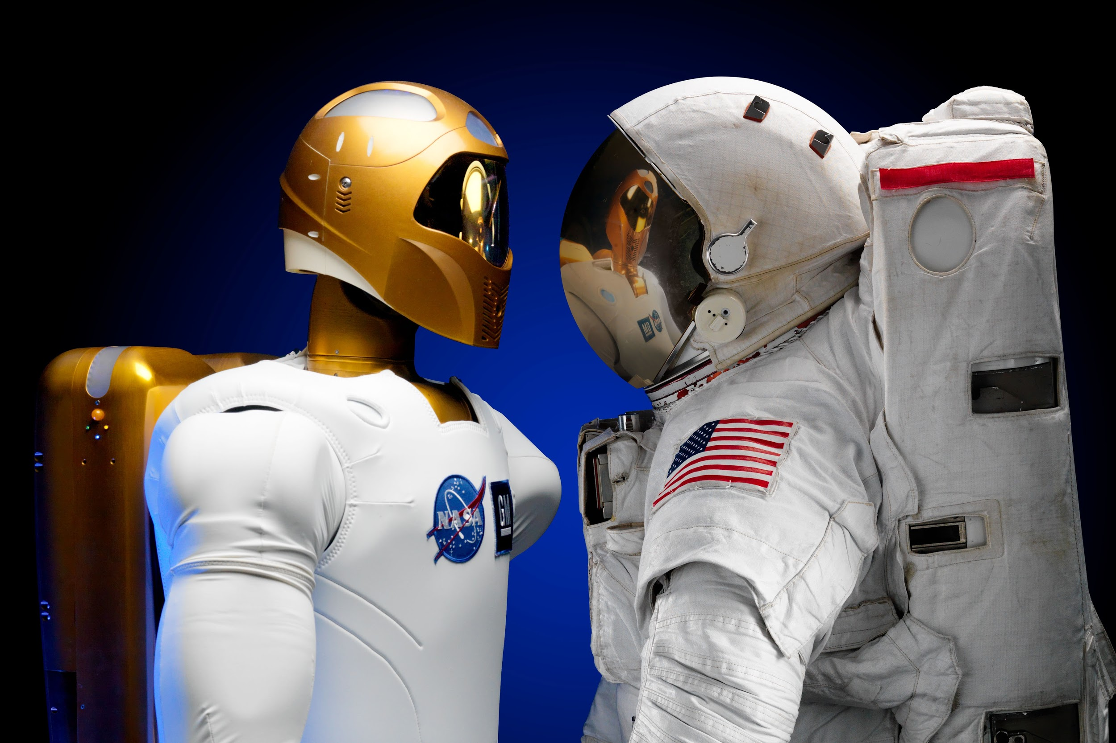
Social Robots
Designed to interact with people
Can interact with the people in their environment
Speech, movement
Applications: therapy, assistants, companions, navigation harsh environments

Slide 3
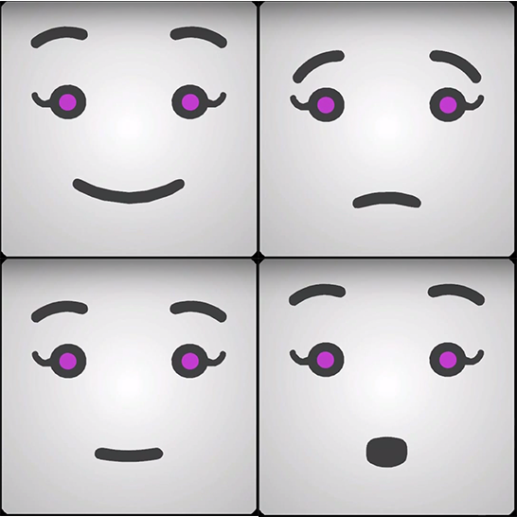
Research Question
Dynamic vs static social robots
Will using gestures influence people’s perception of SARAH
SARAH’s gestures are analogous to human gestures
People’s perception of SARAH based on a survey

Slide 4
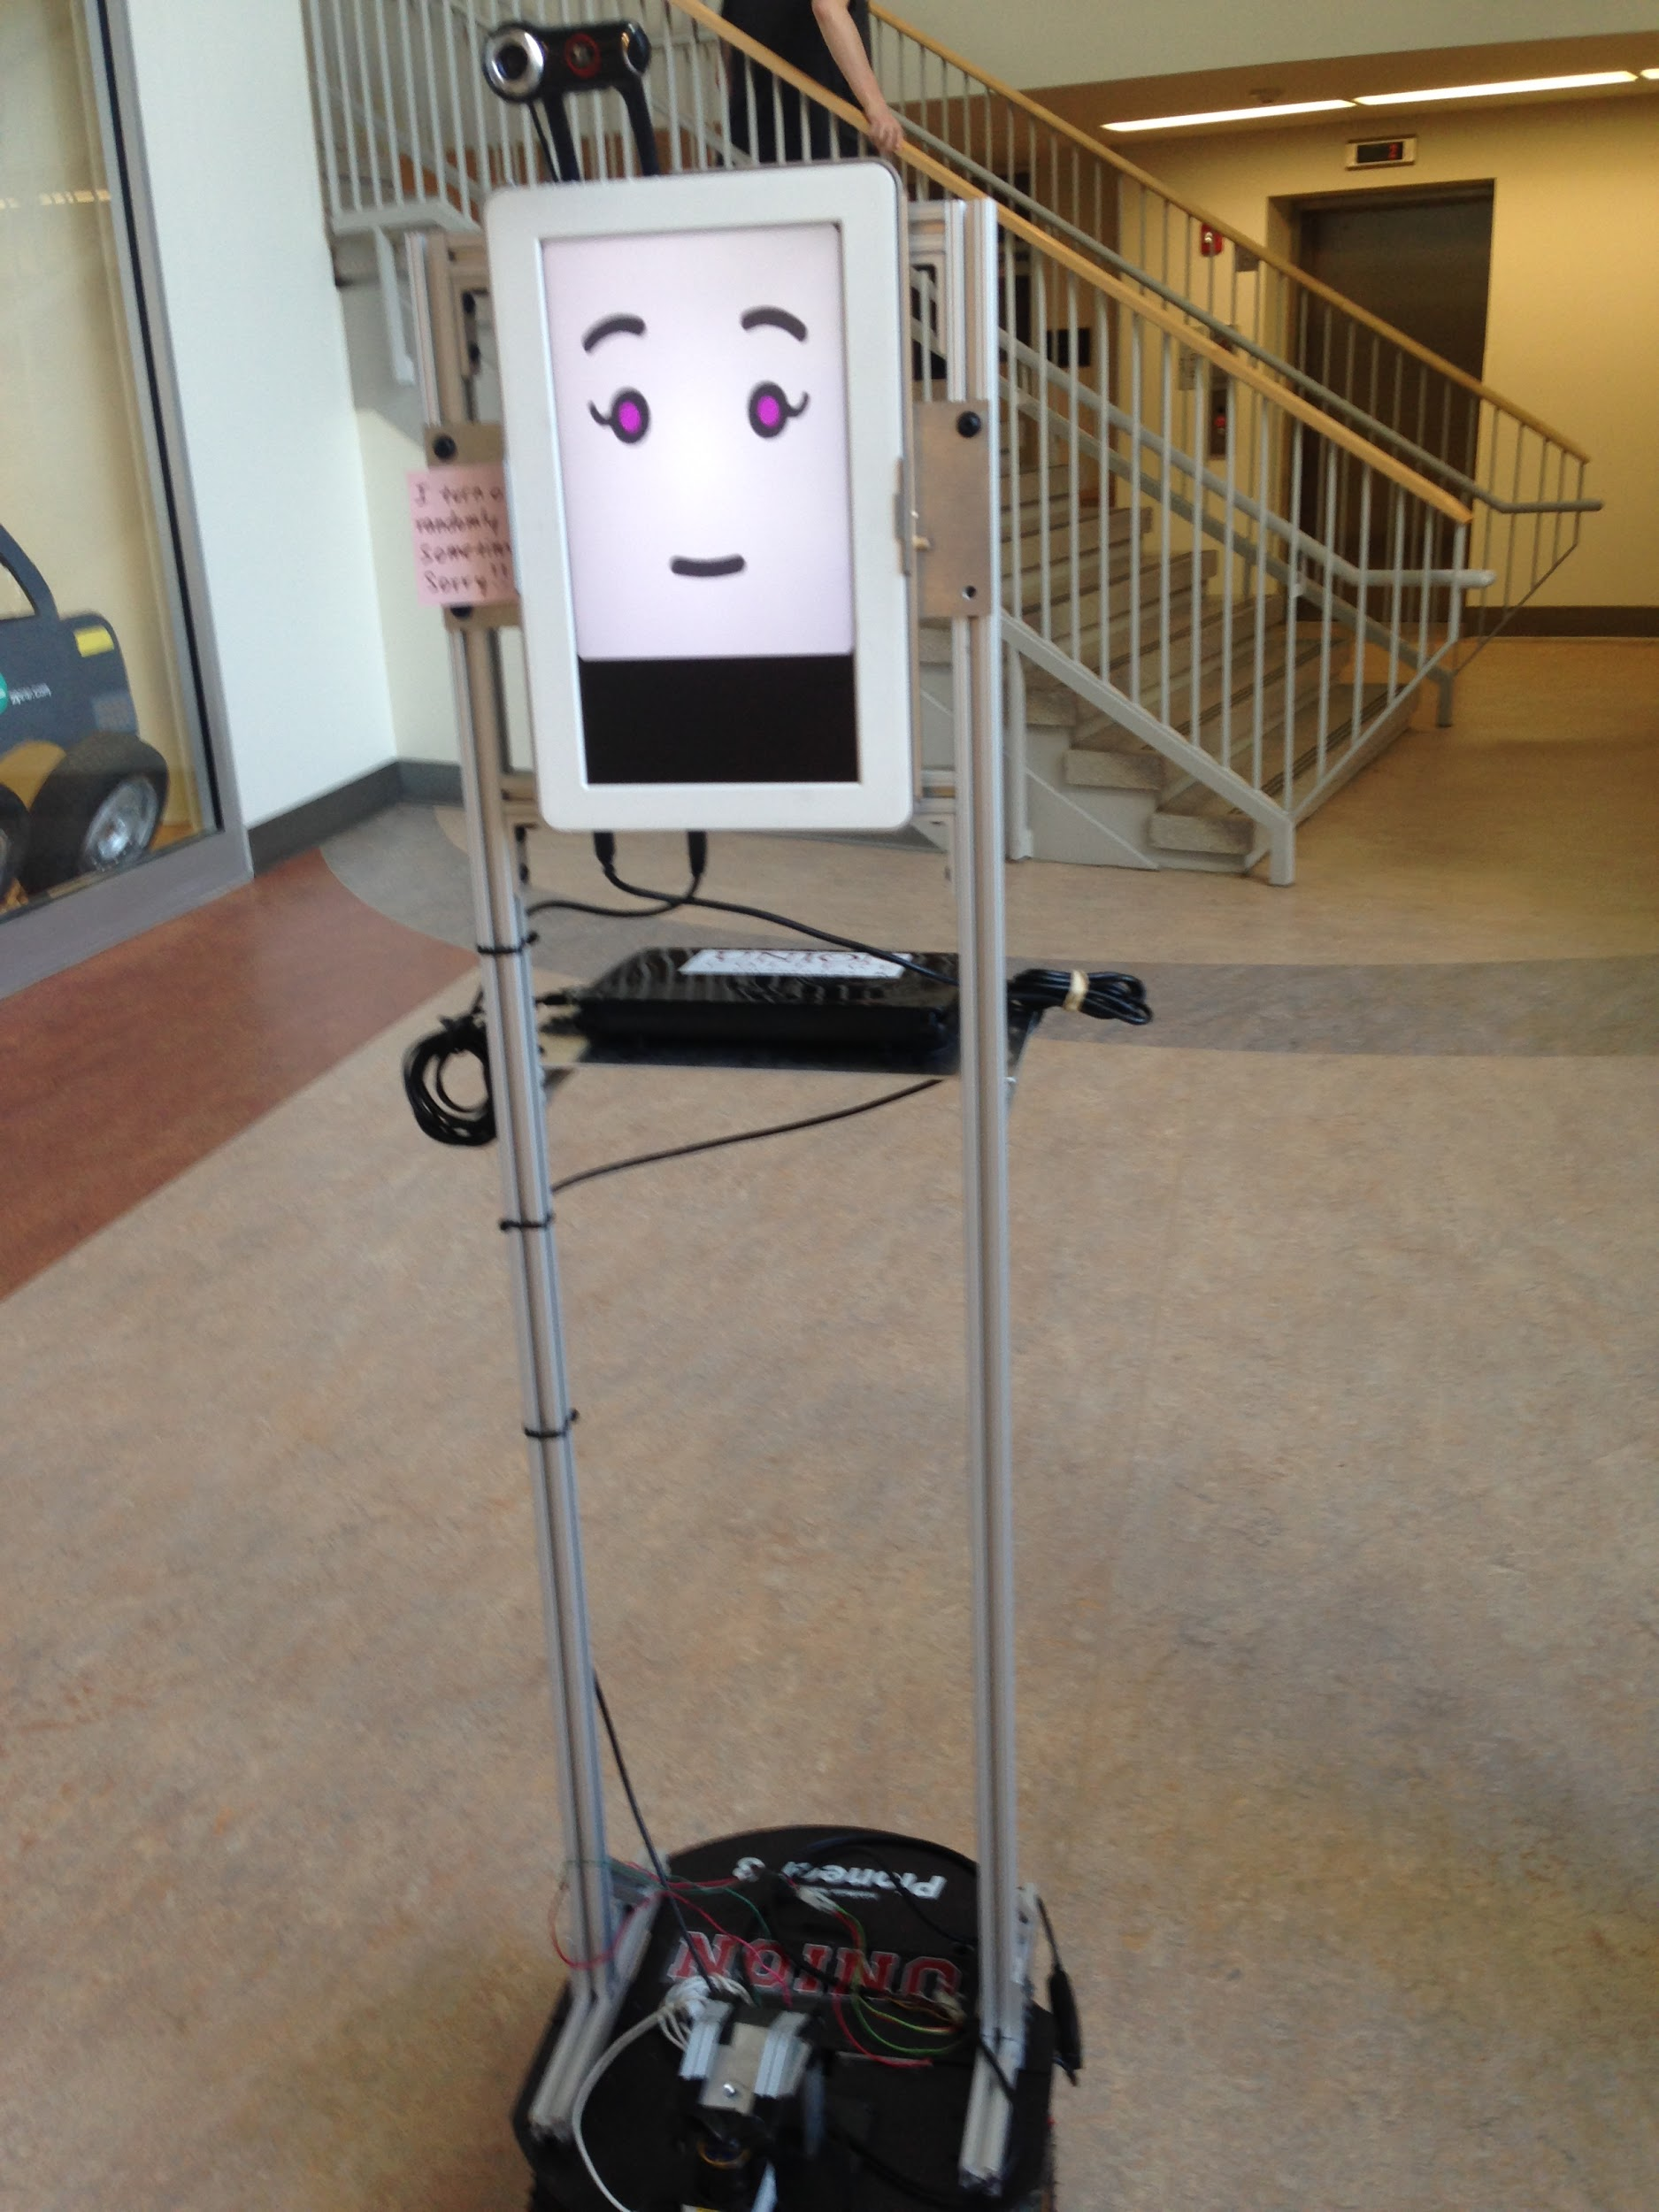
SARAH
Socially acceptable robot asks for help
Physical limitations: cannot climb stairs, no hands
Subgoal: asking a person to press elevator button
SARAH: screen (robot_face), moving base, keypad, kinect, lasers, webcam

Slide 5
Gestures - Agreement

Slide 6
Gestures - Disagreement

Slide 7
Gestures - Confusion

Slide 8
Gestures - Excitement

Slide 9
Experiment - Task
SARAH has a blue pocket and a yellow pocket
She asks participants to take a index card from the blue pocket
Participants ask three questions from the card
Programmed responses and gestures to the questions
Example: “Is the Nile the longest river?”
Response: disagreement gesture and “no”
After the questions, participants asked to complete a survey
Three questions, one open-ended

Slide 10
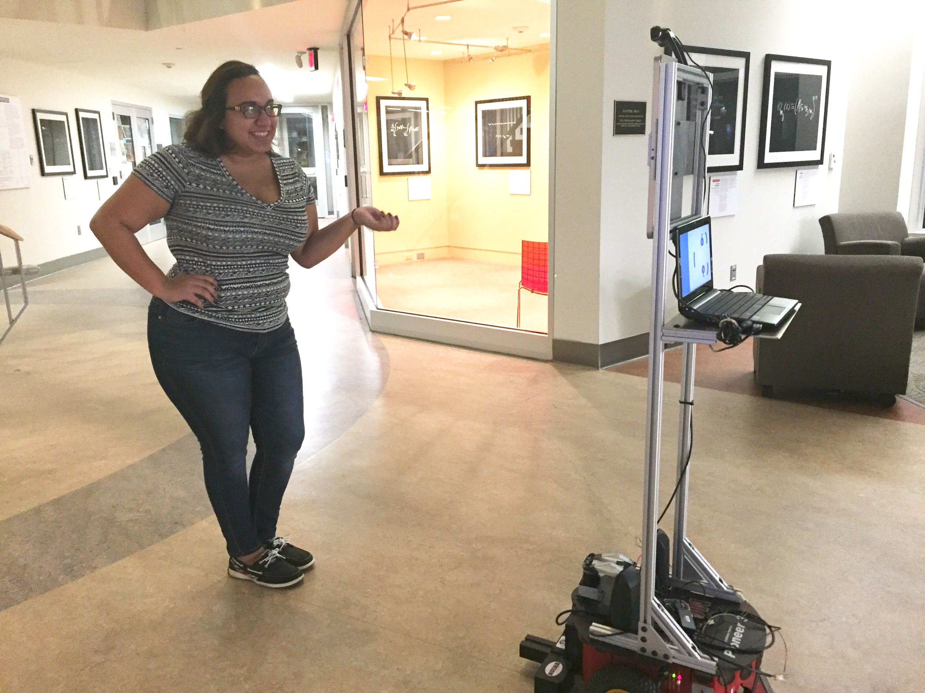
Experiment Design
Groups: SARAH uses gestures, SARAH does not use gestures
Facial expressions accompany gestures
SARAH invites participants to ask her questions
SARAH asks them to complete a survey

Slide 11
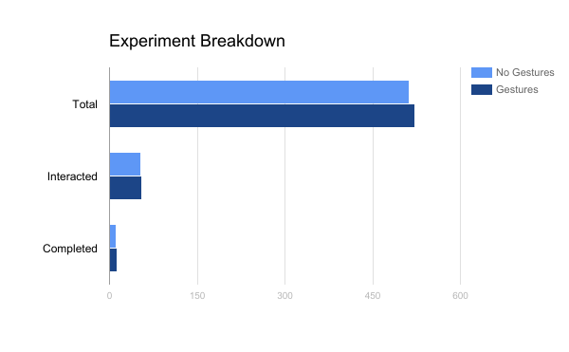
Results - Number of Participants
With Gestures
522 people walked by
55 people talked to SARAH
13 completed the task
Without Gestures
513 people walked by
54 people talked to SARAH
11 completed the task

Slide 12
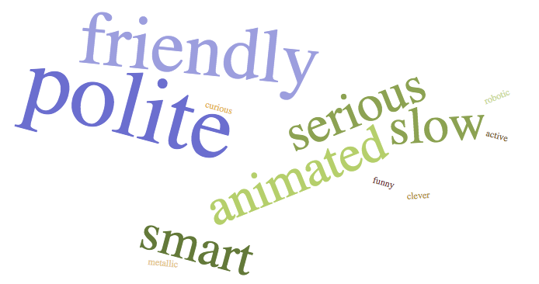
Survey Results
 | Intelligence | Naturalness
Gestures | 4.8 | 2.6
No Gestures | 4.7 | 2.5

Slide 13
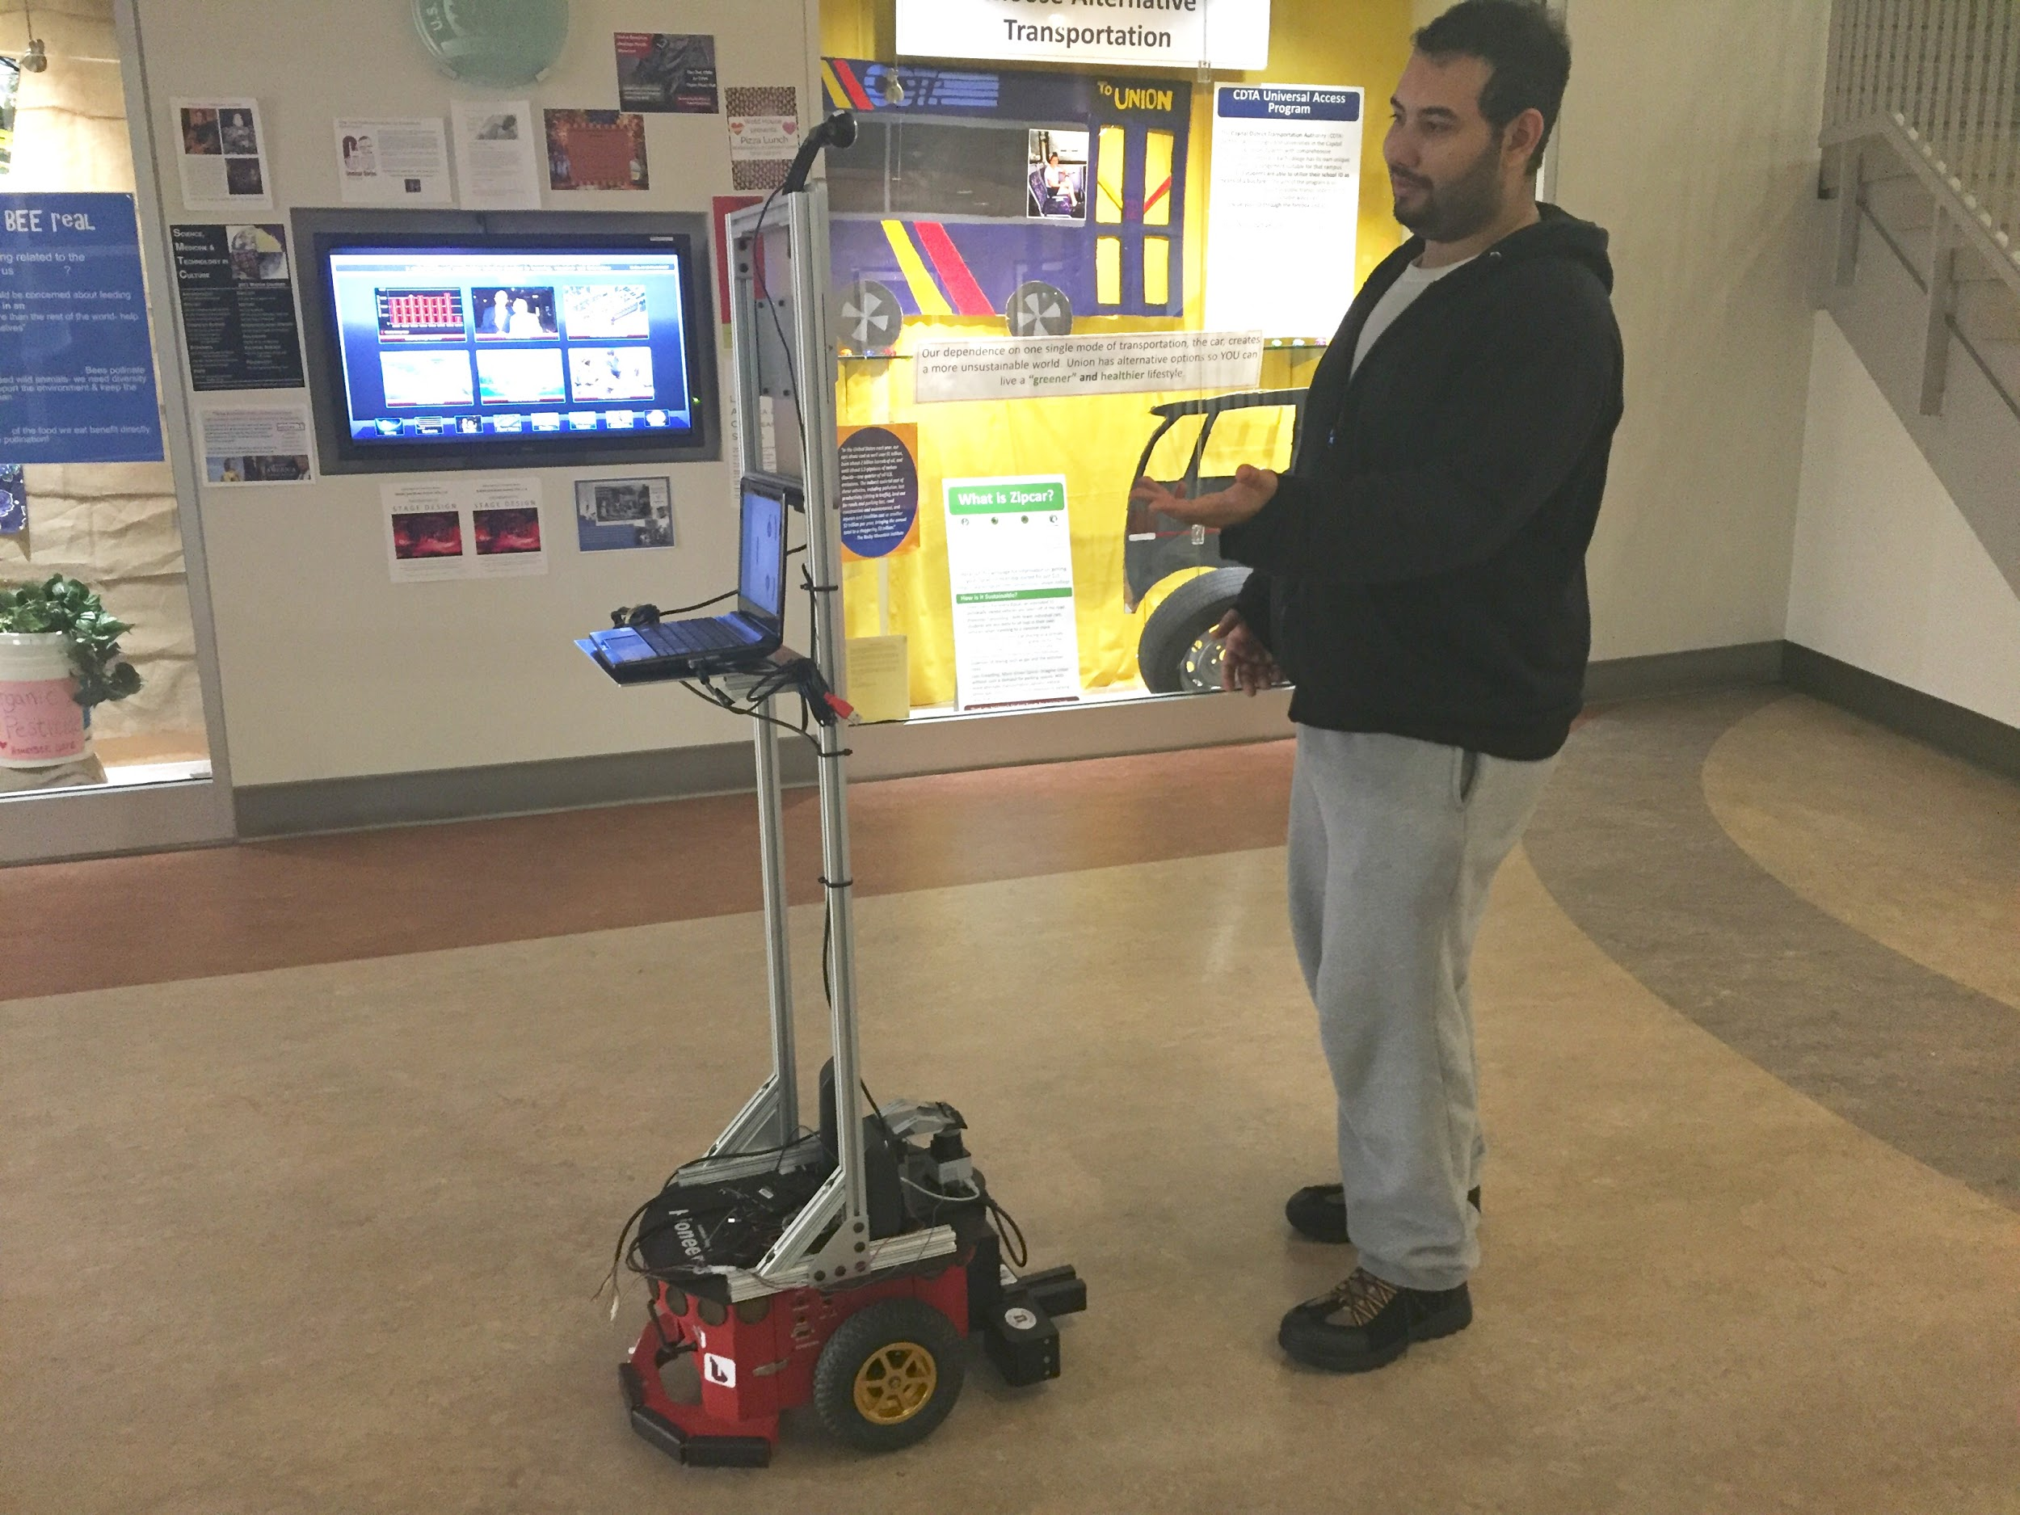
Experiment Observations
People in groups felt more comfortable around SARAH
Most people who didn’t complete the task left after the explanation
People are curious about SARAH’s gestures
People speak to SARAH as a person, not a thing

Slide 14
Conclusions
People’s perception of SARAH’s intelligence and naturalness
little/no difference depending on gestures
Intelligence score high because SARAH answers questions correctly
10% of people walking by SARAH interacted with her
20% of those who talked to SARAH completed the task
The longer people interact with SARAH the more comfortable they are around her

Slide 15
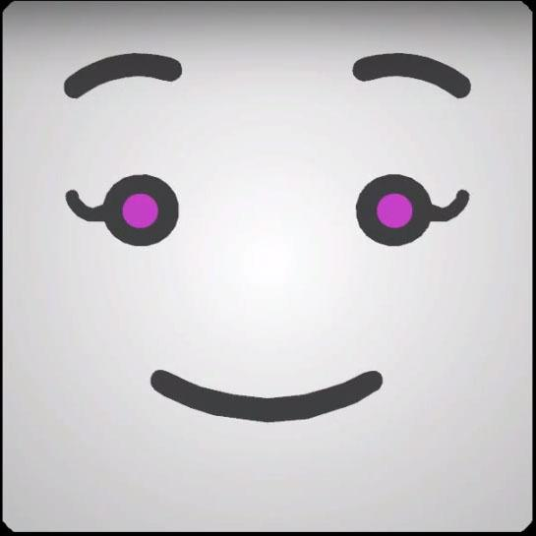
Future Work
Modified gestures
Eye gaze - alone or in combination with other features
A different experiment task
Invites teamwork with participants
Movement during interaction (other than gestures)

