Slide 1
Evolving “Skate Guts”
By Andrew Hilton
Advisor: John Rieffel

Slide 2
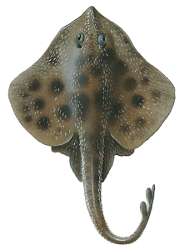
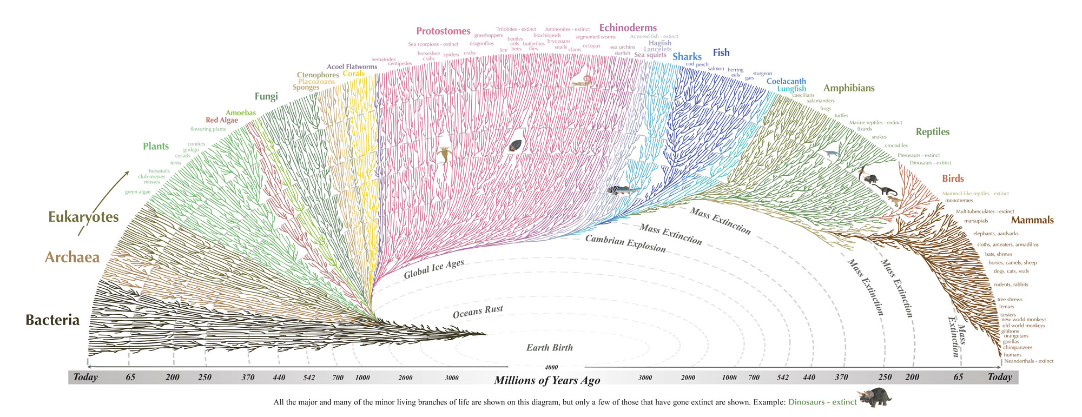
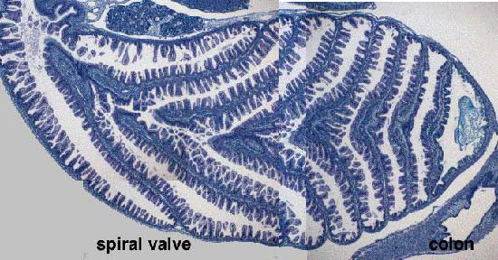
Biological Motivation

Slide 3
What properties of biologically inspired optimization problems lead to the evolution of “interesting” 3D shapes?

Slide 4
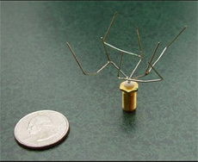
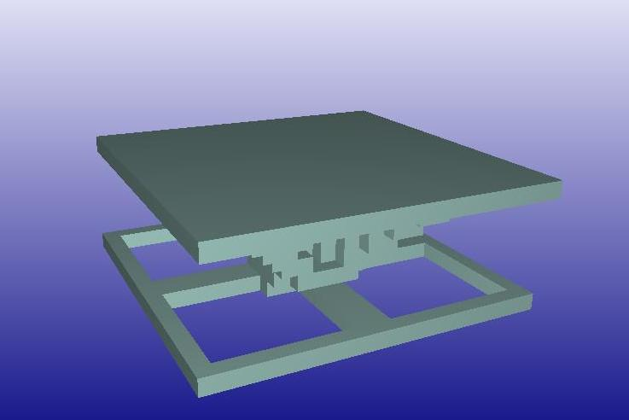
Why Genetic Algorithms?
Gregory. S. Hornby, Jason D. Lohn, and Derek S. Linden. 2011. Computer-automated evolution of an x-band antenna for nasa's space technology 5 mission. Evol. Comput. 19, 1 (March 2011), 1-23. DOI=http://dx.doi.org/10.1162/EVCO_a_00005
http://www.demo.cs.brandeis.edu/pr/evo_design/static.html

Slide 5
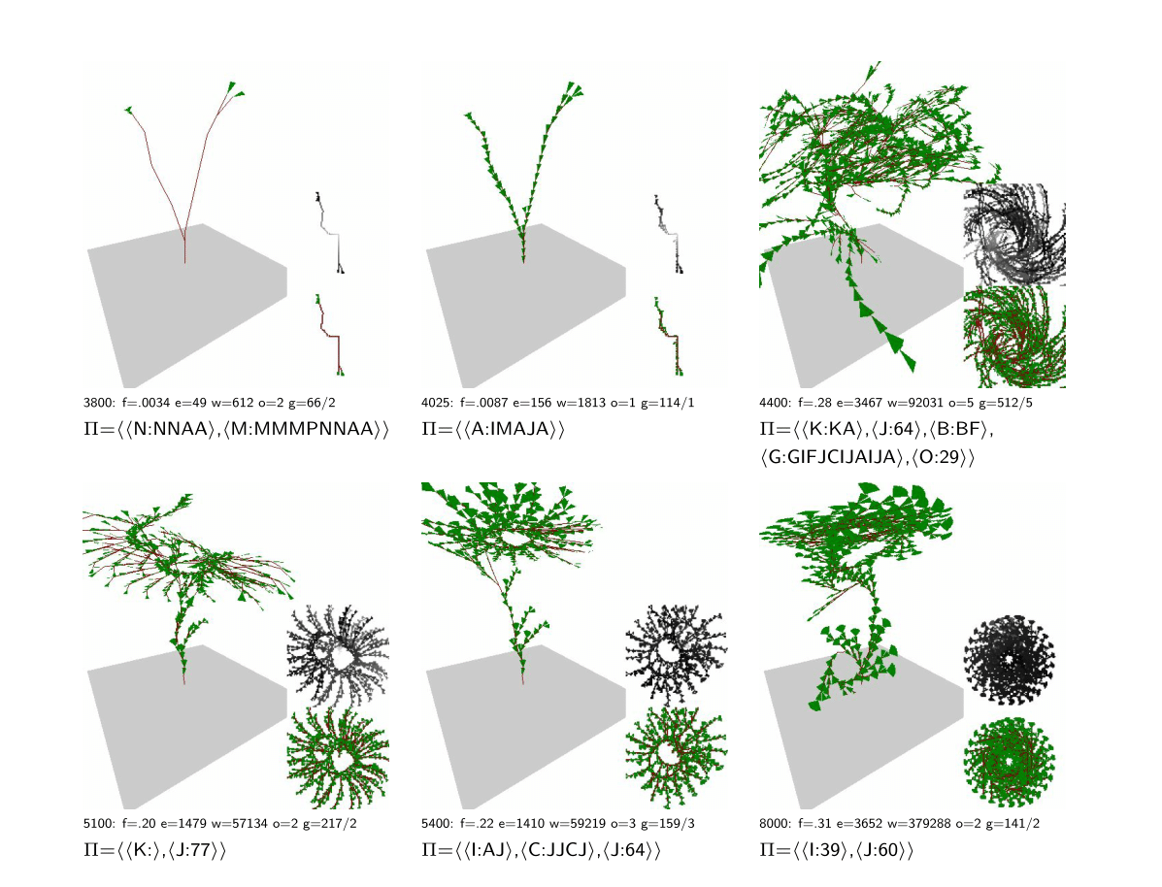
Why Genetic Algorithms?
M. Toussaint: Demonstrating the Evolution of Complex Genetic Representations: An Evolution of Artificial Plants. In Genetic and Evolutionary Computation Conf. (GECCO 2003), 86-97, 2003.

Slide 6
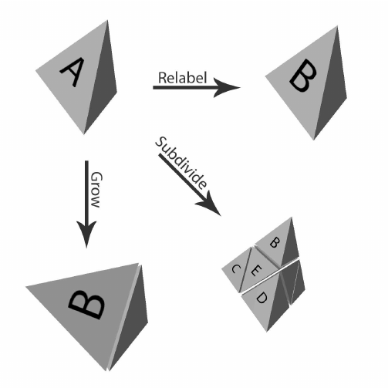
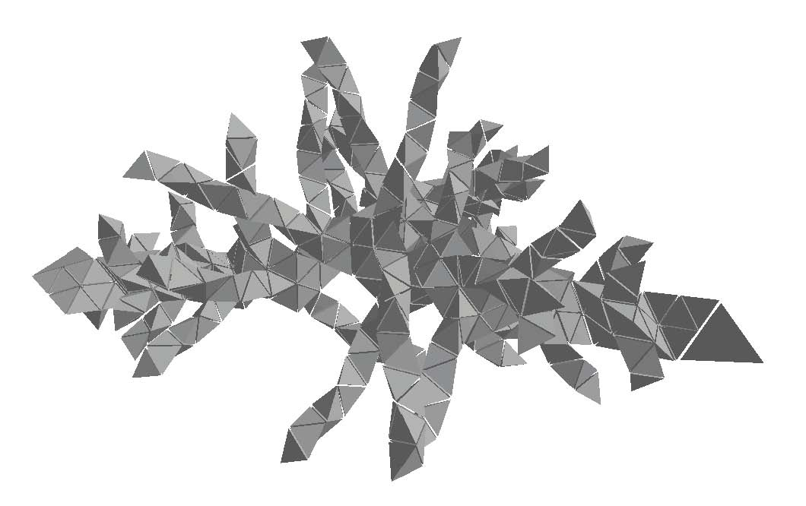
A Face-Encoded Tetrahedral Grammar
Smith, S., and Rieffel, J. (2010) "A Face-Encoding Grammar for the Generation of Tetrahedral-Mesh Soft Bodies". Proceedings of the 12th International Conference on the Synthesis and Simulation of Living Systems (ALIFE12). MIT Press. 414--420.

Slide 7
Implementation
Reimplemented Grammar System
Built Evolutionary System
Python 3
Removed Subdivide
Added Rest
STL Outputs
Uniform Cross
Fine and Coarse Mutation
Multiprocess Support

Slide 8
What kinds of measures of fitness lead to qualitatively interesting 3D shapes?

Slide 9
Some Results - Surface Area / Bounded Volume
A → relabel(A)
B → rest( )
C → relabel(A)
D → relabel(A)
E → relabel(E)
F → relabel(E)
Generations : 100
Population : 50
Time : 10

Slide 10
Some Results - Bounded Volume / Convex Hull Volume
A → grow(DFA)
B → rest( )
C → rest( )
D → rest( )
E → relabel(A)
F → relabel(F)
Generations : 25
Population : 20
Time : 8

Slide 11
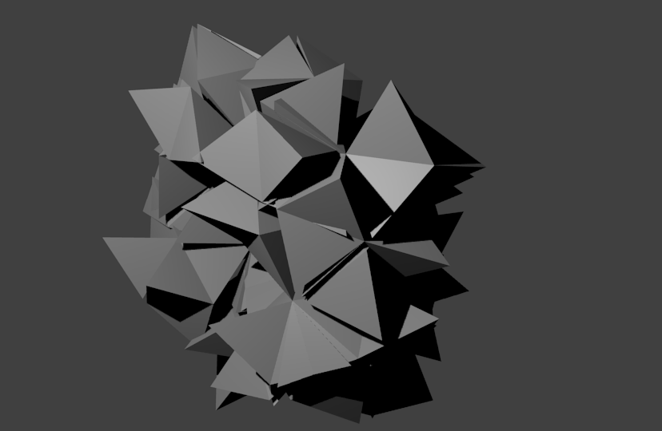
Some Results - Max Convex Hull Volume
A → grow(ADD)
B → relabel(A)
C → grow(CFD)
D → grow(DEE)
E → grow(FFC)
F → grow(DCF)
Generations : 25
Population : 20
Time : 8

Slide 12
Some Results - Bounded Volume / # Faces
A → grow(ABD)
B → rest( )
C → relabel(E)
D → grow(BED)
E → relabel(E)
F → relabel(D)
Generations : 50
Population : 25
Time : 8

Slide 13
What this means...

Slide 14
Any Questions?

