Slide 1
How Do
Video Games Affect Our Study Habits?
By John Enquist
Notes:
Good morning everyone, my name is john enquist and I’m going to talk to you about how our video games can affect our study habits

Slide 2
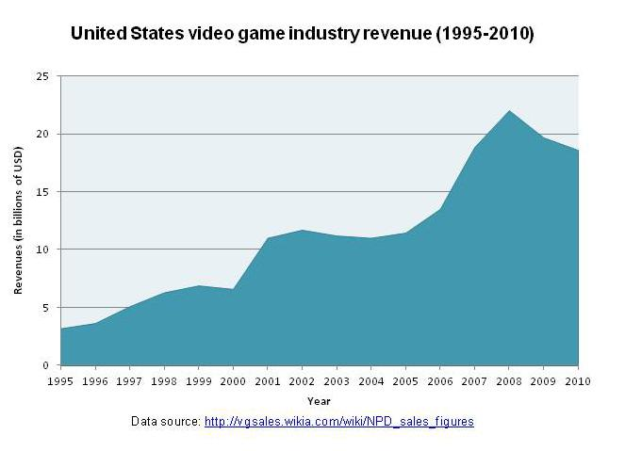
Why Do We Care?
Prevalence of video gaming in our society
The recent market penetration of smartphones
Insufficient studies done on the effects of gaming
1995 2010
Notes:
Video games have only really become a widespread thing since the mid 90’s
Nowadays around ⅓ of all households have a gaming device, and with smartphones becoming increasingly common everyone has easy access to gaming on the go
It has become a significant part of our economy to the point where it’s existence is well established
Because of how new the industry is there have been an insufficient amount of studies on the effects that these video games can have on people

Slide 3
Notes:
Show how the the video game industry is 6.6% of the worlds global market

Slide 4
Related Studies
Vivek Anand
Correlation between video games and SAT scores
Douglas Gentile
Pathological Gaming having a direct correlation with negative behavior
Dorothy Salonius-Pasternak
Found Conclusive results on psychological benefits from playing video games

Slide 5
Does playing video games affect short term memory?
Notes:
Explain question behind your experiment
And state hypothesis

Slide 6
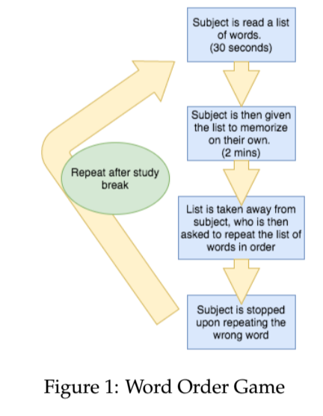
Word Order Design

Slide 7
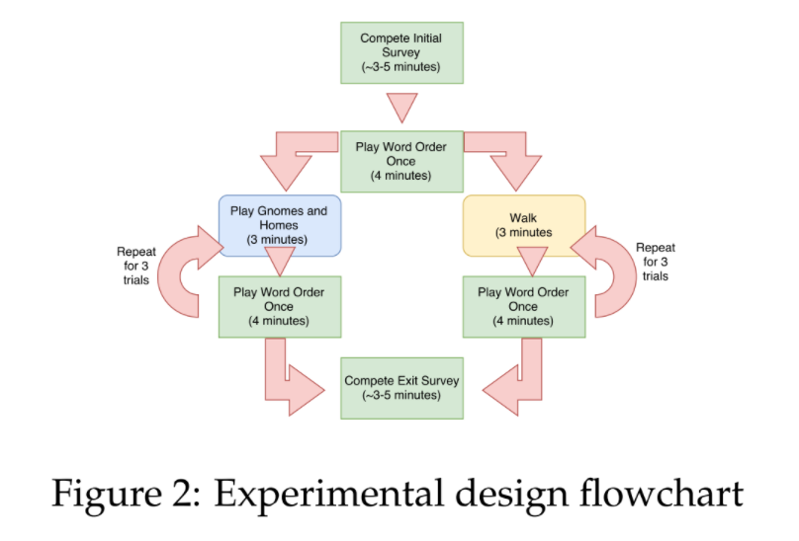
Experimental Design
Notes:
Talk about the rationale behind each group’s study break
What the experiment is intended to simulate
Results gathered
Add title and match style, remove figure

Slide 8
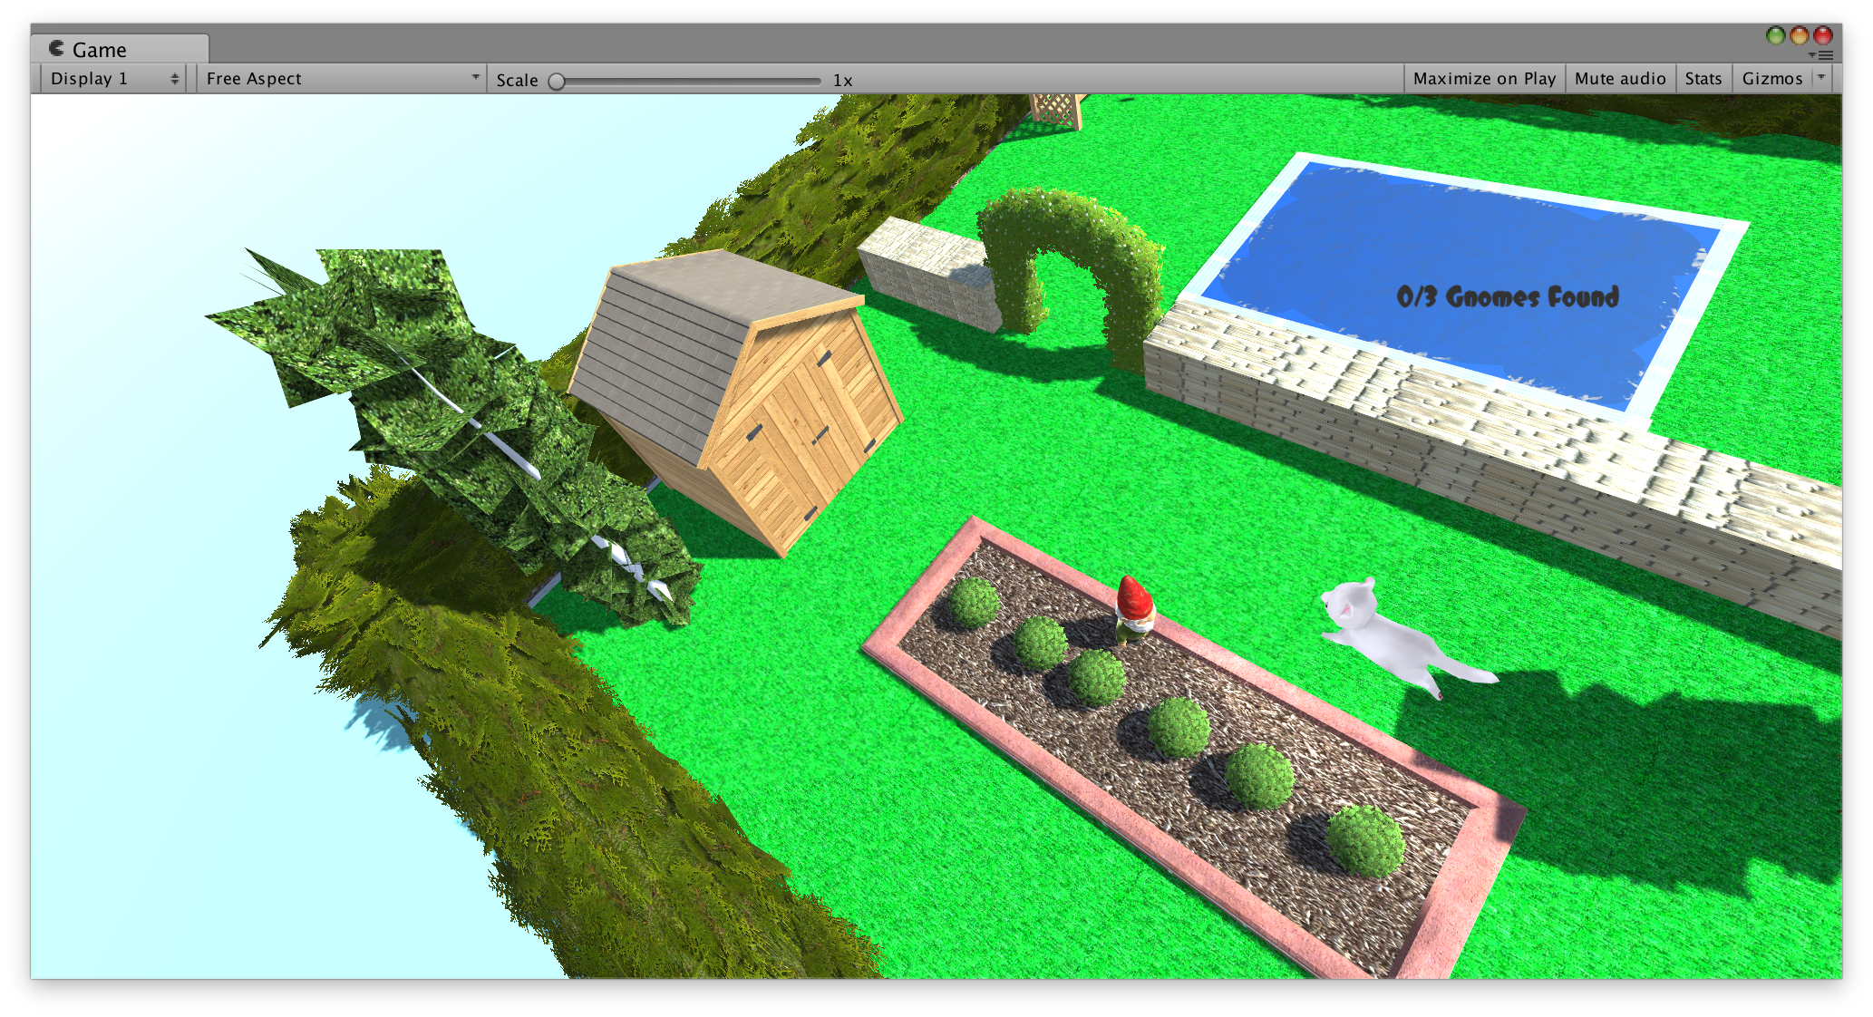
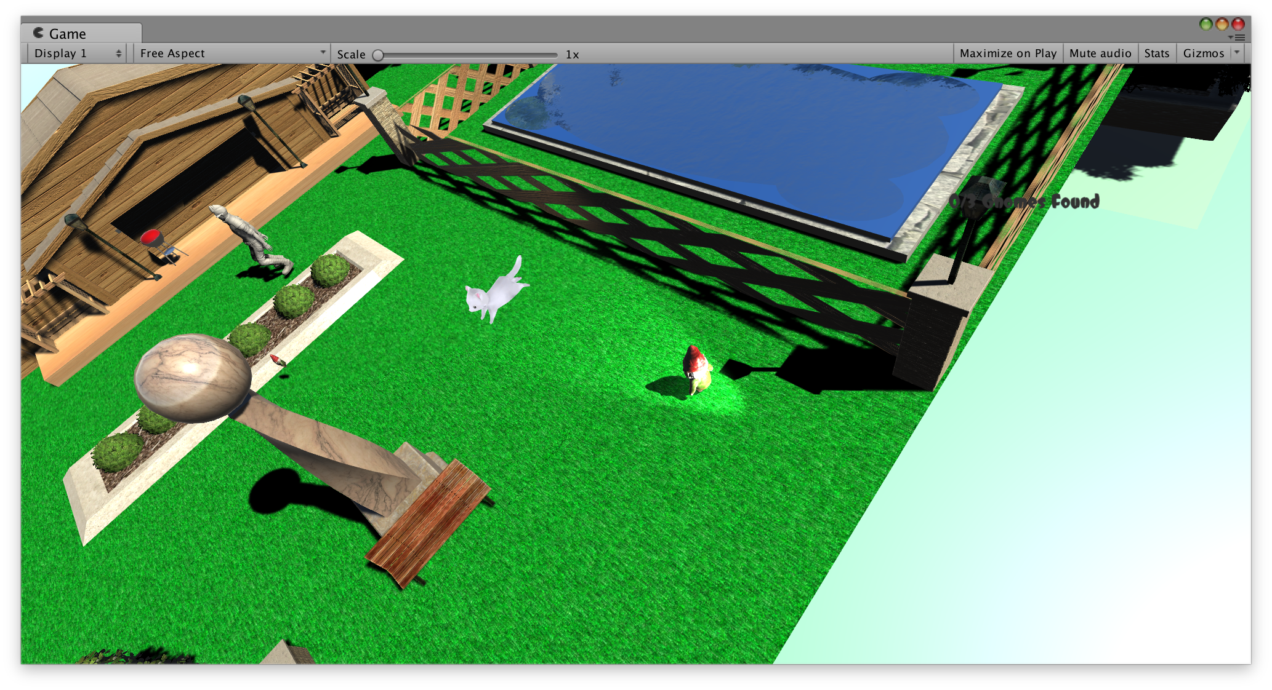
Gnomes
and Homes
Written in C#
Real-Time Strategy game
Player partakes in garden gnome based antics
Notes:
The first thing I had to do was find a game for my experimentees to play
So i made my own!
Also it is something I’m interested in

Slide 9
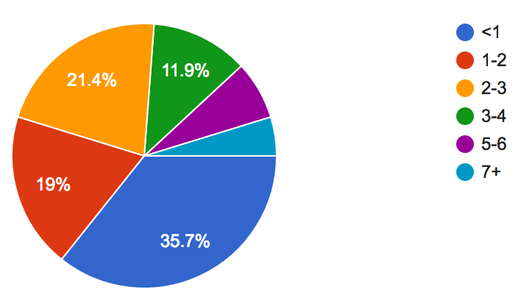
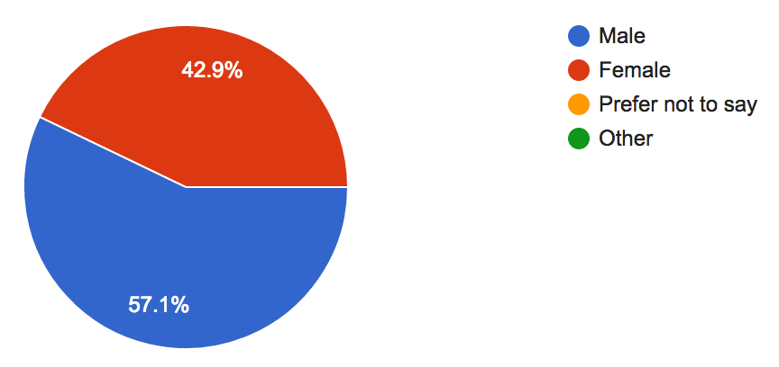
Survey Data
Types of Study Breaks
Study Break | %
Exercising | 37.1
Watching Videos/Shows | 42.9
Social Media | 77.1
Reading | 5.7
Playing Video games | 28.6
Socializing/Talking | 71.4
Eating | 71.4
Napping | 28.6
Weekly Hours Spent playing video games
Participants gender
Notes:
Emphasize that it is my data i collected

Slide 10
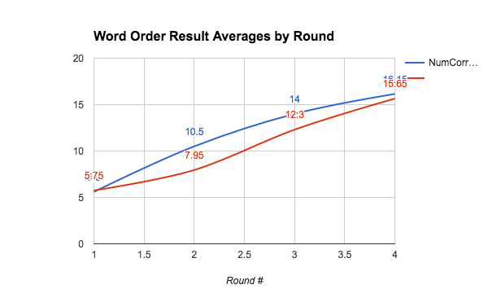
Some Data
Red: Control Group
Blue: Experimental Group
1 2 3 4
Round #
Notes:
Fix graph to make prettier
Make a bar graph

Slide 11
Some Stats
Control Group (20 subjects)
Completion Rate: 25%
Experimental Group (20 subjects)
Completion Rate: 30%
Round # | R1 | R2 | R3 | R4
Mean | 5..75 | 7.95 | 12.3 | 15.65
Stdev (+/-) | 2.6 | 4.0 | 4.5 | 3.3
Round # | R1 | R2 | R3 | R4
Mean | 5.6 | 10.5 | 14 | 16.15
Stdev (+/-) | 1.5 | 2.4 | 4.4 | 4.4
Notes:
Delete variance and mode
Delete +-
Add percent completion

Slide 12
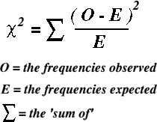
Some Results
Two Sample Chi Square Analysis
Bucketing scores in intervals of 2 and 4
Bucket Size | Degrees of Freedom | Critical value | 𝝌2 R1 | 𝝌2 R2 | 𝝌2 R3 | 𝝌2 R4
By 2 | 9 | 16.19 | 3.644 | 12.88 | 5.466 | 11.19
By 4 | 4 | 9.488 | 3.2 | 12.56 | 4.25 | 5.66
Notes:
What is a chi square analysis
What is a two sample t test
Add process and values of both tests (make a table for both)
Interesting things
Have 8 p values (2 groups 4 rounds)
Explain what the p value is
Chi Square Analysis results indicated that there is a significant enough difference between the results of the two groups to merit an outside factor influencing the scores, i.e the study breaks

Slide 13
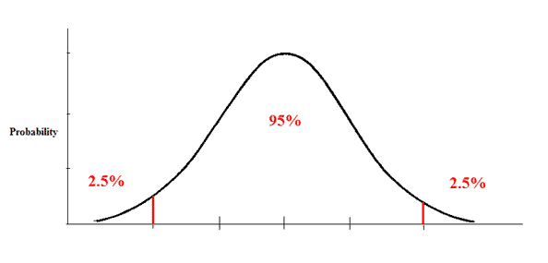
Two Sample T-Test
Round # | R1 | R2 | R3 | R4
P value | .822 | .0201 | .2326 | .6867
Tstat | .2266 | 2.4357 | 1.2131 | .4064
significant | no | yes | no | no

Slide 14
Conclusions
Kind of
Different?
Same?
Sample size
40 participants total
college students
Experimental design
Word memorization
short - term memory
Notes:
1: the data wasn’t exactly different overall, however the fact that the results were more or less the same is a conclusion in itself
Video games do not hurt your short term memory retention (for this experimental group)
2: such a small sample size makes the results more or less negligible in the grand scheme of our population
All the participants are also union college students (smart kids between ages 17 - 21)
Isnt representative of the population of student gamers
3: this experiment focused mainly on memorizing a set of words.
Just one of many ways of tracking memory retention
Doesn’t relate to all types of study material just memorization of words

Slide 15
Questions?
(ask me about my game)

Slide 16
What is a Videogame?
“an electronic game played by means of images on a video screen and often emphasizing fast action” - Merriam-Webster
“The only thing that’s fun to do anymore” - Urban Dictionary
Notes:
Briefly discuss the background of video games in today’s society and their recent booming industry
Widespread use of video games at the turn of the 21st century
Captured the attention of the generation y, and z
So as I am sure you are all

