Slide 1
Improved Captioning
for the
Hearing Impaired
by Samson Drews
Advisor: Valerie Barr

Slide 2
Background
Captions vs. subtitles
Dialogue and sounds vs. dialogue
Ever-shifting landscape of digital media
The internet and its accessibility
Title III of Americans with Disabilities Act (ADA) of 1990:
“Eliminate unnecessary eligibility standards or rules that deny individuals with disabilities an equal opportunity to enjoy the goods and services of a place of public accommodation.”
Finally some relief, but in 2010…
21st Century Communications Video Accessibility Act (CVAA)
Internet used by 30% of the world’s population
Notes:
Internet and accessibility:
Internet has become unifying medium for access to almost all information
National Captioning Institute (NCI) founded in mid 1980’s within Federal Communications Commission (FCC), only broadcast TV
Finally, in 2010…
Congress passed 21st Century Communications Video Accessibility Act (CVAA)
Internet was already being used by 7 billion people around the world
Mandated, “...all video devices that receive or display video programming simultaneously with sound, including those over the internet, must provide captioning capabilities”

Slide 3
Current CC standards DO NOT give disabled individuals equal opportunity to enjoy visual media as non-disabled individuals do.
There is a significant loss of information and context that is otherwise provided by auditory means in visual media.

Slide 4
My research aims to enhance current captioning methods to give disabled individuals more equal opportunity to enjoy visual media.
So what?

Slide 5
Current Captioning Issues
Three Main Problems:
Uncertainty as to which character is speaking

Slide 6
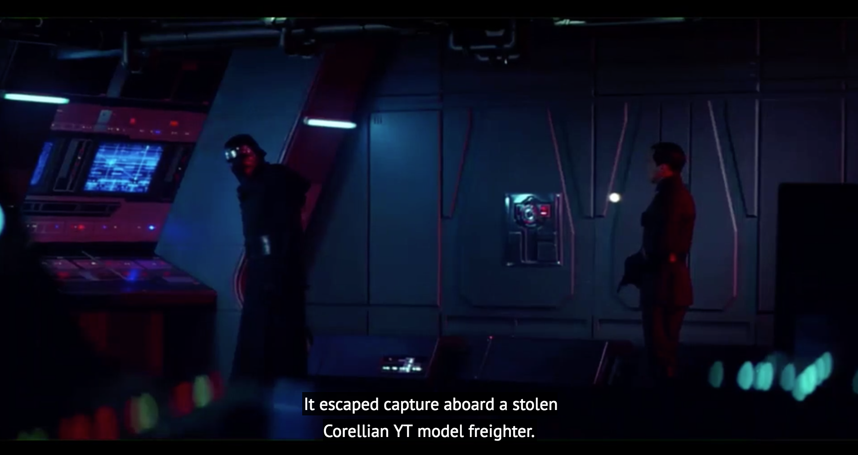

Slide 7
Current Captioning Issues
Three Main Problems:
Uncertainty as to which character is speaking
Conveying volume variations

Slide 8
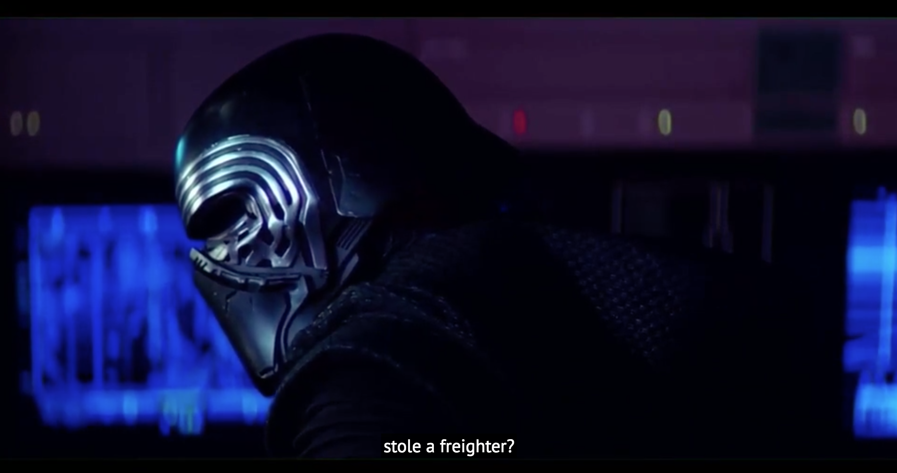

Slide 9
Current Captioning Issues
Three Main Problems:
Uncertainty as to which character is speaking
Conveying volume variations
Displaying contextually important sound words

Slide 10
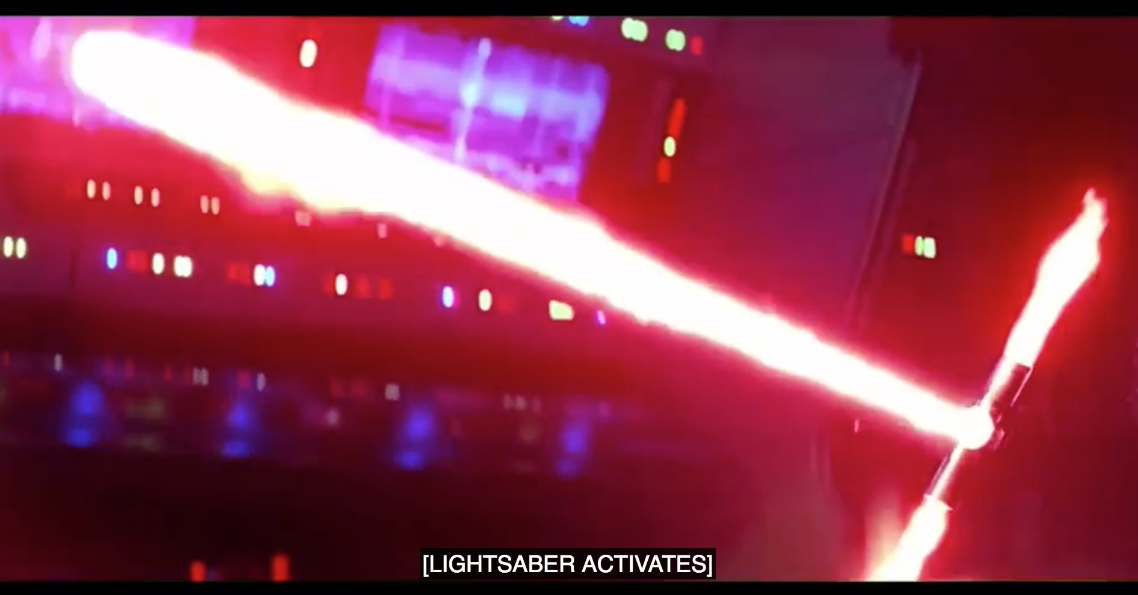

Slide 11
How will these problems be addressed?

Slide 12
The Solution
Uncertainty as to which character is speaking
Using suitable and obvious caption locations

Slide 13
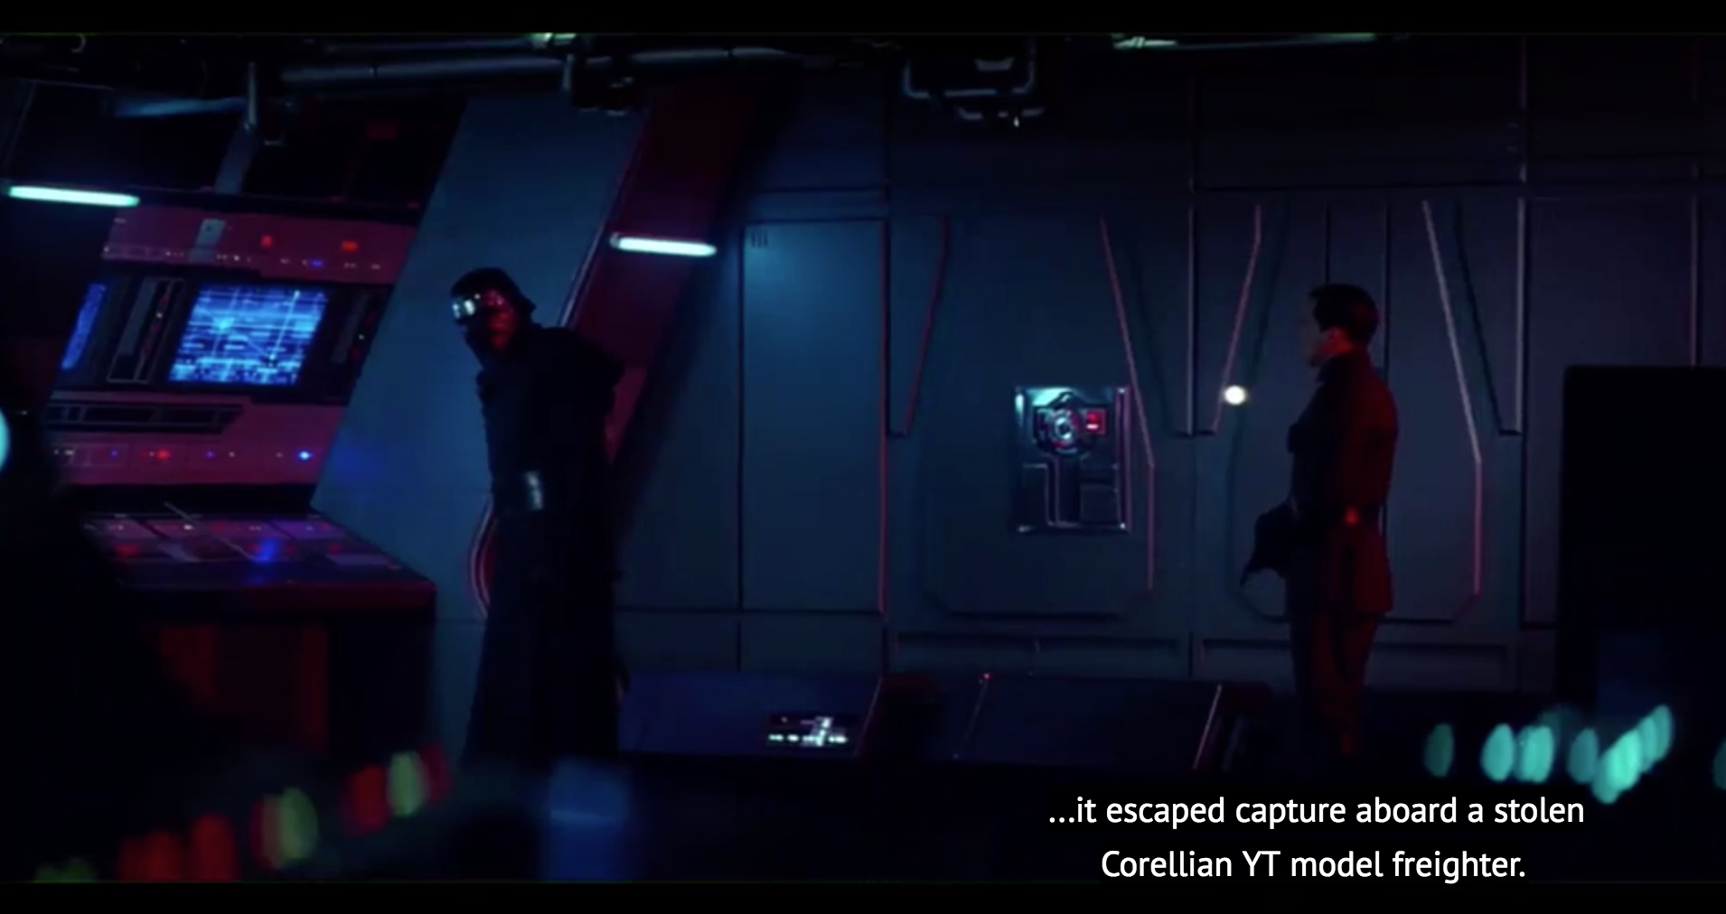

Slide 14
The Solution
Uncertainty as to which character is speaking
Using suitable and obvious caption locations
Conveying volume variations
Increasing and decreasing font sizes

Slide 15
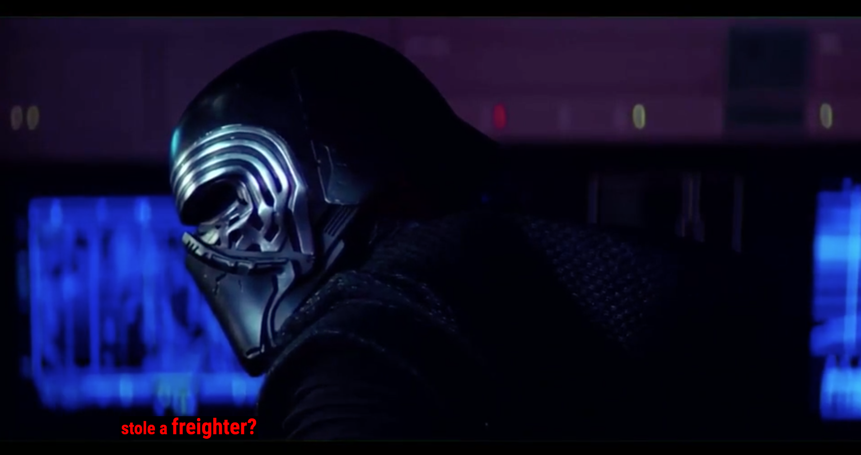

Slide 16
The Solution
Uncertainty as to which character is speaking
Using suitable and obvious caption locations
Conveying volume variations
Increasing and decreasing font sizes
Displaying contextually important sound words
Introducing contextually meaningful sound words

Slide 17
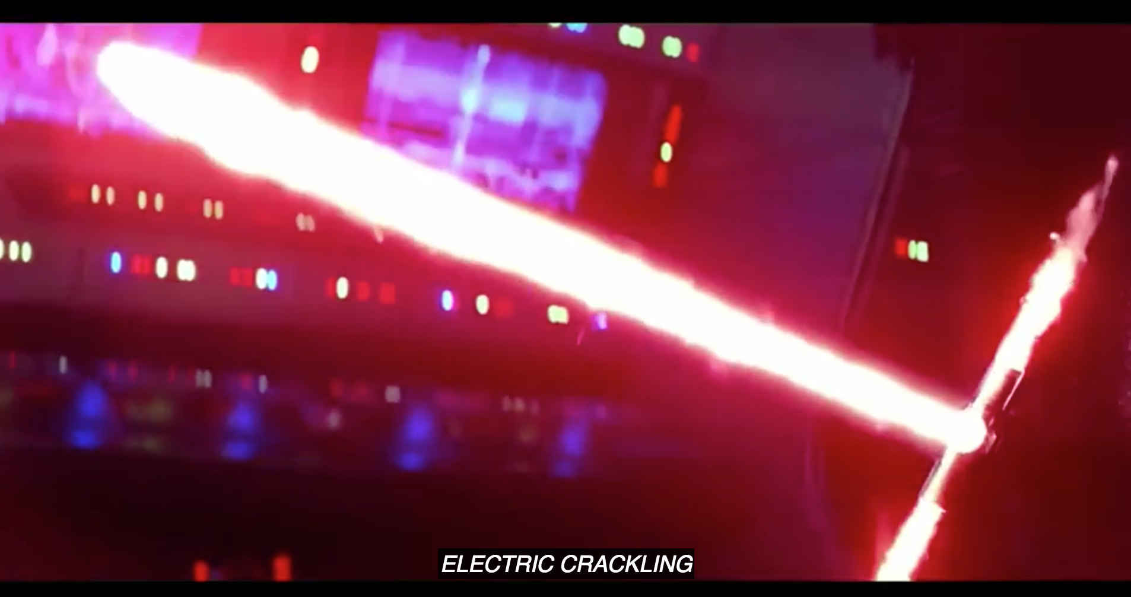
Notes:
Describing a sound vs. describing what’s happening (like lightsaber activating)

Slide 18
The Solution
Uncertainty as to which character is speaking
Using suitable and obvious caption locations
Conveying volume variations
Increasing and decreasing font sizes
Displaying contextually important sound words
Introducing contextually meaningful sound words

Slide 19
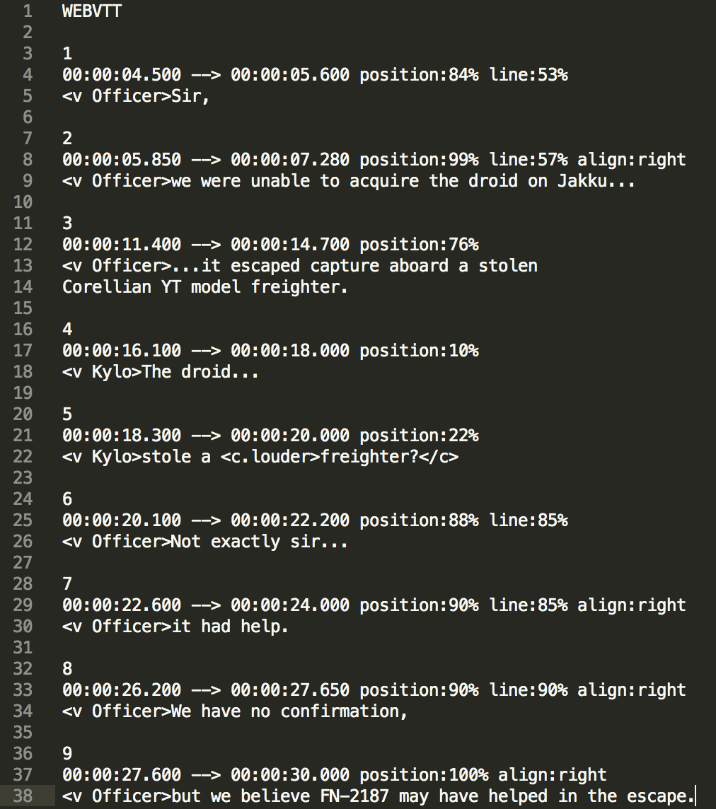
Methodology for re-captioning
Technologies used for web-based captions:
Web pages
Built with HTML, PHP, JavaScript, and CSS
Caption file
WebVTT (.vtt)
Styled using CSS
Bringing them together
HTML <video> tag, new web standard
Allows for a caption <track> to be easily added without embedding anything
Notes:
The way the tech I used applies to “My Solution”
<video> tag replaced having to pick a media player to be embedded, and the corresponding specific caption file
WebVTT → like a text file with timestamps for when to display a given amount of text (or caption)

Slide 20
Experiment Design
Technologies used for evaluating captions:
What’s the experiment?
Blind testing on two forms of captioning:
Industry standard (FCC) captions
“My” captions
Participants are randomly assigned one of the two videos
One survey for each video, both asking the same questions to compare results
Google Forms
An eight question survey asking about their caption viewing experience
Notes:
The way the tech I used applies to “My Solution”
<video> tag replaced having to pick a media player to be embedded, and the corresponding specific caption file
WebVTT → like a text file with timestamps for when to display a given amount of text (or caption)

Slide 21
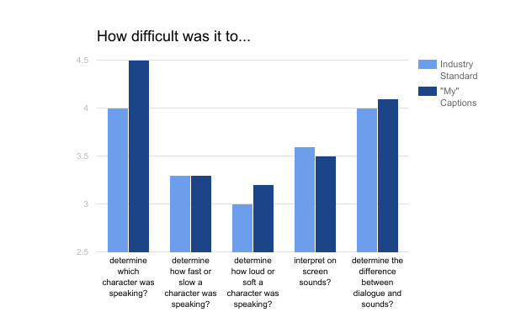
Survey Results

Slide 22
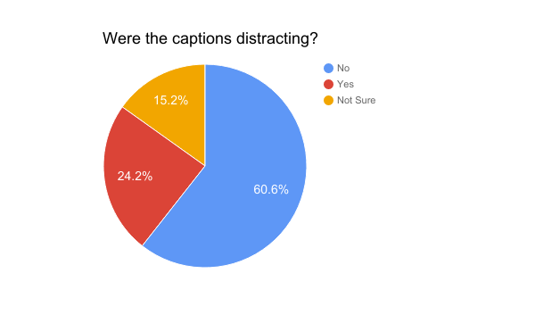
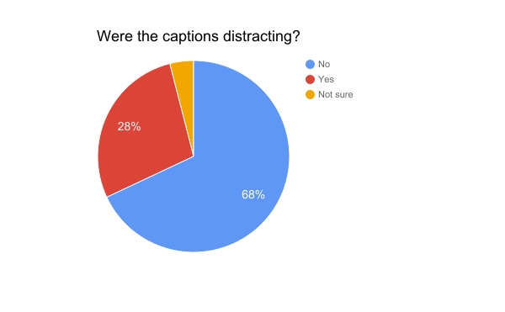
Evaluation
A slight improvement:
6.7 vs 7.3 overall
Sound words
Too similar to industry standard
More dynamic locations
Script location
Too distracting from the way people are used to
Speaking pace
Will be addressed in future work
Finding the happy medium
Need to better utilize the current captioning methods
Notes:
The way the tech I used applies to “My Solution”
<video> tag replaced having to pick a media player to be embedded, and the corresponding specific caption file
WebVTT → like a text file with timestamps for when to display a given amount of text (or caption)

Slide 23
Future Work
Automation:
Pattern recognition
Make scripts for commonly used methods (placement on screen or speaking volume)
Facial recognition
Easier to find suitable script location
Visual saliency analysis instead of timestamps
Current Issues continued:
Speaking pace
Karaoke-style
Highlighting text in real time
Sound Words
Better descriptions, make more obvious
Notes:
The way the tech I used applies to “My Solution”
<video> tag replaced having to pick a media player to be embedded, and the corresponding specific caption file
WebVTT → like a text file with timestamps for when to display a given amount of text (or caption)

Slide 24
Any questions?

