Slide 1


Controlling 3D Printers with Artificial Neural Networks
Frank Chiarulli Jr.
Advisor: John Rieffel

Slide 2
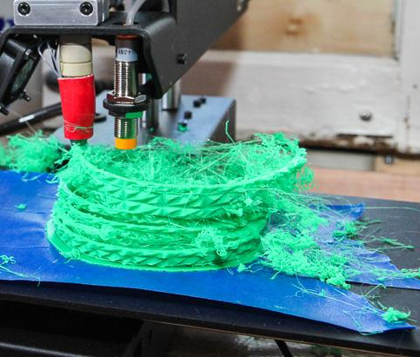
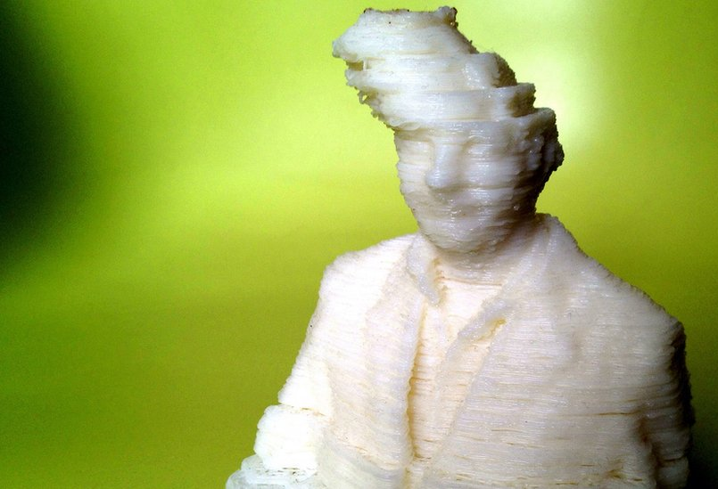
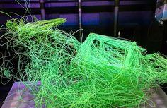

Slide 3
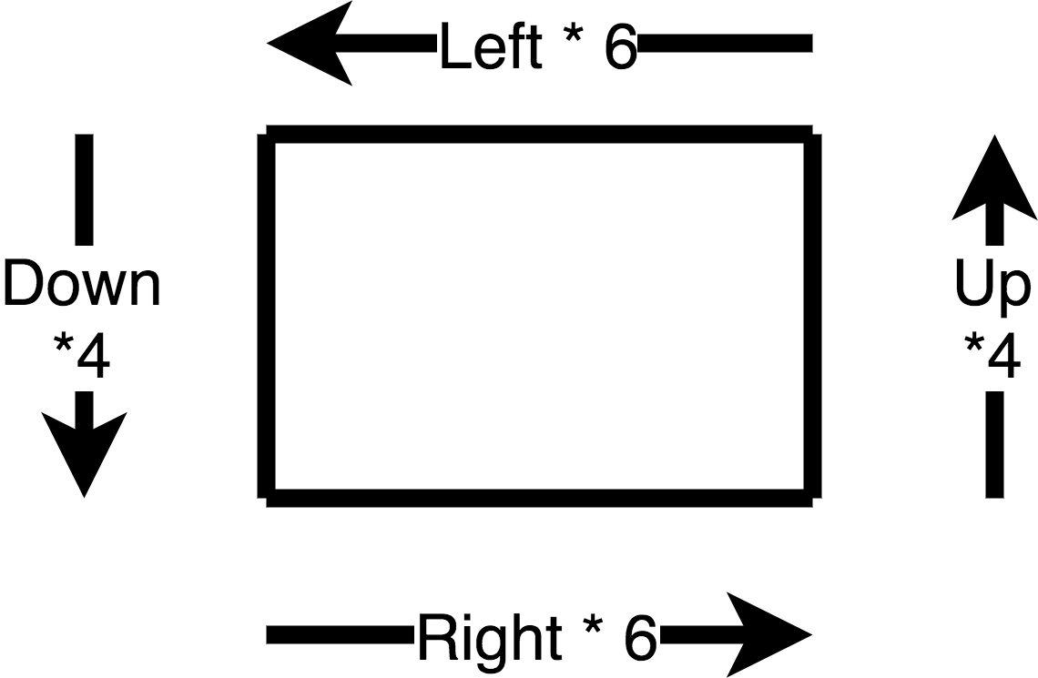
Linear Instructions (G-Code)

Slide 4
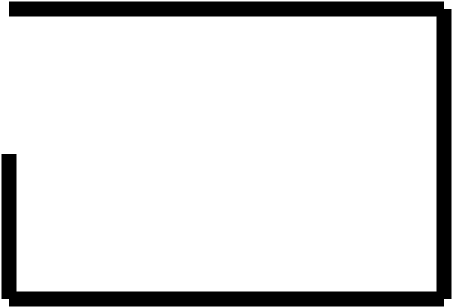

Slide 5
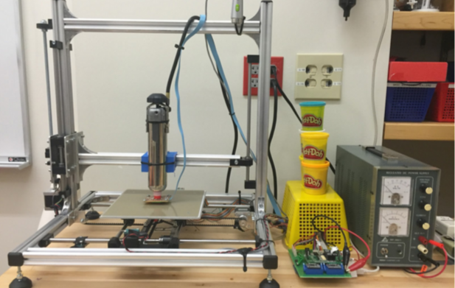
EvoFab 0.3 System

Slide 6
Input layer
Hidden Layer(s)
Output Layer
Notes:
What im trying to do is
Control linear instructions

Slide 7
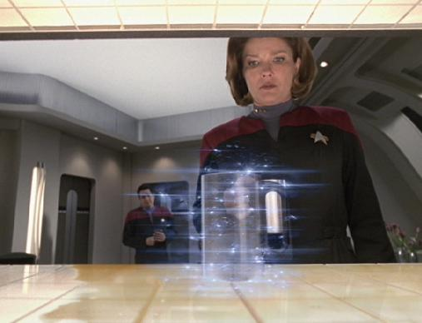
Pipe Dream
Notes:
Big picture, santa clause machine pete is going to talk more about this problem and im going to focus more on the more fundamental question of how you control a 3D printer with a Neural Network
Talk about Genetic algorithms

Slide 8
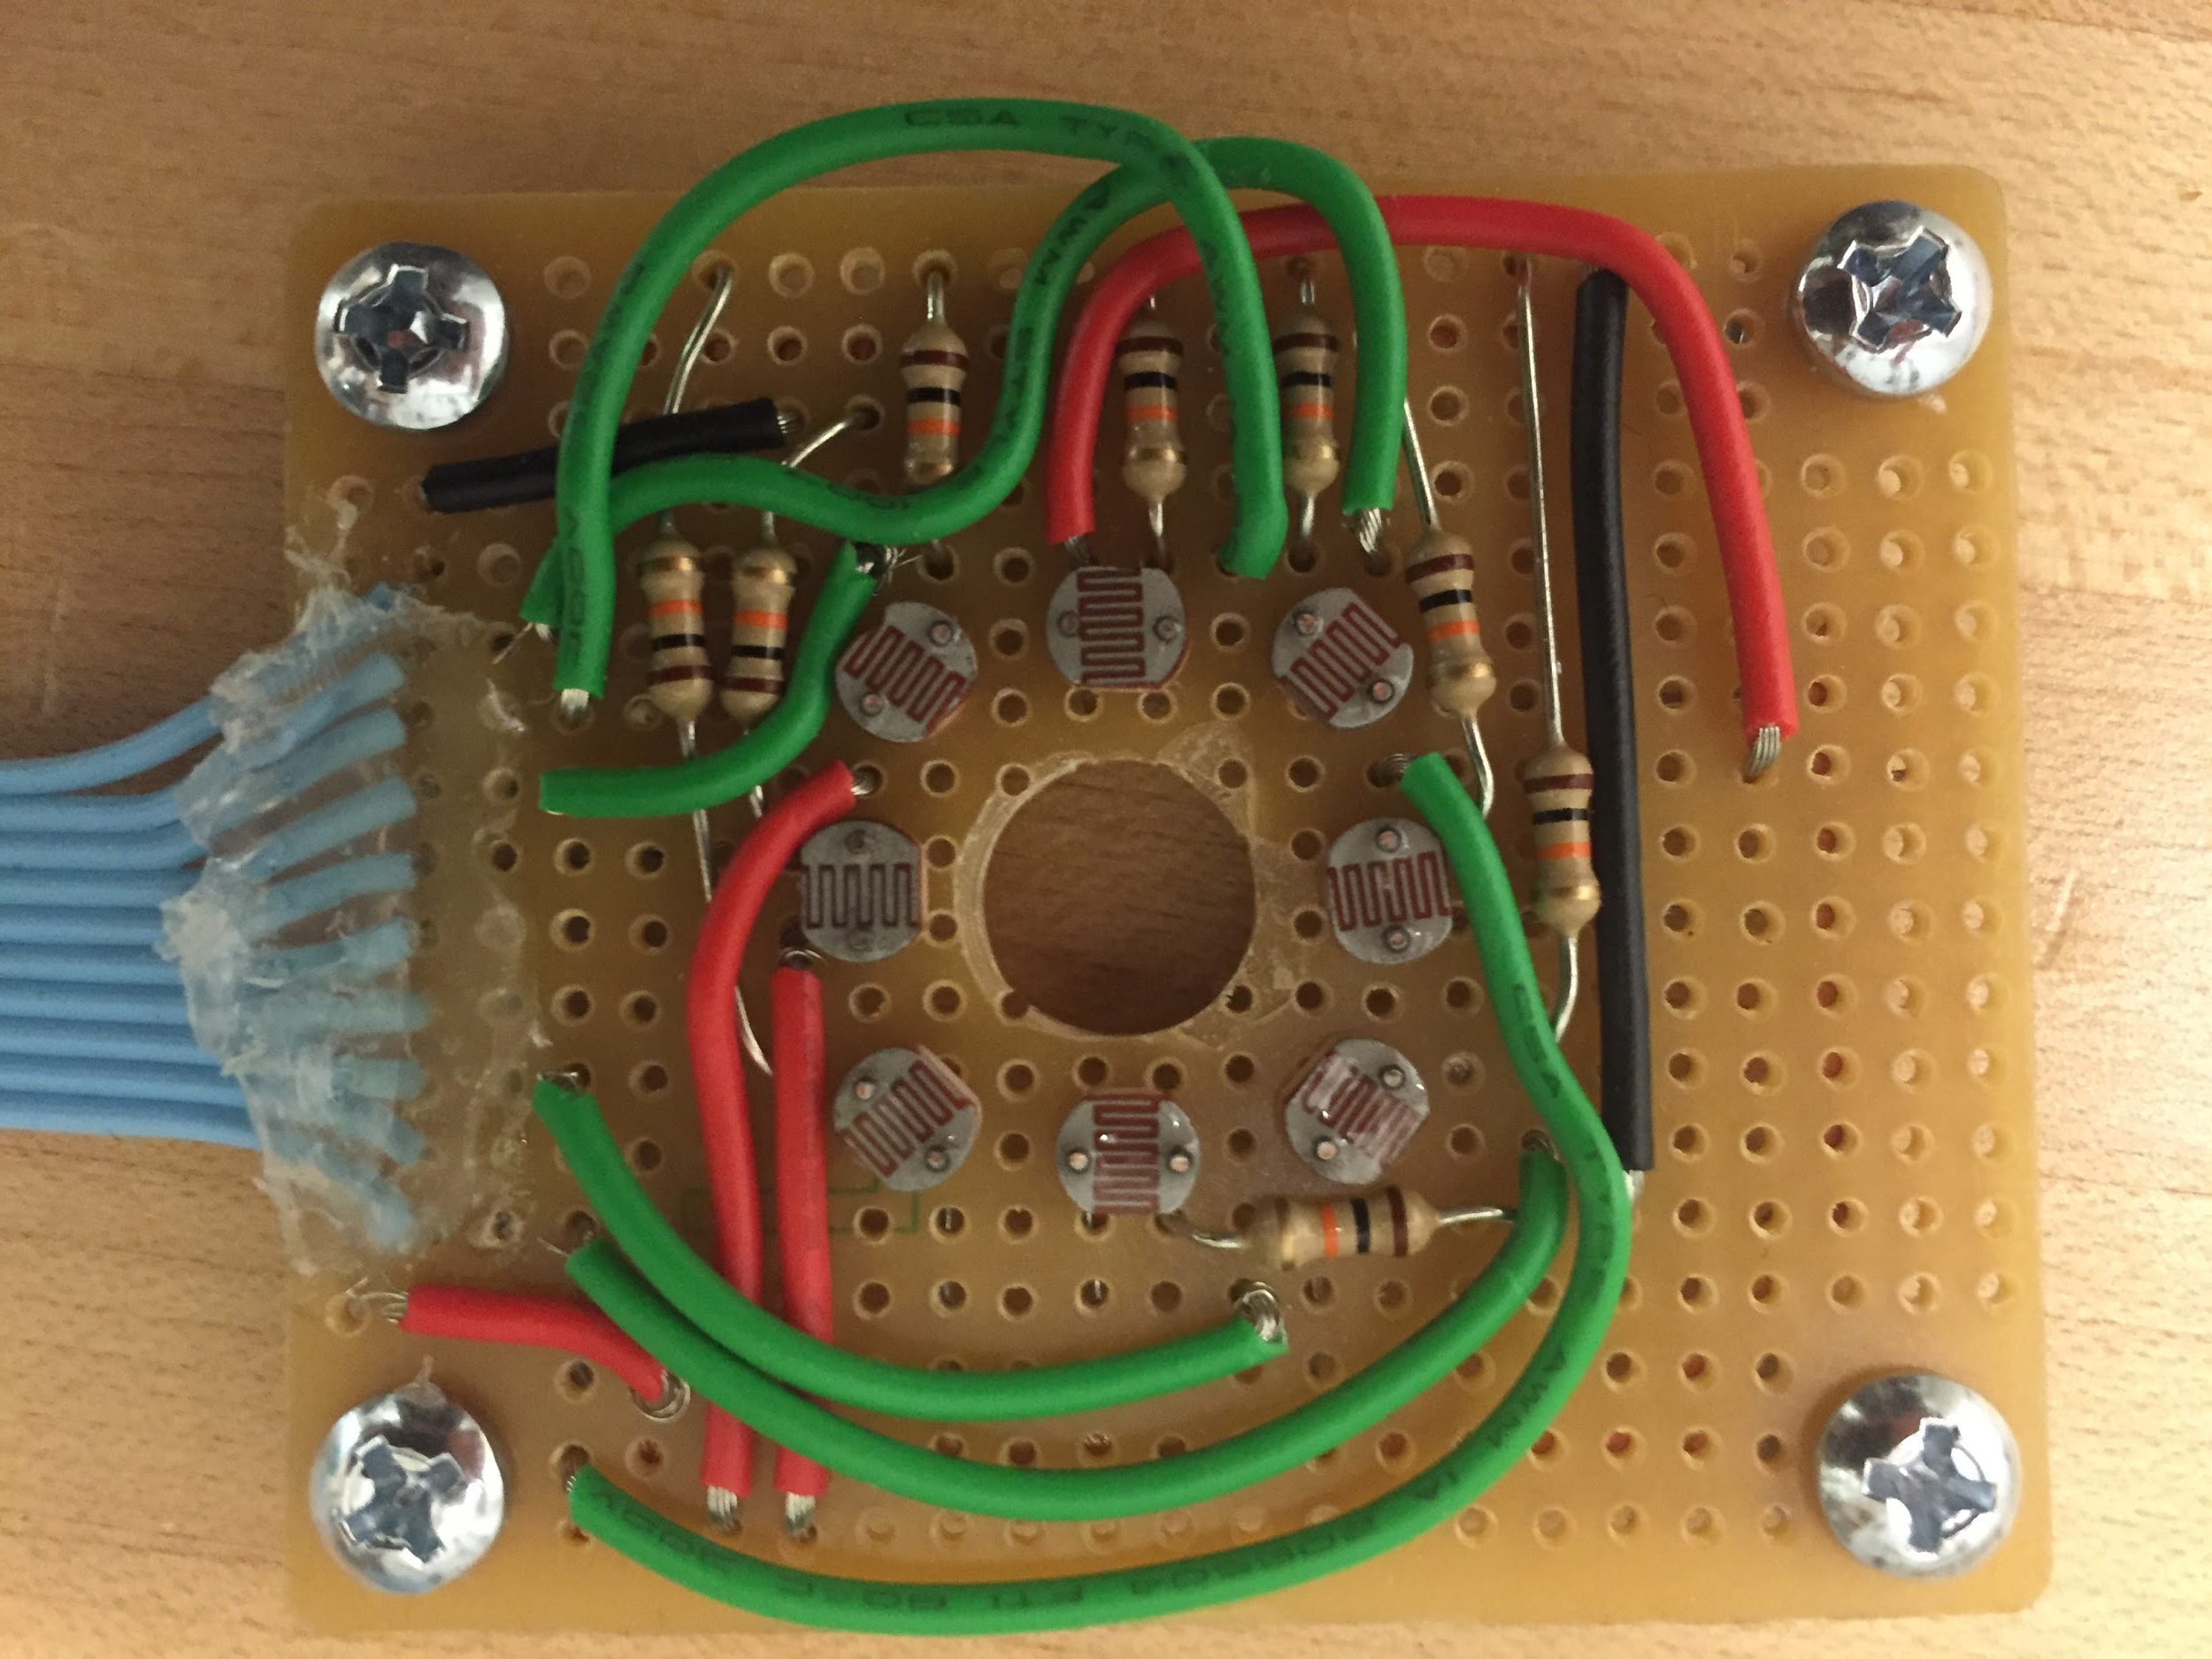
EvoFab 0.3 System

Slide 9
Notes:
Because they are canonically evolvable, they have been shown to perform well under optimization, evolutionary robotics has had a lot of success with them and
Known to behave well under the types of operations needed for our optimization
Evolutionary robotics has had success using this type of optimization

Slide 10
Notes:
Genetic Algorithms:
There is no training set
Training only works if there is a training set
A type of general purpose black box optimization algorithm
Black box optimization: it only needs to know the “fitness of a member” note, this is good because we want an open ended optimization
Don’t want to worry about what factors the ANN is worrying about, don’t want to bias my testing such that I am making assumptions that make it do better in the general purpose
Because
We are trying to ask a question about the type of

Slide 11
Notes:
What im trying to do is
Control linear instructions

Slide 12
Alas, 3D printers are slow, so simulation!
Notes:
For the purpose of deciding whether or not 3d printers will work with ANNs -- simulation
is possible to artificially evolve successful network-based control systems in simulation that generate almost identical behaviors in reality” as long as much care is taken in creating such a simulation and noise is included

Slide 13
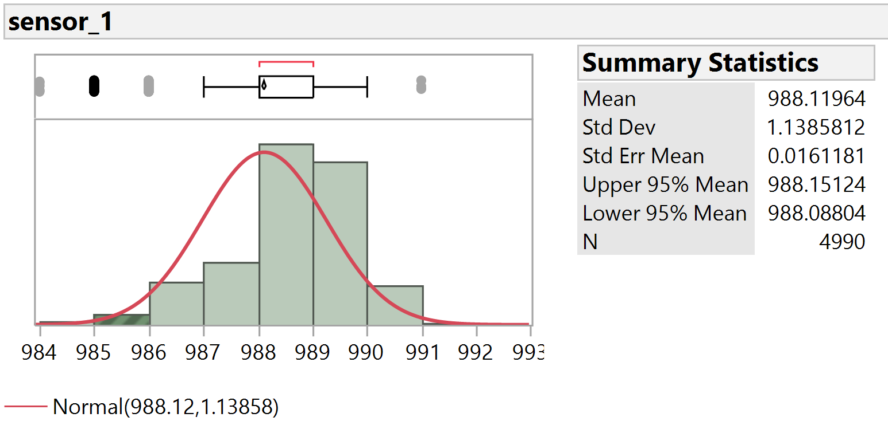
Modeling Noise: Sensor Data
Notes:
Sampled raw sensor data over 5 minutes
Model using Gaussian Noise Function with mean zero[2]
[2] Foi, A., M. Trimeche, V. Katkovnik, and K. Egiazarian. "Practical Poissonian-Gaussian Noise Modeling and Fitting for Single-Image Raw- Data." IEEE Transactions on Image Processing 17.10 (2008): 1737-754.

Slide 14
Modeling Noise: Motor & Belt Noise
Empirical Models
Observed printer during linearly instructed test prints
Captured video via Overhead webcam
  Multiple trials

Slide 15
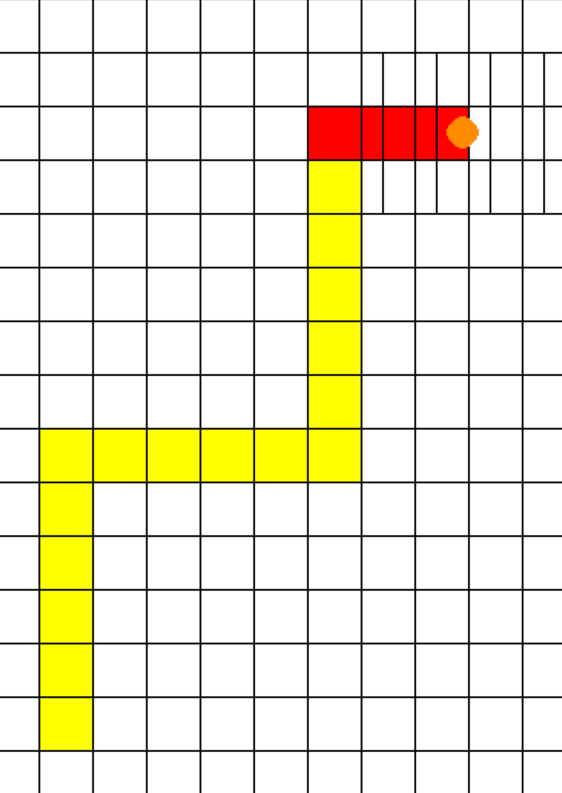
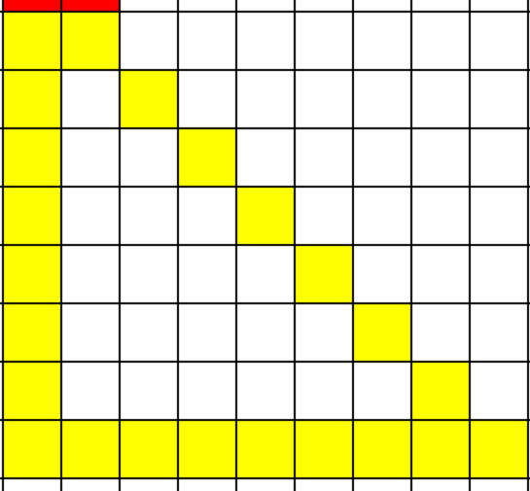
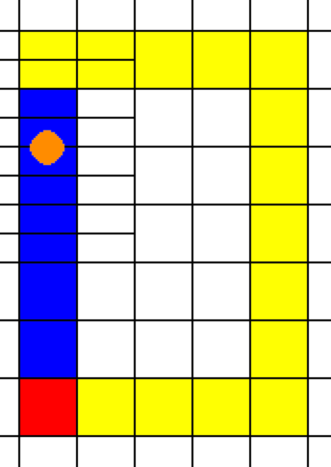
The Problem
Notes:
Problem is drawing a shape

Slide 16
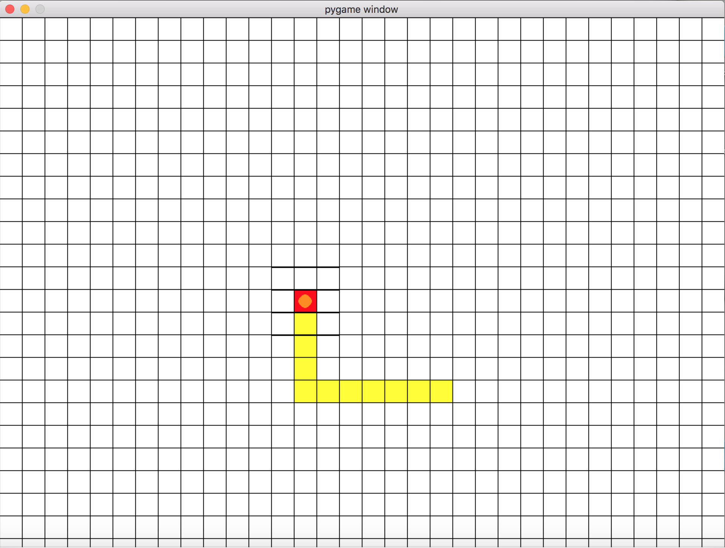
Printer Simulator
Notes:
If i evolve it without noise and test it under noise it does nothing
But when i evolve the weights to solve a goal shape it can do that

Slide 18
Control
Traditional Linear Instructions
  Go left, right, up, down, etc, for X number of steps

Slide 19
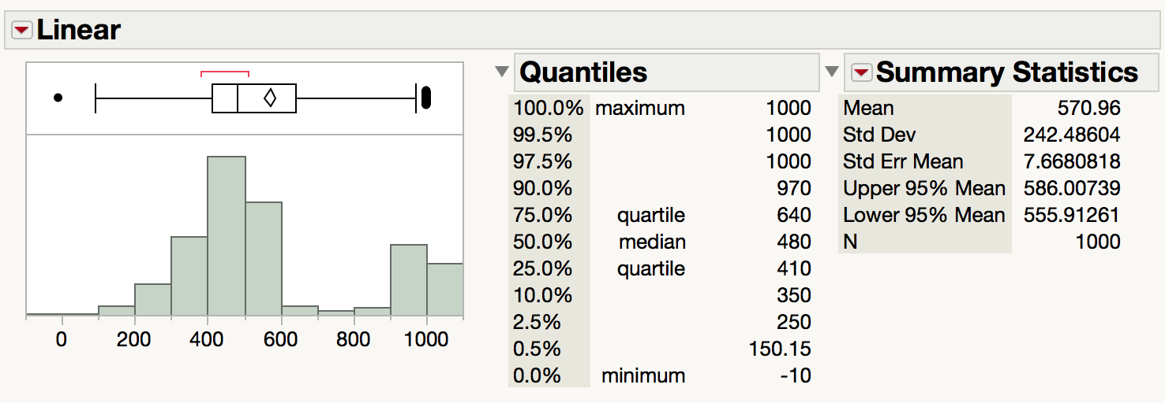
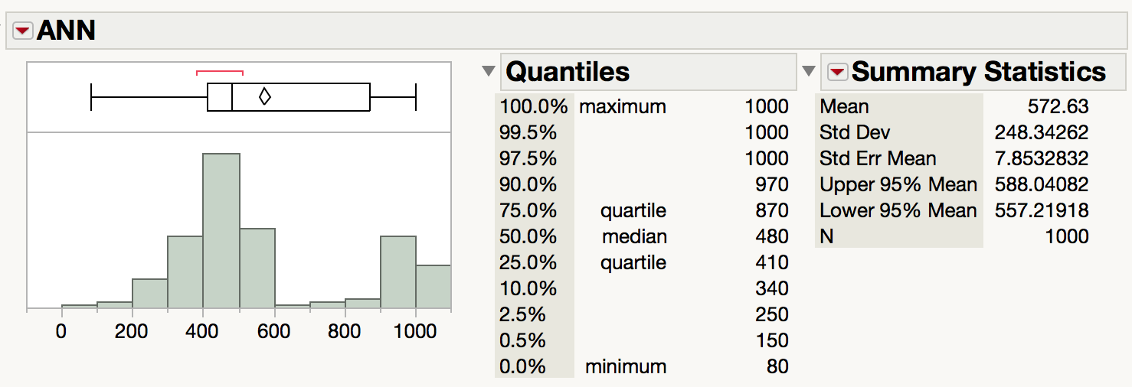
Notes:
Almost Identical, ANN 2 point greater mean

Slide 20
What we have?
A fully functional 3D printer capable of running on our ANN
A simulation of the current state of our 3D printer
A Model of the noise of our physical system
Preliminary findings that suggest that ANNs can perform as well as linear instructions

Slide 21
Where from here?
Increase the input data of the neural network
Looking into different types of optimization
  Are GAs the right choice?
Physical trials, are we over/under complicating the simulation
More nuanced fitness functions?

Slide 22
Questions?

