Slide 1
The Effects of Cashtags in Predicting Daily DJIA Directional Change
By: Vincent Chee
Advisor: Professor Aaron Cass

Slide 2
Background and Motivation
Efficient Market Hypothesis
Stock market prediction still area of interest
Many variables impact market
Focus: Public sentiment
Sentiment source: social media (Twitter)
Cashtag Tweets
E.g. Keep an eye on the new iPhone $AAPL stock to rise!
Machine Learning
Sentiment Analysis
Apple is the worst!
Figure 1. example of what I’m trying to model.
Notes:
Despite the Efficient Market Hypothesis, stock market prediction is still an area of interest for researchers and investors.
The market moves due to many variables, one variable that is often of interest to researchers is public sentiment, and how it may impact the market and thus possibly help in better predicting market movement.
The idea is that emotions and mood are a driving force behind financial decisions and by capturing public sentiment we might be able to better predict the future.
There are several sources of public sentiment online, however we’ve chosen to use Twitter.
As I was initally searching for tweets of companies names to get an idea of the content of these Tweets, we noticed that there were tweets with stock ticker symbols, or cashtags. So we were interested in investigating whether building the model including the cashtag attribute which indicates whether a Tweet contained a cashtag or not would result in a better model.
We hypothesize that including the cashtag attribute may result in a better model. The idea is that maybe cashtag tweets are more positive or negative about the stocks than they should be, so including the cashtag feature might enable the ML algorithm to discover that and discount or account for the effect of cashtag tweets.
In order to investigate this, I will use machine learning to build two classification models, a model with the cashtag attribute and a model without.
We’ve chosen to use machine learning because the method automates analytical model building, which is especially useful when dealing with large datasets.
We also use sentiment analysis to gather sentiment data. This is the process of using natural language processing and text analysis, to identify and categorize opinions expressed in a piece of text as positive or negative.

Slide 3
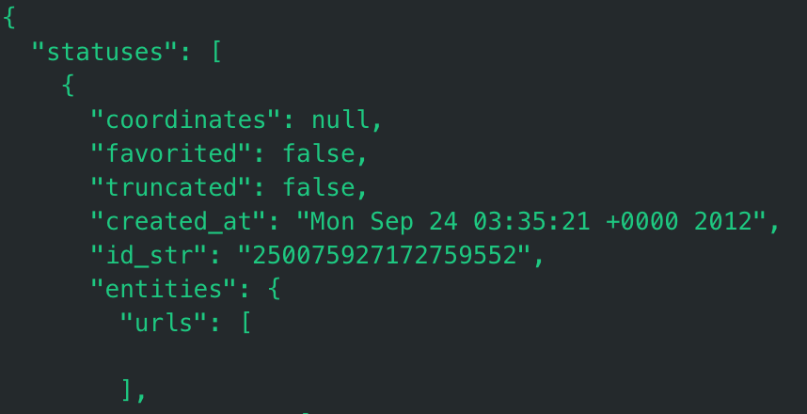
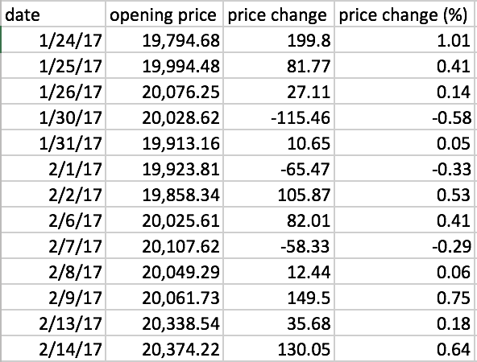
Our Approach: Data Mining
Twitter
Google Finance
Mine tweets
Download stock data
Tweet metadata
Stock data
Figure 2. Snippet of Tweet metadata
Figure 3. Snippet of stock data
Notes:
So to begin, we mined a little over 2 million Tweets from December 8th 2016 to May 18th 2017 using the Twitter API. We chose Twitter because it has an easy to use API, vast amounts of data and people often use it to express their thoughts.
We calculated our market performance variable, the daily price change, with the DJIA opening stock prices we obtained from Google Finance.

Slide 4
Our Approach: Tweet-Level Data
Tweet metadata
Stock data
Tweet Level Program
Sentiment of Tweet on 12/20
Date | Query | Cashtag | Sentiment | Price Change (%)
12/20/2016 | $AAPL | 1 | 0.5 | 0.07
12/20/2016 | $AAPL | 1 | 0.5 | 0.07
12/21/2016 | Apple | 0 | -0.7 | 0.01
12/22/2016 | Apple | 0 | 0.2 | 0.04
Price change from 12/20-12/21
Notes:
Once we have the necessary data, we input it into a python program we wrote, which extracts the sentiment of each Tweet and ultimately collates the data so that the tweet date and price change date aligns.
One problem we encountered was the market being closed on the weekends so there is no price change data for the days Friday thru Sunday. To resolve this issue, we remove all weekend instances.
Now we have a file where each row is an instance representing a single tweet posted on date x, with the sentiment score of that tweet as well as the price change from date x to x+1.
However, these instances don’t capture what I am trying to model in order to answer my research question.
Each of these instances is representative of a single Tweet thus, the sentiment of a single Tweet, however what we really want is public sentiment.

Slide 5
Our Approach: Aggregate-Level Data
Date | Query | Cashtag? | Sentiment | Price Change (%)
12/20/2016 | $AAPL | 1 | 0.5 | 0.07
12/20/2016 | $AAPL | 1 | 0.5 | 0.07
12/21/2016 | Apple | 0 | -0.7 | 0.01
12/22/2016 | Apple | 0 | 0.2 | 0.04
Tweet-Level Data
12/08/2016 → 05/18/2017
CDGR: 0.04%
CDGR ± 0.019: on trend (uncertainty)
>= 0.06: GT trend
<= 0.02: LT trend
Aggregate-Level Program
Date | Cashtag? | Average Sentiment | Price Change (%) | Increase/ Decrease
12/20/2016 | 1 | 0.5 | 0.07 | GT trend
12/21/2016 | 0 | -0.7 | 0.01 | LT trend
12/22/2016 | 0 | 0.2 | 0.04 | On trend
Notes:
To resolve this, we want to aggregate the sentiment of all Tweets on one day into a single row so each instance now captures public sentiment rather than just the sentiment of a single tweet.
We also normalized for the natural upward trend of the DJIA. That is, on some days the price change is actually more positive or negative than the normal increase and we wanted to capture this. So, we calculated the compounded daily growth rate over the observed period and used this value to compare with the price change in order to assign a label to each instance.
Now each row of the aggregate level data represents an instance of the average sentiment of a query on date x with the price change from date x to x + 1 as well as the labeled class. We now have the necessary data to build the model.

Slide 6
Results
Statistic | Model w/ Cashtag Attribute | Model w/o Cashtag Attribute
Total Correctly Classified Instances (%) | 65.2 | 66.9
GT Trend Correctly Classified Instances (%) | 76.6 | 78.4
LT Trend Correctly Classified Instances (%) | 53.6 | 55.5
Dataset
(1)
(2)
lazy.IBK ‘-K 2 –W 0 –A \ ”(100)
66.92
65.26
v – statistically significant compared to ‘baseline’
– uncertain
* – stastically insignificant
(v/ /*)
(0/1/0)
Key:
’wekaized_tweets (x=0) non-cashtag data’
’wekaized_tweets (x=0) cashtag data’
Notes:
The machine learning algorithm I’ve chosen to use to build the models is Instanced Based-k or IBk which implements the k-nearest neighbor algorithm. k-nearest neighbor classification works by classifying objects based on a majority vote of its neighbors, the object is assigned to the class most common among its k-nearest neighbors.
We also used Cross Validation Parameter Selection and ran IBk within it in order to find the value of k which yields the model with the highest number of correctly classified instances, k was equal to 2 for both models.
These are the results of the two models after running a 10 fold cross validation.
When we take a look at the % of correctly classfied instances for the total, gt trend and lt trend, we can see that the non-cashtag model outperforms the cashtag model in all three.
Now, let’s quickly go over these numbers. Coincidentally there isn’t a single instance labeled on trend, so we have 2 labels: GT trend and LT trend, and given our resampling, the baseline for these models is 50%. So both these models slightly outperform the baseline. When we look at the value of GT trend vs. LT trend, we can see that both models were able to classify the gt trend instances far better than the lt trend instances. It outperforms the baseline here by over 25% in both cases whereas the classification for the LT trend instances does slightly better than a coin flip.
It also has a higher area under the ROC (receiver operating characteristic) curve, this number is one indication of the accuracy of the test - how well the test separates the instances being tested into those that are GT trend and LT trend. Another way to interpret the number is the expected proportion of positives ranked before a uniformly drawn random negative.
Finally, we conducted a corrected paired t-test on the total correctly classified instances to determine significance of the two models. The results of the t-test indicates that we are uncertain whether one model performed better than the other as indicated by the blank space. If a v appeared to the right of 65.76, then significant.

Slide 7
Discussion
Model w/o cashtag attribute appears to slightly outperform model w/ cashtag attribute
t-test: Stastically insignificant
Model is far better at classifying GT trend instances
Sentiment analyzer
Cashtag attribute may not be a useful feature to include
Confuses ML algorithm
Notes:
It appears that the non-cashtag model outperforms the cashtag model slightly. However, the results indicate that our hypothesis that including cashtags as an attribute may provide the model with information that improves its predictability is wrong. However, the t-test in the previous section indicates that we cannot conclude whether the model outperforming the other is significant or not.
Both models were better at capturing GT trend, so the sentiment analyzer was likely able to categorize Tweets as positive more accurately, sometimes it’s hard to capture negative sentiment – for example, someone being sarcastic.
This could indicate that the sentiment provided by cashtag tweets isn’t more or less accurate than it should be and thus by including this extra feature, all we end up doing is providing it information which adds noise to the model.
So to improve upon this in the future…

Slide 8
Future Work
Remove or mark Twitterbot Tweets
Include number of followers of Tweet author as attribute in model
Average number of followers when aggregated
Some influence over followers
Sentiment Analyzer
Trained on Tweets
Notes:
One improvement could be to remove Tweets posted by Twitter bots because the data produced by these bots creates noise when aggregating public sentiment.
Investigating the number of followers as a feature may be interesting as we will determine whether Tweets by users with more followers a more accurate sentiment, that is, the sentiment score is more in line with the price change that day.
Finally, one final improvement would be to use or build a sentiment analyzer which is trained on Tweets. The sentiment analyzer we used was trained on the Pattern library and has roughly a 75% accuracy rate on movie reviews. Given the unique nature of Tweets, 140 characters, using an analyzer solely trained on Tweets will likely lead to more accurate sentiment data and hopefully a better overall model.

Slide 9
Questions?

Slide 10
Time Lag
Hypothesis: Tweet sentiment on day x may not impact DJIA price change on day x to day x+1.
Weekend cases
Date | Query | Other metadata | Sentiment | Price Change (%)
12/20/2016 | $AAPL | ? | 0.5 | 0.07
12/21/2016 | Apple | ? | -0.7 | 0.01
12/22/2016 | Apple | ? | 0.2 | 0.04
X = 0: Price change from 12/20 - 12/21
Date | Query | Other metadata | Sentiment | Price Change (%)
12/20/2016 | $AAPL | ? | 0.5 | 0.01
12/21/2016 | Apple | ? | -0.7 | 0.04
12/22/2016 | Apple | ? | 0.2 | 0.10
X = 1: Price change from 12/21 - 12/22
Figure 3. Example of time lag.
Notes:
Before delving into the model, it is important to note that we experimented with a time lag. We hypothesize that the tweet sentiment on day x may not have an immediate impact on the DJIA price change on day x to x+1. In order to investigate this for a lag of 1 day for example, we essentially shift the price change up one row, so that the sentiment on day x is aligned with the price change from day x+1 to day x+2, and so on as we increase x. However, there is a problem if we try to implement the lag because sometimes we end trying to find the DJIA price change on the weekend and we have no data on these dates. So, we just threw out these instances.

Slide 11
Time Lag Results
Statistic | X = 0 |  | X = 1 |  | X = 2 |  | X = 3
 | Cashtag | Non-cashtag | Cashtag | Non-cashtag | Cashtag | Non-cashtag | Cashtag | Non-cashtag
Total Correctly Classified Instances (%) | 67.8 | 65.2 | 60.6 | 68.4 | 68.9 | 66.6 | 63.6 | 68.6
GT Trend Correctly Classified Instances (%) | 77.8 | 68.3 | 72.3 | 78.4 | 79.8 | 75.5 | 62.6 | 71.9
LT Trend Correctly Classified Instances (%) | 57.8 | 62.0 | 48.9 | 58.4 | 58.1 | 57.8 | 64.6 | 65.4
Kappa Statistic | 0.36 | 0.30 | 0.21 | 0.37 | 0.38 | 0.33 | 0.27 | 0.37
ROC Area | 0.760 | 0.747 | 0.681 | 0.764 | 0.752 | 0.757 | 0.729 | 0.761
Notes:
Upon reviewing the results, it is quite clear that neither
Overview of results
Have a table
Ibk
Evaluation of the results – looking at the correctly classified instances, and other statistical signifiers in order to determine if the results are significant at all or not, if they aren’t we can discuss why in the next section.

Slide 13
Precision = t_p / (t_p + f_p)
Recall = t_p / (t_p + f_n)
F-score = 2 * Precision * Recall / (Precision + Recall)
t_p: true positives
f_p: false positives
f_n: false negatives
Notes:
A paired t-test is used to compare two population means where you have two samples in which observations in one sample can be paired with observations in the other sample.

