Slide 1
Data Mining & Machine Learning Approach to Predicting the March Madness Tournament
Jermaine Carn
Advisor: Nick Webb

Slide 2
Motivation & Hypothesis
To find a model for predicting games in the NCAA Basketball Tournament that relied on statistics. More objective approach.
Gain in depth knowledge about specific matchup.
Hypothesis: a hybrid model will provide higher classification accuracy than simply picking the higher seed.
Notes:
Mention what hybrid model is

Slide 3
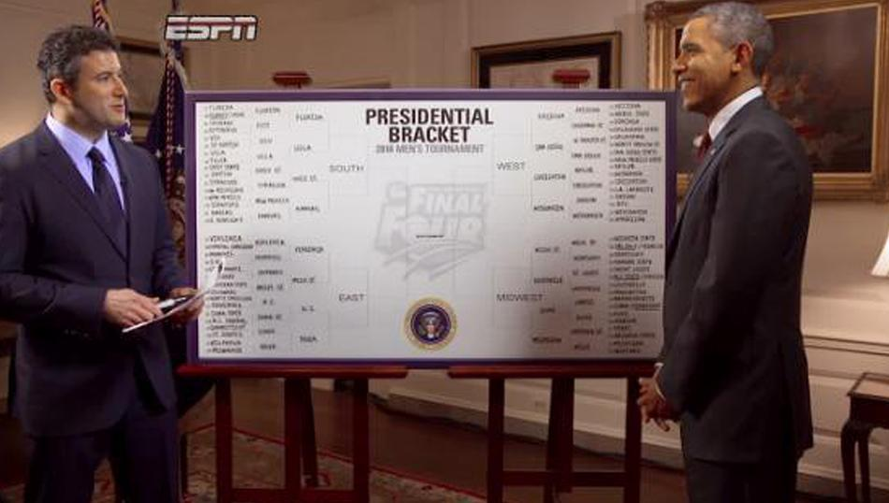
Example Bracket
1 in 9.2 quintillion chance of correctly completing the bracket
Former President Obama pulled out a 63% for the 2016 Tournament

Slide 4
Data
How, What & Where
sports-reference.com/cbb/ (Season statistical totals): FGM, FGA, 3PM, FTM, FTA, ORB, DRB, TOV, OPP ORB, OPP DRB.
basketball.realgm.com/ncaa/team-stats: ORB and DRB
http://www.cbssports.com/collegebasketball/rankings/nitty-gritty-report: Rating Percetnage Index (RPI)
Computed Dean Oliver’s Four Factors (eFG, TR, ORBR, FTR) from aforementioned stats.
1008 total instances
Notes:
There are box score stats available for each team like fga, fta. Scraped those from different websites
Used 2000-2015 for training purposes and held out 2016 for testing.

Slide 5
Advanced Stats
Rating Percentage Index (RPI) = (WP × 0.25) + (OWP × 0.50) + (OOWP × 0.25)
Dean Oliver “Four Factors”:
(40%) Effective Field Goal Percentage (eFG)
Measure of shooting efficiency that accounts for three pointers being worth more.
(25%) Turnover Ratio (TR)
An estimate of turnovers per possession.
(20%) Offensive Rebounding Percentage (ORBR)
Measure of offensive rebounds obtained out of all possible offensive rebounds.
(15%) Free Throw Rate (FTR)
Measures how often a team gets to the free throw line.
Notes:
The RPI is a measure of strength of schedule. Strength of schedule refers to the degree of difficulty a given team opponents are in comparison to another team's opponents.
The statistician Dean Oliver discusses a measurement called the ”Four Factors” that determine the success of a basketball team. The "Four Factors”, with their corresponding weights in parentheses.

Slide 6
Experiment 1: All Data
2000-2015 Data
1008 instance and all attributes
Higher Seed: 64.6825%
Algorithm | ZeroR | OneR | J48 | JRip | IBk (k=1) | SMO | LibSVM
Accuracy | 49.6032 | 64.6825 | 82.0437 | 74.4048 | 83.4325 | 60.7143 | 86.8056
Notes:
All algorithms were statistically worse than LibSVM at 5% level.

Slide 7
Experiment 2: Matchup Data
Looking at 2 different matchups: Possible Upsets and Toss Ups.
Possible Upsets Dataset
Defined as when the difference in seeding is greater than 4.
286 instances
Toss Up Dataset
Defined as difference in seeding being no larger than 4.
394 instances
Notes:
Dataset for Possible Upset contains half upsets and half non upsets.
Dataset for Toss Up consist of all possible toss up games.
Make clear that the following is on 2000-2015
Mention that i am trying to learn over the entire tournament and look these different types of matchups

Slide 8
Experiment 2: Results
Possible Upset
Toss Ups
Algorithm | ZeroR | OneR | J48 | JRip | IBk (k=1) | SMO | LibSVM | Higher Seed
Accuracy | 48.951 | 68.5315 | 79.7203 | 69.9301 | 81.1189 | 67.1329 | 84.6154 | 56.993
Algorithm | ZeroR | OneR | J48 | JRip | IBk (k=1) | SMO | LibSVM | Higher Seed
Accuracy | 47.9167 | 80.7292 | 87.5 | 85.4167 | 89.0625 | 72.3958 | 93.2292 | 61.4583
Notes:
Using the WEKA interface, ran these 7 algorithms to find accuracy levels.
A comparison of the algorithms resulted in all of the algorithms being statistically worse than LibSVM except for IBk in which there was no statistical difference all at P(x≥ .05).

Slide 9
Attribute Subset Selection
Started with 35 attributes
Possible Upset
Final Subset (5 attributes): Free Throw Attempts (FTA), Defensive Rebounds (DRB), Field Goal Attempts (FGA 2), Free Throw Attempts (FTA 2), Defensive Rebounds (DRB 2)
Toss Ups
Final Subset (4 attributes): Field Goals Made (FGM), Field Goal Attempts (FGA), Free Throw Attempts (FTA), Free Throw Made (FTM)
Notes:
Note that I removed seed and year from the upset and toss up dataset and started with 35 attributes.
Using WEKA and comparing different subsets using significance test, I found the following subsets for each matchup
PROVIDE INSIGHT ON FINAL SUBSET!

Slide 10
Experiment 3: 2016 Data
Baseline 1: Picking higher seed
68.254%
Baseline 2: General Model
LibSVM: 68.254%
Hybrid Model
Possible Upsets
LibSVM: 75%
Toss Ups
IBk: 68.4211%
Overall Accuracy: 73.02%
Notes:
Mention what the General Model is: using entire dataset and finding subset of attributes then testing the 2016 tournament over it.
Hybrid is breaking the 2016 tournament into the two matchups than testing over the respective 2000-2015 data

Slide 11
Discussion & Future Work
More data points
Additional statistics
Notes:
Discuss what results and subsets tell me about the matchups (Reaffirms that its hard and where the subset tells me where the focus should be).
Possible expansion to including regular season games as well. Then dividing those into Possible Upsets and Toss Ups.
Additional statistics should be included to get a better picture of the identity of a team. Stats such as win/loss streak going into the tournament, True Shooting Percentage and other advanced stats. This may give us a better picture of the makeup of a team being that box scores stats can be influenced by the level of competition played over the season.

