Slide 1
Power Outage Prediction via Twitter
Rodolfo Santana
Advisors: Chris Fernandes
Nick Webb

Slide 2
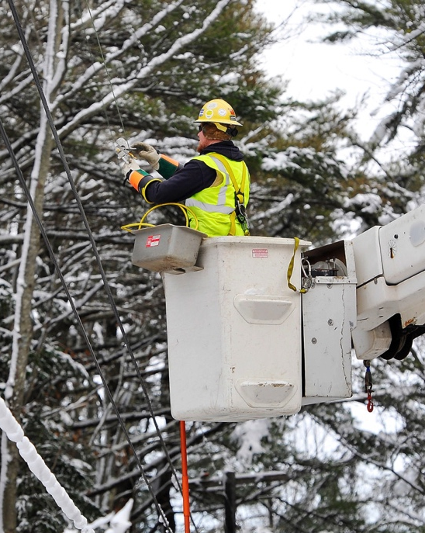
Motivations
Identification of weak points in system
Help improve reaction and restoration time

Slide 3
Process Diagram

Slide 4
Data Collection
Tweets that:
Contain searched terms
Power outage
Power failure
Flickering lights
Etc.
Are geo-tagged

Slide 5
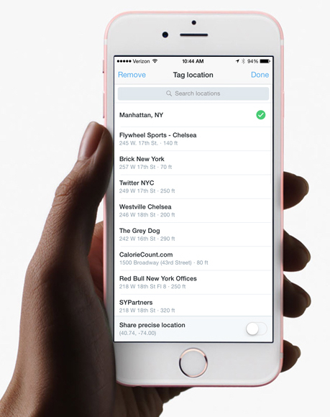
Getting the Precise Location
Location Types:
Admin (State)
City
Neighborhood
POI (Point of Interest)
Sharing Precise Location

Slide 6
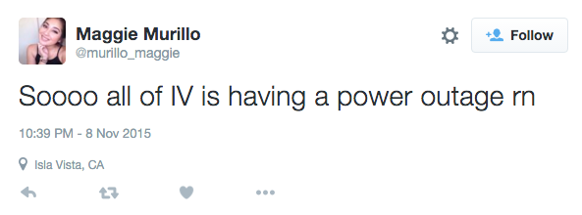
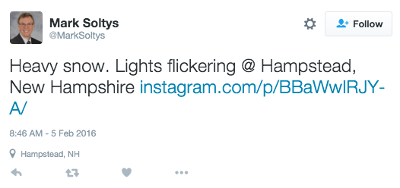
Classifying Data
WEKA: machine learning software used for predictive modeling
Decision Tree Algorithm
PO (Power Outage)
PL (Power Low)

Slide 7
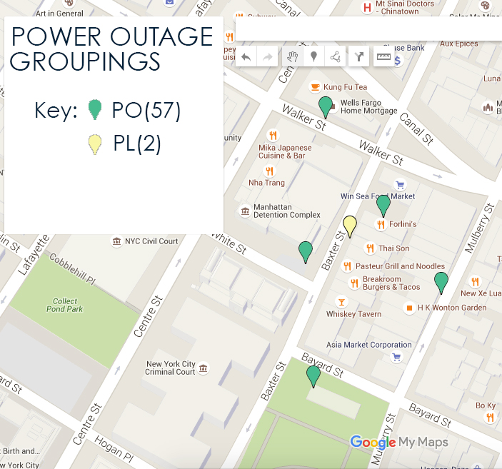
Visualization
Aid for prediction
Group tweets
Close in Space and Time
Limitations based on trial and error

Slide 8
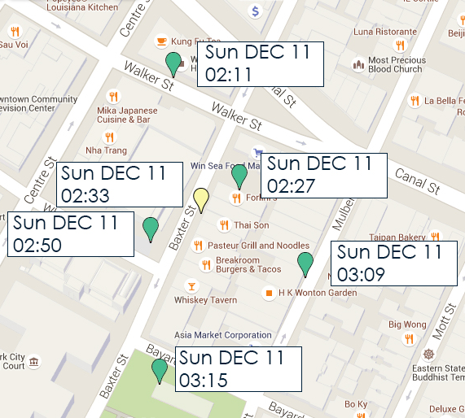
Patterns Found in Grouping
Directional Pattern
Case-Study:
Limitations
25 miles
3 hour timeframe
14 Locales
9 showed directional pattern

Slide 9
Conclusion
Power Outage Detection
Find groups of tweets
Prediction of power outages from directional pattern

Slide 10
Future Work
Collect more data for further research
More Efficient Filter
Look at other features of Tweets
Number of Likes
Number of Retweets

Slide 11
Questions…

Slide 12
Reliability of Tweets

Slide 13
Filtering Data
Kept
Filtered Out

Slide 14
Filter Impact

Slide 15
Geo-Tag Bounding Box
A bounding box of coordinates which encloses a place.

Slide 16
Decision Tree

Slide 17
WEKA Results
 | ALGORITHM
FILTERS | Decision Tree | Naive Bayes | Rules | Support Vector Machine
Original | 87.7941 | 88.3824 | 87.6471 | 87.7941
Lower Case Tokens | 89.2353 | 88.5588 | 88.0882 | 88.5294
Output Word Counts | 87.6471 | 87.3529 | 87.6471 | 87.3529
Root Words | 87.7941 | 88.3824 | 87.6471 | 87.7941
IDF Transform | 87.7941 | 48.6765 | 87.6471 | 87.3529
DF Transform | 87.7941 | 87.9412 | 87.7941 | 87.9412

