Slide 1

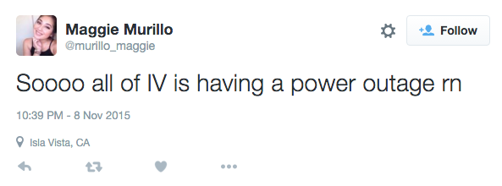
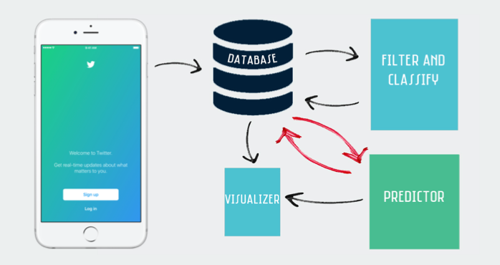
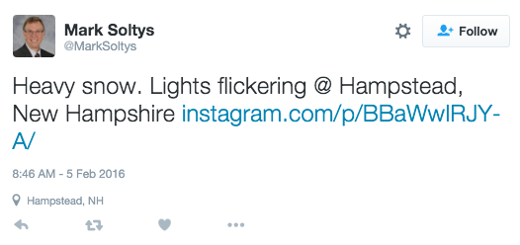
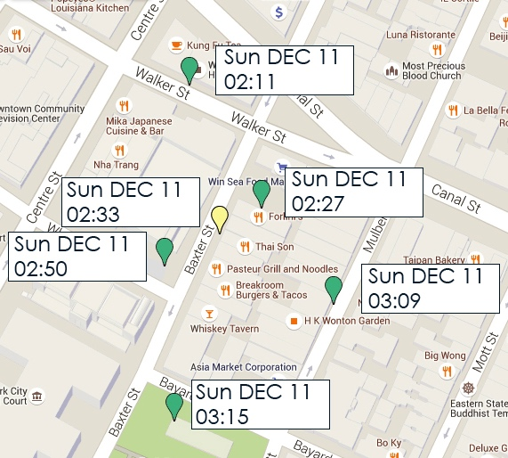
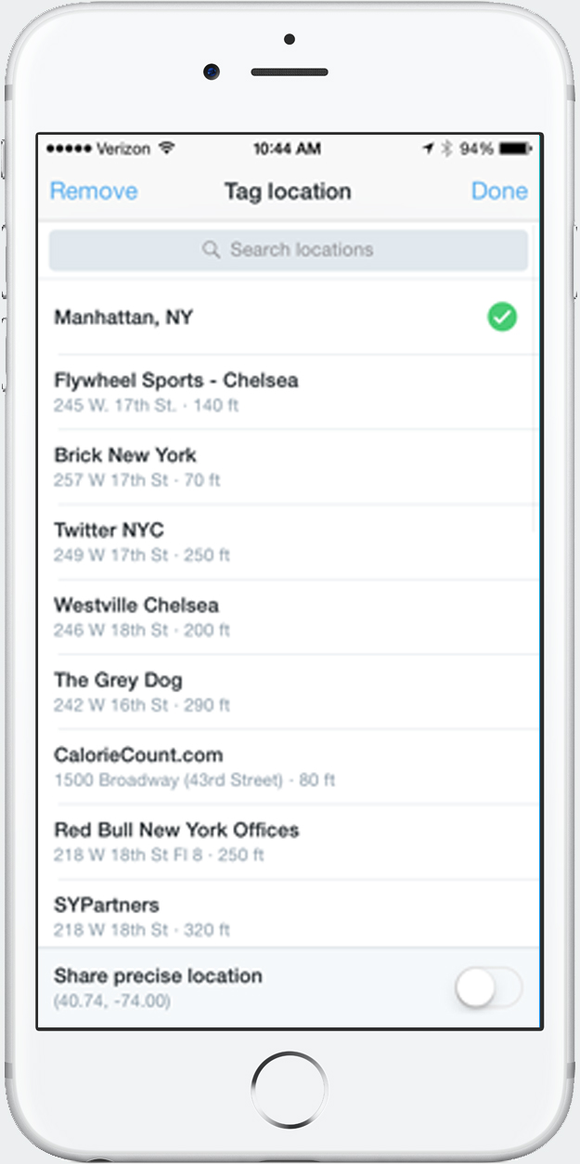
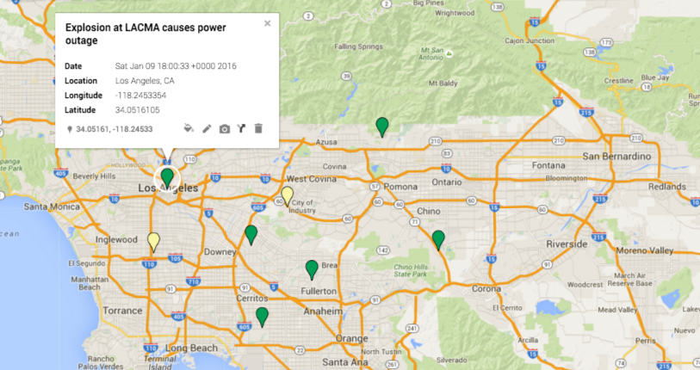

Predicting Power Outages via Twitter
Rodolfo Santana
Advisors: Chris Fernandes, Nick Webb
Introduction:
It is no surprise that social media has become a part of our everyday lives. With approximately 500 million users, Twitter has become one of most popular social networks today. With over 302 million active users, people have begun to utilize Twitter as a predictor of everyday life occurrences such as predicting disease transmission and predicting stock markets. The goal of this research project is to determine whether I can predict power outages with Twitter.
Classifying the Data:
Using a Decision Tree algorithm we classify the tweet into one of two groups, PO or PL. A PO is a tweet that reports an outage occurring at the tweets precise location while a PL is a tweet that warns of an outage possibly occurring.
The screenshot above is an example of a tweet that is classified as a PO while the screenshot below is an example of a tweet that is classified as a PL.
Prediction:
Utilizing the Real-Time option of the system, we are able to predict where an outage is likely to occur by seeing the direction in which outages are occurring. Once initiated, the visualizer plots tweets being tweeted at that instance. From there we create clusters of tweets as they come in that are at most 25 miles from each other and within a 3 hour time frame. Once groups are plotted, three or more tweets to a group, we can begin to see the direction in which the outages are occurring. Therefore, we are able to predict that the are that will be affected next by following the direction of the tweets. This level of prediction is not as specific as we would like, but it is a step towards achieving a more granular-specific form of predicting where an outage will occur. From these clusters, we are able to also see the time frame in which the tweets are being tweeted. In the example below, we see that this southward directed cluster fall of at most 20 minutes before the next person tweets. Therefore we can predict not only the direction of the outage, but roughly the timing in which the next one is bound to happen.
Conclusion:
As of now I am able to successfully detect outages across the U.S. via Twitter. With the tweets collected, I can group them according to their distance and time. Once grouped, I am able to plot them and see any patterns that they may have. Roughly 64% of the generated locales follow a directional pattern according to time, as showed in the screenshot below. Therefore we are able to predict the area in which an outage will most likely occur by following the groups direction.
Future Work:
Improving my filter to retain all relevant tweets.
Making visualizer produce tags containing tweet information automatically
Use other entities within a tweet such as number of likes or retweets one tweet gets in order to form predictions.
Find ways to utilize the tweets collected to make a much more precise prediction.
Test detection system to see whether reaction/restoration times improve.
Analyze what other people are tweeting around the time the power outage tweets occur.
Process Diagram:
Data Collected:
Being that millions and millions of tweets are generated on a daily basis, there are two questions I ask when collecting data: Is the data relevant and do we know the users exact location. That being said, I search for tweets that contain terms significant to the topic such as power outage, power failure, flickering lights, etc. and that are geo-tagged.
Although a tweet may be geo-tagged, that does not necessarily tell us the users precise location. Therefore, we look for tweets in which the user has chosen to share their precise location or we look at the tag the user has chosen to see if it is categorized as a POI (point of interest) in where the tagged location is as specific as the Bank of America on State Street for instance.
Visualization:
Using Google Maps API I was able to plot out tweets in their precise location. When running the system, the user has the opportunity to choose between Day-to-Day, Real-Time or Group. Day-to-Day plots tweets according to the dates given by the user, starting from X date and ending in Y date. Real-Time plots tweets starting from the current date and streams for new tweets being tweeted. The Real-Time map updates every 10 minutes. The Group option plots out clusters of tweets that are within X miles in distance from each other and within Y timeframe.
Acknowledgements:
Thomas Yanuklis, Gerry Oxx, Carolyn Fielder, Southern California Edison

