Slide 1
Automated Data Analysis Pipeline
For Gene Expression Studies
Anton Morozov
Computer Science & Biology ID Major ’2016
Chris Fernandes (CS Dept.) and Steve Horton (Biology Dept.), Advisors
In collaboration with Columbia University, New York
March 5, 2016
Notes:
Designed, implemented and validated the data analysis pipeline and applied it to a biological study.

Slide 2
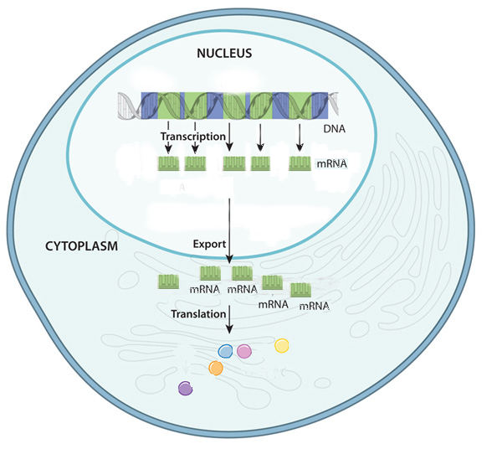
Biological Background
In a living cell, genes are recipes to make proteins
Gene is a portion of DNA
~ thousands of genes
Genes:
1
2
3
4
5
6
7
8
9
DNA:
RNAs
Only some genes are active
(produce RNA)
2
3
5
6
8
RNA produce proteins
Proteins
Proteins determine the cell’s functions

Slide 3
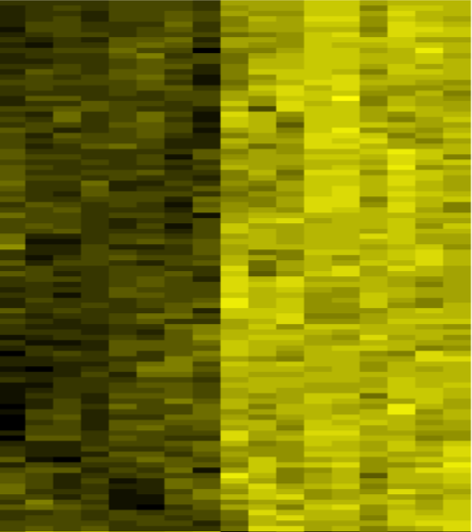
Heatmap of Active Genes
  In different cells, genes can be more active (expressed) or less active
yellow= high activity
black=low activity
Cell 1
Cell 2
Genes
Notes:
Comparing active genes - Good separation of profiles at 5% p-value
Only DE genes are shown in the heat diagram. There are 185 genes.
4 rectangles originated from the following:
Left half of the diagram: genes are active (yellow) in R2, but inactive (black) in SN;
Right half of the diagram: genes are active (yellow) in SN, but inactive in R2.

Slide 4
Active genes determine the type of a cell
(cell identity)
Detecting all RNAs in a cell = identifying active genes
  The Main Question of the Project:
  Which genes determine the identity
  of specific types of neuronal cells?

Slide 5
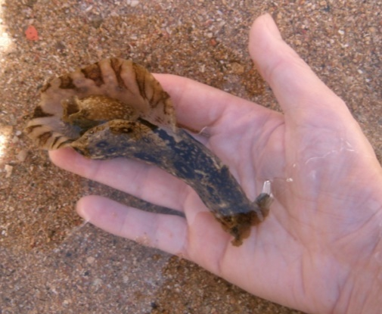
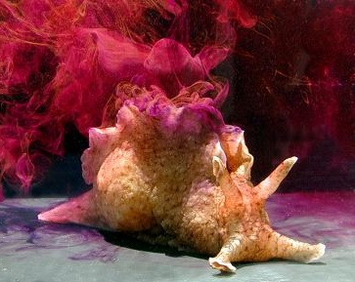
Mollusk Aplysia californica
popular model in neuroscience
genome is poorly studied / annotated
huge neurons (about 0.5mm in diameter!)
the types of neurons are easily identifiable
(Source: The NIH/University of Miami. National Resource for Aplysia)
Notes:
Aplysia neurons are huge: ~0.5mm, visible with naked eye;
Shown: abdominal ganglion of Aplysia with identified individual neuronal cells, including the R2 motor neuron used in this study

Slide 6
Project’s Importance
Before this project:
  Analysis semi-manual and slow
  Not well-suited for poorly annotated genomes
What this project achieves:
  Combines several analysis tools in a single system
  Single data repository for several projects:
      SQL database accessible via website
  Analysis simplified and automated
  Able to work with poorly researched organisms
  Accepts data produced by various experimental methods
Research Objective:
  Analyze biological data on gene activity in neurons

Slide 7
Aplysia Neurons under Study
R2 | major motor neuron; controls defense reflexes | Data: 9 samples
SN | sensory (touch receptor) neuron; participates in memory | 8 samples
Notes:
RNA data (in replicates for statistics) provided by Columbia University Genome Center, 17 samples in total

Slide 8
Methods

Slide 9
Analysis Pipeline Part 1 --- For each sample:
DATA TABLES
INPUT / OUTPUT
SOFTWARE TOOLS
START: RNA-Seq
sequence data
START: Microarray
RNA color intensities
Filtering for quality
High quality reads
Mapping to known transcripts to identify genes
Gene expression matrix:
Gene → Expression Value
RESULT: A gene expression table (matrix) for each sample
Notes:
RNA-Seq - genes are unknown and sequences have to be assigned to gene names by mapping the sequences to transcriptome (database of predicted genes)
Microarrays: gene names for the RNAs are known

Slide 10
Analysis Pipeline Part 2 --- Compare samples:
SOFTWARE TOOLS
DATA TABLES
INPUT / OUTPUT
Identify
Differentially Expressed genes
START:
Gene Expression Matrix
for several samples
SQL Database
& Web Interface
FINISH:
DE gene table
Gene Pathways
(“DAVID” system)
RESULT:
List of Gene Pathways (functions) that change activity from sample to sample
Notes:
Part 2 is the same for RNA-Seq and Microarray data

Slide 11
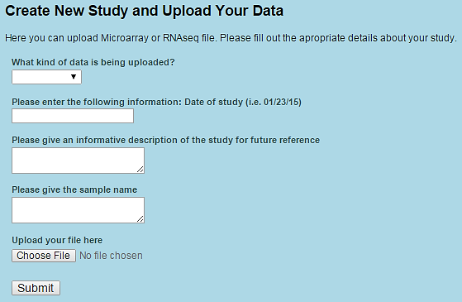
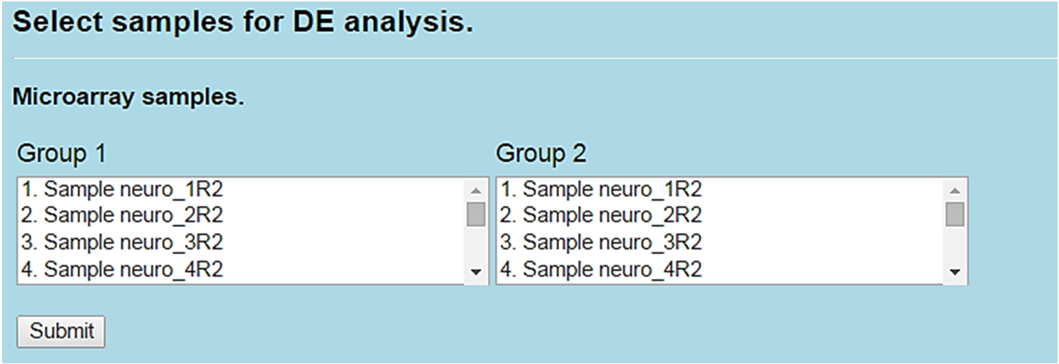
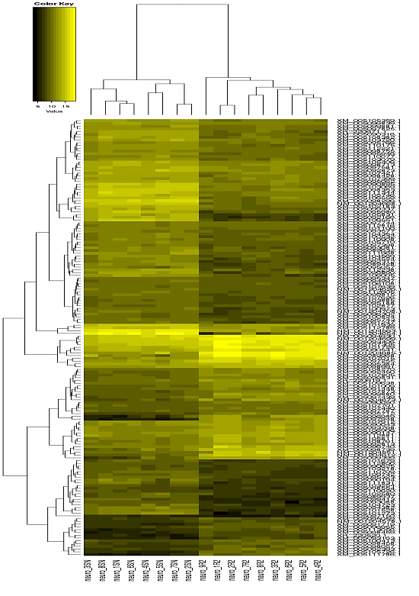
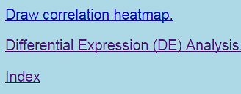
Web Interface

Slide 12
Results
Computational Pipeline validated by comparing with test data analysis from Columbia University
Motor and sensory neurons have significantly different sets of active genes and gene pathways:
Identified 185 DE genes and 24 DE gene pathways
Notes:
Motor and sensory neurons have significantly different sets of active genes and gene pathways:
Identified 185 DE genes and 24 DE gene pathways

Slide 13
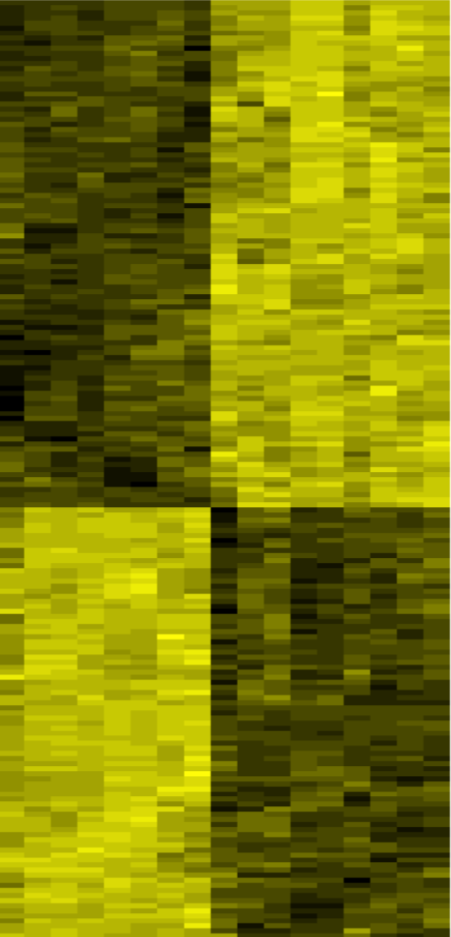
Comparing Active Genes
R2 motor neurons
Yellow = high activity
Black = low activity
SN sensory neurons
185 DE genes
  These genes determine the identity and function
  of the two specific types of neurons
Notes:
Comparing active genes - Good separation of profiles at 5% p-value
Only DE genes are shown in the heat diagram. There are 185 genes.
4 rectangles originated from the following:
Left half of the diagram: genes are active (yellow) in R2, but inactive (black) in SN;
Right half of the diagram: genes are active (yellow) in SN, but inactive in R2.

Slide 14
An Example of an Identified DE Pathway
Cell Signaling group
Pathway | DE Genes
hsa04020: Calcium signaling | TACR1, TRHR, PPP3CB, PLCB1
hsa04910: Insulin signaling | HK2P1, IRS2, HK2, PCK1
hsa04330: Notch signaling | JAG2, NUMBL
hsa04310: Wnt signaling | FZD8, PPP3CB, PLCB1
hsa04722: Neurotrophin signaling | IRS2, ABL1
hsa04010: MAPK signaling | PPP3CB, CACNG4
hsa03320: PPAR signaling | CYP27A1, SCP2, PCK1
Calcium signaling pathway is known to be important in neurological processes
Notes:
Calcium signaling is one of the important neuronal regulatory pathways.
It carries signals from outside the cell to the inside and turns the cell’s genes on or off.
A complex pathways, let’s take a look at the subset of it which involves 4 of our DE genes.

Slide 15
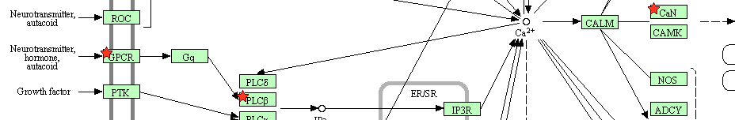
A close-up on the Calcium Signaling Pathway
1. Neurotransmitter activates a receptor on the cell surface
2. Activated enzymes produce intracellular signals
3. Cell proliferation, learning and memory
Cell type | Active Receptor | Active Enzyme
SN | TACR1 | Phospholipase C
R2 | TRHR | Phosphatase 3
The same pathway is performing in different ways in SN and R2 neurons
Notes:
Steps of the signaling pathways involving DE genes:
1. Neurotransmitter activates a receptor on the cell surface
2. Extracellular signal is carried inside the cell to enzymes
3. Activated enzymes produce intracellular signaling molecules
4. Cell proliferation, learning and memory
These are involved in memory and learning formation.
This signaling pathway is active in both Motor and Sensory neuron types. But the pathway is performing in different ways between neurons meaning different genes are active in SN and R2 (table).

Slide 16
Conclusions
Method development:
Implemented and validated: pipeline, website and database
The system is universal: can be used in any gene expression study (drug treatment, disease, cancer research)
BioResearch:
185 genes and 24 pathways identify motor and sensory neurons.
Major pathways: Cell interactions, Signal transduction and Cell receptors.
Several of the identified genes and pathways have been previously connected to neurological disorders, such as Alzheimer and Huntington’s diseases.
Future work:
Analysis of all the identified pathways
Web interface usability analysis and modification

Slide 17
References
Langmead B, Trapnell C, Pop M, Salzberg SL. Ultrafast and memory-efficient alignment of short DNA sequences to the human genome. Genome Biol., 10(3):R25, 2009
Mortazavi A., Williams B. A., McCue K., Schaeffer L., and Wold B. Mapping and quantifying mammalian transcriptomes by rna-seq. Nat. Methods, 5(7):621–628, 2008.
Efroni I, Ip PL, Nawy T, Mello A and Birnbaum KD. Quantification of cell identity from single-cell gene expression profiles. Genome Biology, 16:9, 2015
D.W. Huang, B.T. Sherman, and R.A. Lempicki. Bioinformatics enrichment tools: path toward the comprehensive functional analysis of large gene lists. Nucleic Acid Research, 37(1):1–13, 2008.
O.Yu. Naumova, M. Lee, S.Yu. Rychkov, N.V. Vlasova, and E.L. Grigorenko. Gene expression in the human brain: The current state of the study of specificity and spatio-temporal dynamics. Child Development,
84(1):76–88, 2013.
T. Werner. Bioinformatics applications for pathway analysis of microarray data. Current Opinions in biotechnology, 19(1):50–54, 2008.

Slide 18
Acknowledgments
Faculty advisors (Union College):
Dr. Steve Horton and Dr. Chris Fernandes -
for guidance
Dr. Sergey Kalachikov (Columbia University) –
for helpful discussions and providing the data

Slide 19
Thank you!

