Slide 1

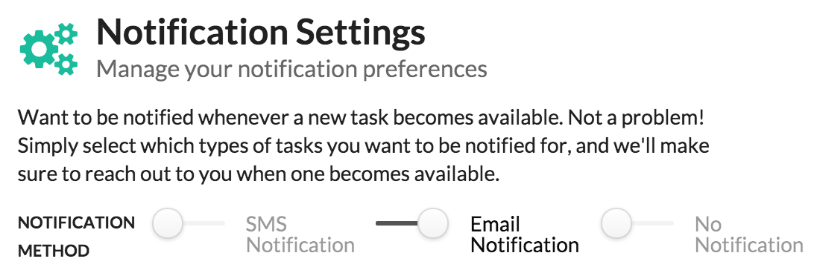
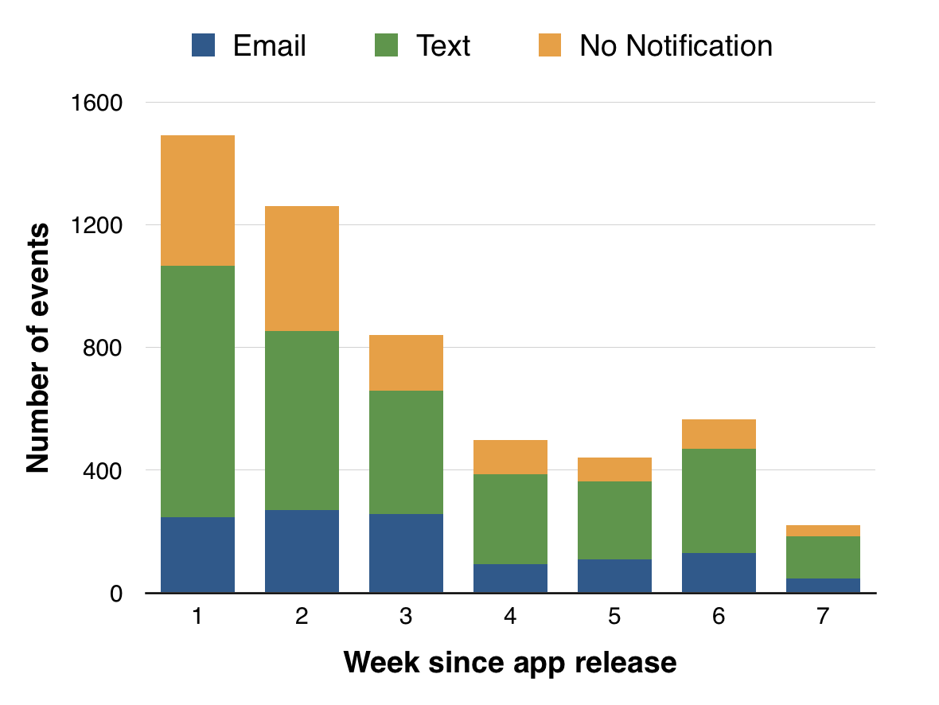
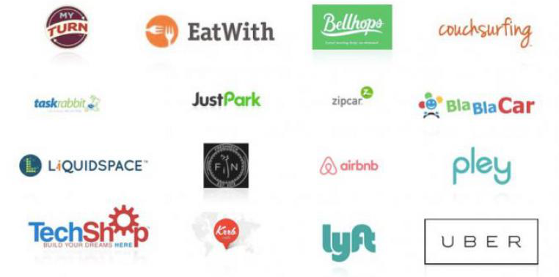
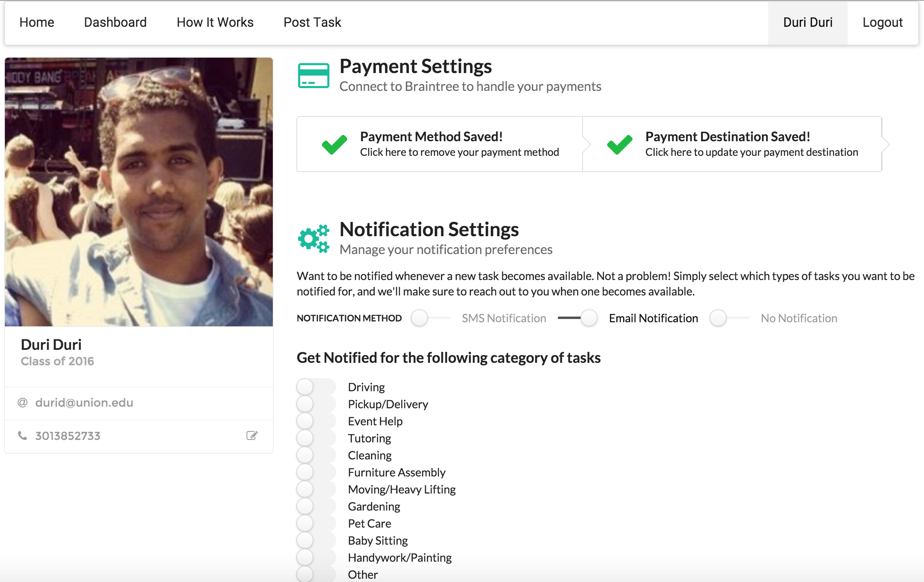
Disruptive communication and user engagement in the collaborative consumption model
Duri Abdurahman Duri
Chris S. T. Fernandes, Advisor
Introduction
Companies have leveraged the capabilities of software, and formed what is known as the collaborative consumption model - an economic model based on users sharing, swapping, trading or renting products and services to simplify our daily lives [1]. Uber, AIRBNB, and Instacart are all companies that follow that model. They provide software, in the form of apps, to help you find a ride, find a place to stay when you’re traveling, and even order your groceries and have them delivered home. All without leaving the comfort of your seat, you needs nothing more than a couple of clicks on your computer or smart phone.
Analysis
The data was filtered to only include events that best describe our definition of engagement. Events were grouped based on the way the user received notifications. The distribution of events between notification groups was compared. Figure 5 illustrates the distribution of events across time. We compared the current distribution of events by that of our expected distribution given that notification type didn't’t affect user engagement.
Figure 2. Ways the app can interact with the user
The Study
This project builds a peer-to-peer app that follows the collaborative consumption model. It allows students to post tasks that they need completed, and helps connect them with other students who are willing to provide the needed service. The app communicated with the user by either email or text messages. Some users didn’t receive notifications and had to go to the app to get information. This study used analytical software to monitor the activity of users who use the app. Everything the user does on the app is classified as an event. Events describe what the user was did, when did it, and have descriptive information about the user who fired the event. Data was collected for a span of 7 weeks. In that time the app had 430 registered members and a total of 45 tasks were accepted. The collected data was then used to determine whether or not communication with the app affected user engagement.
Figure 1. A plethora of apps aimed to make life much easier
Figure 4.Distribution of events grouped by notification type across time
Motivation:
Conclusion and Future work
Results from the data analysis tell us that notification type does indeed correlate with whether a person was engaged or not. The current distribution of events is significantly different to that of the distribution we would expect if notification type had no effect on engagement. Results also found that users within the text messaging subgroup were the most engaged with the web app. Future work could look into the effects on engagement from switching into each notification type.
We as users have a plethora of different apps from which to choose (Figure 1). The question for all these new ventures is how do they attract users? I believe that the ability of the app to communicate with the user generates more user engagement than if it were left to the user alone. This research study looks into the different ways users, both consumers and service providers, receive information from the app, and how emails and text messaging affect the user’s participation with the app.
References
[1] Rachel Botsman. The sharing economy lacks a shared definition. Collaborative Consumption, 2012.
Figure 3. Our peer-to-peer app used in this study

