Slide 1
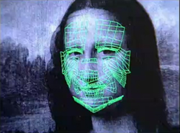
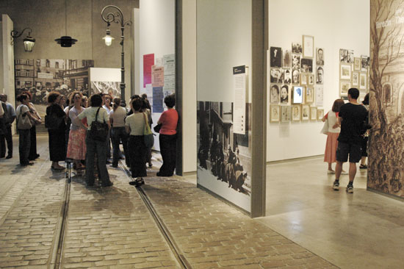
Automatic Age Estimation and Interactive Museum Exhibits
Kyle Patterson
Advisors: Prof. Cass and Prof. Lawson

Slide 2
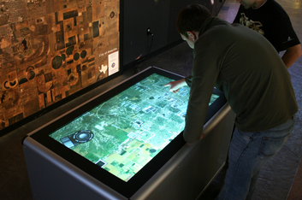
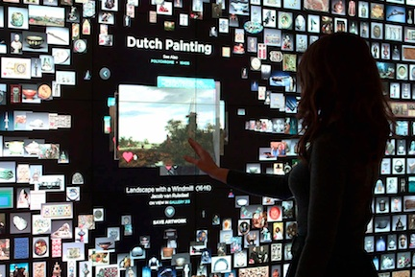
Motivation
Museums have begun to use more technology in interactive exhibits.
Interactions are still general for all users.

Slide 3
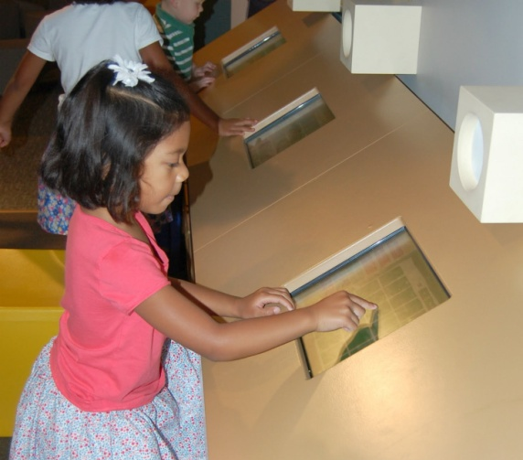
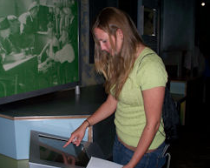
Research Problem
Change the content of museum exhibits to match the age of their audience.

Slide 4
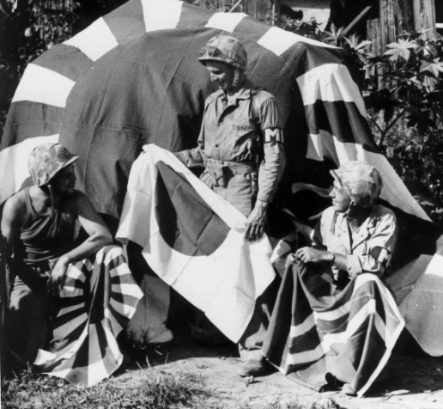
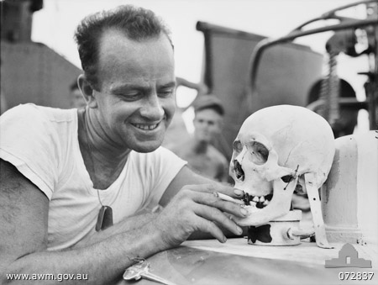
Research Problem
Change interactive museum exhibits to the age of their audience.
Children Shown
Adults Shown

Slide 5
Possible Solutions
Physical user input…

Slide 6
Possible Solutions
Physical user input…
User must understand and use the interface.

Slide 7
Possible Solutions
Physical user input…
User must understand and use the interface.
Audio user input…

Slide 8
Possible Solutions
Physical user input…
User must understand and use the interface.
Audio user input…
Language dependent, must isolate user’s answer.

Slide 9
Possible Solutions
Physical user input…
User must understand and use the interface.
Audio user input…
Language dependent, must isolate user’s answer.
Gait analysis…

Slide 10
Possible Solutions
Physical user input…
User must understand and use the interface.
Audio user input…
Language dependent, must isolate user’s answer.
Gait analysis…
Requires video input and human tracking from multiple angles.

Slide 11
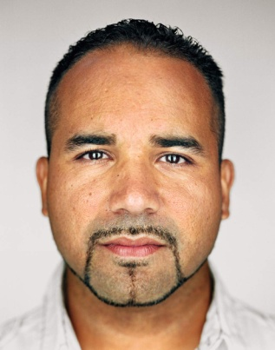
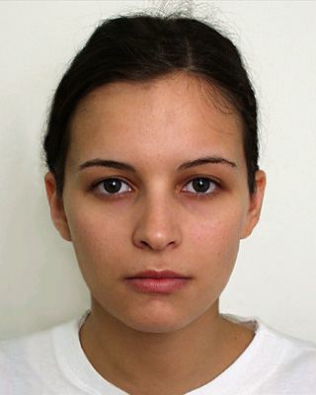
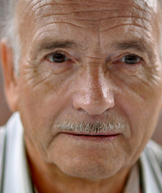
Project Goal
Classify humans by age group using facial images.
Child
Young Adult
Senior

Slide 12
Approach
Training Images
Feature Extraction
Training Dataset
Feature Extraction
Machine Learning Algorithm
Test Image
Test Dataset
Classifier
Age Group

Slide 13
Data Collection
Use video or stills to provide images of the user.
Extract usable data from the images.
Output data to classification program.

Slide 14
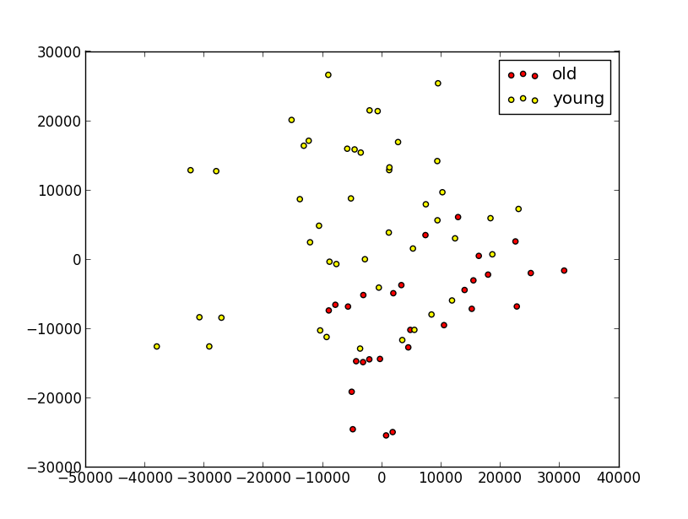
Principal Component Analysis
PCA reduces the complexity of data by reducing the number of features in the dataset.
The result is a series of vectors for each image.

Slide 15
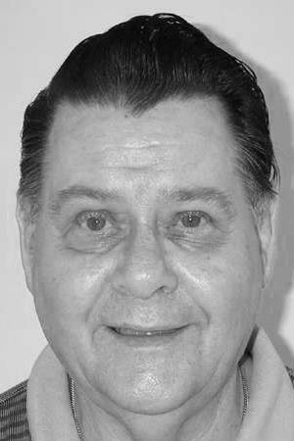
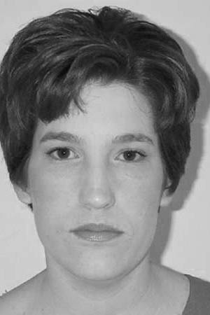
Evaluation
Training and test images from the Center for Vital Longevity Face Database.
Evaluation of the approach is carried out using
10-fold cross validation.
Kennedy, K. M., Hope, K., & Raz, N. (2009). Lifespan Adult Faces: Norms for Age, Familiarity, Memorability, Mood, and Picture Quality. Experimental Aging Research, 35(2), 268-275.

Slide 16
Results
PCA Performed Over 5 Dimensions
 | Successful Classification Percentage
Age Groups | Only Males | Only Females | Both Sexes
18 - 33 | 90.9 | 78.0 | 68.8
34 - 64 | 16.6 | 22.2 | 25.0
65 - 92 | 78.5 | 64.5 | 72.8
All Ages | 72.2 | 62.2 | 60.2

Slide 17
Results
PCA Performed Over 5 Dimensions
 | Successful Classification Percentage
Age Groups | Only Males | Only Females | Both Sexes
18 - 33 | 90.9 | 78.0 | 68.8
34 - 64 | 16.6 | 22.2 | 25.0
65 - 92 | 78.5 | 64.5 | 72.8
All Ages | 72.2 | 62.2 | 60.2

Slide 18
Results
PCA Performed Over 5 Dimensions
 | Successful Classification Percentage
Age Groups | Only Males | Only Females | Both Sexes
18 - 33 | 90.9 | 78.0 | 68.8
34 - 64 | 16.6 | 22.2 | 25.0
65 - 92 | 78.5 | 64.5 | 72.8
All Ages | 72.2 | 62.2 | 60.2

Slide 19
Results
PCA Performed Over 5 Dimensions
 | Successful Classification Percentage
Age Groups | Only Males | Only Females | Both Sexes
18 - 33 | 90.9 | 78.0 | 68.8
34 - 64 | 16.6 | 22.2 | 25.0
65 - 92 | 78.5 | 64.5 | 72.8
All Ages | 72.2 | 62.2 | 60.2

Slide 20
Results
PCA Performed Over 5 Dimensions
 | Successful Classification Percentage
Age Groups | Only Males | Only Females | Both Sexes
18 - 33 | 90.9 | 78.0 | 68.8
34 - 64 | 16.6 | 22.2 | 25.0
65 - 92 | 78.5 | 64.5 | 72.8
All Ages | 72.2 | 62.2 | 60.2

Slide 21
Results
PCA Performed Over 5 Dimensions
 | Successful Classification Percentage Per Group
Age Groups | Only Males | Only Females | Both Sexes
18 - 33 | 90.9 | 78.0 | 68.8
34 - 64 | 16.6 | 22.2 | 25.0
65 - 92 | 78.5 | 64.5 | 72.8
All Ages | 72.2 | 62.2 | 60.2

Slide 22
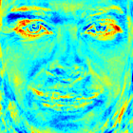
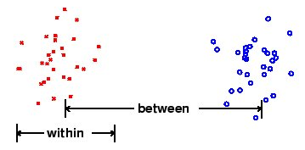
Fisherfaces
Algorithm designed to perform facial recognition between defined classes.
Uses Linear Discriminant Analysis to find the features that define the difference between classes.
dtreg.com/lda.htm
Opencv.org

Slide 23
Future Work
Classify gender before determining age.
Multimodal support for determining gender or age.
Webcam support for museum websites.

Slide 24
Any Questions?

