Slide 1
STRUCTURING THE UNSTRUCTURED NOTE:
AUTOMATIC ORGANIZING AND FORMATTING FOR LECTURE NOTES
Shiqing (Licia) He
Adivisor: prof.Kristina Striegnitz
SPRING 2014

Slide 2
Digital Note Taking
Pros
Easy to organize
Easy to edit
Cons
Slow
Distracting

Slide 3
Traditional Note Taking>Digital Note Taking?
Option 1: Typing in class
typing that leads to mindless processing.
Option 2: Writing in class
Ink and paper prompts students to go beyond merely hearing and recording new information.
---Pam Mueller of Princeton and Daniel Oppenheimer
--Wray Herbert’s reporting on psychological science
Notes:
http://www.huffingtonpost.com/wray-herbert/ink-on-paper-some-notes-o_b_4681440.html
LINK TO ORIGINAL SITE
Pam Mueller of Princeton and Daniel Oppenheimer of UCLA ran several related experiments aimed at evaluating how well written vs. typed notetaking helped students learn.

Slide 4
Option 3? No Note-taking at all?
Note Taker
=your computer
Focus on the lecture and review notes after lecture.

Slide 5
Plan Overview
Note Taker
=your computer
Use speech recognition to record lecture into notes.

Slide 6
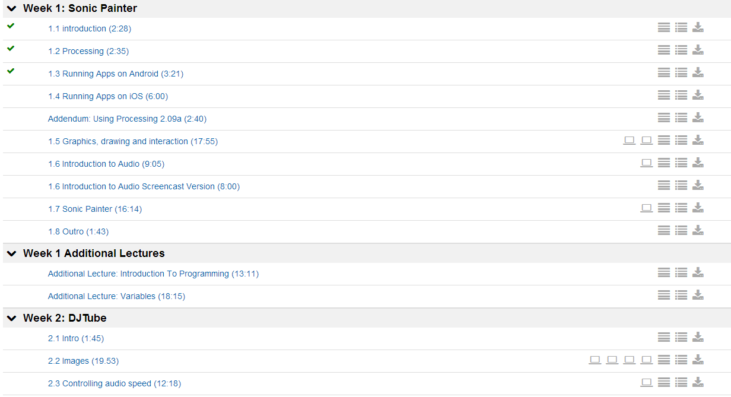
Step 1: Record Lecture
Use coursera subtitles

Slide 7
Example
[SOUND] . Hi , welcome to Lesson 1 of Creative Programming for Digital Media and Mobile Apps . I'm Mick , and this is Matt and Marco . And we're going to take you through six individual lessons starting with this week , which is all about the basics of drawing and the basics of sound . So , first of all , we need to know how to manipulate graphics and draw them to the screen and we also need to know how images are represented on the screen . Marco is going to take you through that , and he's also going to give you a introduction on how to use processing for making desktop applications . Matt's going to take you through how to control sound and how to find and play back sounds from the internet . He's also going to talk a little bit about manipulating sound , and how sound is represented in the computer . In addition , he's going to show you a little about how to run applications that we develop on Android phones . And then , I'm going to take you through the basics of using Apple devices . And after that , I'm going to show you how to make a basic app with simple interactions , like mouse and touch interaction . That plays back different sounds in different ways . And also changes the way that certain types of images are drawn . So , that's really what this lesson is about . It's kind of easing you in to the whole idea of making creative applications . And if you've got any questions , you can check the forums . We'll be looking out for any of you who have particular issues . It's always a bit difficult getting started running software for the first time . So , we've got a whole load of examples that you can download from the Coursera website . We're going to be referring to them throughout the next six weeks starting this week . So , make sure that before you ask questions , you have a look on the documentation that we've put on the website . There's a lot there . There are also people who are going to be on the forums , expecting you to ask good , relevant questions .
Unstructured Note

Slide 8
Plan Overview
Note Taker
=your computer
Use speech recognition to record lecture into notes.
Organize raw text into note.
How do I do that?

Slide 9
Plan
Raw Text
Find Topics
Break Text into topic segments
Attach Format
Extract Main Idea

Slide 10
Find Topics
discovering the abstract "topics" that occur in documents.
Topic Modeling
Statistical model
Topic=word cloud
--Introduction to Probabilistic Topic Models - David M. Blei
McCallum, Andrew Kachites. "MALLET: A Machine Learning for Language Toolkit." http://mallet.cs.umass.edu.
2002
Notes:
Probabilistic topic models are a suite of algorithms whose aim is to discover the
hidden thematic structure in large archives of documents

Slide 11
Sample Output-Topic Cloud
0 audio sound maxim ve player play sketch file ll code folder data environment create beat files store hear set
1 sound ve ll speed make time bit week good sounds yeah people graphics things stuff thing lot detail type
2 width line brush mouse simple brushes music divided map mapping ve idea talk mirrors symmetry distance refresh tells interesting
3. android processing device ll run ve running java simple devices javascript ios app desktop write screen ip network address
4 color draw position ve mouse screen program drawing colors red green line code rectangle numbers point blue basic background

Slide 12
Tag words into Topics
“He's also going to talk a little bit about manipulating sound , and how sound is represented in the computer . In addition , he's going to show you a little about how to run applications that we develop on Android phones . And then , I'm going to take you through the basics of using Apple devices . And after that , I'm going to show you how to make a basic app with simple interactions , like mouse and touch interaction”
Topic 0, 1
Topic :3
Topic -1

Slide 14
Topic Frequency :
0: 6
1: 4
2: 1
3: 4
4: 2

Slide 15
Topic Frequency :
0: 5
1: 5
2: 1
3: 7
4: 3
Break!

Slide 16
Notes:
31 64 159 208 255 456 810 862

Slide 17
Plan
Raw Text
Find Topic
Break Text into topic segments
Attach Format
Extract Main Idea

Slide 18
Extractive Summarize
Algorithm to assess the importance of sentences.
Package: SummarizeLib:
Input( String content, int number of sentences)
Output: String Importance sentences (summarization)
Generate
Overview: Summarization for raw text( 1%)
Summarization for each topic segments (1-5 sentences)

Slide 19
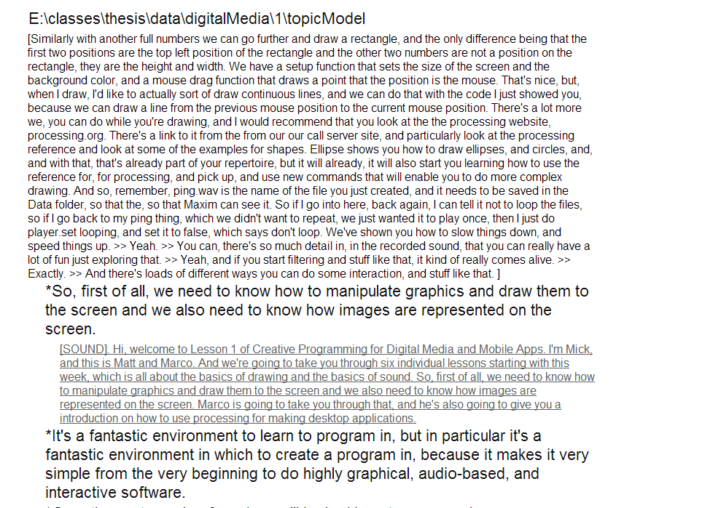
Attach Format
Summarization for raw text
Foldable HTML file
Example: digital Media
Summarization for individual topic segments
Click to fold/expand topic segments.

Slide 20
Future Study
How to make it better?
User Evaluation
Abstractive Summarization
User interface

Slide 21
Questions?
Questions?

Slide 22
Approximately 121 words away from real breaks .
Video Segment
Generated Breaks
Real Breaks
Good Breaks
Hand Annotated
Precision= 0.704545
Recall=0.574074
Notes:
0.005 0.008 522 589 43 43 50 61 5 84 15 204 43 5 26 60 344 372 44 36 121.3333 161.5556 522 589 5 5
Precision=“No garbage?”= 0.704545
Recall=“Got everything?”=0.574074

