Slide 1
Designing a superscalar processor simulation
BY: William Callanan
Advisors: Chris Fernandes and John Rieffel
Notes:
My name is William Callanan and my project was on creating a simulation of a superscalar processor for use in a classroom setting, my advisors on this project were Chris Fernandes and John Rieffel

Slide 2
Project goals
Build simulation of superscalar processor
Help CS students understand processors
Notes:
As I mentioned before the goal of my project was to design a simulation, this simulation was designed to be used by computer science students taking the computer organization course here at union.

Slide 3
3 options for orders
Grill (3 time units)
Deep fryer (2 time units)
Coffee (1 time unit)
Notes:
We can think of things like the coffee machine, the grill, and the deep fryer as different units in the restaurant. Of all of these things it would make sense for the grill to take the longest, we’ll say it takes 3 units of time, then the deep fryer to take the second longest, so say 2 units of time, and the coffee machine to take the shortest amount of time, so one unit of time. So say we have 2 orders that come into this restaurant, the first is for a cheeseburger and coffee, so those get started at the same time, then one unit of time passes and a new order comes in for fries. Since nothing is using the coffee machine that second order is actually finished first, but it can’t be delivered to the customer until the first order is done since the pick up window is blocked by the car from the earlier order. But it makes much more sense to do this than it does to wait for the first order to be totally finished, deliver that order, and then keep the second person waiting at the window to make the coffee when it could have been made with no trouble earlier. This is the same way superscalar processors function, they attempt to use all the hardware available to them it the most efficient way possible to keep instructions running as quickly as possible.

Slide 4
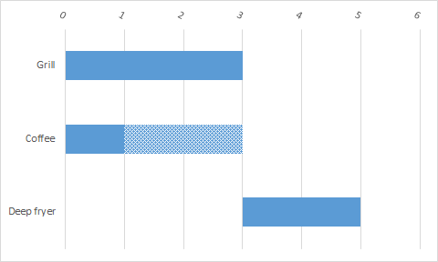
SUPERSCALAR
SCALAR
Notes:
Here is a chart showing how the orders are dealt with in the restaurant, in the first method we are using the superscalar method, Orders are started whenever they are able to be and because of this the first full order gets delivered at time 3, then the deep fryer is able to be delivered right away at time 4. In the version on the right we use a scalar method where we only deal with one order at a time. This means that the second order for the deep fryer doesn’t start until time 3 when the first is delivered, meaning order 2 isn’t finished until time 5

Slide 5
What is a superscalar processor?
attempts to use all hardware available to it as efficiently as possible
Notes:
A superscalar processor is very similar to the example from before, instructions will enter in order, execute, then exit in order. And while inside the processor instructions can be completed in any order, just like how we cooked food items out of order in the restaurant.

Slide 6
Features of current prototype
Movable camera
Execution units with built in execution time
Automated instruction movement
Notes:
Here are some of the features of the current prototype I have working, I have a camera that can be moved in 4 directions on a 2D plane using wasd or up down left right. I have multiple execution units that each have a specified time for them to finish an instruction, I also have set up scripted paths for the instructions to move through the simulation

Slide 7
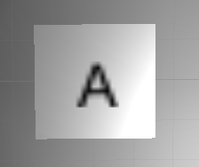
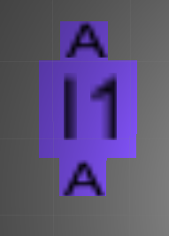
Features of current prototype (cont)
registers
instructions
Notes:
Registers are units in a processor that can hold the results of calculations for other instructions to use later, by default they are white squares, but they have their register name written on them, they can do something called renaming when an instruction wants to write data back into them, which is a really neat way that superscalar processors are able to avoid data hazards. Data hazards happen when an instruction wants to write to a register and another instruction wants to read from that register before the first instruction has put in its new data. The result of this is the later instruction getting bad data and the result is wrong. To avoid this we can rename registers, when an instruction wants to write back into a register later the data in that register changes from being a value to being a pointer to the instruction that will have the most up to date data, then the later instruction watches for the instruction it is waiting for to return its result before it can move, that way it has the most up to date data.
My program also has a winged instruction model, the top wing will normally have a value that represents the register it is reading data from, the bottom wing will have a value that shows what register it will be writing data to, and the center will have the number of the instruction in the format “I _” they also get special colorings depending on what type of instruction they are. The instruction in the picture is colored blue, which tells the user that it is an integer instruction, there are two other colors as well, red and yellow. Red is for floating point instructions, and yellow is for load and store instructions.

Slide 8
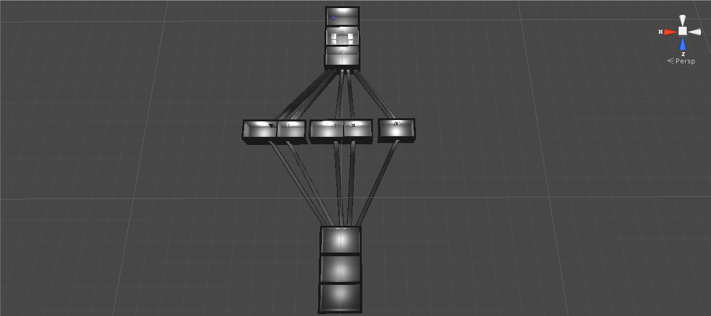
Final mockup
Notes:
Here we have my final built design compared to my final version of the mockup, overall the design stayed more or less the same, however I redesigned the units in the mockup to be in full 3D, making it a little easier to show how things move around in the simulation. Unit was used for this project because it was easy for me to learn it quickly and build things easily in it

Slide 9
Video Demonstration
https://www.youtube.com/watch?v=EZAUsSyEiKQ
Notes:
Here is a video of the simulation running in a basic way, it is just one instruction flying through because a full example would take too long. But this should give an idea of how it will look for the students when they see the full simulation running

Slide 10
Evaluation
Look for design improvements based on student feedback
Notes:
Evaluation for this project would come mostly in the form of suggested improvements. I would want to show this project to a mix of students who both have, haven’t, and are in computer organization. From them I should be able to get an idea of how easy it is to understand my designs for this project and possibly come up with improved designs for the units. I would also hope to hear if there are any features that they would like to see that I haven’t thought of.

Slide 11
Future work
Support for student programs
Manual mode
Scalar mode
Support for adjustable numbers of instructions-
Adjustable speed
Full examples
Ability to zoom in and out on specific processor sections
Notes:
There are a lot of things that simply didn’t make it into the scope of this project that I would really have liked to implement, the biggest of these is the support for user programs, which would allow students to have their own programs simulated to see how they move through a processor. I also would have liked to implement a manual mode where a student can pick how they want to move the instructions, and test their understanding of how the superscalar processor is supposed to work. Similar to manual is scalar mode, where we would treat the processor as a basic processor that doesn’t attempt to do multiple things at once, this method of running will be a bit more familiar to students learning about processors, and would help make it apparent what improvements can be gained from superscalar processors. The next few pieces of future work are more about removing limitations on my current design, currently I can’t do an adjustable program size because the size of my instruction model limits the amount of them I can put in one unit at once, hopefully in the future I would have a way to either scale up the size of my main model or scale down my instruction size if I wanted to support long instructions.

Slide 12
Future work (cont)
Add additional effects and colors to draw attention to important things
Register renaming

Slide 13
Questions?

