Slide 1
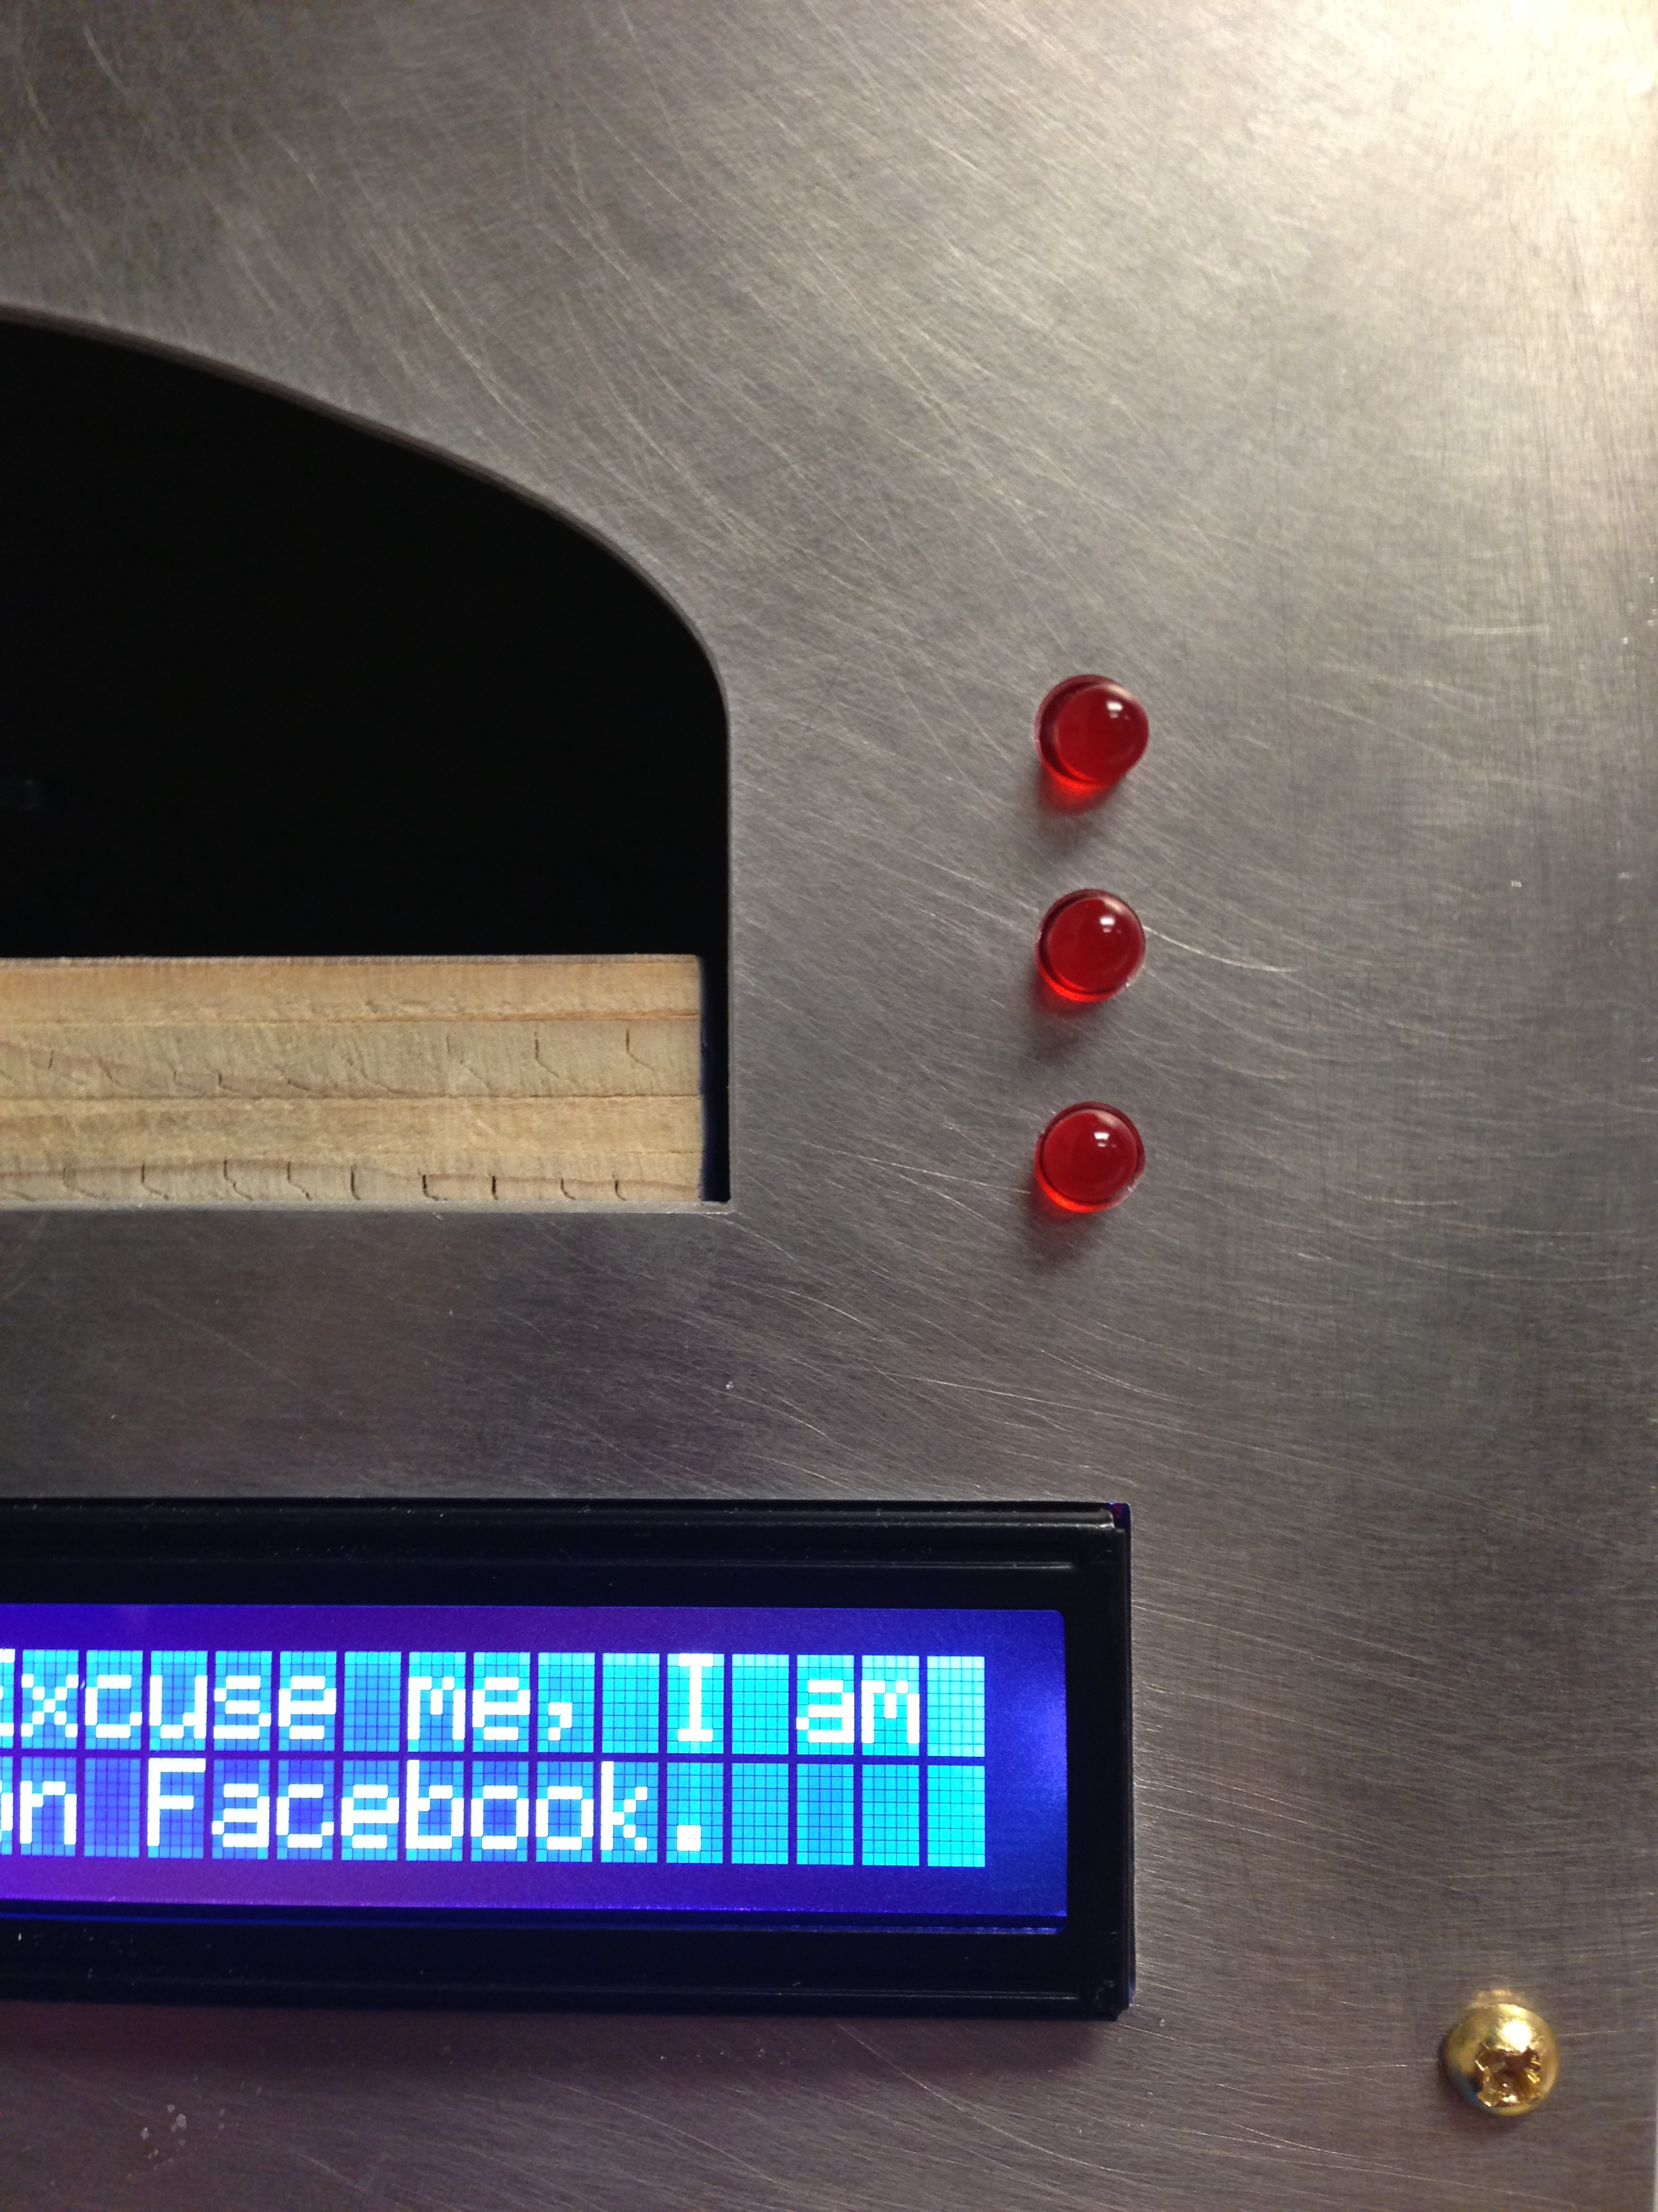
Unconscious Automatons on Facebook
Adam Pere – ID Computer Science & Visual Arts
Advisors: Chris Fernandes & Fernando Orellana

Slide 2
Introduction
Internet + Facebook
Mindless Web browsing
3 robots
Sensors + Webcam “eye” to take photos of surroundings
Facebook Accounts
Notes:
I want to start a conversation about Facebook, the Internet and the trap of mindlessly web browsing that they have created

Slide 3
Motivation
The Internet has changed the way we
think
interact with one another
spend our free time
Notes:
The Internet is a relatively new phenomenon that has become an indispensable resource in the modern world.
Think: Learning how to look things up instead of memorized (GOOGLE)
Interact: Facebook, IM, SMS – Less physical interaction (isolation?)
Free Time: Indoors instead of outdoors, web browsing, video games etc

Slide 4
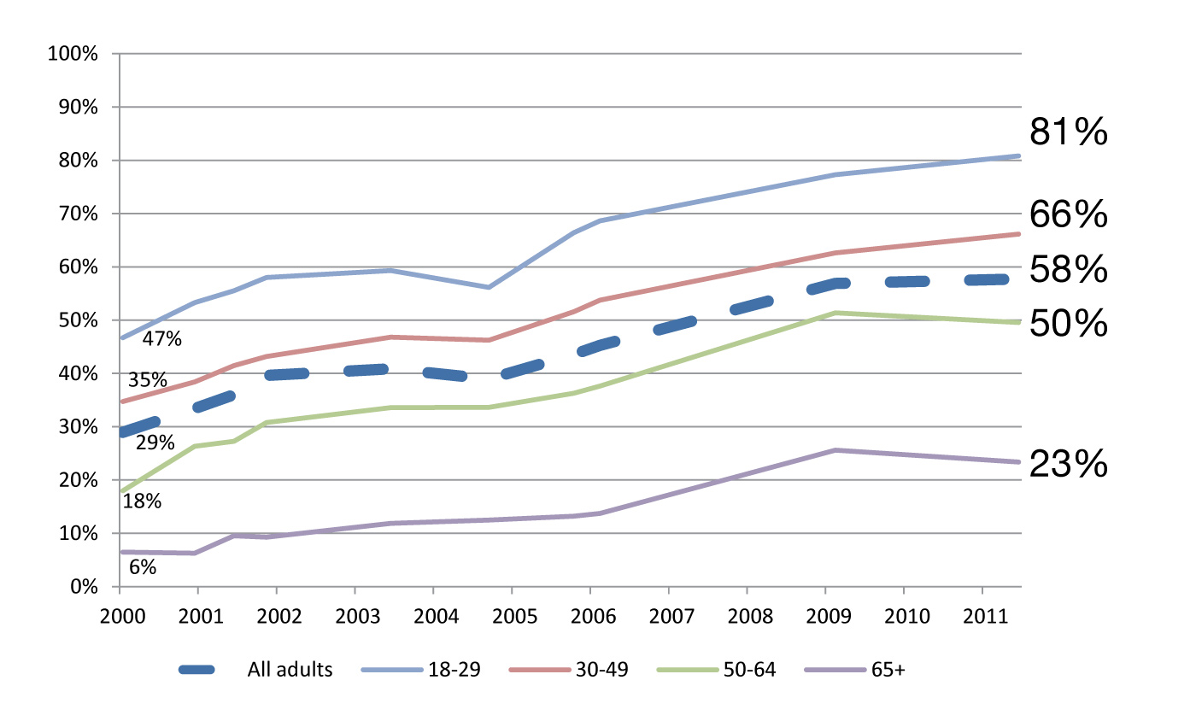
Motivation – “Cyberloafing”
Do you ever go online for no particular reason, just for fun or to pass the time?
% answered “yes”
"When you're not looking for anything special, the un-special will do just fine,”
– Mitch Albom,
Free Press Columnist
Notes:
Waking up in the morning – Immediately check my phone/internet – see what’s going on in my day/the world

Slide 5
Motivation
According to a Nielsen report the average American spends approximately
29 hours/month on the Internet
8 of those on Facebook ^{[1]}

Slide 6
What are we doing on Facebook?
Posting content for the user’s friends to see
Status updates
Comments
Photos/Videos
Reading/scrolling through friend’s content
Notes:
Both can be (and are frequently) done without much thought

Slide 7
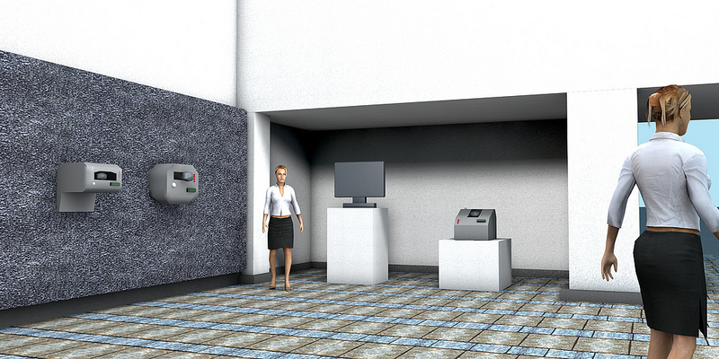
Design
3 Robots + 1 Monitor
Notes:
This is a 3D model that I have made

Slide 8
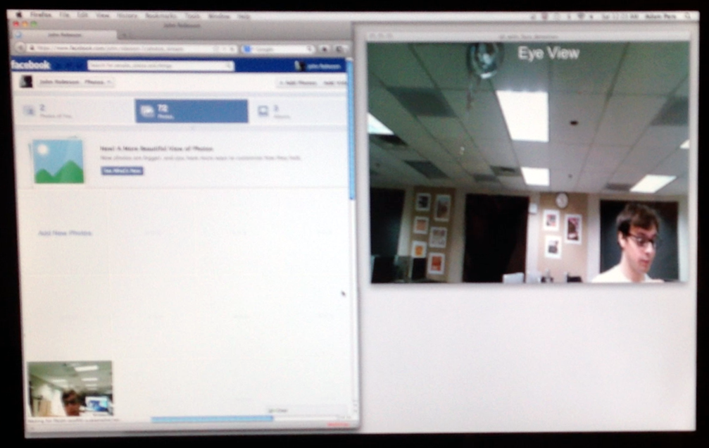
Design
Sensor
monitor
Webcam
LCD
Screen
LED’s
Notes:
Explain everything:
2 Sensors
Webcam attached to a sensor w/ ~75º rotation
LCD Screen to display a small amount of text (something along the lines of “I’m posting to Facebook”)

Slide 9
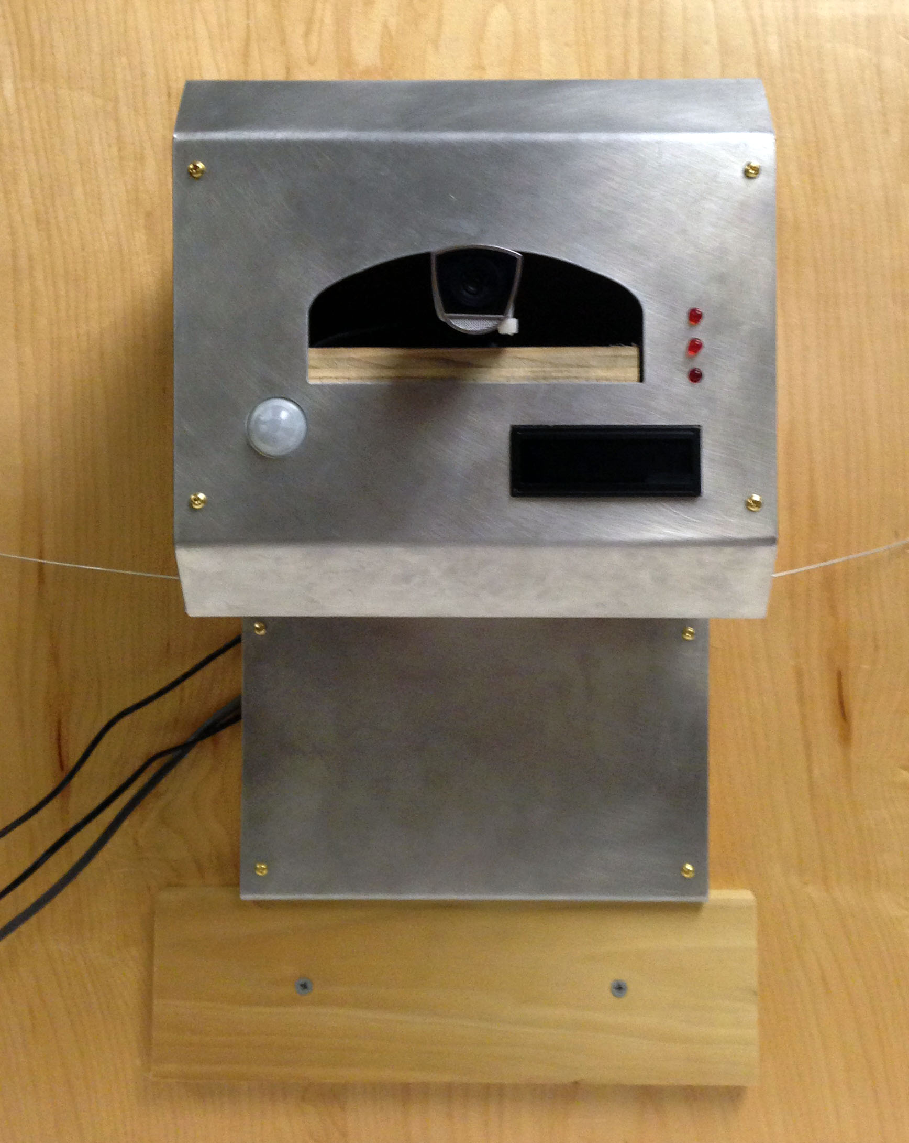
Design – Final Product

Slide 10
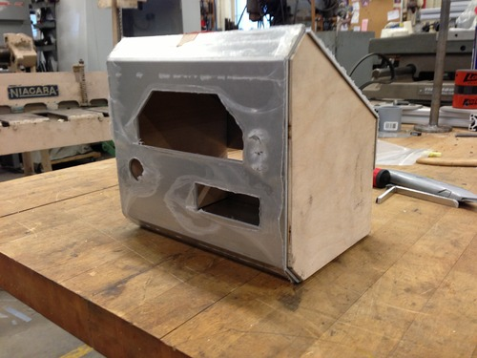
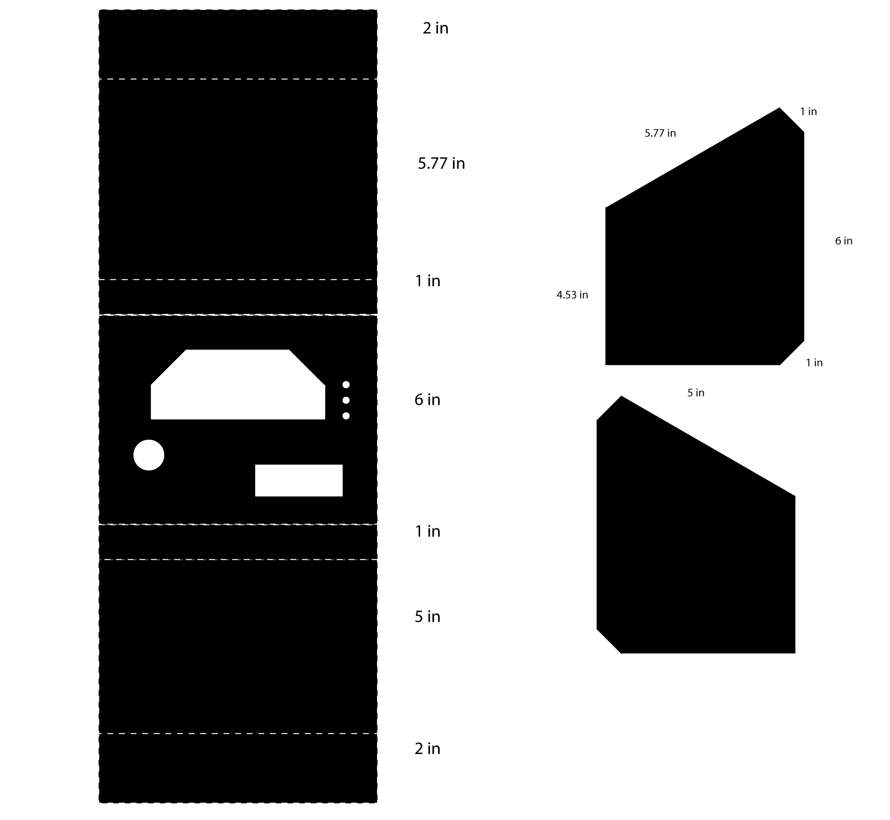
Design - Hardware
Materials
Aluminum + Wood
Water Jet Cutter

Slide 11
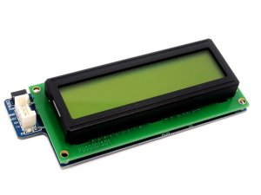
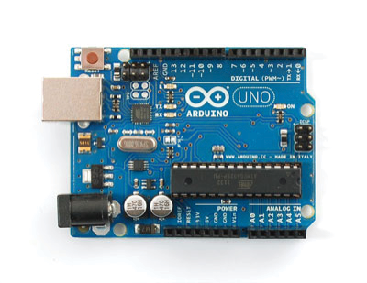
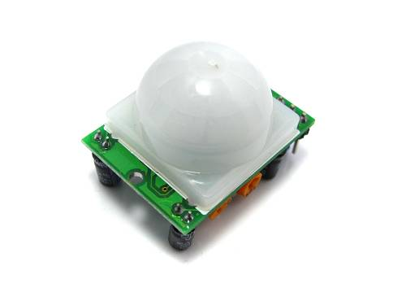
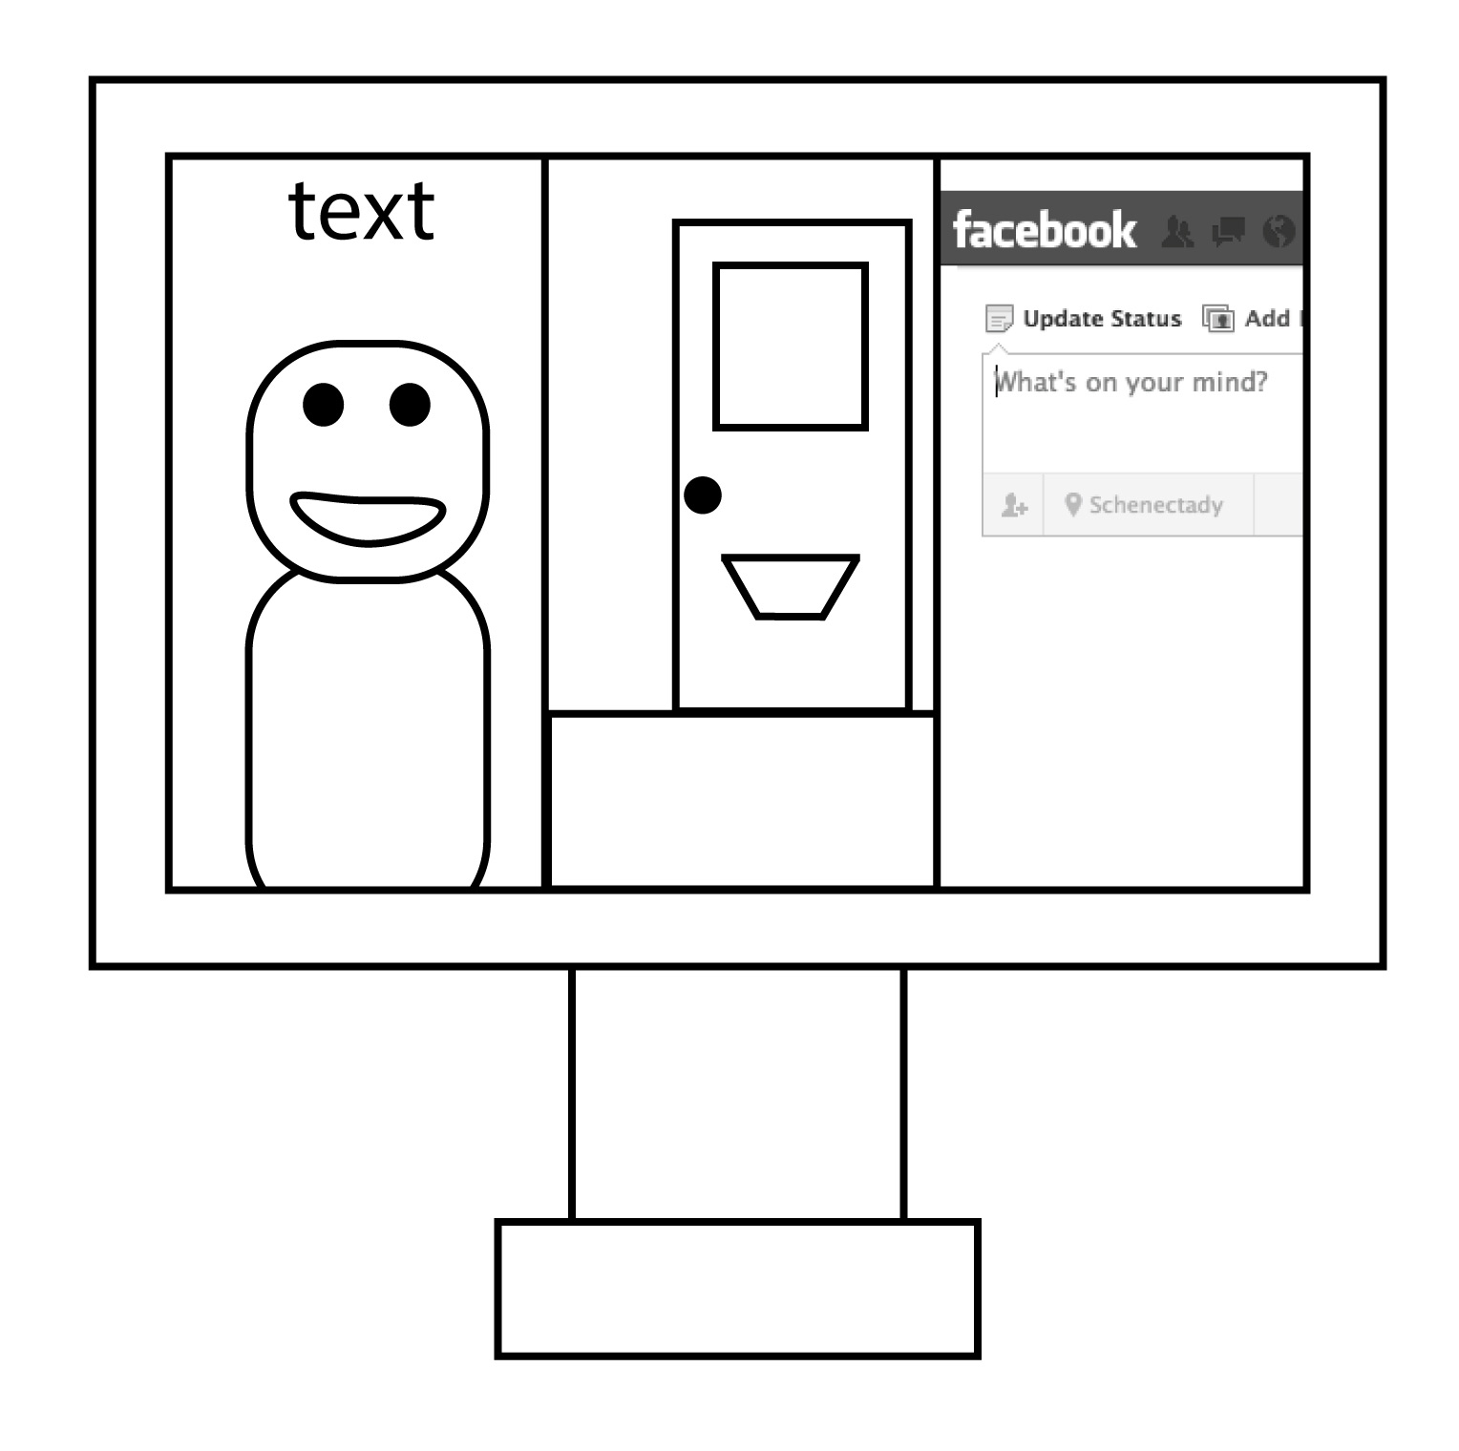
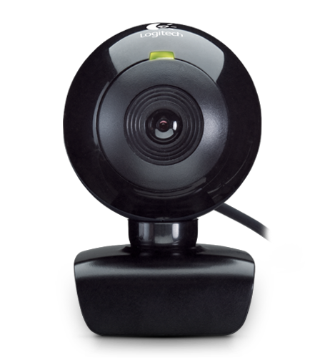
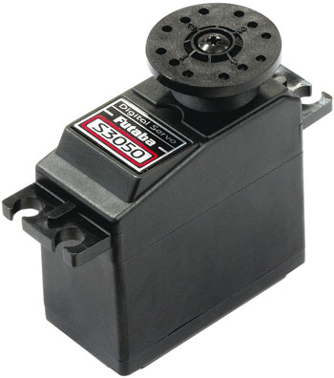
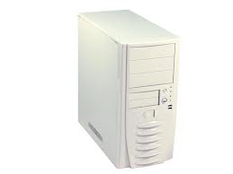
Design - Hardware
Motion Sensor
LCD Screen
Arduino
Monitor
Webcam
Servo Motor
Computer
Notes:
9V Power Supply for the Arduino
5V Power Supply for the servo
Servo controls the webcam movement

Slide 12
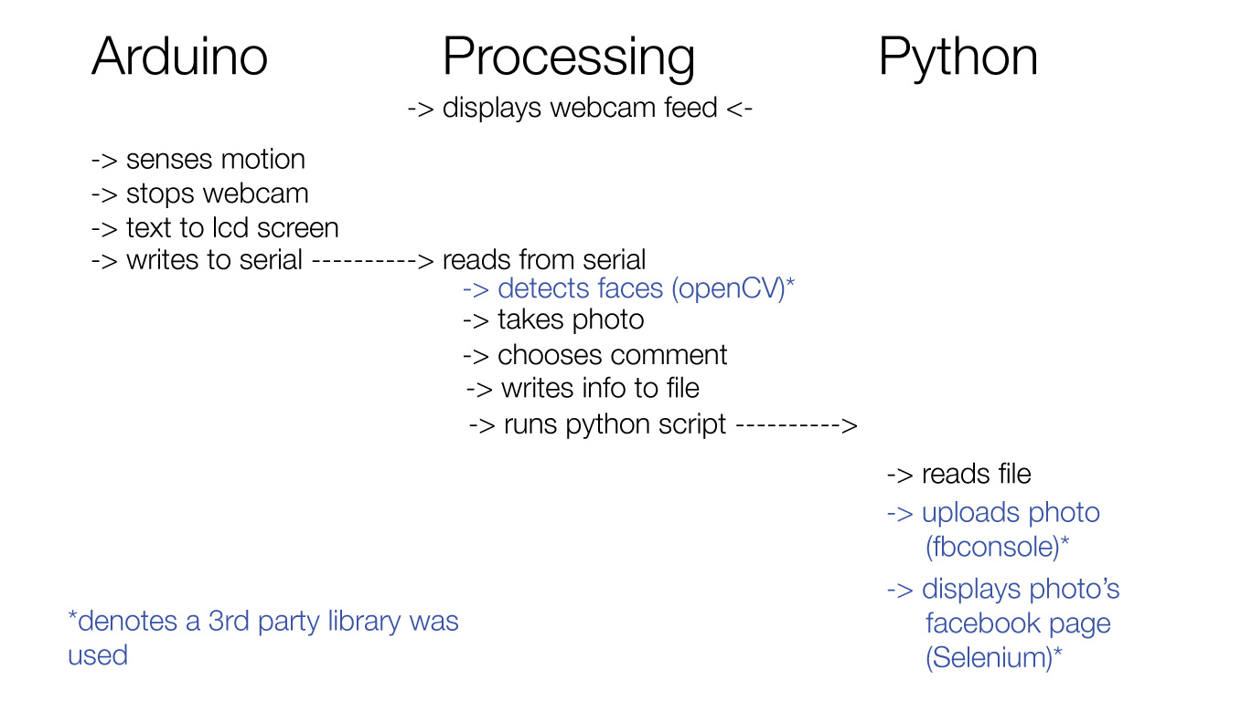
Design - Software

Slide 13
Design – Software: Robot’s Personality
Choosing a status, comment, or caption
Randomly chosen from a database of pre-written comments
Attention to slang, punctuation

Slide 14
Design – Video
Insert video here

Slide 15
Evaluation
How do we know if the project is successful?
Working Robots
Aesthetically pleasing
Viewers begin to think about

Slide 16
Near Future Work
Finish other two robots (replication of the 1st)

Slide 17
Questions
Any questions?

Slide 18
Works Cited
1. "May 2012 - Top U.S. Web Brands and News Websites." May 2012 - Top U.S. Web Brands and News Websites. Nielson, 22 June 2012. Web. 17 Sept. 2012. <http://blog.nielsen.com/nielsenwire/online_mobile/may-2012-top-u-s- web-brands-and-news-websites/>.
2. Lee, Rainie “The Internet as a Diversion and Destination.” December 2, 2012 – Pew Internet and American Life Project. Pew Research Center. Web. http://pewinternet.org/~/media//Files/Reports/2011/PIP_Logging-on-for-fun.pdf.

