Slide 1
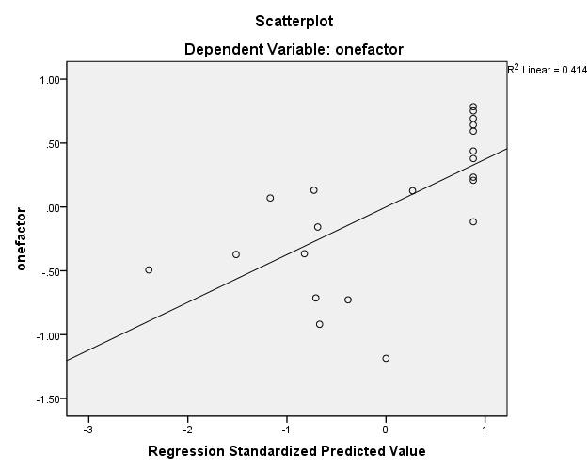
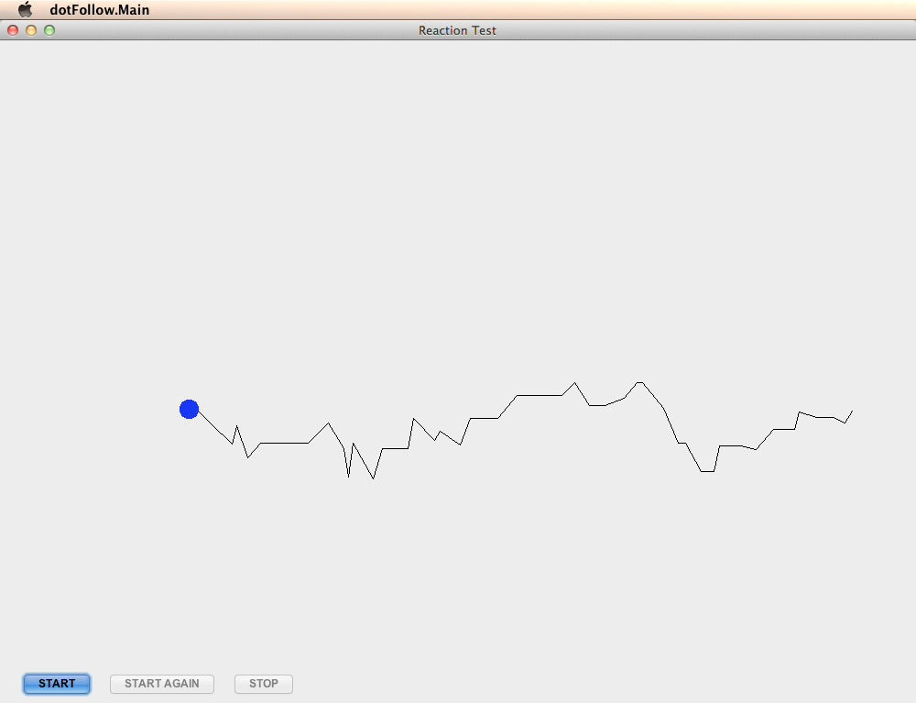
Senior Project – Computer Engineering – 2012
-The Mobile Intoxication Assessment Tool-
Project Authors: Adam Burns and Max Neumeyer
Project Advisors: Aaron Cass and Josh Hart
Computer Engineering, Union College & Psychology, Union College
Abstract
Whereas a variety of applications are available which estimate BAC based purely on the number of drinks consumed, there is no such BAC estimate based on the results of a cognitive assessment. The current research assessed the extent to which such a cognitive test could be used to predict BAC. After multiple sessions in which participants consumed alcohol, participants were given a series of cognitive tests that would be scored and compared to BAC. Results replicated that of previous research in which multiple cognitive abilities were impaired by the consumption of alcohol. There was a relationship between the participant’s BAC and their score on the cognitive tests, such that those with higher BAC scored significantly lower on the cognitive tests. Our research therefore leads us to be able to develop an application that will accurately estimate BAC based on cognitive results.
Objective
The purpose of this research is to generate a mobile phone application designed to predict Blood Alcohol Content based on participants’ cognitive abilities, specifically their deviation between sober scores and intoxicated scores. We are hoping that when used correctly, this application will be used to prevent users from drinking to excess and/or committing acts that should not be performed while intoxicated.
Methods
Results
Twenty-one Union College students participated in the study associated with this project voluntarily and without compensation. Ages ranged from 21 to 23 years. 14 males and seven females participated in the study. The study was executed to evaluate a set of 9 physical and low fidelity Java prototype versions of the proposed tests, derived from 5 affects of alcohol on the body. The tasks were administered to each participant in a sober state, and later in various stages of alcohol intoxication. Based on the data collected throughout the study the the weakly correlated tasks were eliminated from the final set programmed into the application and an equation relating the performance on the finalized set of tasks to BAC values was derived.
There was a significant effect of BAC on test scores (t(20) = 3.66, p = .002). There was a relationship between participant’s cognitive task scores and BAC (β = -.64, p = .002) such that test scores predicted BAC. BAC also explained a significant proportion of variance in test scores (R² = .41, F (1,20) = 13.42, p = .002). The scores were found to be reliable (α = .75).
Memory Impairment:
Simon Says - Required the participant to play a color pattern memory game similar to the electronic “Simon Says” game that was popular throughout the 80s and early 90s. A color pattern was displayed to the subject and upon its completion the participant was asked to reconstruct the pattern by clicking the colors they just saw in the correct order.
???
Questions – A number of questions pertaining to other portions of the over all test interspersed between various subtests, were asked of the participant. Questions were posed in an explicit (told to remember) as well as implicit (caught off guard) fashion.
Problem Solving:
Math Progression – The participant was asked to complete a set of simple mathematical equations. Each equation consisted of five single digit numbers and each of the four simple operators (+, -, ÷, ×). The equation was revealed one symbol or number at a time and the subject was asked to keep a running total in their head. Finally when the equals sign was revealed the participant was prompted for their final answer.
Mental Rotation - The subject was given one image of a geometric object seen from a single perspective (“base image”) and three other images with the same or similar objects seen from various perspectives. The participant was then asked to compare the “base image” to the three alternate images and decide which was the same object, seen from a different perspective.
Future Work
Fine Muscle Control:
A project of this type requires a certain level of calibration, most of which can be derived from a large collection of user data and can only be improved with additional statistics. This being said, there will always be room for further increases in the accuracy of the BAC to test score relationship equation and the tuning of the individual tasks via continued data collection.
The most straightforward way to enlarge the pool of data would be to complete another human study, similar to the one that was completed during this project, but on a larger scale with respect to the number of participants and the duration of study. The study of a much larger group of social drinkers over a period of longer than a month would allow for a better read on how test scores relate to blood alcohol content. The larger, as well as broader, sample size would allow for the minimization of extraneous variables such as differing levels of intellect from subject to subject. The longer period of the proposed study would compensate for any potential learning curve associated with using “The Mobile Intoxication Assessment Tool” as everyone would reach a similar level of understanding over time.
Dot Follow - The participant was asked to place a finger on a dot slightly smaller than the average fingertip so that no part of it was visible. The dot would start on the left side of the screen and move to the right side, following a randomized black line. The subject was asked to follow it with their finger, maintaining coverage.
Shape Draw - The subject was asked to trace within the outline of a geometric shape (square, right triangle, or circle) with a flat tipped marker approximately equal to the size of their fingertip. The participant would start drawing at a point of their choosing and end at the same point, attempting to keep the color inside the lines.
Vision:
Line Counting – Consisted of a group of horizontal lines with equal lengths, but with a fluctuating number of lines per group. The distance between individual lines in any one grouping was held constant. Once presented to the subject, the number of lines in the grouping would be counted as quickly and as accurately as possible.
Conclusion
The goal of the current study was to create a mobile device that could offer an accurate, convenient, and fun way to measure BAC. Previous research has shown that there are a variety of cognitive tasks that demonstrate a hindrance in performance due to the consumption of alcohol. The current research investigated whether it was possible to determine BAC based on the collective performance on these cognitive tasks while intoxicated when compared to performance while sober. We determined that performance on these cognitive tasks can be used to predict BAC. This study was conducted using participants who were given cognitive trials when sober and in various states of intoxication. Scores were then correlated with BAC. Our research suggests that, with enough data, BAC can be accurately determined using a series of cognitive tasks. This allows us to create an application that will allow users to receive an estimate of their BAC at any time.
Reaction Time:
Random Dot – Consisted of a computer application that displayed a window with a single large dark green circle in the center. The participant was asked to tap the space bar when ready to start the task. The green “light” represented by the darkened circle would illuminate (change to bright green) after a randomized delay and the subject was instructed to tap the space bar as quickly as they could after illumination.
Nine Circle Reaction (aka Whack-a-Mole) - Comprised of nine circles in a 3x3 matrix. When started, one of the nine circles would turn red after a delay. In a random pattern, the previously red circle would return to neutral, and a new circle would be illuminated in red. In all there were ten red circles illuminated in the duration of the task and each remained illuminated for one second. The goal on the part of the participant was to tap, with their finger, the red circle before it returned to the neutral background color.
Notes:
MEMORY IMPAIRMENT:
Simon Says - Required the participant to play a color pattern memory game similar to the electronic “Simon Says” game that was popular throughout the 80s and early 90s. A color pattern was displayed to the subject and upon its completion the participant was asked to reconstruct the pattern by clicking the colors they just saw in the correct order.
Questions – A number of questions pertaining to other portions of the over all test interspersed between various subtests, were asked of the participant. Questions were posed in an explicit (told to remember) as well as implicit (caught off guard) fashion.
PROBLEM SOLVING:
Math Progression – The participant was asked to complete a set of simple mathematical equations. Each equation consisted of five single digit numbers and each of the four simple operators (+, -, ÷, ×). The equation was revealed one symbol or number at a time and the subject was asked to keep a running total in their head. Finally when the equals sign was revealed the participant was prompted for their final answer.
Mental Rotation - The subject was given one image of a geometric object seen from a single perspective (“base image”) and three other images with the same or similar objects seen from various perspectives. The participant was then asked to compare the “base image” to the three alternate images and decide which was the same object, seen from a different perspective.
FINE MUSCLE CONTROL:
Dot Follow - The participant was asked to place a finger on a dot slightly smaller than the average fingertip so that no part of it was visible. The dot would start on the left side of the screen and move to the right side, following a randomized black line. The subject was asked to follow it with their finger, maintaining coverage.
Shape Draw - The subject was asked to trace within the outline of a geometric shape (square, right triangle, or circle) with a flat tipped marker approximately equal to the size of their fingertip. The participant would start drawing at a point of their choosing and end at the same point, attempting to keep the color inside the lines.
VISION:
Line Counting – Consisted of a group of horizontal lines with equal lengths, but with a fluctuating number of lines per group. The distance between individual lines in any one grouping was held constant. Once presented to the subject, the number of lines in the grouping would be counted as quickly and as accurately as possible.
REACTION TIME:
Random Dot – Consisted of a computer application that displayed a window with a single large dark green circle in the center. The participant was asked to tap the space bar when ready to start the task. The green “light” represented by the darkened circle would illuminate (change to bright green) after a randomized delay and the subject was instructed to tap the space bar as quickly as they could after illumination.
Nine Circle Reaction (aka Whack-a-Mole) - Comprised of nine circles in a 3x3 matrix. When started, one of the nine circles would turn red after a delay. In a random pattern, the previously red circle would return to neutral, and a new circle would be illuminated in red. In all there were ten red circles illuminated in the duration of the task and each remained illuminated for one second. The goal on the part of the participant was to tap, with their finger, the red circle before it returned to the neutral background color.
Based on the data collected throughout the study the the weakly correlated tasks were eliminated from the final set programmed into the application and an equation relating the performance on the finalized set of tasks to BAC values was derived.

